Slide 1
Browser Stack Demo Website Using TestNG & BDD Framework with Page Object Model
By Putcha Bharath
Under The Guidance Of Mrs. Vaishali Sonanis Mam

Slide 2
Introduction
Browser Stack Demo is a sample e-commerce website designed for practicing testing and automation.
It is a cloud platform that enables developers and testers to verify the functionality and performance of websites and apps across multiple devices, browsers, and operating systems.

Slide 3
Overview
Browser Stack Demo Website
A practice e-commerce site by Browser Stack for testers and developers.
Simulates a real online store, allowing testing of product search, login, add-to-cart, and checkout features.
Automated 12+ modules including login, favorites, cart, checkout, filters, search, and more.
Applied Page Object Model (POM) for maintainable and scalable test automation.
Implemented TestNG and Cucumber frameworks for structured testing.
Integrated with Maven and Jenkins to enable a CI/CD pipeline.

Slide 4
Modules
MODULE 1: SIGN-IN PAGE
Objective: To check user is able to login into the website using valis credentials.
MODULE 2: SEARCH
Objective: To verify search button is working properly for specified requirements.
MODULE 3: ADD TO CART
Objective: To Validate the cart functionality for a smooth shopping experience.
MODULE 4: REMOVE FROM CART
Objective: To confirm that users can easily modify their cart.

Slide 5
Modules
MODULE 5: FAVOURITES
Objective: To Validate the users can add & remove items from favourites.
MODULE 6: CHECKOUT
Objective: To Validate end-to-end functionality
MODULE 7: VENDORS FILTER
Objective: To test vendors based on filter.
MODULE 8: DROPDOWN FILTER
Objective: To validate the sorting and filtering via dropdown.

Slide 6
Modules
MODULE 9: FOOTER LINKS
Objective: To verify the footer navigation links.
MODULE 10: NEWSLETTER SUBSCRIPTION
Objective: To validate email subscription functionality.
MODULE 11: HEADER LINKS
Objective: To test header validation links.
MODULE 12: LOGOUT
Objective: To check user is able to logout from the website.

Slide 7
Defects
During the execution of test cases, certain fields did not function as expected, indicating defects. I have documented these issues in a Defect Report.
Defects are :
Searching product.
Newsletter Subscription.

Slide 8
Defect identifier :- BSD_001
Defect summary :- The “Search results” showing unrelated mobiles data when searching for specified product like "iPhone 12“ it is showing other products too.
Test Id :- TC_001
Test case name :- TC_Searchproduct
Module name :- Search & Filtering
Reproducible :- Search bar
Severity :- Medium
Priority :- Medium
Raised by :- Putcha bharath
Assigned to :- Developer Team Lead
Ø Date of assignment :- 28/08/2025
Ø Status :- Pending
Ø Snap shots :- Added Below
Ø Fixed by :- Developer
Ø Date of fixing :-

Slide 9
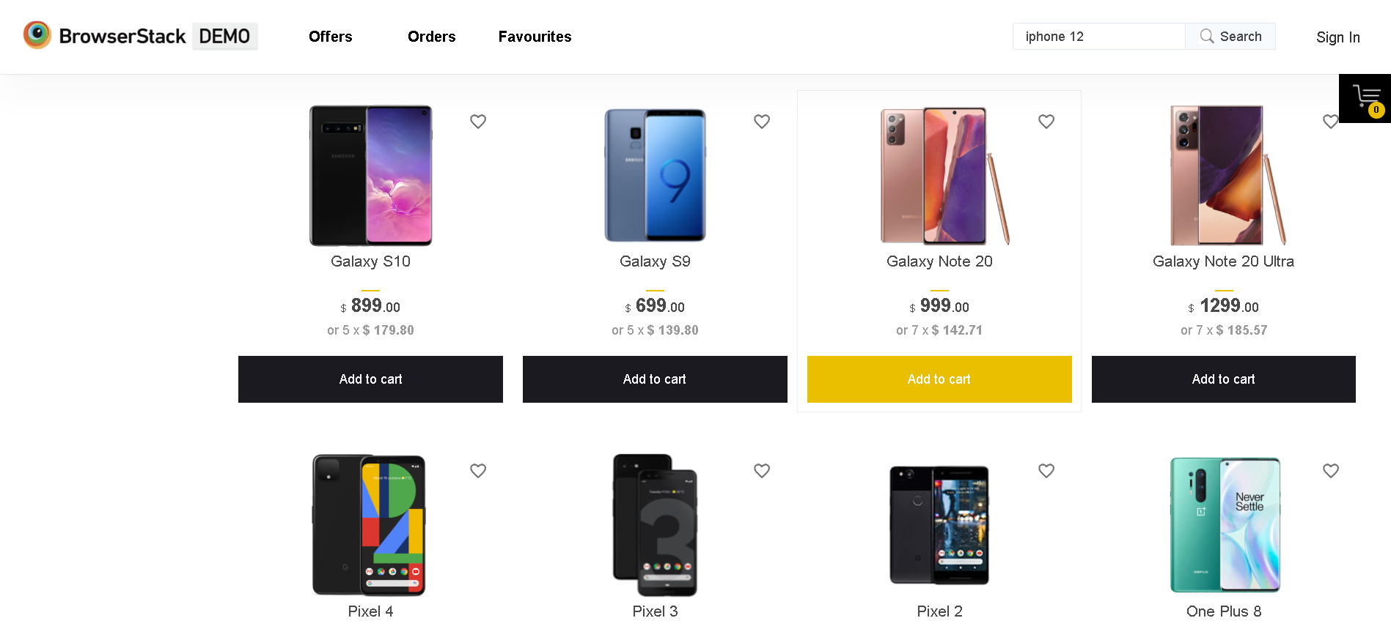

Slide 10
Defect identifier :- BSD_002
Defect summary :- When entered the mail id in “Subscribe to Newsletter”, no message appears and we are not confirmed that it is working properly or not.
Test Id :- TC_002
Test case name :- TC_NewsSubscription
Module name :- Newsletter Subscription
Reproducible :- Subscription to Newsletter
Severity :- Medium
Priority :- Medium
Raised by :- Putcha bharath
Assigned to :- Developer Team Lead
Ø Date of assignment :- 28/08/2025
Ø Status :- Pending
Ø Snap shots :- Added Below
Ø Fixed by :- Developer
Ø Date of fixing :-

Slide 11
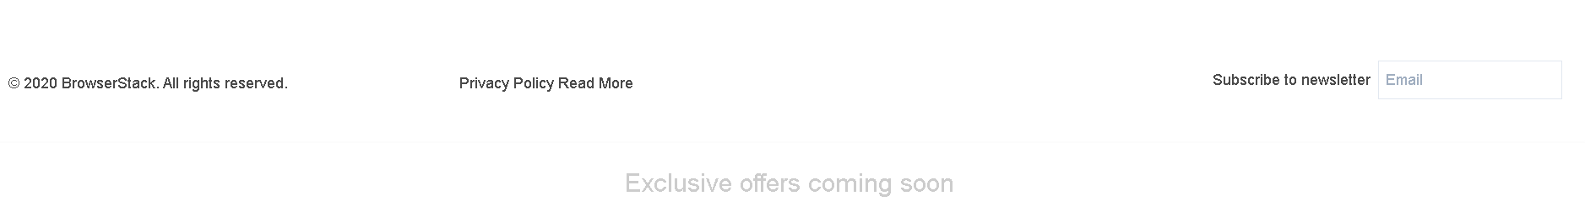
No message related to Subscription to Newsletter

Slide 12
Challenges
Handling the entire project on my individual within less time was most challenging.
Identifying and handling locators is difficult and time consuming.

Slide 13
Experience
Working on individual helped me strengthen my skills.
I stopped looking at the website as a user and started looking at it as a tester.
Gained hands on experience on both Automation testing, Manual Testing and Jenkins.
Learned to handle test failures.

Slide 14
Thank You !
Vaishali Mam For Guiding Us through out the Project.

