Slide 1

EIOM
Emergency Information on Mobile

Slide 2
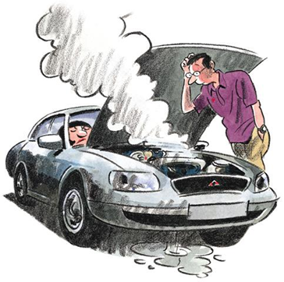
Emergency Information on Mobile
Application on a mobile device
Runs on Android OS
Provides the contact information or phone numbers of the nearest help place
Provides a map
Offline mode in case of lost internet connection
○collects name, contract number, address
○update collected data automatically

Slide 3
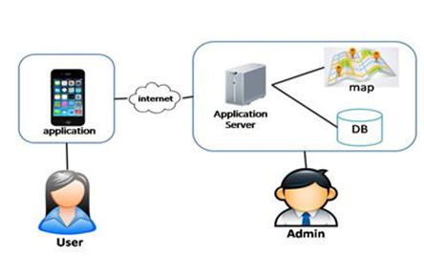
Two parts
●Mobile part for the user
●Server part for the admin
●The user uses the application
and internet to connect with the application server
●The admin manages the the help data
and updates the data to the application server

Slide 4
System Architecture
Mobile Part
Automatic collecting data system
Rating location system
Map and help information system
Search information system
Manage information system
Server Part

Slide 5
Server Part
Emergency Information on Mobile
Feature 5: Manage Information System

Slide 6
URS & SRS
User Requirement Specification : consist of 7 URS
System Requirement Specification: consist of 44 SRS

Slide 7
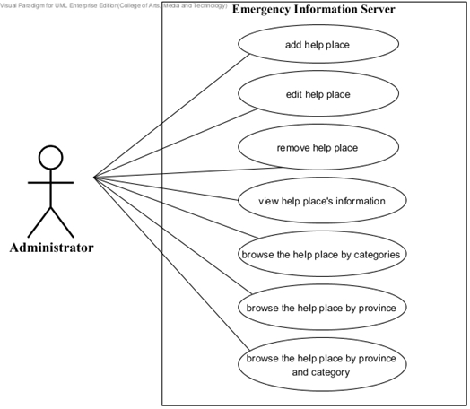
Use Case

Slide 8
User Requirement Specification
URS-06: The administrator can browse the help place by province of Thailand.
SRS-39: The system provides UI to show lists of Thailand’s provinces.
SRS-40: The system shall retrieve the help place from database by the selected province.
SRS-41: The system shall show lists of help places by the selected province.

Slide 9
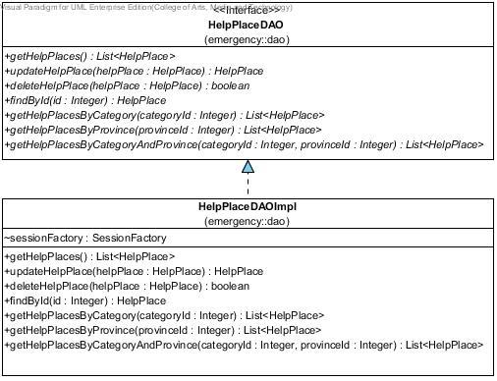
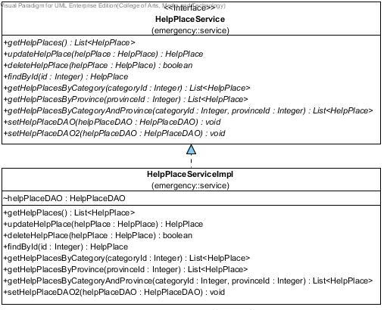
Class Diagram

Slide 10
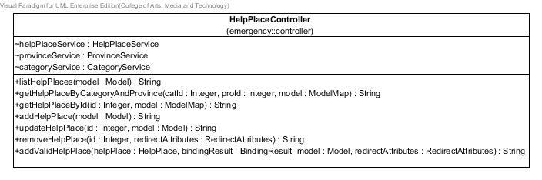
Class Diagram

Slide 11
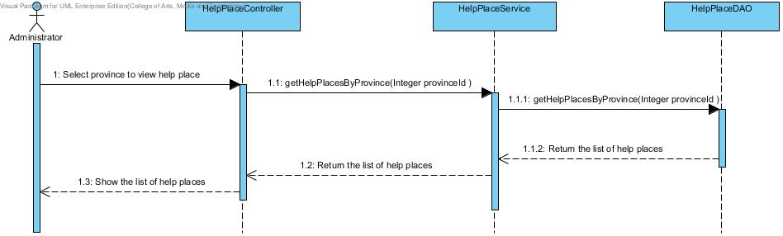
Sequence Diagram

Slide 12
Unit Test Case
Unit Test Case 6 (UTC-06): getHelpPlacesByProvince(Integer provinceId):List<HelpPlace>
Case | Description | Input | Expected Result
 |  |  | List of help place object
 |  |  | ID
1 | Test get help place by input province id | 1 | 1,2,5
2 | Test get help place by input province id | 2 | 4
3 | Test get help place by input province id which is not in database | 5 | null

Slide 13
Test Record
Case | Description | Expected Result | Actual Result | Pass/Fail
 |  | List of help place object | List of help place object
 |  | ID | ID
1 | Test get help place by input province id | 1,2,5 | 1,2,5 | Pass
2 | Test get help place by input province id | 4 | 4 | Pass
3 | Test get help place by input province id which is not in database | null | null | Pass

Slide 14
User Interface
Server Part

Slide 15
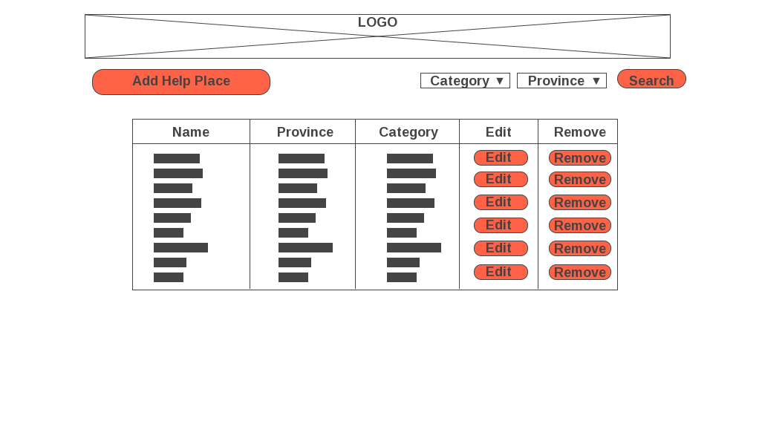
Home Page

Slide 16
Mobile Part
Emergency Information on Mobile
Feature 1: Map and Help Information System

Slide 17
URS & SRS
User Requirement Specification : consist of 8 URS
System Requirement Specification: consist of 19 SRS

Slide 18
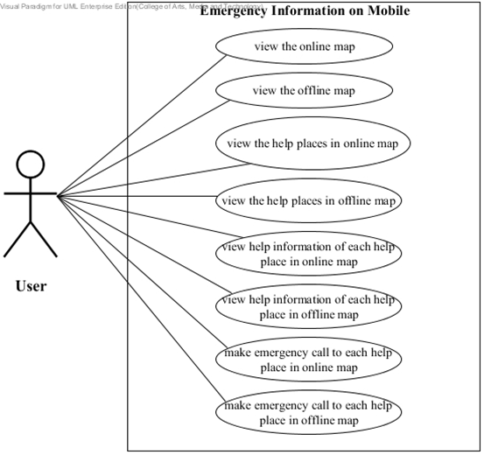
Use Case
View the help places in online map

Slide 19
User Requirement Specification
URS-10: The user can view help places in online map.
SRS-46: The system shall show the online map UI.
SRS-53: The system will retrieve all help places from server.
SRS-54: The system shall input marker of help places into online map UI.
SRS-55: The system shall show all markers of help places on an online map UI.

Slide 20
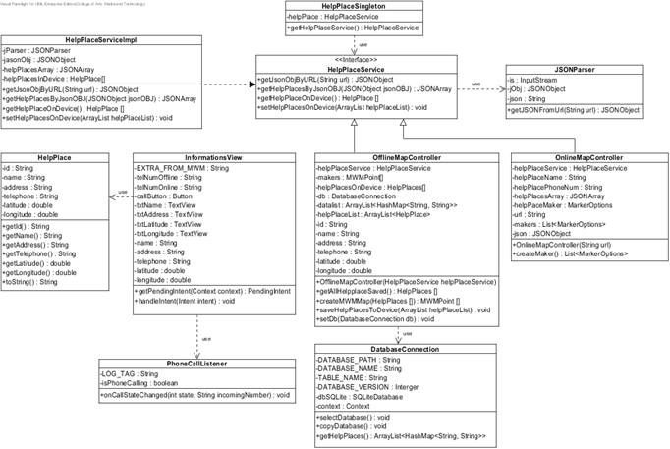
Class Diagram

Slide 21
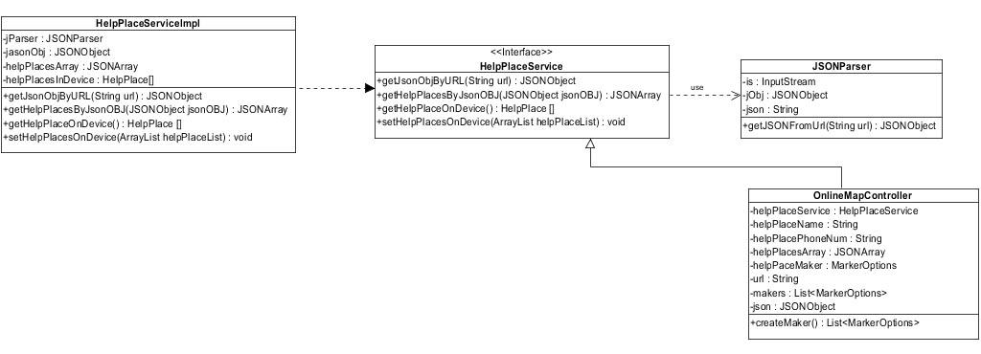
Class Diagram

Slide 22
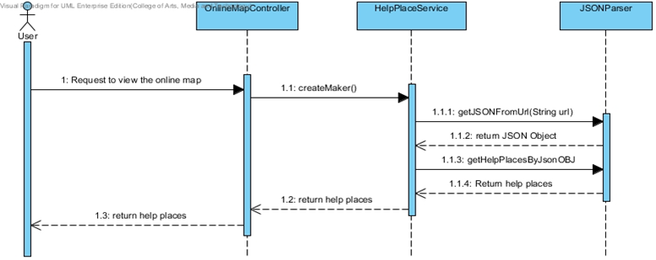
Sequence Diagram

Slide 23
Unit Test Case
Case | Description | Expected Result
 |  | HelpPlace object
 |  | Id | Name | Address | Phone Number | Latitude | Longitude
1 | Test to get help place from device database | 1 | Maharaj Nakorn Chiang Mai Hospital | 110 Suthep Rd, Mueang Chiang Mai District, Chiang Mai | 053947700 | 18.789602 | 98.974209
2 | Test to get help place from device database | 2 | Lanna Hospital | Chang Phuak Amphoe Mueang Chiang Mai, Chang Wat Chiang Mai | 053999758 | 18.812723 | 98.991151

Slide 24
Test Record
Case | Actual Result |  |  |  |  |  | Pass/Fail
 | HelpPlace object
 | Id | Name | Address | Phone Number | Latitude | Longitude
1 | 1 | Maharaj Nakorn Chiang Mai Hospital | 110 Suthep Rd, Mueang Chiang Mai District, Chiang Mai | 053947700 | 18.789602 | 98.974209 | Pass
2 | 2 | Lanna Hospital | Chang Phuak Amphoe Mueang Chiang Mai, Chang Wat Chiang Mai | 053999758 | 18.812723 | 98.991151 | Pass

Slide 25
User Interface
Mobile Part

Slide 26
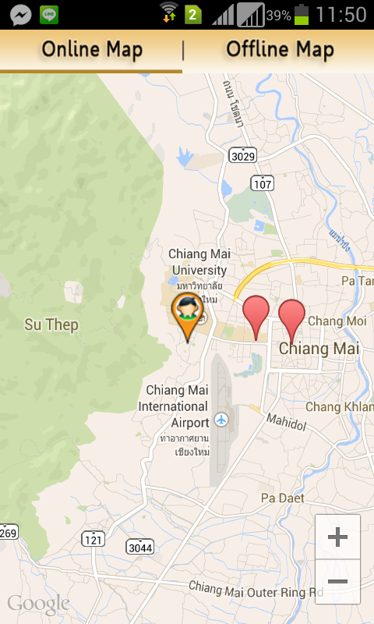
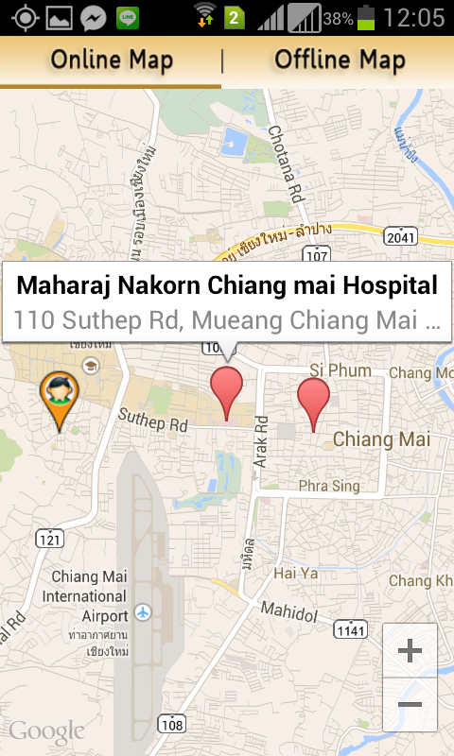
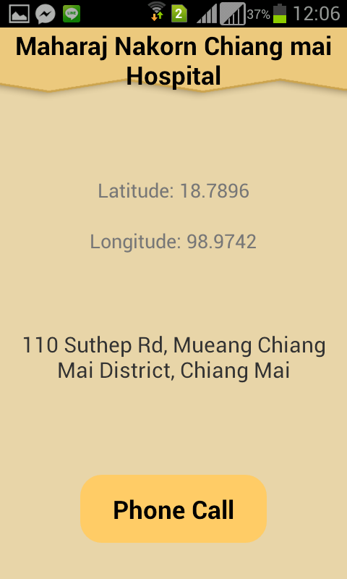
Show Online Map

Slide 27
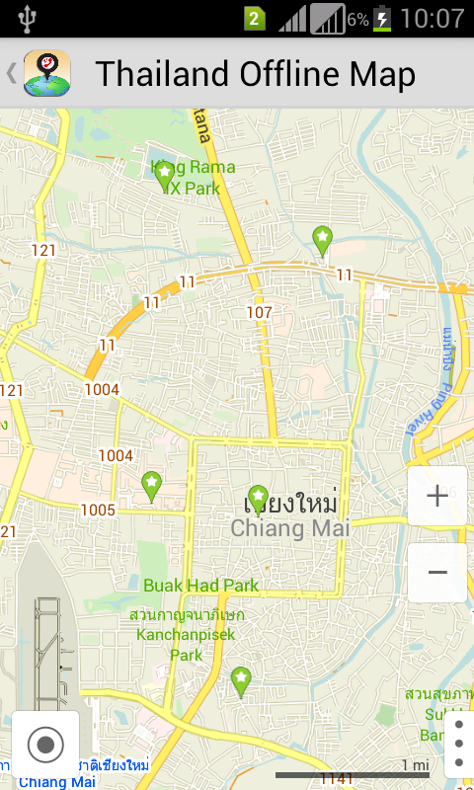

Show Offline Map

Slide 28
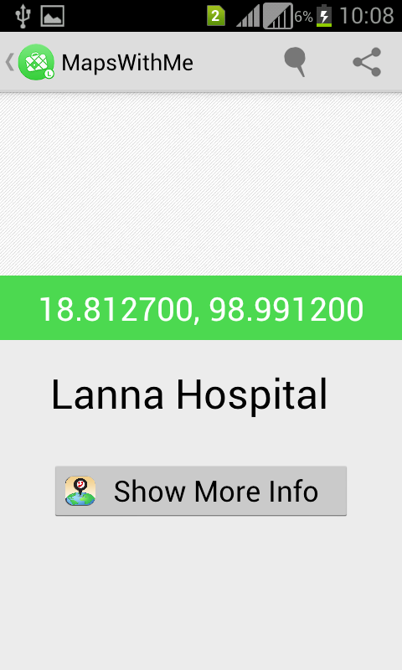
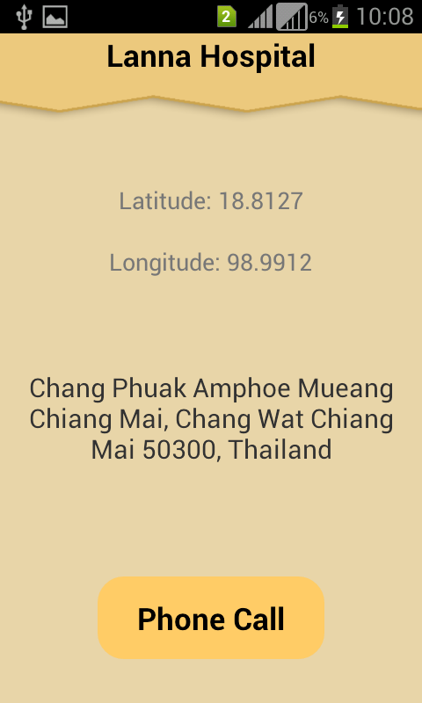
Show Information of help place

Slide 29
Problem & Solution
• Problem
- Group members lack skill and knowledge
- The Requirement changed
• Solution
- study hard and discuss with people who have knowledge about topic which is required for development.
- Improve the requirement to consistency with changing requirement

Slide 30
Code Testing

Slide 31
Q/A
Emergency Information on Mobile

