Slide 1
Principles of Information Systems, Tenth Edition
Chapter 10
Information and Decision Support Systems
‹#›
Notes:
‹#›

Slide 2
Principles and Learning Objectives
Good decision-making and problem-solving skills are the key to developing effective information and decision support systems
Define the stages of decision making
Discuss the importance of implementation and monitoring in problem solving
Principles of Information Systems, Tenth Edition
‹#›
Notes:
‹#›

Slide 3
Principles and Learning Objectives (continued)
The management information system (MIS) must provide the right information to the right person in the right format at the right time
Explain the uses of MISs and describe their inputs and outputs
Discuss information systems in the functional areas of business organizations
Principles of Information Systems, Tenth Edition
‹#›
Notes:
‹#›

Slide 4
Principles and Learning Objectives (continued)
Decision support systems (DSSs) are used when the problems are unstructured
List and discuss important characteristics of DSSs that give them the potential to be effective management support tools
Identify and describe the basic components of a DSS
Principles of Information Systems, Tenth Edition
‹#›
Notes:
‹#›

Slide 5
Principles and Learning Objectives (continued)
Specialized support systems, such as group support systems (GSSs) and executive support systems (ESSs), use the overall approach of a DSS in situations such as group and executive decision making
State the goals of a GSS and identify the characteristics that distinguish it from a DSS
Identify the fundamental uses of an ESS and list the characteristics of such a system
List and discuss other special-purpose systems
Principles of Information Systems, Tenth Edition
‹#›
Notes:
‹#›

Slide 6
Why Learn About Information and Decision Support Systems?
True potential of information systems:
Is in helping you and your coworkers make more informed decisions
Transportation coordinators can:
Use management information reports to find the least expensive way to ship products to market and to solve bottlenecks
Principles of Information Systems, Tenth Edition
‹#›

Slide 7
Decision Making and Problem Solving
Every organization needs effective decision making
In most cases, strategic planning and overall goals of the organization set the course for decision making
Principles of Information Systems, Tenth Edition
‹#›

Slide 8
Decision Making as a Component of Problem Solving
Decision-making phase:
Intelligence stage:
Identify and define potential problems or opportunities
Design stage:
Develop alternative solutions to the problem and evaluate their feasibility
Choice stage:
Select a course of action
Principles of Information Systems, Tenth Edition
‹#›
Notes:
‹#›

Slide 9
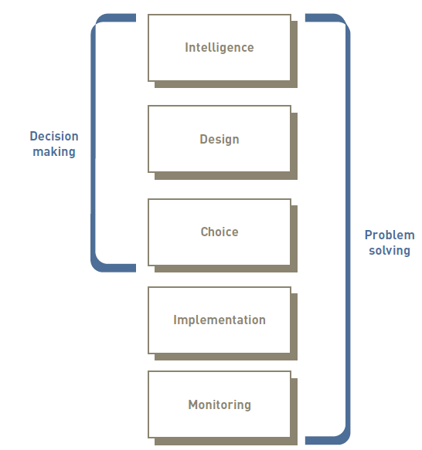
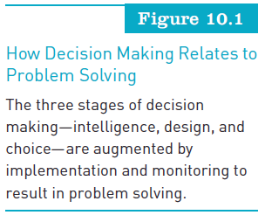
Decision Making as a Component of Problem Solving (continued)
Principles of Information Systems, Tenth Edition
‹#›

Slide 10
Decision Making as a Component of Problem Solving (continued)
Problem solving:
Includes and goes beyond decision making
Includes implementation stage
Monitoring stage:
Decision makers evaluate the implementation
Principles of Information Systems, Tenth Edition
‹#›
Notes:
‹#›

Slide 11
Programmed versus Nonprogrammed Decisions
Programmed decisions:
Made using a rule, procedure, or quantitative method
Easy to computerize using traditional information systems
Nonprogrammed decisions:
Decisions that deal with unusual or exceptional situations
Not easily quantifiable
Principles of Information Systems, Tenth Edition
‹#›
Notes:
‹#›

Slide 12
Optimization, Satisficing, and Heuristic Approaches
Optimization model:
Finds the best solution, usually the one that will best help the organization meet its goals
Satisficing model:
Finds a good, but not necessarily the best, problem solution
Heuristics:
Commonly accepted guidelines or procedures that usually find a good solution
Principles of Information Systems, Tenth Edition
‹#›
Notes:
‹#›

Slide 13
The Benefits of Information and Decision Support Systems
Decision support systems: គុណភាពនៃការសម្រេចចិត្ត
Performance is typically a function of decision quality and problem complexity
Problem complexity:កម្រិតស្មុគស្មាញ់
Depends on how hard the problem is to solve and implement

Slide 14
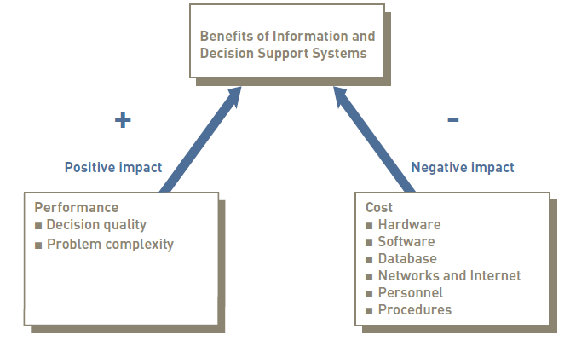
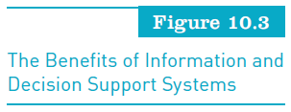
The Benefits of Information and Decision Support Systems (continued)
Principles of Information Systems, Tenth Edition
‹#›

Slide 15
An Overview of Management Information Systems
Management information system (MIS):
Integrated collection of people, procedures, databases, and devices
Can give the organization a competitive advantage
Principles of Information Systems, Tenth Edition
‹#›

Slide 16
Management Information Systems in Perspective
Purpose of an MIS:
To help an organization achieve its goals
Provide the right information to the right person in the right format at the right time
Business transactions: សកម្មភាពរបស់ជំនួញ
Can enter the organization through traditional methods, or via the Internet, or via an extranet
Principles of Information Systems, Tenth Edition
‹#›
Notes:
‹#›

Slide 17
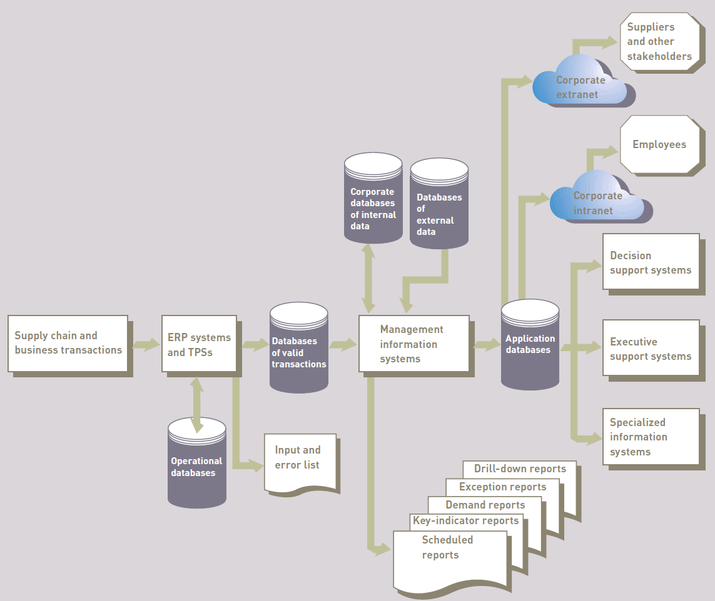
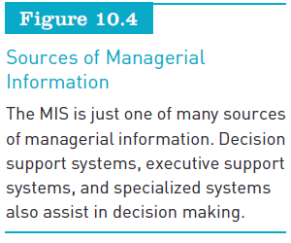
Management Information Systems in Perspective (continued)
Principles of Information Systems, Tenth Edition
‹#›

Slide 18
Inputs to a Management Information System
Internal data sources:
TPS and ERP systems and related databases
Data warehouses and data marts
Specific functional areas throughout the firm
External data sources:
Customers, suppliers, competitors, and stockholders whose data is not already captured by the TPS and ERP systems
Internet
Principles of Information Systems, Tenth Edition
‹#›
Notes:
‹#›

Slide 19
Outputs of a Management Information System
Scheduled reports: (every day , month, years)
Produced periodically, such as daily, weekly, or monthly
Key-indicator (ពត័មាន) report summarizes the previous day’s critical activities
Demand reports:
Developed to provide certain information upon request
Principles of Information Systems, Tenth Edition
‹#›
Notes:
‹#›

Slide 20
Outputs of a Management Information System (continued)
Exception reports:
Automatically produced when a situation is unusual or requires management action
Trigger points should be set carefully
Drill-down reports:
Provide increasingly detailed data about a situation
Principles of Information Systems, Tenth Edition
‹#›

Slide 21
Characteristics of a Management Information System
MISs perform the following functions:
Provide reports with fixed and standard formats
Produce hard-copy and soft-copy reports
Use internal data stored in computer system
Allow users to develop custom reports
Require user requests for reports developed by systems personnel
Principles of Information Systems, Tenth Edition
‹#›
Notes:
‹#›

Slide 22
Functional Aspects of the MIS
Most organizations are structured along functional lines or areas
MIS can be divided along functional lines to produce reports tailored to individual functions
Principles of Information Systems, Tenth Edition
‹#›
Notes:
‹#›

Slide 23
Financial Management Information Systems
Financial MIS:
Provides financial information to executives and others
Some financial MIS subsystems and outputs:
Profit/loss and cost systems
Auditing
Uses and management of funds
Principles of Information Systems, Tenth Edition
‹#›
Notes:
‹#›

Slide 24
Manufacturing Management Information Systems
Manufacturing MIS subsystems and outputs:
Used to monitor and control the flow of materials, products, and services through the organization
Common information subsystems and outputs used in manufacturing:
Design and engineering
Master production scheduling
Inventory control
Process control
Quality control and testing
Principles of Information Systems, Tenth Edition
‹#›
Notes:
‹#›

Slide 25
Marketing Management Information Systems
Marketing MIS:
Supports managerial activities in product development, distribution, pricing decisions, promotional effectiveness, and sales forecasting
Subsystems:
Marketing research
Product development
Promotion and advertising
Product pricing
Sales analysis
Principles of Information Systems, Tenth Edition
‹#›
Notes:
‹#›

Slide 26
Human Resource Management Information Systems
Concerned with activities related to employees and potential employees
Subsystems:
Human resource planning
Personnel selection and recruiting
Training and skills inventory
Scheduling and job placement
Wage and salary administration
Outplacement
Principles of Information Systems, Tenth Edition
‹#›
Notes:
‹#›

Slide 27
Other Management Information Systems
Accounting MIS:
Provides aggregate information on accounts payable, accounts receivable, payroll, and many other applications
Geographic information system (GIS):
Capable of assembling, storing, manipulating, and displaying geographically referenced information
Principles of Information Systems, Tenth Edition
‹#›
Notes:
‹#›

Slide 28
An Overview of Decision Support Systems
DSS:
Organized collection of people, procedures, software, databases, and devices used to help make decisions that solve problems
Used at all levels
Focus of a DSS:
Is on decision-making effectiveness regarding unstructured or semistructured business problems
Principles of Information Systems, Tenth Edition
‹#›
Notes:
‹#›

Slide 29
Characteristics of a Decision Support System
Some important characteristics:
Provide rapid access to information
Handle large amounts of data from different sources
Provide report and presentation flexibility
Offer both textual and graphical orientation
Support drill-down analysis
Principles of Information Systems, Tenth Edition
‹#›
Notes:
‹#›

Slide 30
Capabilities of a Decision Support System
Support problem-solving phases:
A specific DSS might support only one or a few phases
Support various decision frequencies:
Ad hoc DSS is concerned with situations or decisions that come up only a few times
Institutional DSS handles situations or decisions that occur more than once
Principles of Information Systems, Tenth Edition
‹#›
Notes:
‹#›

Slide 31
Capabilities of a Decision Support System (continued)
Support various problem structures:
Highly structured problems are straightforward, requiring known facts and relationships
Semistructured or unstructured problems are more complex
Support various decision-making levels:
DSSs can provide help for managers at various levels within the organization
Principles of Information Systems, Tenth Edition
‹#›

Slide 32
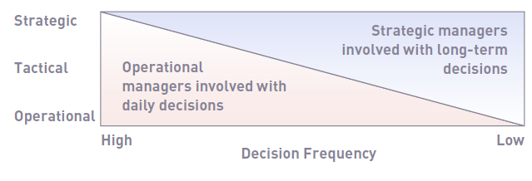
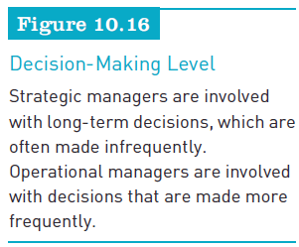
Capabilities of a Decision Support System (continued)
Principles of Information Systems, Tenth Edition
‹#›

Slide 33
A Comparison of DSS and MIS
DSS differs from an MIS in numerous ways, including:
The type of problems solved
The support given to users
The decision emphasis and approach
The type, speed, output, and development of the system used

Slide 34
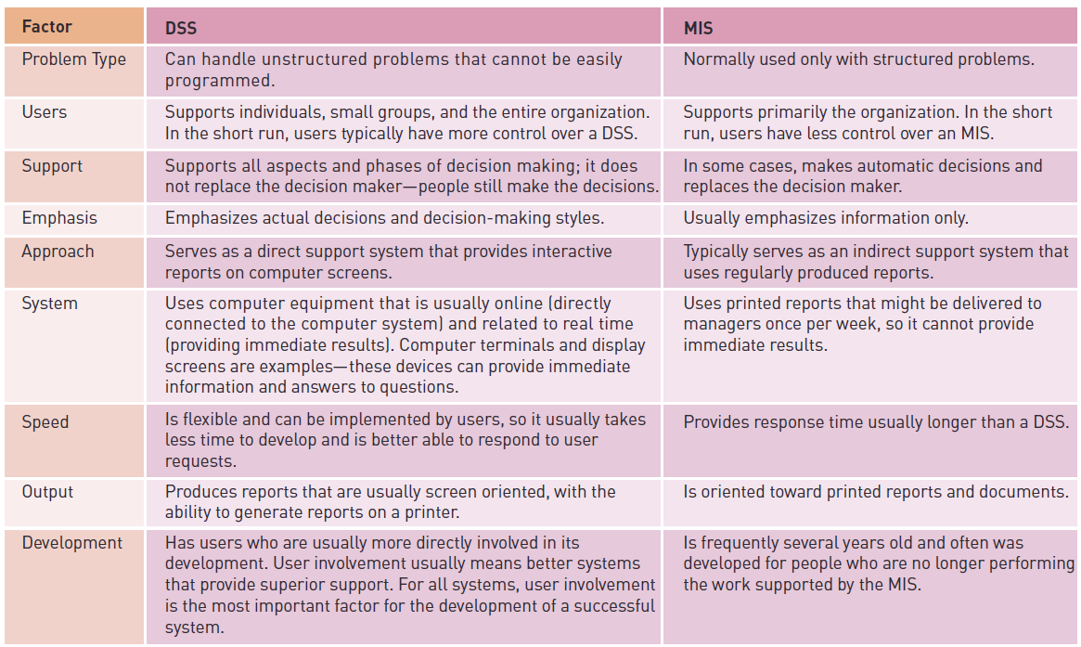

A Comparison of DSS and MIS (continued)
Principles of Information Systems, Tenth Edition
‹#›

Slide 35
Components of a Decision Support System
At the core of a DSS are a database and a model base
Dialogue manager:
Allows decision makers to easily access and manipulate the DSS and to use common business terms and phrases
Principles of Information Systems, Tenth Edition
‹#›

Slide 36
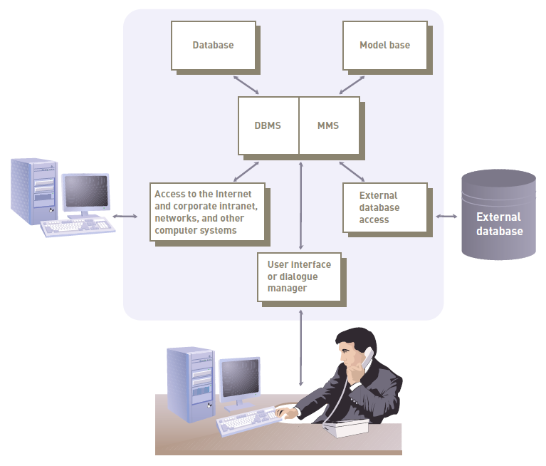
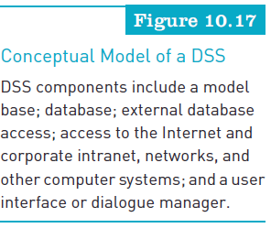
Components of a Decision Support System (continued)
Principles of Information Systems, Tenth Edition
‹#›

Slide 37
The Database
Database management system:
Allows managers and decision makers to perform qualitative analysis on data stored in company’s databases, data warehouses, and data marts
Can also be used to connect to external databases
Data-driven DSS:
Performs qualitative analysis based on the company’s databases
Principles of Information Systems, Tenth Edition
‹#›

Slide 38
The Model Base
Model base:
Allows managers and decision makers to perform quantitative analysis on both internal and external data
Model-driven DSS:
Performs mathematical or quantitative analysis
Model management software (MMS):
Coordinates the use of models in a DSS
Principles of Information Systems, Tenth Edition
‹#›

Slide 39
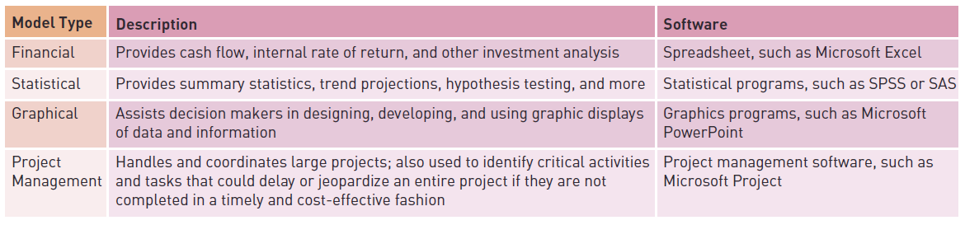
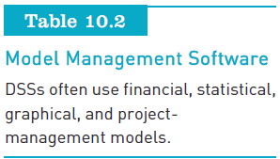
The Model Base (continued)
Principles of Information Systems, Tenth Edition
‹#›

Slide 40
The User Interface or Dialogue Manager
Allows users to interact with the DSS to obtain information
Assists with all aspects of communications between user and hardware and software that constitute the DSS
Principles of Information Systems, Tenth Edition
‹#›
Notes:
‹#›

Slide 41
Group Support Systems
Group support system (GSS):
Consists of most elements in a DSS, plus software to provide effective support in group decision making
Also called group decision support system or computerized collaborative work system
Principles of Information Systems, Tenth Edition
‹#›
Notes:
‹#›

Slide 42
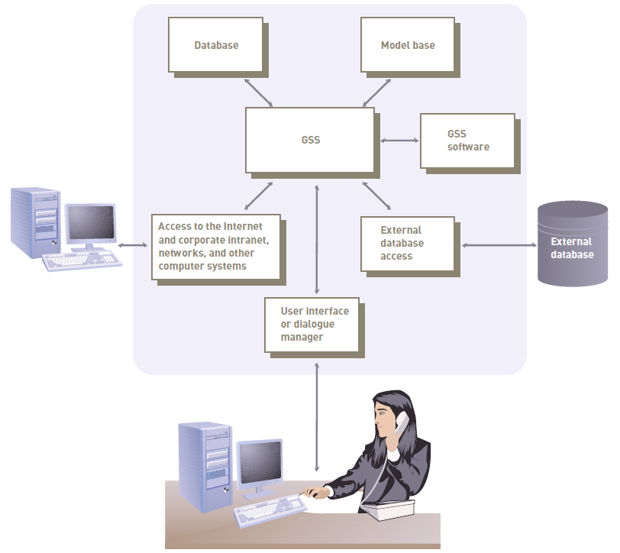
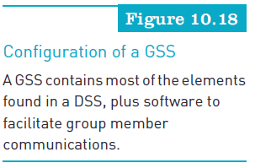
Group Support Systems (continued)
Principles of Information Systems, Tenth Edition
‹#›

Slide 43
Characteristics of a GSS That Enhance Decision Making
Special design
Ease of use
Flexibility
Decision-making support:
Delphi approach
Brainstorming
Group consensus approach
Nominal group technique
Principles of Information Systems, Tenth Edition
‹#›
Notes:
‹#›

Slide 44
Characteristics of a GSS That Enhance Decision Making (continued)
Anonymous input
Reduction of negative group behavior
Parallel and unified communication
Automated record keeping
Principles of Information Systems, Tenth Edition
‹#›
Notes:
‹#›

Slide 45
GSS Software
Often called groupware or workgroup software
Helps with joint work group scheduling, communication, and management
GSS software packages:
Collabnet
OpenMind
TeamWare
Principles of Information Systems, Tenth Edition
‹#›

Slide 46
GSS Software (continued)
GSSs use a number of tools, including:
E-mail, instant messaging (IM), and text messaging (TM)
Videoconferencing
Group scheduling
Project management
Document sharing
Principles of Information Systems, Tenth Edition
‹#›

Slide 47
GSS Alternatives
Decision room:
Decision makers are located in the same building or geographic area
Decision makers are occasional users of the GSS approach
Local area decision network:
Group members are located in the same building or geographic area
Group decision making is frequent
Principles of Information Systems, Tenth Edition
‹#›

Slide 48
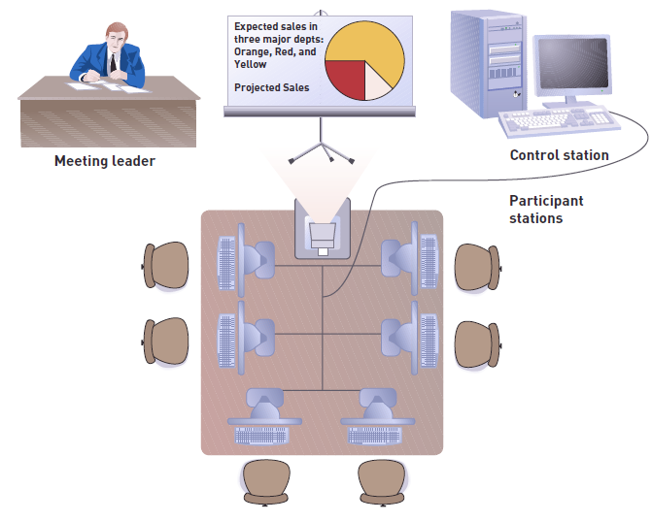
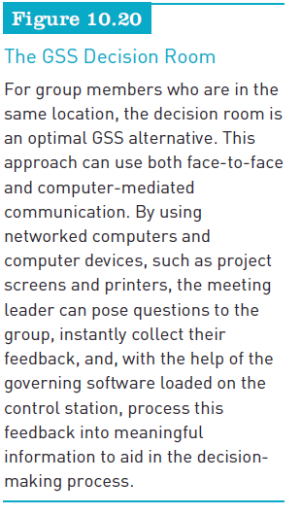
GSS Alternatives (continued)
Principles of Information Systems, Tenth Edition
‹#›

Slide 49
GSS Alternatives (continued)
Teleconferencing:
Decision frequency is low
Location of group members is distant
Wide area decision network:
Decision frequency is high
Location of group members is distant
Principles of Information Systems, Tenth Edition
‹#›

Slide 50
Executive Support Systems
Executive support system (ESS):
Specialized DSS
Includes hardware, software, data, procedures, and people used to assist senior-level executives
Also called an executive information system (EIS)
Principles of Information Systems, Tenth Edition
‹#›
Notes:
‹#›

Slide 51
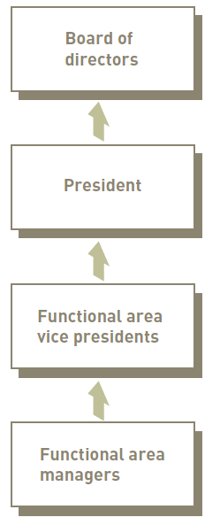
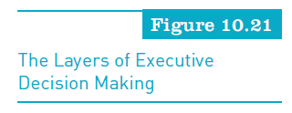
Executive Support Systems (continued)
Principles of Information Systems, Tenth Edition
‹#›

Slide 52
Capabilities of Executive Support Systems
Support for defining overall vision
Support for strategic planning
Support for strategic organizing and staffing
Support for strategic control
Support for crisis management
Principles of Information Systems, Tenth Edition
‹#›
Notes:
‹#›

Slide 53
Summary
Problem solving:
Begins with decision making
Includes implementation and monitoring
Decision making is a component
Management information system:
Integrated collection of people, procedures, databases, and devices
Data that enters the MIS:
Originates from both internal and external sources
Principles of Information Systems, Tenth Edition
‹#›
Notes:
‹#›

Slide 54
Summary (continued)
Output of most MISs:
Scheduled reports, key-indicator reports
Demand reports, exception reports
Drill-down reports
Primary sources of input to functional MISs:
Corporate strategic plan
Data from the ERP system and TPS
Information from supply chain and business transactions
External sources including the Internet and extranets
Principles of Information Systems, Tenth Edition
‹#›
Notes:
‹#›

Slide 55
Summary (continued)
Components of a DSS:
The database, model base, extranets, networks
User interface or dialogue manager
Link to external databases, the Internet
The corporate intranet, extranets, networks
Group support system (GSS):
Consists of most of the elements in a DSS, plus software to provide effective support in group decision-making settings
Principles of Information Systems, Tenth Edition
‹#›
Notes:
‹#›

Slide 56
Summary (continued)
Executive support systems (ESSs)
Specialized decision support systems designed to meet the needs of senior management
Typically easy to use, offer a wide range of computer resources, and handle a variety of internal and external data
Principles of Information Systems, Tenth Edition
‹#›
Notes:
‹#›

