Slide 1
Principles of Information Systems, Tenth Edition
Chapter 11
Knowledge Management and Specialized Information Systems
‹#›
Notes:
‹#›
‹#›

Slide 2
Principles and Learning Objectives
Knowledge management allows organizations to share knowledge and experience among managers and employees
Discuss the differences among data, information, and knowledge
Describe the role of the chief knowledge officer (CKO)
List some of the tools and techniques used in knowledge management
Principles of Information Systems, Tenth Edition
‹#›
Notes:
‹#›

Slide 3
Principles and Learning Objectives (continued)
Artificial intelligence systems form a broad and diverse set of systems that can replicate human decision making for certain types of well-defined problems
Define the term artificial intelligence and state the objective of developing artificial intelligence systems
List the characteristics of intelligent behavior and compare the performance of natural and artificial intelligence systems for each of these characteristics
Identify the major components of the artificial intelligence field and provide one example of each type of system
Principles of Information Systems, Tenth Edition
‹#›

Slide 4
Principles and Learning Objectives (continued)
Expert systems can enable a novice to perform at the level of an expert but must be developed and maintained very carefully
List the characteristics and basic components of expert systems
Outline and briefly explain the steps for developing an expert system
Identify the benefits associated with the use of expert systems
Principles of Information Systems, Tenth Edition
‹#›

Slide 5
Principles and Learning Objectives (continued)
Multimedia and virtual reality systems can reshape the interface between people and information technology by offering new ways to communicate information, visualize processes, and express ideas creatively
Discuss the use of multimedia in a business setting
Define the term virtual reality and provide three examples of virtual reality applications
Principles of Information Systems, Tenth Edition
‹#›

Slide 6
Principles and Learning Objectives (continued)
Specialized systems can help organizations and individuals achieve their goals
Discuss examples of specialized systems for organizational and individual use
Principles of Information Systems, Tenth Edition
‹#›

Slide 7
Why Learn About Knowledge Management and Specialized Information Systems?
Knowledge management and specialized information systems are used in almost every industry
Learning about these systems:
Will help you discover new ways to use information systems in your day-to-day work
Principles of Information Systems, Tenth Edition
‹#›

Slide 8
Knowledge Management Systems
Data consists of raw facts
Information:
Collection of facts organized so that they have additional value beyond the value of the facts themselves
Knowledge:
Awareness and understanding of a set of information and the ways that information can be made useful to support a specific task or reach a decision
Principles of Information Systems, Tenth Edition
‹#›

Slide 9
Knowledge Management Systems (continued)
Knowledge management system (KMS):
Organized collection of people, procedures, software, databases, and devices
Used to create, store, share, and use the organization’s knowledge and experience
Principles of Information Systems, Tenth Edition
‹#›

Slide 10
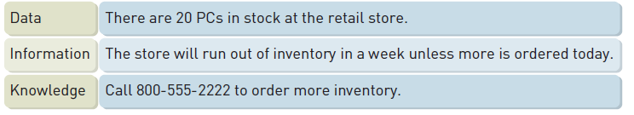
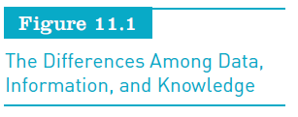
Knowledge Management Systems (continued)
Principles of Information Systems, Tenth Edition
‹#›

Slide 11
Overview of Knowledge Management Systems
Explicit knowledge:
Objective
Can be measured and documented in reports, papers, and rules
Tacit knowledge:
Hard to measure and document
Typically not objective or formalized
Principles of Information Systems, Tenth Edition
‹#›

Slide 12
Data and Knowledge Management Workers and Communities of Practice
Data workers:
Secretaries, administrative assistants, bookkeepers, etc.
Knowledge workers:
Create, use, and disseminate knowledge
Professionals in science, engineering, or business; writers; researchers; educators; corporate designers; etc.
Principles of Information Systems, Tenth Edition
‹#›

Slide 13
Data and Knowledge Management Workers and Communities of Practice (continued)
Chief knowledge officer (CKO):
Top-level executive who helps the organization use a KMS to create, store, and use knowledge to achieve organizational goals
Communities of practice (COP):
Group of people dedicated to a common discipline or practice
May be used to create, store, and share knowledge
Principles of Information Systems, Tenth Edition
‹#›

Slide 14
Obtaining, Storing, Sharing, and Using Knowledge
Knowledge workers:
Often work in teams
Can use collaborative work software and group support systems to share knowledge
Knowledge repository:
Includes documents, reports, files, and databases
Principles of Information Systems, Tenth Edition
‹#›

Slide 15
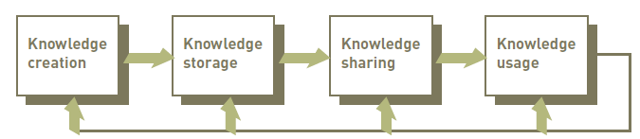
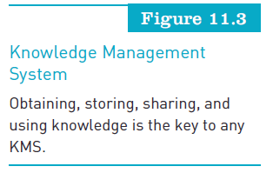
Obtaining, Storing, Sharing, and Using Knowledge (continued)
Principles of Information Systems, Tenth Edition
‹#›

Slide 16
Technology to Support Knowledge Management
Effective KMS:
Is based on learning new knowledge and changing procedures and approaches as a result
Microsoft offers a number of knowledge management tools, including Digital Dashboard
Principles of Information Systems, Tenth Edition
‹#›

Slide 17
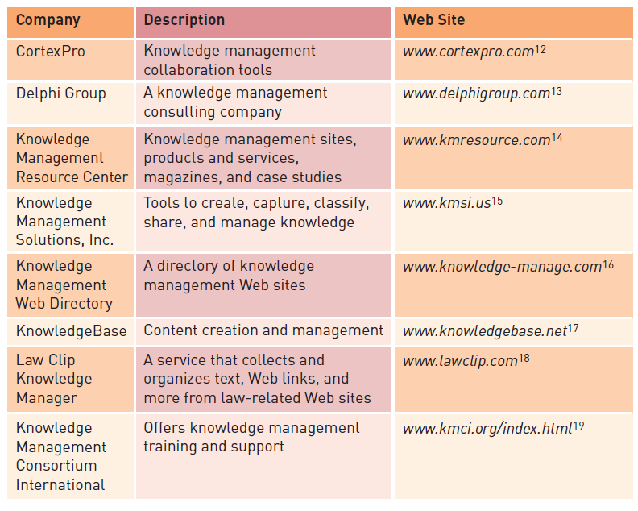
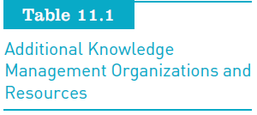
Technology to Support Knowledge Management (continued)
Principles of Information Systems, Tenth Edition
‹#›

Slide 18
An Overview of Artificial Intelligence
Artificial intelligence (AI):
Computers with the ability to mimic or duplicate the functions of the human brain
Computer systems that use the notion of AI:
Help to make medical diagnoses
Explore for natural resources
Determine what is wrong with mechanical devices
Assist in designing and developing other computer systems
Principles of Information Systems, Tenth Edition
‹#›
Notes:
‹#›

Slide 19
Artificial Intelligence in Perspective
Artificial intelligence systems:
Include the people, procedures, hardware, software, data, and knowledge needed to develop computer systems and machines that demonstrate characteristics of intelligence
Principles of Information Systems, Tenth Edition
‹#›

Slide 20
The Nature of Intelligence
Turing Test:
Determines whether responses from a computer with intelligent behavior are indistinguishable from those from a human being
Characteristics of intelligent behavior include the ability to:
Learn from experiences and apply knowledge acquired from experience
Handle complex situations
Solve problems when important information is missing
Principles of Information Systems, Tenth Edition
‹#›
Notes:
‹#›

Slide 21
The Nature of Intelligence (continued)
Characteristics of intelligent behavior include the ability to (continued):
Determine what is important
React quickly and correctly to a new situation
Understand visual images
Process and manipulate symbols
Be creative and imaginative
Use heuristics (guidline)
Principles of Information Systems, Tenth Edition
‹#›
Notes:
‹#›

Slide 22
The Brain Computer Interface
Brain Computer Interface (BCI):
Idea is to directly connect the human brain to a computer and have human thought control computer activities
If successful:
The BCI experiment will allow people to control computers and artificial arms and legs through thought alone
Principles of Information Systems, Tenth Edition
‹#›

Slide 23
The Major Branches of Artificial Intelligence
AI is a broad field that includes:
Expert systems, robotics
Vision systems, natural language processing
Learning systems, neural networks (like neural brain)
Principles of Information Systems, Tenth Edition
‹#›

Slide 24
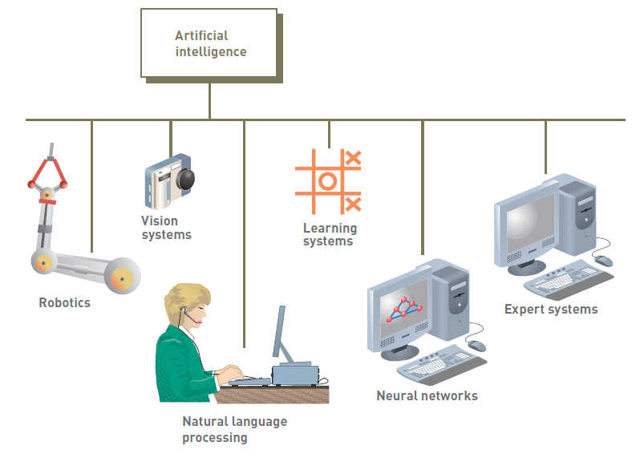
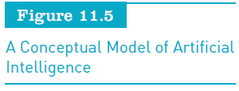
The Major Branches of Artificial Intelligence (continued)
Principles of Information Systems, Tenth Edition
‹#›

Slide 25
Expert Systems
Hardware and software that stores knowledge and makes inferences, similar to a human expert
Used in many business applications
Principles of Information Systems, Tenth Edition
‹#›
Notes:
‹#›

Slide 26
Robotics
Developing mechanical devices that can:
Paint cars, make precision welds, and perform other tasks that require a high degree of precision
Manufacturers use robots to assemble and paint products
Contemporary robotics:
Combine both high-precision machine capabilities and sophisticated(advance) controlling software
Principles of Information Systems, Tenth Edition
‹#›
Notes:
‹#›

Slide 27
Vision Systems
Hardware and software that permit computers to capture, store, and manipulate visual images and pictures
Effective at identifying people based on facial features
Principles of Information Systems, Tenth Edition
‹#›
Notes:
‹#›

Slide 28
Natural Language Processing and Voice Recognition
Processing that allows the computer to understand and react to statements and commands made in a “natural” language, such as English
Voice recognition:
Converting sound waves into words
Principles of Information Systems, Tenth Edition
‹#›
Notes:
‹#›

Slide 29
Learning Systems
Combination of software and hardware that:
Allows the computer to change how it functions or reacts to situations based on feedback it receives
Learning systems software:
Requires feedback on results of actions or decisions
Principles of Information Systems, Tenth Edition
‹#›
Notes:
‹#›

Slide 30
Neural Networks
Computer system that simulates functioning of a human brain
Can process many pieces of data at the same time and learn to recognize patterns
Neural network software:
Simulates a neural network using standard computers
Principles of Information Systems, Tenth Edition
‹#›
Notes:
‹#›

Slide 31
Other Artificial Intelligence Applications
Genetic algorithm:
Approach to solving complex problems in which a number of related operations or models change and evolve until the best one emerges
Intelligent agent:
Programs and a knowledge base used to perform a specific task for a person, a process, or another program
Principles of Information Systems, Tenth Edition
‹#›
Notes:
‹#›

Slide 32
An Overview of Expert Systems
Computerized expert systems:
Use heuristics, or rules of thumb, to arrive at conclusions or make suggestions
The U.S. Army:
Uses the Knowledge and Information Fusion Exchange (KnIFE) expert system to help soldiers in the field make better military decisions
Principles of Information Systems, Tenth Edition
‹#›

Slide 33
When to Use Expert Systems
People and organizations should develop an expert system if it can:
Provide a high potential payoff or significantly reduce downside risk
Capture and preserve irreplaceable human expertise
Solve a problem that is not easily solved using traditional programming techniques
Develop a system more consistent than human experts
Principles of Information Systems, Tenth Edition
‹#›
Notes:
‹#›

Slide 34
When to Use Expert Systems (continued)
People and organizations should develop an expert system if it can (continued):
Provide expertise needed at a number of locations at the same time or in a hostile environment that is dangerous to human health
Provide expertise that is expensive or rare
Develop a solution faster than human experts can
Provide expertise needed for training and development
Principles of Information Systems, Tenth Edition
‹#›

Slide 35
Components of Expert Systems
Expert system:
Consists of a collection of integrated and related components
Knowledge base:
Stores all relevant information, data, rules, cases, and relationships used by expert system
Creates knowledge base by:
Using rules
Using cases
Principles of Information Systems, Tenth Edition
‹#›
Notes:
‹#›

Slide 36
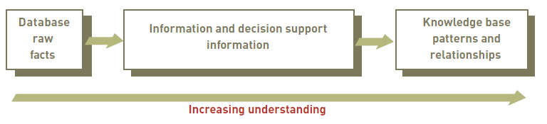
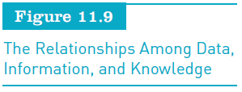
Components of Expert Systems (continued)
Principles of Information Systems, Tenth Edition
‹#›

Slide 37
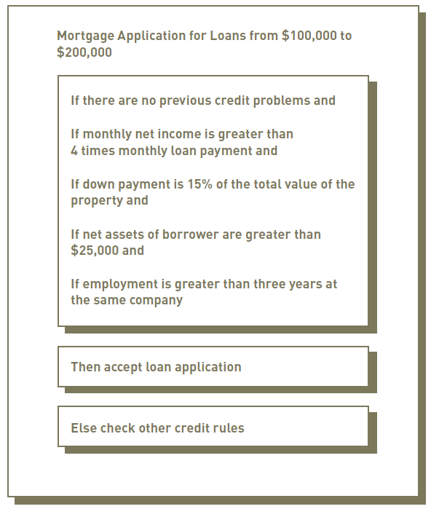

Components of Expert Systems (continued)
Principles of Information Systems, Tenth Edition
‹#›

Slide 38
The Inference Engine
Purpose:
To seek information and relationships from the knowledge base
To provide answers, predictions, and suggestions like a human expert
Principles of Information Systems, Tenth Edition
‹#›
Notes:
‹#›

Slide 39
The Explanation Facility
Allows a user or decision maker to understand how the expert system arrived at certain conclusions or results
Example:
A doctor can find out the logic or rationale of a diagnosis made by a medical expert system
Principles of Information Systems, Tenth Edition
‹#›
Notes:
‹#›

Slide 40
The Knowledge Acquisition Facility
Provides convenient and efficient means of capturing and storing all components of knowledge base
Knowledge acquisition software:
Can present users and decision makers with easy-to-use menus
Principles of Information Systems, Tenth Edition
‹#›
Notes:
‹#›

Slide 41
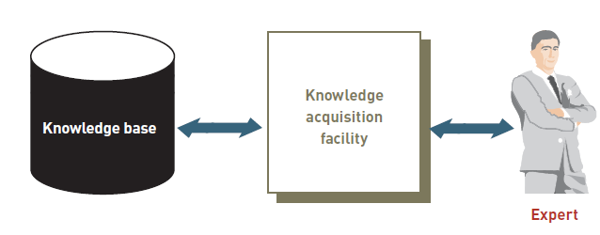
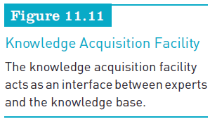
The Knowledge Acquisition Facility (continued)
Principles of Information Systems, Tenth Edition
‹#›

Slide 42
The User Interface
Permits decision makers to develop and use their own expert systems
Main purpose:
To make development and use of an expert system easier for users and decision makers
Principles of Information Systems, Tenth Edition
‹#›
Notes:
‹#›

Slide 43
Participants in Developing and Using Expert Systems
Domain expert:
Person or group with the expertise or knowledge the expert system is trying to capture
Knowledge engineer:
Person who has training or experience in the design, development, implementation, and maintenance of an expert system
Knowledge user:
Person or group who uses and benefits from the expert system
Principles of Information Systems, Tenth Edition
‹#›
Notes:
‹#›

Slide 44
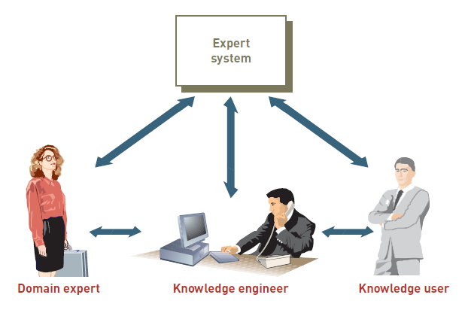
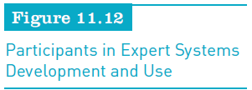
Participants in Developing and Using Expert Systems (continued)
Principles of Information Systems, Tenth Edition
‹#›

Slide 45
Expert Systems Development Tools and Techniques
Theoretically, expert systems can be developed from any programming language
Expert system shells and products
Collections of software packages and tools used to design, develop, implement, and maintain expert systems
Principles of Information Systems, Tenth Edition
‹#›
Notes:
‹#›

Slide 46
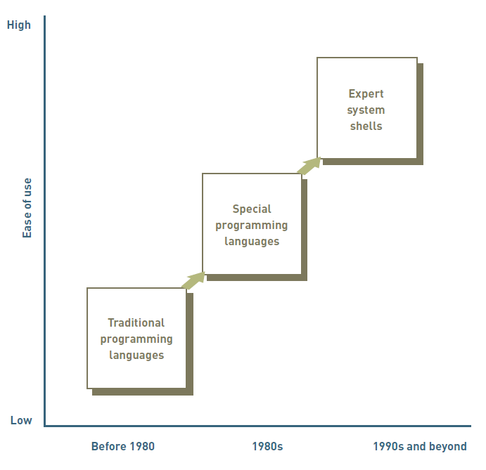
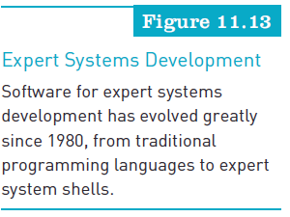
Expert Systems Development Tools and Techniques (continued)
Principles of Information Systems, Tenth Edition
‹#›

Slide 47
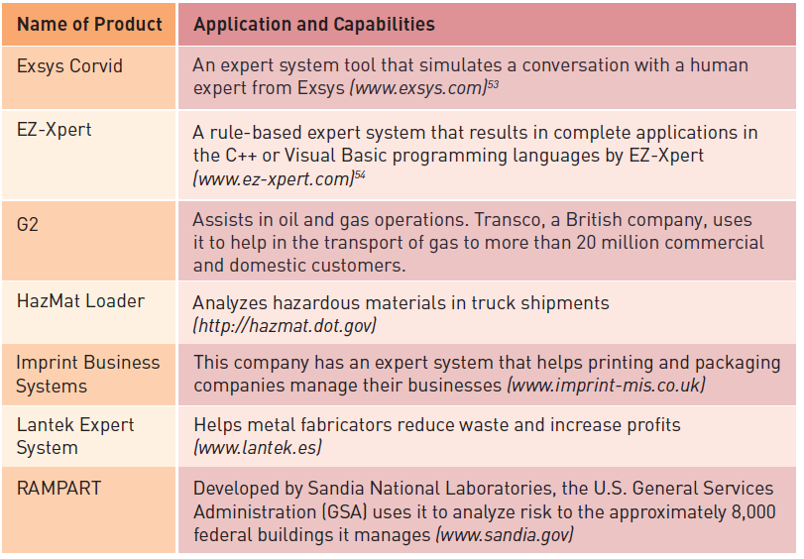
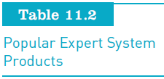
Expert Systems Development Tools and Techniques (continued)
Principles of Information Systems, Tenth Edition
‹#›

Slide 48
Multimedia and Virtual Reality
Use of multimedia and virtual reality:
Has helped many companies achieve a competitive advantage and increase profits
The approach and technology used in multimedia:
Is often the foundation of virtual reality systems
Principles of Information Systems, Tenth Edition
‹#›
Notes:
‹#›

Slide 49
Overview of Multimedia
Multimedia is:
Text and graphics
Audio
Video and animation
File conversion and compression
Designing a multimedia application:
Requires careful thought and a systematic approach
Requires that the end use of the document or file be carefully considered
Principles of Information Systems, Tenth Edition
‹#›

Slide 50
Overview of Virtual Reality
Virtual reality system:
Enables one or more users to move and react in a computer-simulated environment
Immersive virtual reality:
User becomes fully immersed in an artificial, 3D world that is completely generated by a computer
Principles of Information Systems, Tenth Edition
‹#›
Notes:
‹#›

Slide 51
Interface Devices
To see in a virtual world:
Often the user wears a head-mounted display (HMD) with screens directed at each eye
Haptic interface:
Relays sense of touch and other sensations in a virtual world
Most challenging to create
Principles of Information Systems, Tenth Edition
‹#›
Notes:
‹#›

Slide 52
Forms of Virtual Reality
Immersive virtual reality
Applications that are not fully immersive:
Mouse-controlled navigation through a 3D environment on a graphics monitor
Stereo projection systems
Stereo viewing from the monitor via stereo glasses
Principles of Information Systems, Tenth Edition
‹#›
Notes:
‹#›

Slide 53
Virtual Reality Applications
Medicine:
VR program called SnowWorld helps treat burn patients
Education and training:
Virtual technology has also been applied by the military
Business and commerce:
Boeing used virtual reality to help it design and manufacture airplane parts and new planes
Entertainment:
Movies use CGI to bring realism to the silver screen
Principles of Information Systems, Tenth Edition
‹#›
Notes:
‹#›

Slide 54
Specialized Systems
Segway:
Uses sophisticated software, sensors, and gyro motors to transport people
Radio frequency identification (RFID) tags:
Contain small chips with information about products or packages and can be quickly scanned to perform inventory control
Principles of Information Systems, Tenth Edition
‹#›
Notes:
‹#›

Slide 55
Specialized Systems (continued)
Game theory:
Involves the use of information systems to develop competitive strategies for people, organizations, or even countries
Informatics:
Combines traditional disciplines, such as science and medicine, with computer systems and technology
Principles of Information Systems, Tenth Edition
‹#›

Slide 56
Summary
Knowledge:
Awareness and understanding of a set of information
Knowledge workers:
People who create, use, and disseminate knowledge
Artificial intelligence:
Broad field that includes:
Expert systems, robotics, vision systems
Natural language processing, learning systems, and neural networks
Principles of Information Systems, Tenth Edition
‹#›
Notes:
‹#›

Slide 57
Summary (continued)
Expert system consists of a collection of integrated and related components
Inference engine:
Processes the rules, data, and relationships stored in the knowledge base
Virtual reality system:
Enables one or more users to move and react in a computer-simulated environment
Principles of Information Systems, Tenth Edition
‹#›
Notes:
‹#›

Slide 58
Summary (continued)
Virtual reality:
Can refer to applications that are not fully immersive
Specialized systems:
Segway
Radio frequency identification (RFID) tags
Game theory
Principles of Information Systems, Tenth Edition
‹#›

