Slide 1
Principles of Information Systems, Tenth Edition
Chapter 12
Systems Development: Investigation and Analysis

Slide 2
Principles and Learning Objectives
Effective systems development requires a team effort from stakeholders, users, managers, systems development specialists, and various support personnel, and it starts with careful planning
  Identify the key participants in the systems development process and discuss their roles
  Define the term information systems planning and list several reasons for initiating a systems project
Principles of Information Systems, Tenth Edition

Slide 3
Principles and Learning Objectives (continued)
Systems development often uses tools to select, implement, and monitor projects, including prototyping, rapid application development, CASE tools, and object-oriented development
  Discuss the key features, advantages, and disadvantages of the traditional, prototyping, rapid application development, and end-user systems development life cycles
Principles of Information Systems, Tenth Edition

Slide 4
Principles and Learning Objectives (continued)
  Identify several factors that influence the success or failure of a systems development project
  Discuss the use of CASE tools and the object-oriented approach to systems development
Principles of Information Systems, Tenth Edition

Slide 5
Principles and Learning Objectives (continued)
Systems development starts with investigation and analysis of existing systems
  State the purpose of systems investigation
  Discuss the importance of performance and cost objectives
  State the purpose of systems analysis and discuss some of the tools and techniques used in this phase of systems development
Principles of Information Systems, Tenth Edition

Slide 6
Why Learn About Systems Investigation and Analysis?
In this chapter:
  You will see how you can initiate the systems development process
  You will see how you can use the systems development approach to start your own business
First two steps of the systems development process:
  Systems investigation and systems analysis
Principles of Information Systems, Tenth Edition

Slide 7
An Overview of Systems Development
In today’s businesses:
  Managers and employees in all functional areas work together and use business information systems
This chapter will:
  Help you avoid systems development failures or projects that go over budget
Principles of Information Systems, Tenth Edition

Slide 8
Participants in Systems Development
Development team:
  Determines objectives of the information system
  Delivers system that meets objectives
Project:
  Planned collection of activities that achieves a goal
Project manager:
  Responsible for coordinating all people and resources needed to complete a project on time
Principles of Information Systems, Tenth Edition

Slide 9
Participants in Systems Development (continued)
Stakeholders:
  People who ultimately benefit from project
Users:
  People who will interact with the system regularly
Systems analysts:
  Professional who specializes in analyzing and designing business systems
Programmer:
  Responsible for modifying or developing programs to satisfy user requirements
Principles of Information Systems, Tenth Edition

Slide 10
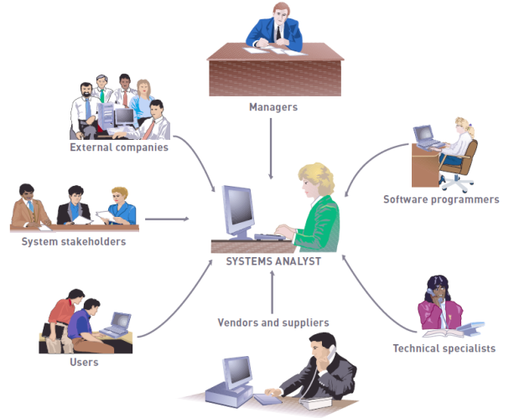
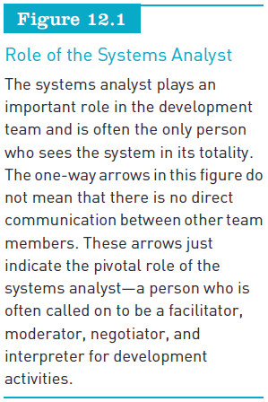
Participants in Systems Development (continued)
Principles of Information Systems, Tenth Edition

Slide 11
Individual Systems Developers and Users
Individual systems developer:
  Person who performs all of the systems development roles
Individual users:
  Acquire applications for both personal and professional use
End-user systems development:
  Describes any systems development project in which business managers and users assume the primary effort
Principles of Information Systems, Tenth Edition

Slide 12
Initiating Systems Development
Systems development initiatives:
  Arise from all levels of an organization
  Can be planned or unplanned
Mergers and acquisitions can trigger many systems development projects
Principles of Information Systems, Tenth Edition

Slide 13
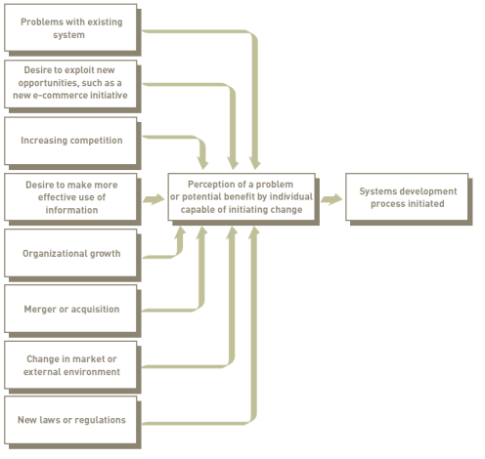
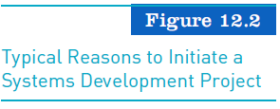
Initiating Systems Development (continued)
Principles of Information Systems, Tenth Edition

Slide 14
Information Systems Planning and Aligning Corporate and IS Goals
Information systems planning:
  Translating strategic and organizational goals into systems development initiatives
Aligning organizational goals and IS goals:
  Critical for successful systems development effort
Developing a competitive advantage:
  Creative analysis
  Critical analysis
Principles of Information Systems, Tenth Edition

Slide 15
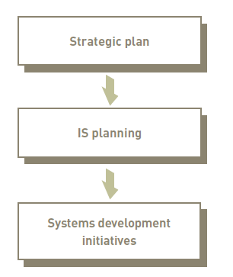
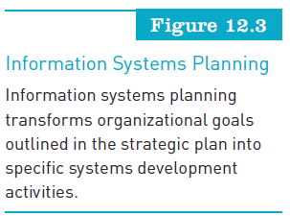
Information Systems Planning and Aligning Corporate and IS Goals (continued)
Principles of Information Systems, Tenth Edition

Slide 16
Establishing Objectives for Systems Development
Mission-critical systems:
  Play pivotal role in organization’s continued operations and goal attainment
Critical success factors (CSFs):
  Factors essential to success of a functional area of an organization
Principles of Information Systems, Tenth Edition

Slide 17
Establishing Objectives for Systems Development (continued)
Performance objectives:
  Output quality or usefulness
  Output accuracy
  Speed at which output is generated
  Flexibility of the system
  Ease of use of the application
  Scalability of resulting system
  Risk of the system
Principles of Information Systems, Tenth Edition

Slide 18
Establishing Objectives for Systems Development (continued)
Cost objectives:
  Development costs
  Costs related to the uniqueness of the system application
  Fixed investments in hardware and related equipment
  Ongoing operating costs
Principles of Information Systems, Tenth Edition

Slide 19
Systems Development Life Cycles
The later in the SDLC an error is detected, the more expensive it is to correct
  Reason for mounting costs:
    Previous phases must be reworked
    More people are affected
Principles of Information Systems, Tenth Edition

Slide 20
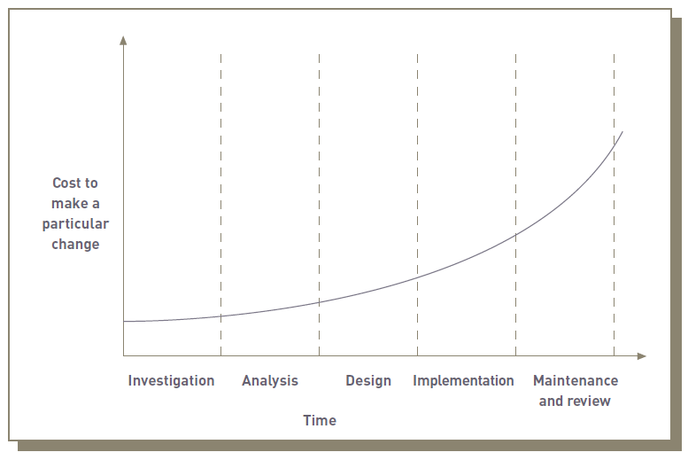
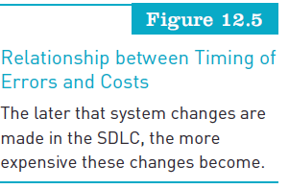
Systems Development Life Cycles (continued)
Principles of Information Systems, Tenth Edition

Slide 21
Systems Development Life Cycles (continued)
Common systems development life cycles:
  Traditional
  Prototyping
  Rapid application development (RAD)
  Individual development
Principles of Information Systems, Tenth Edition

Slide 22
The Traditional Systems Development Life Cycle
Systems investigation:
  Identifies problems and opportunities and considers them in light of business goals
Systems analysis:
  Studies existing systems and work processes to identify strengths, weaknesses, and opportunities for improvement
Systems design:
  Defines how the information system will do what it must do to obtain the problem’s solution
Principles of Information Systems, Tenth Edition

Slide 23
The Traditional Systems Development Life Cycle (continued)
Systems implementation:
  Creates or acquires various system components detailed in systems design, assembles them, and places new or modified system into operation
Systems maintenance and review:
  Ensures the system operates as intended
  Modifies the system so that it continues to meet changing business needs
Principles of Information Systems, Tenth Edition

Slide 24
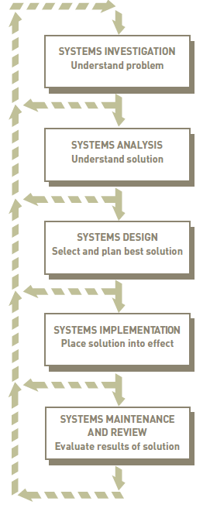
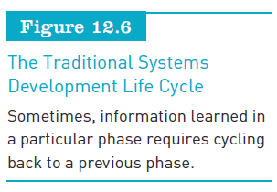
Principles of Information Systems, Tenth Edition

Slide 25
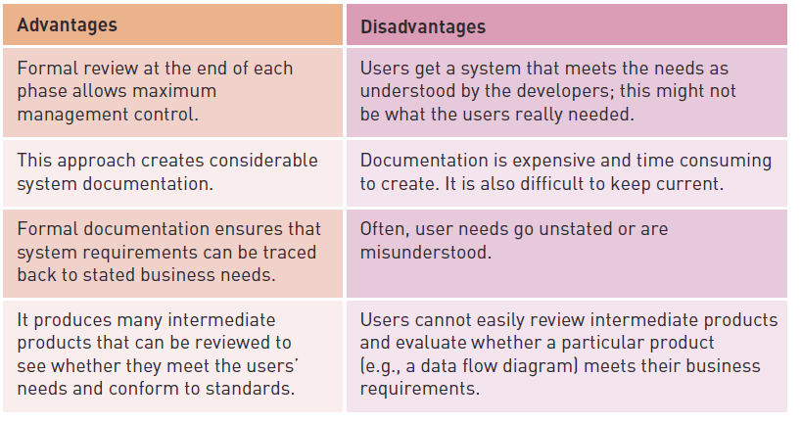
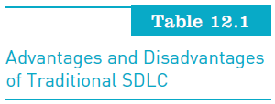
The Traditional Systems Development Life Cycle (continued)
Principles of Information Systems, Tenth Edition

Slide 26
Prototyping
An iterative approach
Operational prototype:
  Prototype that works
  Accesses real data files, edits input data, makes necessary computations and comparisons, and produces real output
Nonoperational prototype:
  A mock-up, or model
  Includes output and input specifications and formats
Principles of Information Systems, Tenth Edition

Slide 27
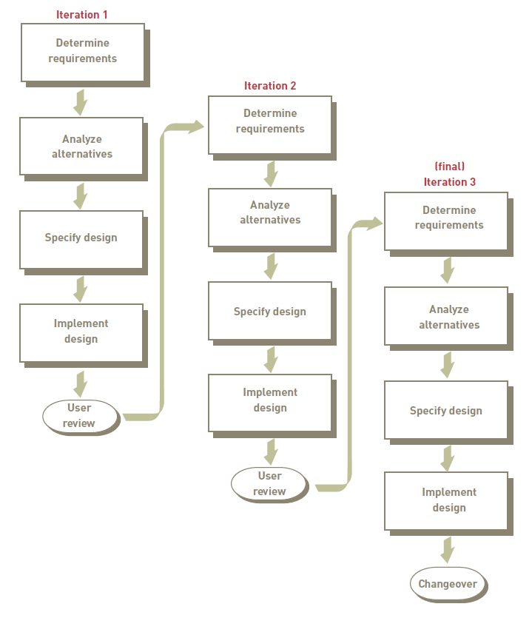
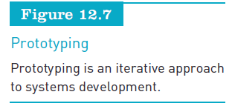
Principles of Information Systems, Tenth Edition

Slide 28
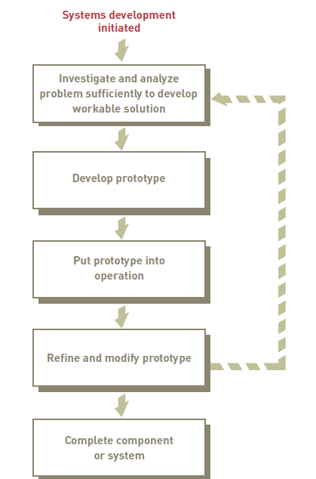
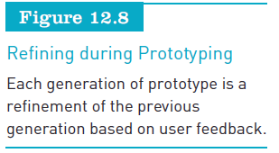
Principles of Information Systems, Tenth Edition

Slide 29
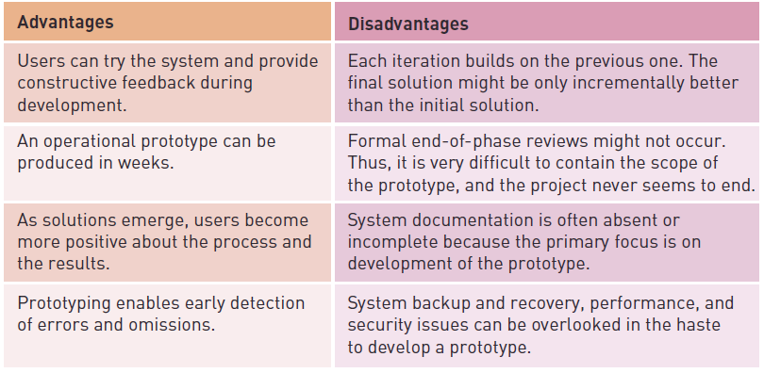
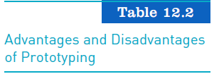
Prototyping (continued)
Principles of Information Systems, Tenth Edition

Slide 30
Rapid Application Development, Agile Development, and Other Systems Development Approaches
Rapid application development (RAD)
  Employs tools, techniques, and methodologies designed to speed application development
Other approaches to rapid development
  Agile development
  Extreme programming (XP)
Principles of Information Systems, Tenth Edition

Slide 31
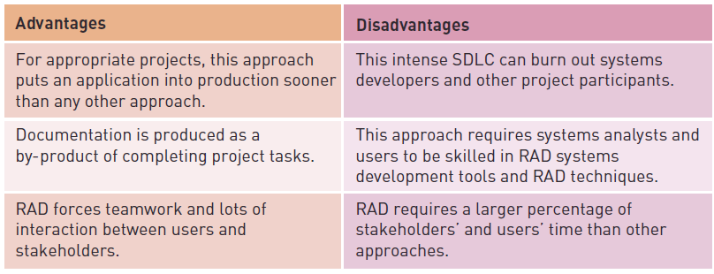
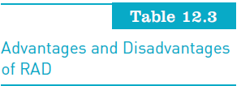
Rapid Application Development, Agile Development, and Other Systems Development Approaches (continued)
Principles of Information Systems, Tenth Edition

Slide 32
Outsourcing and On-Demand Computing
Reasons for using outsourcing and on-demand computing approaches:
  To reduce costs
  To obtain state-of-the-art technology
  To eliminate staffing and personnel problems
  To increase technological flexibility
Principles of Information Systems, Tenth Edition

Slide 33
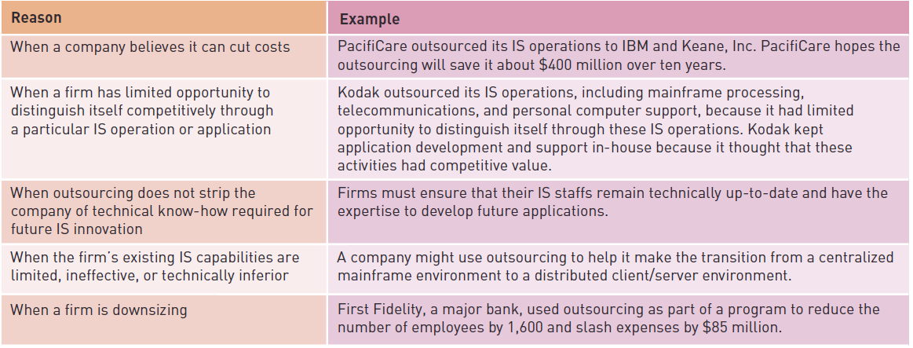
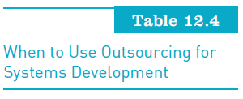
Outsourcing and On-Demand Computing (continued)
Principles of Information Systems, Tenth Edition

Slide 34
Factors Affecting Systems Development Success
Successful systems development:
  Delivers a system that meets user and organizational needs on time and within budget
Critical for most systems development projects:
  Getting users and stakeholders involved
Principles of Information Systems, Tenth Edition

Slide 35
Degree of Change
Continuous improvement projects versus reengineering:
  Continuous improvement projects have a high degree of success
  Reengineering projects tend to have a high degree of risk but also a high potential for benefits
Managing change:
  It is essential to recognize and deal with existing or potential problems
Principles of Information Systems, Tenth Edition

Slide 36
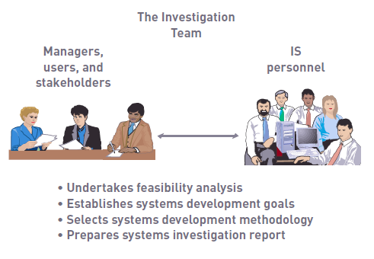
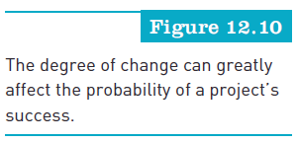
Degree of Change (continued)
Principles of Information Systems, Tenth Edition

Slide 37
Quality and Standards
Quality of project planning:
  Bigger the project, the more likely that poor planning will lead to significant problems
Capability Maturity Model (CMM):
  One way to measure organizational experience
Principles of Information Systems, Tenth Edition

Slide 38
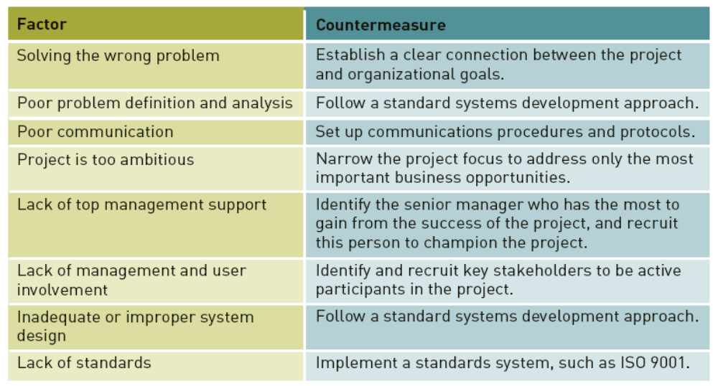
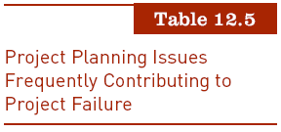
Principles of Information Systems, Tenth Edition

Slide 39
The Importance of Planning
The bigger the project:
  The more likely that poor planning will lead to significant problems
Important factor for systems development success:
  Organizational experience with the systems development process
Principles of Information Systems, Tenth Edition

Slide 40
Use of Project Management Tools
Project schedule:
  Detailed description of what is to be done
Project milestone:
  Critical date for completion of a major part of the project
Project deadline:
  Date that the entire project is to be completed and operational
Critical path:
  Activities that, if delayed, would delay the entire project
Principles of Information Systems, Tenth Edition

Slide 41
Use of Project Management Tools (continued)
Program Evaluation and Review Technique (PERT):
  Creates three time estimates for an activity:
    Shortest possible time
    Most likely time
    Longest possible time
Gantt chart:
  Graphical tool used for planning, monitoring, and coordinating projects
Principles of Information Systems, Tenth Edition

Slide 42
Use of Computer-Aided Software Engineering (CASE) Tools
CASE tools:
  Automate many tasks required in a systems development effort
  Encourage adherence to SDLC
Upper-CASE tools:
  CASE tools that focus on activities associated with the early stages of systems development
Principles of Information Systems, Tenth Edition

Slide 43
Object-Oriented Systems Development
Combines logic of systems development life cycle with power of object-oriented modeling and programming
OOSD tasks:
  Identifying potential problems and opportunities that would be appropriate for OO approach
  Defining what kind of system users require
Principles of Information Systems, Tenth Edition

Slide 44
Object-Oriented Systems Development (continued)
OOSD tasks (continued):
  Designing the system
  Programming or modifying modules
  Evaluation by users
  Periodic review and modification
Principles of Information Systems, Tenth Edition

Slide 45
Systems Investigation
What primary problems might a new or enhanced system solve?
What opportunities might a new or enhanced system provide?
What new hardware, software, databases, telecommunications, personnel, or procedures will improve an existing system or are required in a new system?
What are the potential costs (variable and fixed)?
What are the associated risks?
Principles of Information Systems, Tenth Edition

Slide 46
Initiating Systems Investigation
Systems request form:
  Submitted by someone who wants IS department to initiate systems investigation
  Information included:
    Problems in or opportunities for system
    Objectives of systems investigation
    Overview of proposed system
    Expected costs and benefits of proposed system
Principles of Information Systems, Tenth Edition

Slide 47
Participants in Systems Investigation
Members of development team change from phase to phase
Keys to successful investigation teams:
  Cooperation and collaboration
Principles of Information Systems, Tenth Edition

Slide 48
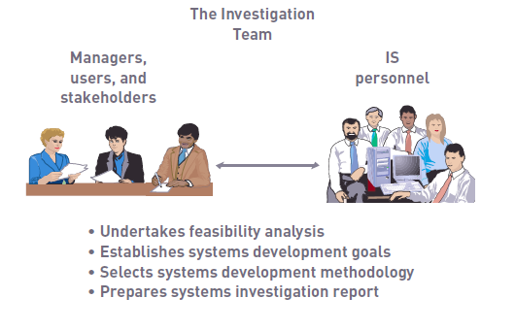
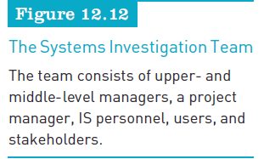
Principles of Information Systems, Tenth Edition

Slide 49
Feasibility Analysis
Assesses:
  Technical feasibility
  Economic feasibility
  Legal feasibility
  Operational feasibility
  Schedule feasibility
Principles of Information Systems, Tenth Edition

Slide 50
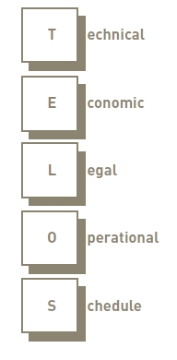
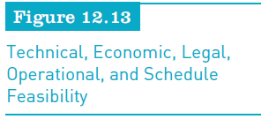
Feasibility Analysis (continued)
Principles of Information Systems, Tenth Edition

Slide 51
Object-Oriented Systems Investigation
Object-oriented approach:
  Can be used during all phases of systems development
Use case diagram:
  Part of the Unified Modeling Language (UML) that is used in object-oriented systems development
Principles of Information Systems, Tenth Edition

Slide 52
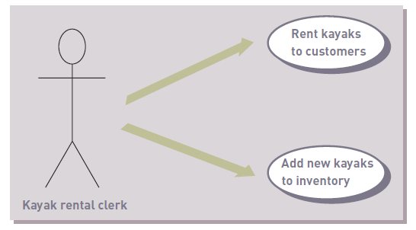

Object-Oriented Systems Investigation (continued)
Principles of Information Systems, Tenth Edition

Slide 53
The Systems Investigation Report
Summarizes results of systems investigation
Summarizes the process of feasibility analysis
Recommends a course of action:
  Continue on into systems analysis
  Modify the project in some manner
  Drop the project
Reviewed by steering committee
Principles of Information Systems, Tenth Edition

Slide 54
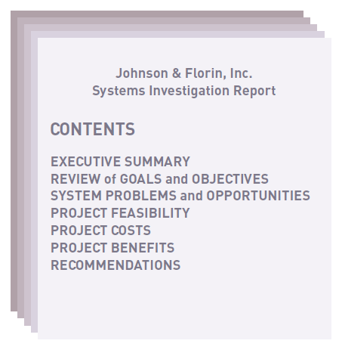
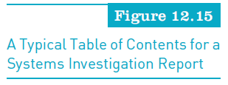
The Systems Investigation Report (continued)
Principles of Information Systems, Tenth Edition

Slide 55
Systems Analysis
Overall emphasis of analysis:
  Gathering data on existing system
  Determining requirements for new system
  Considering alternatives
  Investigating feasibility of solutions
Primary outcome of systems analysis:
  Prioritized list of systems requirements
Principles of Information Systems, Tenth Edition

Slide 56
General Considerations
Steps of a formalized analysis procedure:
  Assembling participants for systems analysis
  Collecting data and requirements
  Analyzing data and requirements
  Preparing a report on existing system, new system requirements, and project priorities
Principles of Information Systems, Tenth Edition

Slide 57
Participants in Systems Analysis
Includes members of the original investigation team
Systems analysis team develops:
  List of objectives and activities
  Schedule for meeting the objectives and completing the specific activities
  Deadlines for each stage
  Statement of the resources required at each stage
Principles of Information Systems, Tenth Edition

Slide 58
Data Collection
Identifying sources of data:
  Internal and external sources
Collecting data:
  Interviews
  Direct observation
  Questionnaires
Principles of Information Systems, Tenth Edition

Slide 59
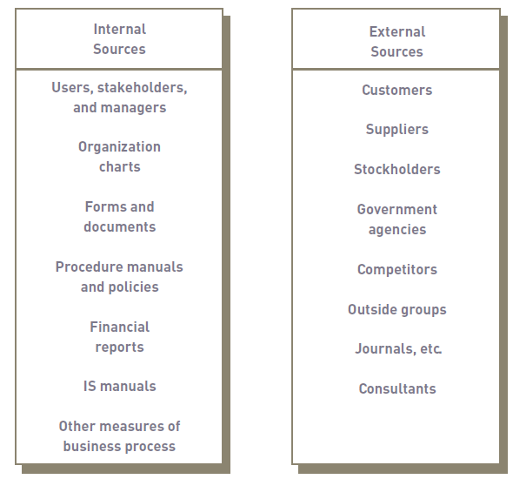
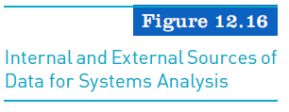
Principles of Information Systems, Tenth Edition

Slide 60
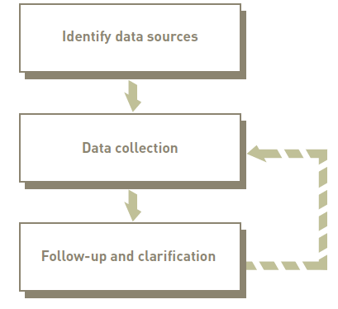

Principles of Information Systems, Tenth Edition

Slide 61
Data Analysis
Data modeling
Activity modeling
Application flowcharts
Grid charts
CASE tools
Principles of Information Systems, Tenth Edition

Slide 62
Requirements Analysis
Purpose is to determine user, stakeholder, and organizational needs
Techniques used to capture systems requirements:
  Asking directly
  Critical success factors (CSFs)
  IS plan
  Screen and report layout
  Requirements analysis tools
Principles of Information Systems, Tenth Edition

Slide 63
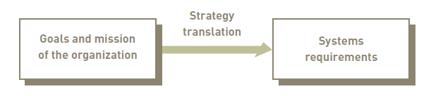
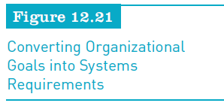
Requirements Analysis (continued)
Principles of Information Systems, Tenth Edition

Slide 64
Object-Oriented Systems Analysis
Identify problems or potential opportunities
Identify key participants and collect data
With the OO approach a class is used to describe different types of objects
Principles of Information Systems, Tenth Edition

Slide 65
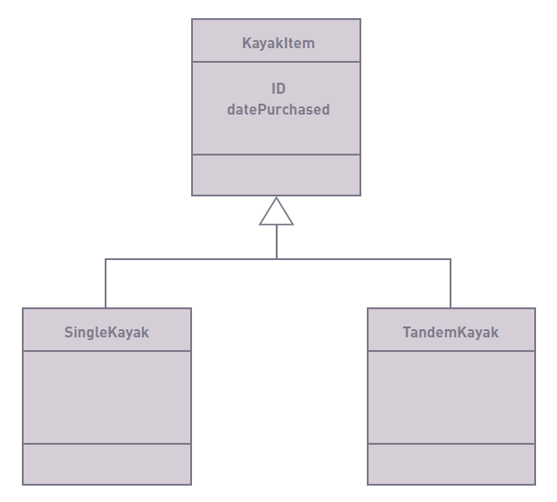
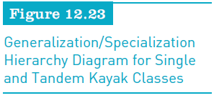
Principles of Information Systems, Tenth Edition

Slide 66
The Systems Analysis Report
Elements:
  Strengths and weaknesses of existing system from a stakeholder’s perspective
  User/stakeholder requirements for new system
  Organizational requirements for new system
  Description of what new information system should do to solve the problem
Principles of Information Systems, Tenth Edition

Slide 67
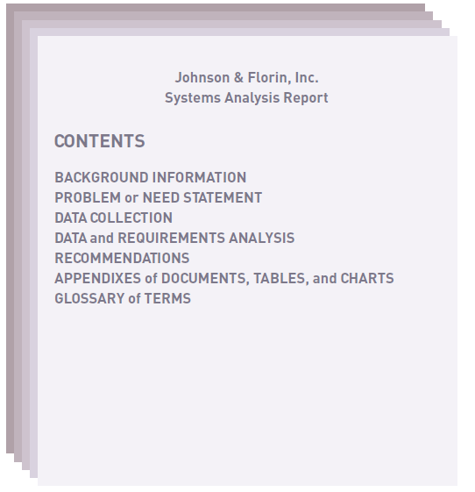
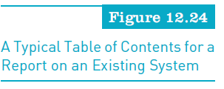
Principles of Information Systems, Tenth Edition

Slide 68
Summary
Systems development team:
  Stakeholders, users, managers, systems development specialists, and various support personnel
Five phases of the traditional SDLC:
  Investigation, analysis, design, implementation, and maintenance and review
Advantages of the traditional SDLC:
  Provides for maximum management control
  Creates considerable system documentation
  Produces many intermediate products for review
Principles of Information Systems, Tenth Edition

Slide 69
Summary (continued)
Rapid application development (RAD):
  Reduces paper-based documentation
  Automates program source code generation
  Facilitates user participation in development activities
Factors that affect systems development success:
  Degree of change introduced by the project
  Continuous improvement and reengineering
  Use of project management tools
Principles of Information Systems, Tenth Edition

Slide 70
Summary (continued)
Participants in systems investigation:
  Stakeholders, users, managers, employees, analysts, and programmers
Data collection methods:
  Observation, interviews, questionnaires, and statistical sampling
Requirements analysis:
  Determines the needs of users, stakeholders, and the organization in general
Principles of Information Systems, Tenth Edition

