Slide 1
Principles of Information Systems, Tenth Edition
Chapter 14
The Personal and Social Impact of Computers
‹#›
Notes:
‹#›

Slide 2
Principles and Learning Objectives
Policies and procedures must be established to avoid waste and mistakes associated with computer usage
Describe some examples of waste and mistakes in an IS environment, their causes, and possible solutions
Identify policies and procedures useful in eliminating waste and mistakes
Discuss the principles and limits of an individual’s right to privacy
Principles of Information Systems, Tenth Edition
‹#›
Notes:
‹#›

Slide 3
Principles and Learning Objectives (continued)
Computer crime is a serious and rapidly growing area of concern requiring management attention
Explain the types of computer crime and their effects
Identify specific measures to prevent computer crime
Principles of Information Systems, Tenth Edition
‹#›

Slide 4
Principles and Learning Objectives (continued)
Jobs, equipment, and working conditions must be designed to avoid negative health effects from computers
List the important negative effects of computers on the work environment
Identify specific actions that must be taken to ensure the health and safety of employees
Principles of Information Systems, Tenth Edition
‹#›

Slide 5
Principles and Learning Objectives (continued)
Practitioners in many professions subscribe to a code of ethics that states the principles and core values that are essential to their work
Outline criteria for the ethical use of information systems
Principles of Information Systems, Tenth Edition
‹#›

Slide 6
Why Learn About the Personal and Social Impact of the Internet?
Both opportunities and threats:
Surround a wide range of nontechnical issues associated with the use of information systems and the Internet
You need to know about the topics in this chapter:
To help avoid becoming a victim of crime, fraud, privacy invasion, and other potential problem
Principles of Information Systems, Tenth Edition
‹#›

Slide 7
Computer Waste and Mistakes
Computer waste:
Inappropriate use of computer technology and resources
Computer-related mistakes:
Errors, failures, and other computer problems that make computer output incorrect or not useful
Principles of Information Systems, Tenth Edition
‹#›
Notes:
‹#›

Slide 8
Computer Waste
Spam filter:
Software that attempts to block unwanted e-mail
Some might require first-time e-mailers to be verified before their e-mails are accepted
Image-based spam:
New tactic spammers use to circumvent spam-filtering software
Principles of Information Systems, Tenth Edition
‹#›
Notes:
‹#›

Slide 9
Computer-Related Mistakes
Common causes:
Unclear expectations and a lack of feedback
Program development that contains errors
Incorrect data entry by data-entry clerk
Principles of Information Systems, Tenth Edition
‹#›
Notes:
‹#›

Slide 10
Preventing Computer-Related Waste and Mistakes
Preventing waste and mistakes involves:
Establishing, implementing, monitoring, and reviewing effective policies and procedures
Principles of Information Systems, Tenth Edition
Principles of Information Systems, Tenth Edition
‹#›
‹#›
Notes:
‹#›

Slide 11
Establishing Policies and Procedures
Types of computer-related mistakes:
Data-entry or data-capture errors
Errors in computer programs
Mishandling of computer output
Inadequate planning for and control of equipment malfunctions
Inadequate planning for and control of environmental difficulties
Installing computing capacity inadequate for the level of activity
Failure to provide access to the most current information
Principles of Information Systems, Tenth Edition
Principles of Information Systems, Tenth Edition
‹#›
‹#›

Slide 12
Implementing Policies and Procedures
Policies to minimize waste and mistakes:
Changes to critical tables, HTML, and URLs should be tightly controlled
User manual should be available covering operating procedures
Each system report should indicate its general content in its title
System should have controls to prevent invalid and unreasonable data entry
Principles of Information Systems, Tenth Edition
‹#›

Slide 13
Monitoring Policies and Procedures
Monitor routine practices and take corrective action if necessary
Implement internal audits to measure actual results against established goals
Principles of Information Systems, Tenth Edition
‹#›

Slide 14
Reviewing Policies and Procedures
Questions to be answered:
Do current policies cover existing practices adequately?
Does the organization plan any new activities in the future?
Are contingencies and disasters covered?
Principles of Information Systems, Tenth Edition
‹#›

Slide 15
Computer Crime
Top four categories of computer crime reported to law enforcement organizations during 2009:
Undelivered merchandise or nonpayment
Identity theft
Credit card fraud
Auction fraud
Principles of Information Systems, Tenth Edition
‹#›
Notes:
‹#›

Slide 16
The Computer as a Tool to Commit Crime
Social engineering:
Using social skills to get computer users to provide information to access an information system
Dumpster diving:
Going through trash cans to find secret or confidential information
Principles of Information Systems, Tenth Edition
‹#›
Notes:
‹#›

Slide 17
Cyberterrorism
Homeland Security Department’s Information Analysis and Infrastructure Protection Directorate:
Serves as a focal point for threat assessment, warning, investigation, and response for threats or attacks against the country’s critical infrastructure
Cyberterrorist:
Intimidates or coerces a government or organization to advance his or her political or social objectives
Principles of Information Systems, Tenth Edition
‹#›
Notes:
‹#›

Slide 18
Identity Theft
Imposter obtains personal identification information in order to impersonate someone else:
To obtain credit, merchandise, and services in the name of the victim
To have false credentials
More than 6 million customers of online brokerage firm TD Ameritrade were:
Involved in a class action lawsuit resulting from a data theft
Principles of Information Systems, Tenth Edition
‹#›
Notes:
‹#›

Slide 19
Internet Gambling
Revenues generated by Internet gambling represent a major untapped source of income for state and federal governments
Study showed that:
While people of all income levels played state lottery games, those people with an annual income of less than $10,000 spent nearly three times as much
Principles of Information Systems, Tenth Edition
‹#›

Slide 20
The Computer as a Tool to Fight Crime
Leads Online Web-based service system:
Used by law enforcement to recover stolen property
Contains more than 250 million records in its database
Allows law enforcement officers to search the database by item serial number or by individual
Principles of Information Systems, Tenth Edition
‹#›

Slide 21
Monitoring Sex Offenders
Offender Watch:
Web-based system used to track registered sex offenders
Stores the registered offender’s address, physical description, and vehicle information
GPS tracking devices and special software:
Used to monitor the movement of registered sex offenders
Principles of Information Systems, Tenth Edition
‹#›

Slide 22
Use of Geographic Information Systems
Enables law enforcement agencies to gain a quick overview of crime risk at a given address or in a given locale
Common GIS systems include:
The National Equipment Registry
The CompStat program
CargoNet
Principles of Information Systems, Tenth Edition
‹#›

Slide 23
The Computer as the Object of Crime
Crimes fall into several categories:
Illegal access and use
Data alteration and destruction
Information and equipment theft
Software and Internet piracy
Computer-related scams
International computer crime
Principles of Information Systems, Tenth Edition
‹#›
Notes:
‹#›

Slide 24
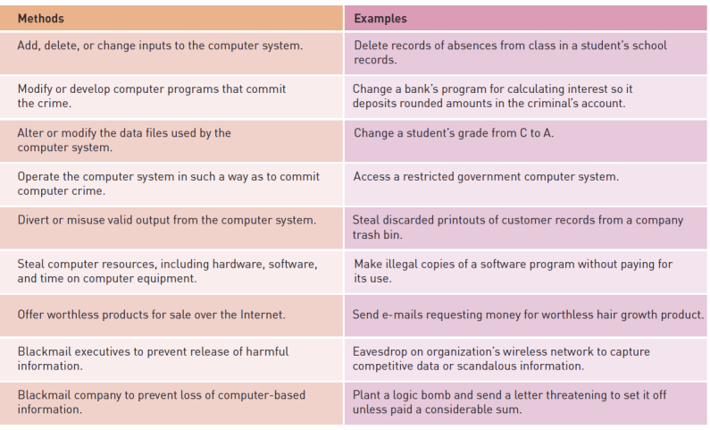

Principles of Information Systems, Tenth Edition
‹#›

Slide 25
Illegal Access and Use
Hacker:
Learns about and uses computer systems
Criminal hacker:
Gains unauthorized use or illegal access to computer systems
Script bunny:
Automates the job of crackers
Insider:
Employee who comprises corporate systems
Principles of Information Systems, Tenth Edition
‹#›
Notes:
‹#›

Slide 26
Illegal Access and Use (continued)
Virus:
Program file capable of attaching to disks or other files and replicating itself repeatedly
Worm:
Parasitic computer programs that replicate but, unlike viruses, do not infect other computer program files
Trojan horse:
Malicious program that disguises itself as a useful application or game and purposefully does something the user does not expect
Principles of Information Systems, Tenth Edition
Principles of Information Systems, Tenth Edition
‹#›
‹#›
Notes:
‹#›

Slide 27
Illegal Access and Use (continued)
Rootkit:
Set of programs that enable its user to gain administrator level access to a computer or network
Logic bomb:
Type of Trojan horse that executes when specific conditions occur
Variant:
Modified version of a virus that is produced by virus’s author or another person
Principles of Information Systems, Tenth Edition
‹#›
Notes:
‹#›

Slide 28
Spyware
Software installed on a personal computer to:
Intercept or take partial control over user’s interaction with the computer without knowledge or permission of the user
Similar to a Trojan horse in that:
Users unknowingly install it when they download freeware or shareware from the Internet
Principles of Information Systems, Tenth Edition
‹#›

Slide 29
Information and Equipment Theft
Password sniffer:
Small program hidden in a network that records identification numbers and passwords
Portable computers such as laptops and portable storage devices are especially easy for thieves to take:
Data and information stored in these systems are more valuable than the equipment
Principles of Information Systems, Tenth Edition
‹#›
Notes:
‹#›

Slide 30
Safe Disposal of Personal Computers
Deleting files and emptying the Recycle Bin does not make it impossible for determined individuals to view the data
Use disk-wiping software utilities that overwrite all sectors of your disk drive, making all data unrecoverable
Principles of Information Systems, Tenth Edition
‹#›

Slide 31
Patent and Copyright Violations
Software piracy:
Act of unauthorized copying or distribution of copyrighted software
Penalties can be severe
Patent infringement:
Occurs when someone makes unauthorized use of another’s patent
Principles of Information Systems, Tenth Edition
‹#›

Slide 32
Computer-Related Scams
Over the past few years:
Credit card customers of various banks have been targeted by scam artists trying to get personal information
Vishing:
Similar to phishing
Instead of using the victim’s computer, it uses the victim’s phone
Principles of Information Systems, Tenth Edition
‹#›

Slide 33
International Computer Crime
Computer crime becomes more complex when it crosses borders
Money laundering:
Disguising illegally gained funds so that they seem legal
Principles of Information Systems, Tenth Edition
‹#›

Slide 34
Preventing Computer-Related Crime
Efforts to curb computer crime are being made by:
Private users
Companies
Employees
Public officials
Principles of Information Systems, Tenth Edition
‹#›

Slide 35
Crime Prevention by State and Federal Agencies
Computer Fraud and Abuse Act of 1986:
Mandates punishment based on the victim’s dollar loss
Computer Emergency Response Team (CERT):
Responds to network security breaches
Monitors systems for emerging threats
Principles of Information Systems, Tenth Edition
‹#›

Slide 36
Crime Prevention by Corporations
Guidelines to protect your computer from criminal hackers:
Install strong user authentication and encryption capabilities on your firewall
Install the latest security patches
Disable guest accounts and null user accounts
Turn audit trails on
Consider installing caller ID
Install a corporate firewall between your corporate network and the Internet
Principles of Information Systems, Tenth Edition
‹#›
Notes:
‹#›

Slide 37
Using Intrusion Detection Software
Using intrusion detection software:
Intrusion detection system (IDS):
Monitors system and network resources
Notifies network security personnel when it senses a possible intrusion
Can provide false alarms
Principles of Information Systems, Tenth Edition
‹#›

Slide 38
Using Intrusion Detection Software (continued)
Security Dashboard:
Provides comprehensive display on a single computer screen of:
All the vital data related to an organization’s security defenses, including threats, exposures, policy compliance, and incident alerts
Principles of Information Systems, Tenth Edition
‹#›

Slide 39
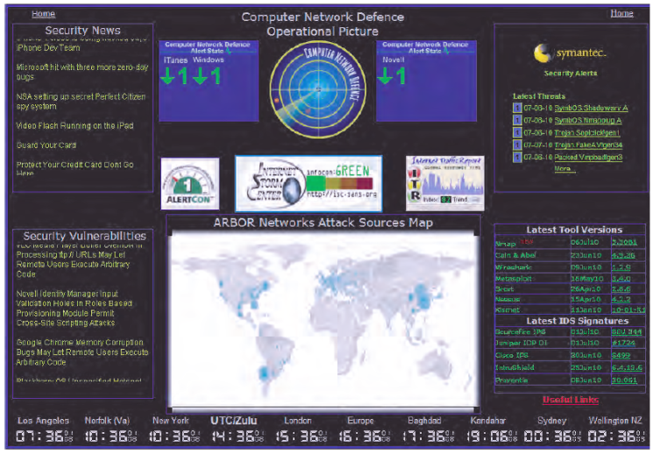
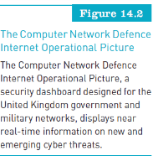
Principles of Information Systems, Tenth Edition
‹#›

Slide 40
Using Intrusion Detection Software (continued)
Using managed security service providers (MSSPs):
Many are outsourcing their network security operations to:
Managed security service providers (MSSPs) such as Counterpane, Guardent, IBM, Riptech, and Symantec
Guarding against theft of equipment and data:
Organizations need to take strong measures to guard against the theft of computer hardware and the data stored on it
Principles of Information Systems, Tenth Edition
‹#›
Notes:
‹#›

Slide 41
Crime Prevention for Individuals and Employees
Identity theft:
To protect yourself, regularly check credit reports with major credit bureaus
Malware attacks:
Antivirus programs run in the background to protect your computer
Many e-mail services and ISP providers offer free antivirus protection
Principles of Information Systems, Tenth Edition
‹#›

Slide 42
Crime Prevention for Individuals and Employees (continued)
Computer scams:
Tips to help you avoid becoming a victim:
Don’t agree to anything in a high-pressure meeting or seminar
Don’t judge a company based on appearances
Avoid any plan that pays commissions simply for recruiting additional distributors
Beware of shills
Beware of a company’s claim that it can set you up in a profitable home-based business
Principles of Information Systems, Tenth Edition
‹#›

Slide 43
Privacy Issues
Issue of privacy:
Deals with the right to be left alone or to be withdrawn from public view
Data is constantly being collected and stored on each of us
Principles of Information Systems, Tenth Edition
‹#›
Notes:
‹#›

Slide 44
Privacy and the Federal Government
The federal government:
Has implemented a number of laws addressing personal privacy
European Union:
Has data-protection directive that requires firms transporting data across national boundaries to have certain privacy procedures in place
Principles of Information Systems, Tenth Edition
‹#›

Slide 45
E-Mail Privacy
Federal law:
Permits employers to monitor e-mail sent and received by employees
E-mail messages that have been erased from hard disks can be retrieved and used in lawsuits
Use of e-mail among public officials might violate “open meeting” laws
Principles of Information Systems, Tenth Edition
‹#›

Slide 46
Instant Messaging Privacy
To protect your privacy and your employer’s property:
Do not send personal or private IMs at work
Choose a nonrevealing, nongender-specific, unprovocative IM screen name
Do not open files or click links in messages from people you do not know
Never send sensitive personal data such as credit card numbers via IM
Principles of Information Systems, Tenth Edition
‹#›

Slide 47
Privacy and Personal Sensing Devices
RFID tags:
Microchips with antenna
Embedded in many of the products we buy:
Medicine containers, clothing, computer printers, car keys, library books, tires
Generate radio transmissions that, if appropriate measures are not taken, can lead to potential privacy concerns
Principles of Information Systems, Tenth Edition
‹#›

Slide 48
Privacy and the Internet
Huge potential for privacy invasion on the Internet:
E-mail messages
Visiting a Web site
Buying products over the Internet
Platform for Privacy Preferences (P3P):
Screening technology
Social network services:
Parents should discuss potential dangers, check their children’s profiles, and monitor their activities
Principles of Information Systems, Tenth Edition
‹#›

Slide 49
Internet Libel Concerns
Libel:
Publishing an intentionally false written statement that is damaging to a person’s or organization’s reputation
Individuals:
Can post information to the Internet using anonymous e-mail accounts or screen names
Must be careful what they post on the Internet to avoid libel charges
Principles of Information Systems, Tenth Edition
‹#›

Slide 50
Filtering and Classifying Internet Content
Filtering software:
Help screen Internet content
Internet Content Rating Association (ICRA):
Goals are to protect children from potentially harmful material while also safeguarding free speech on the Internet
Principles of Information Systems, Tenth Edition
‹#›

Slide 51
Fairness in Information Use
The Privacy Act of 1974:
Provides privacy protection from federal agencies
Applies to all federal agencies except the CIA and law enforcement agencies
Requires training for all federal employees who interact with a “system of records” under the act
Principles of Information Systems, Tenth Edition
Principles of Information Systems, Tenth Edition
‹#›
‹#›
Notes:
‹#›

Slide 52
Electronic Communications Privacy Act
Gramm-Leach-Bliley Act:
Requires financial institutions to protect customers’ nonpublic data
USA Patriot Act:
Internet service providers and telephone companies must turn over customer information
Corporate privacy policies:
Should address a customer’s knowledge, control, notice, and consent over the storage and use of information
Principles of Information Systems, Tenth Edition
Principles of Information Systems, Tenth Edition
‹#›
‹#›

Slide 53
Individual Efforts to Protect Privacy
To protect personal privacy:
Find out what is stored about you in existing databases
Be careful when you share information about yourself
Be proactive to protect your privacy
Take extra care when purchasing anything from a Web site
Principles of Information Systems, Tenth Edition
‹#›
Notes:
‹#›

Slide 54
The Work Environment
Use of computer-based information systems has changed the workforce:
Jobs that require IS literacy have increased
Less-skilled positions have decreased
Enhanced telecommunications:
Has been the impetus for new types of business
Has created global markets in industries once limited to domestic markets
Principles of Information Systems, Tenth Edition
‹#›

Slide 55
Health Concerns
Occupational stress
Seated immobility thromboembolism (SIT)
Carpal tunnel syndrome (CTS)
Video display terminal (VDT) bill:
Employees who spend at least four hours a day working with computer screens should be given 15-minute breaks every two hours
Principles of Information Systems, Tenth Edition
‹#›
Notes:
‹#›

Slide 56
Avoiding Health and Environment Problems
Work stressors:
Hazardous activities associated with unfavorable conditions of a poorly designed work environment
Ergonomics:
Science of designing machines, products, and systems to maximize safety, comfort, and efficiency of people who use them
Principles of Information Systems, Tenth Edition
‹#›
Notes:
‹#›

Slide 57
Ethical Issues in Information Systems
Code of ethics:
States the principles and core values essential to a set of people and, therefore, govern their behavior
Can become a reference point for weighing what is legal and what is ethical
Principles of Information Systems, Tenth Edition
‹#›
Notes:
‹#›

Slide 58
Summary
Computer waste:
The inappropriate use of computer technology and resources in both the public and private sectors
Preventing waste and mistakes involves:
Establishing, implementing, monitoring, and reviewing effective policies and procedures
Some crimes use computers as tools
Cyberterrorist:
Intimidates or coerces a government or organization to advance his or her political or social objectives
Principles of Information Systems, Tenth Edition
‹#›
Notes:
‹#›

Slide 59
Summary (continued)
To detect and prevent computer crime use:
Antivirus software
Intrusion detection systems (IDSs)
Privacy issues:
A concern with government agencies, e-mail use, corporations, and the Internet
Businesses:
Should develop a clear and thorough policy about privacy rights for customers, including database access
Principles of Information Systems, Tenth Edition
‹#›
Notes:
‹#›

Slide 60
Summary (continued)
Computer-related scams:
Have cost people and companies thousands of dollars
Ergonomics:
The study of designing and positioning computer equipment
Code of ethics:
States the principles and core values that are essential to the members of a profession or organization
Principles of Information Systems, Tenth Edition
‹#›
Notes:
‹#›

