Slide 1
Principles of Information Systems, Tenth Edition
Chapter 4
Software: Systems and Application Software

Slide 2
Principles and Learning Objectives
Systems and application software are critical in helping individuals and organizations achieve their goals
  Identify and briefly describe the functions of the two basic kinds of software
  Outline the role of the operating system and identify the features of several popular operating systems
Principles of Information Systems, Tenth Edition

Slide 3
Principles and Learning Objectives (continued)
Organizations use off-the-shelf application software for common business needs and proprietary application software to meet unique business needs and provide a competitive advantage
  Discuss how application software can support personal, workgroup, and enterprise business objectives
  Identify three basic approaches to developing application software and discuss the pros and cons of each
Principles of Information Systems, Tenth Edition

Slide 4
Principles and Learning Objectives (continued)
Organizations should choose programming languages with functional characteristics that are appropriate for the task at hand and well suited to the skills and experience of the programming staff
  Outline the overall evolution and importance of programming languages and clearly differentiate among the generations of programming languages
Principles of Information Systems, Tenth Edition

Slide 5
Principles and Learning Objectives (continued)
The software industry continues to undergo constant change; users need to be aware of recent trends and issues to be effective in their business and personal life
  Identify several key software issues and trends that have an impact on organizations and individuals
Principles of Information Systems, Tenth Edition

Slide 6
Why Learn About Software?
Software is indispensable for any computer system and the people using it
Applications software:
  Key to helping you achieve your career goals and enrich your life
  Stock trading, scientific, accounting, tax, etc.
Principles of Information Systems, Tenth Edition

Slide 7
An Overview of Software
Computer programs:
  Sequences of instructions for the computer
Documentation:
  Describes program functions to help the user operate the computer system
Types of software:
  Systems software
  Application software
Principles of Information Systems, Tenth Edition

Slide 8
Systems Software
Set of programs that coordinates the activities and functions of hardware and other programs
Computer system platform:
  Combination of a hardware configuration and systems software
Principles of Information Systems, Tenth Edition

Slide 9
Application Software
Helps users solve particular problems
In most cases, resides on the computer’s hard disk
Can be stored on CDs, DVDs, and even USB flash drives
Principles of Information Systems, Tenth Edition

Slide 10
Supporting Individual, Group, and Organizational Goals
Sphere of influence:
  Scope of problems and opportunities addressed by a particular organization
Personal sphere of influence:
  Serve the needs of an individual user
Personal productivity software:
  Help users improve their personal effectiveness
Workgroup:
  When two or more people work together to achieve a common goal
Principles of Information Systems, Tenth Edition

Slide 11
Supporting Individual, Group, and Organizational Goals (continued)
Workgroup sphere of influence:
  Serves the needs of a workgroup
Enterprise sphere of influence:
  Supports the firm in its interaction with its environment
Principles of Information Systems, Tenth Edition

Slide 12
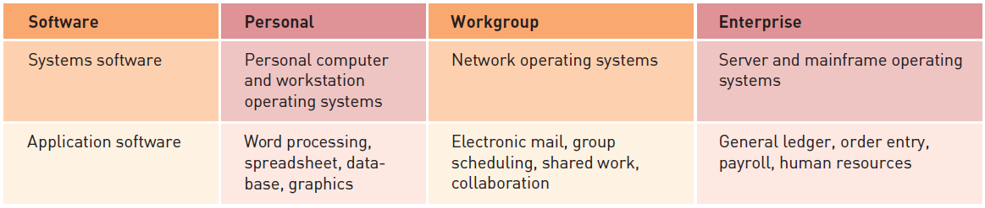
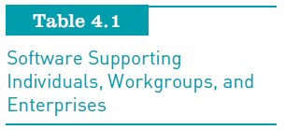
Supporting Individual, Group, and Organizational Goals (continued)
Principles of Information Systems, Tenth Edition

Slide 13
Systems Software
Controls the operations of computer hardware
Supports the application programs’ problem-solving capabilities
Types of systems software:
  Operating systems
  Utility programs
  Middleware
Principles of Information Systems, Tenth Edition

Slide 14
Operating Systems
Set of programs that controls computer hardware and acts as an interface with application programs
Kernel:
  Ties all components of the OS together and regulates other programs
Principles of Information Systems, Tenth Edition

Slide 15
Operating Systems (continued)
Combinations of OSs, computers, and users:
  Single computer with a single user
  Single computer with multiple simultaneous users
  Multiple computers with multiple users
  Special-purpose computers
Principles of Information Systems, Tenth Edition

Slide 16
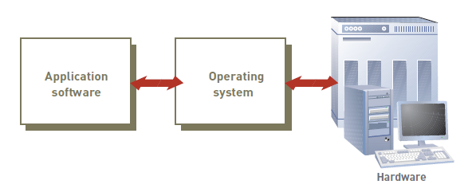
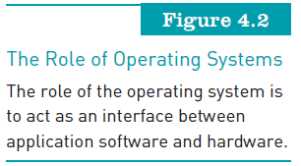
Operating Systems (continued)
Principles of Information Systems, Tenth Edition

Slide 17
Operating Systems (continued)
Activities performed by the operating system:
  Perform common computer hardware functions
  Provide a user interface and input/output management
  Provide a degree of hardware independence
  Manage system memory
Principles of Information Systems, Tenth Edition

Slide 18
Operating Systems (continued)
Activities performed by the operating system (continued):
  Manage processing tasks
  Provide networking capability
  Control access to system resources
  Manage files
Principles of Information Systems, Tenth Edition

Slide 19
Operating Systems (continued)
Common hardware functions:
  Get input from keyboard or another input device
  Retrieve data from disks
  Store data on disks
  Display information on a monitor or printer
Principles of Information Systems, Tenth Edition

Slide 20
Operating Systems (continued)
User interface and input/output management
  User interface:
    Allows individuals to access and command the computer system
  Command-based user interface:
    Requires that text commands be given to the computer to perform basic activities
  Graphical user interface (GUI):
    Uses icons and menus displayed on screen to send commands to the computer system
Principles of Information Systems, Tenth Edition

Slide 21
Operating Systems (continued)
Hardware independence:
  Application program interface (API):
    Allows applications to make use of the operating system
Memory management:
  Allows computer to execute program instructions effectively and to speed processing
Principles of Information Systems, Tenth Edition

Slide 22
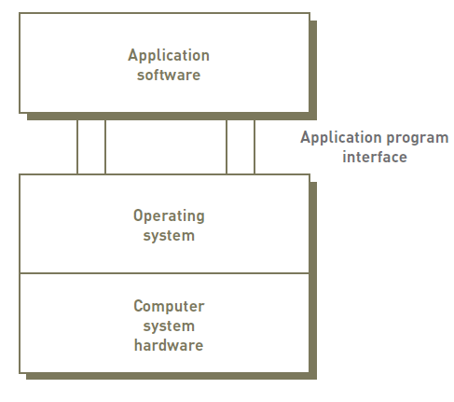
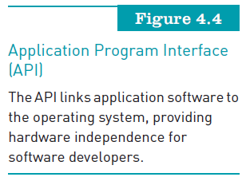
Operating Systems (continued)
Principles of Information Systems, Tenth Edition

Slide 23
Operating Systems (continued)
Processing tasks:
  Multitasking:
    More than one program can run at the same time
  Time-sharing:
    Allows more than one person to use a computer system at the same time
  Scalability:
    Ability of the computer to handle an increasing number of concurrent users smoothly
Principles of Information Systems, Tenth Edition

Slide 24
Operating Systems (continued)
Networking capability:
  Allows computers in a network to send and receive data and share computing resources
Access to system resources and security:
  Protection against unauthorized access
  OS establishes a logon procedure
File management:
  Ensures that files in secondary storage are available when needed and that they are protected from access by unauthorized users
Principles of Information Systems, Tenth Edition

Slide 25
Current Operating Systems
Microsoft PC operating systems:
  Windows XP
  Windows Vista
  Windows 7
Apple Computer Operating Systems:
  Wintel
  Snow Leopard (OS X v10.6)
Linux:
  Red Hat Linux
  Caldera OpenLinux
Principles of Information Systems, Tenth Edition

Slide 26
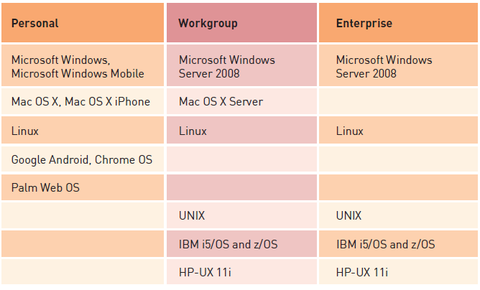
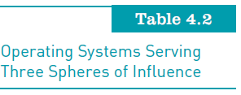
Current Operating Systems (continued)
Principles of Information Systems, Tenth Edition

Slide 27
Current Operating Systems (continued)
Google Chrome OS:
  Linux-based operating system designed for netbooks and nettops
  Designed to run on inexpensive low-power computers
  Chromium OS:
    Open-source version of Chrome OS
Principles of Information Systems, Tenth Edition

Slide 28
Workgroup Operating Systems
Windows Server:
  Can be used to prevent unauthorized disclosure of information
UNIX:
  Can be used on many computer system types and platforms
Red Hat Linux:
  Can manage a cluster of up to eight servers
Mac OS X Server:
  Includes support for 64-bit processing
Principles of Information Systems, Tenth Edition

Slide 29
Enterprise Operating Systems
z/OS:
  IBM’s first 64-bit enterprise OS
HP-UX and Linux:
  HP-UX:
    Robust UNIX-based OS from Hewlett-Packard
    Supports Internet, database, and business applications on server and mainframe enterprise systems
Principles of Information Systems, Tenth Edition

Slide 30
Operating Systems for Small Computers, Embedded Computers, and Special-Purpose Devices
Cell phone embedded systems and operating systems:
  Embedded systems provide communication and limited personal information management services
Windows embedded:
  Included with or embedded into small computer devices
Proprietary Linux-based systems:
  Linux is a major competitor to Symbian
Principles of Information Systems, Tenth Edition

Slide 31
Utility Programs
Help to perform maintenance or correct problems with a computer system
Common types of utilities:
  Hardware utilities
  Security utilities
  File-compression utilities
  Spam-filtering utilities
  Network and Internet utilities
  Server and mainframe utilities
Principles of Information Systems, Tenth Edition

Slide 32
Utility Programs (continued)
Other utilities:
  Key logging software allows a manager to see every keystroke a worker makes on a computer system
  Monitoring software can catalog the Internet sites that employees visit
  Keyboard shortcut utilities allow users to map common tasks to defined keyboard combinations
Principles of Information Systems, Tenth Edition

Slide 33
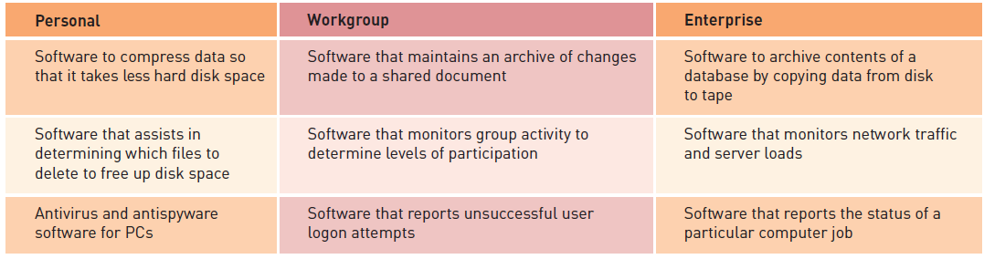

Utility Programs (continued)
Principles of Information Systems, Tenth Edition

Slide 34
Middleware
Software that allows different systems to communicate and exchange data
Can also be used as an interface between the Internet and older legacy systems
Service-oriented architecture (SOA):
  Uses modular application services to allow users to interact with systems, and systems to interact with each other
Principles of Information Systems, Tenth Edition

Slide 35
Application Software
Application programs:
  Interact with systems software
  Help you perform common tasks, such as:
    Creating and formatting text documents
    Performing calculations
    Managing information
Principles of Information Systems, Tenth Edition

Slide 36
Overview of Application Software
Proprietary software:
  One-of-a-kind program for a specific application, usually developed and owned by a single company
Off-the-shelf software:
  Existing software program that is purchased
Application service provider (ASP):
  Company that can provide software, support, and computer hardware on which to run the software from the user’s facilities over a network
Principles of Information Systems, Tenth Edition

Slide 37
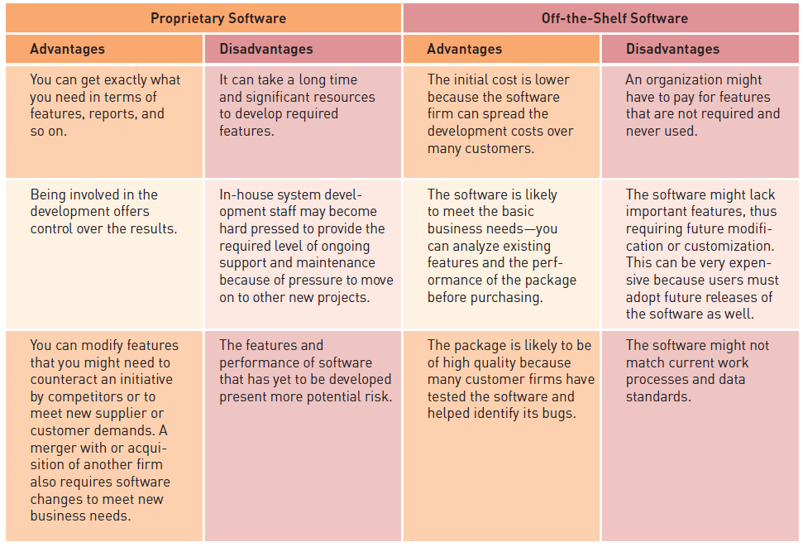
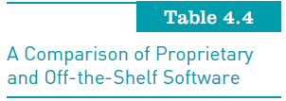
Overview of Application Software (continued)
Principles of Information Systems, Tenth Edition

Slide 38
Overview of Application Software (continued)
Software as a service (SaaS):
  Allows businesses to subscribe to Web-delivered business application software by paying a monthly service charge or a per-use fee
  Can reduce expenses by sharing its running applications among many businesses
Cloud computing:
  Use of computing resources on the Internet (the cloud) rather than on local computers
Principles of Information Systems, Tenth Edition

Slide 39
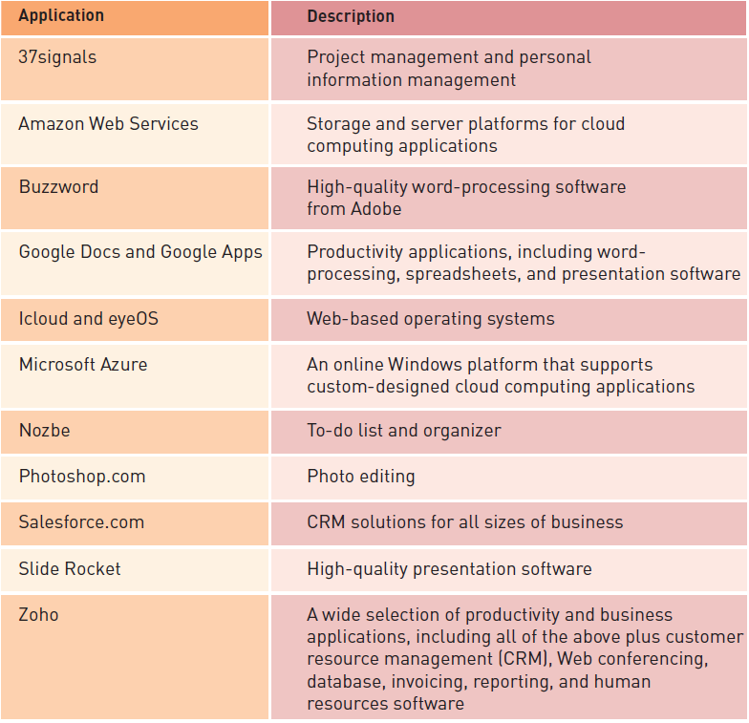
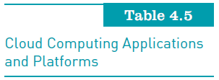
Overview of Application Software (continued)
Principles of Information Systems, Tenth Edition

Slide 40
Personal Application Software
Word processing
Spreadsheet analysis
Database applications
Presentation graphics program
Personal information managers
Software suites and integrated software packages
Other personal application software
Principles of Information Systems, Tenth Edition

Slide 41
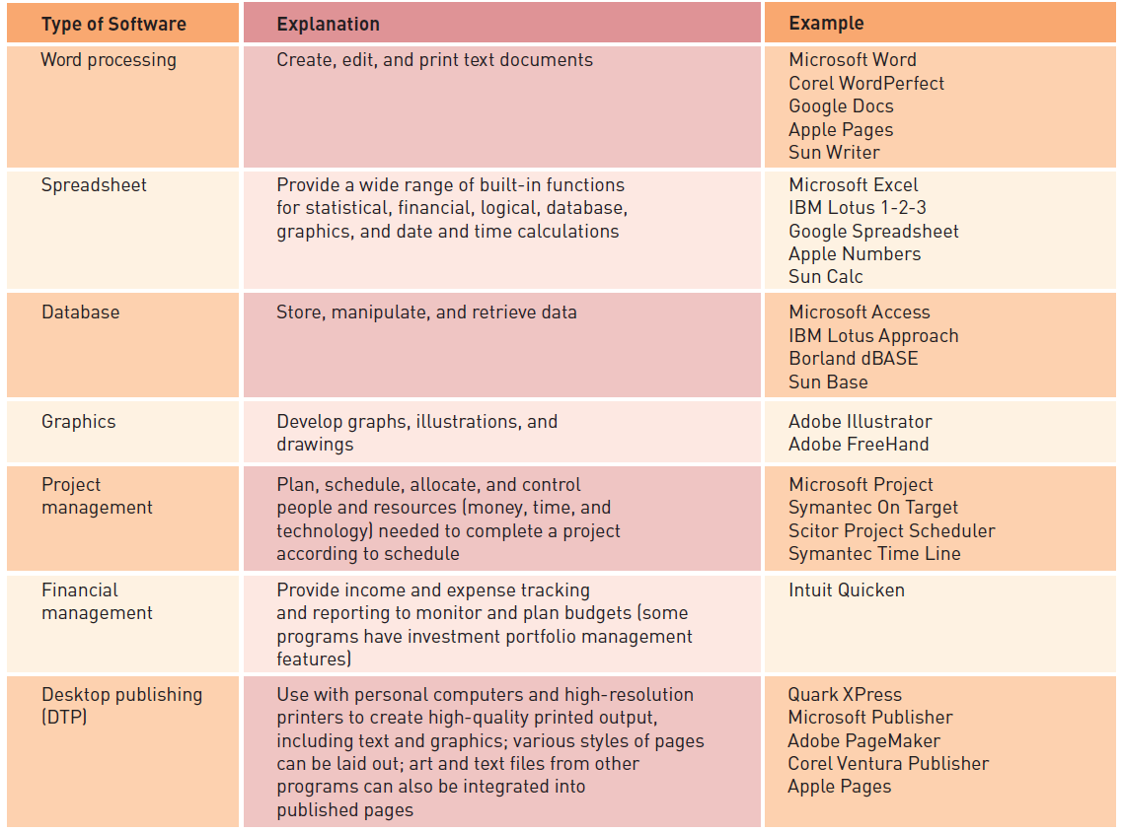
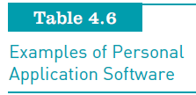
Personal Application Software (continued)
Principles of Information Systems, Tenth Edition

Slide 42
Mobile Application Software
Smartphone operating systems include:
  OS X iPhone, Android, and WebOS, Windows?
Tens of thousands of applications have been:
  Developed by third parties for the iPhone
  Changing face of app development!
Palm WebOS:
  Recently released its software development kit
  Being made OpenSource-9/2012!
Principles of Information Systems, Tenth Edition

Slide 43
Workgroup Application Software
Support teamwork, whether people are in the same location or dispersed around the world
Groupware:
  Software that helps groups of people work together more effectively
Principles of Information Systems, Tenth Edition

Slide 44
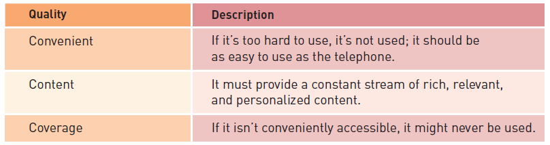
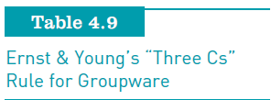
Workgroup Application Software (continued)
Principles of Information Systems, Tenth Edition

Slide 45
Enterprise Application Software
Software that benefits an entire organization
Enterprise resource planning (ERP) software:
  Set of integrated programs that manage a company’s vital business operations for an entire multisite, global organization
Principles of Information Systems, Tenth Edition

Slide 46
Application Software for Information, Decision Support, and Specialized Purposes
Available in every industry:
  Specialized application software for information, decision support, and other purposes
Principles of Information Systems, Tenth Edition

Slide 47
Programming Languages
Sets of keywords, symbols, and a system of rules for constructing statements:
  By which humans can communicate instructions to be executed by a computer
Program code:
  Set of instructions that signal the CPU to perform circuit-switching operations
Syntax
  Set of rules associated with a programming language
Principles of Information Systems, Tenth Edition

Slide 48
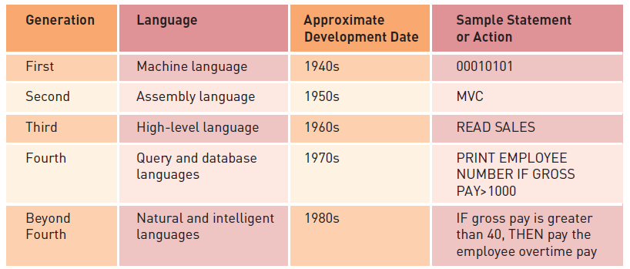
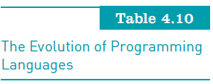
The Evolution of Programming Languages
Principles of Information Systems, Tenth Edition

Slide 49
Visual, Object-Oriented, and Artificial Intelligence Languages
Visual programming:
  Uses a graphical or “visual” interface combined with text-based commands
Object-oriented programming languages:
  Programming languages that are based on objects
Fifth-generation languages (5GLs):
  Used to create artificial intelligence or expert systems applications
Compiler:
  Converts the programmer’s source code into machine-language instructions
Principles of Information Systems, Tenth Edition

Slide 50
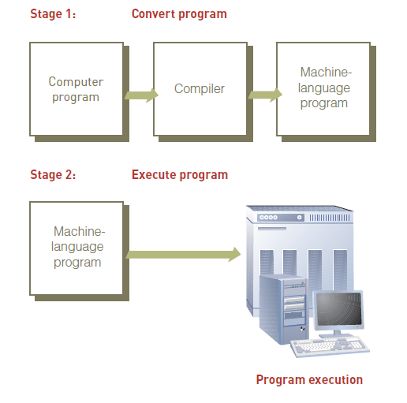
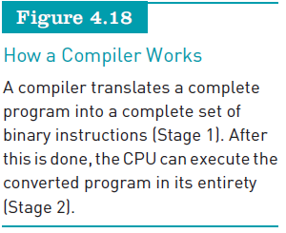
Visual, Object-Oriented, and Artificial Intelligence Languages (continued)
Principles of Information Systems, Tenth Edition

Slide 51
Software Issues and Trends
Software bug:
  Defect in a program that keeps it from performing as it should
Some tips for reducing impact of software bugs:
  Register all software
  Check read-me files for work-arounds
  Access support area of the manufacturer’s Web site for patches
  Install latest software updates
Principles of Information Systems, Tenth Edition

Slide 52
Copyrights and Licenses
Most software products are protected by law using copyright or licensing provisions:
  In some cases, you are given unlimited use of software on one or two computers
  In other cases, you pay for your usage; if you use the software more, you pay more
Some software now requires that you register or activate it before it can be fully used
CREATIVE COMMONS
Principles of Information Systems, Tenth Edition

Slide 53
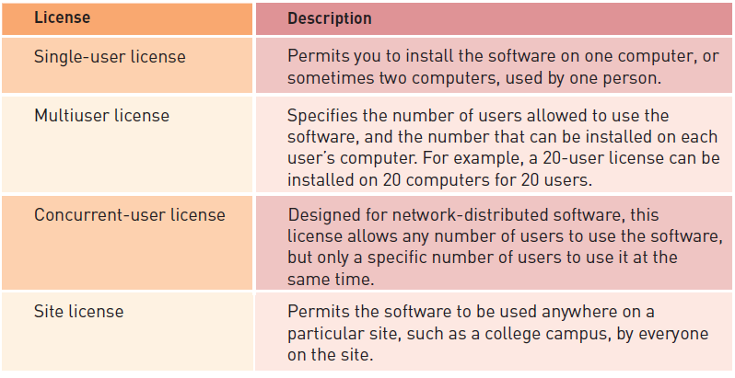

Copyrights and Licenses (continued)
Principles of Information Systems, Tenth Edition

Slide 54
Freeware and Open-Source Software
Freeware:
  Software that is made available to the public for free
Open-source software:
  Distributed, typically for free, with the source code
GPL grants you the right to:
  Run the program for any purpose
  Study how the program works and adapt it to your needs
  Redistribute copies so you can help others
  Improve the program and release improvements to the public
Principles of Information Systems, Tenth Edition

Slide 55
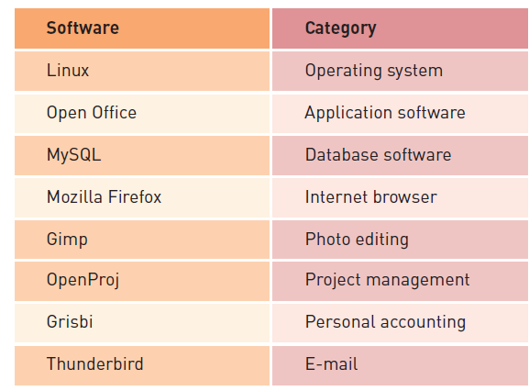
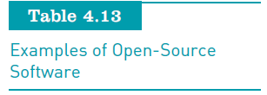
Freeware and Open-Source Software (continued)
Principles of Information Systems, Tenth Edition

Slide 56
Software Upgrades
Software companies revise their programs and sell new versions periodically
Most software upgrades:
  Offer new features and capabilities
Some users do not always get the most current software upgrades or versions:
  Unless it includes significant improvements or capabilities
Principles of Information Systems, Tenth Edition

Slide 57
Global Software Support
Supporting local operations:
  One of the biggest challenges IS teams face when putting together standardized, company-wide systems
Trend:
  Outsourcing global support to one or more third-party distributors
Principles of Information Systems, Tenth Edition

Slide 58
Summary
Main categories of software:
  Systems software and application software
Operating system (OS):
  Set of computer programs that controls the computer hardware to support users’ computing needs
Three approaches to developing application software:
  Build proprietary application software
  Buy existing programs off the shelf
  Use a combination of customized and off-the-shelf application software
Principles of Information Systems, Tenth Edition

Slide 59
Summary (continued)
Application service provider (ASP):
  Can provide software, support, and computer hardware on which to run the software from the user’s facilities over a network
Important software issues and trends:
  Software bugs, software licensing and copyrighting
  Open-source software and freeware
  Multiorganizational software development
  Software upgrades
  Global software support
Principles of Information Systems, Tenth Edition

