Slide 1
Principles of Information Systems, Tenth Edition
Chapter 6
Telecommunications and Networks

Slide 2
Principles and Learning Objectives
A telecommunications system consists of several fundamental components
  Identify and describe the fundamental components of a telecommunications system
  Discuss two broad categories of telecommunications media and their associated characteristics
  Briefly describe several options for short-range, medium-range, and long-range communications
Principles of Information Systems, Tenth Edition

Slide 3
Principles and Learning Objectives (continued)
Networks are an essential component of an organization’s information technology infrastructure
  Identify the benefits of using a network
  Describe three distributed processing alternatives and discuss their basic features
  Identify several telecommunications hardware devices and discuss their functions
Principles of Information Systems, Tenth Edition

Slide 4
Principles and Learning Objectives (continued)
Network applications are essential to organizational success
  List and describe several network applications that organizations benefit from today
Principles of Information Systems, Tenth Edition

Slide 5
Why Learn About Telecommunications and Networks?
Effective communication:
  Essential to the success of every major human undertaking
Regardless of your chosen career field:
  You will need the communications capabilities provided by telecommunications and networks
Principles of Information Systems, Tenth Edition

Slide 6
An Overview of Telecommunications
Telecommunications:
  Electronic transmission of signals for communications
Telecommunications medium:
  Any material substance that carries an electronic signal to support communications between a sending and receiving device
Networking protocol:
  Set of rules, algorithms, messages, and other mechanisms that enable software and hardware in networked devices to communicate effectively
Principles of Information Systems, Tenth Edition

Slide 7
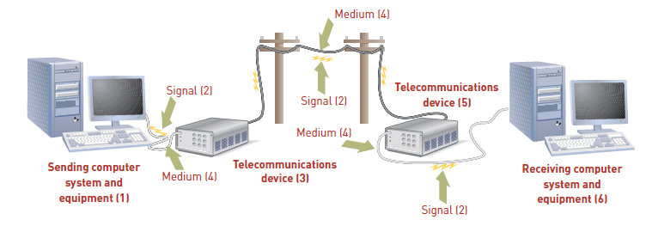
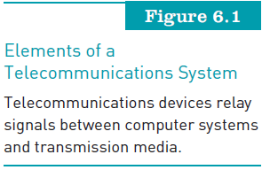
An Overview of Telecommunications (continued)
Principles of Information Systems, Tenth Edition

Slide 8
An Overview of Telecommunications (continued)
Synchronous communications:
  Receiver gets message instantaneously
Asynchronous communications:
  Receiver gets message after some delay
Principles of Information Systems, Tenth Edition

Slide 9
Basic Telecommunications Channel Characteristics
Simplex channel:
  Transmits data in only one direction
Half-duplex channel:
  Transmits data in either direction, but not simultaneously
Full-duplex channel:
  Permits data transmission in both directions at the same time
Principles of Information Systems, Tenth Edition

Slide 10
Basic Telecommunications Channel Characteristics (continued)
Channel bandwidth:
  Rate at which data is exchanged
Circuit switching network:
  Sets up a circuit between the sender and receiver before any communications can occur
Packet switching network:
  No fixed path is created between the communicating devices
Telecommunications media
  Categories: guided transmission media and wireless
Principles of Information Systems, Tenth Edition

Slide 11
Basic Telecommunications Channel Characteristics (continued)
Guided transmission media types:
  Available in many types
Twisted-pair wire:
  Classified by category: category 2, 3, 5, 5E, and 6
Coaxial cable:
  Offers cleaner and crisper data transmission (less noise) than twisted-pair wire
Fiber-optic cable:
  Transmits signals with light beams
Principles of Information Systems, Tenth Edition

Slide 12
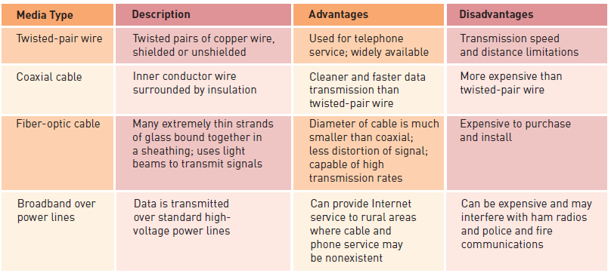
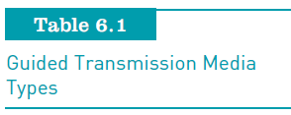
Basic Telecommunications Channel Characteristics (continued)
Principles of Information Systems, Tenth Edition

Slide 13
Basic Telecommunications Channel Characteristics (continued)
Broadband over power lines:
  Potential problem: transmitting data over unshielded power lines can interfere with both amateur (ham) radio broadcasts and police and fire radios
Wireless communications options:
  Wireless transmission involves the broadcast of communications in one of three frequency ranges
    Radio, microwave, or infrared frequencies
Principles of Information Systems, Tenth Edition

Slide 14
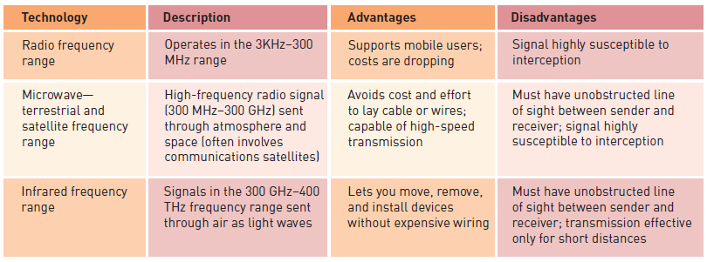
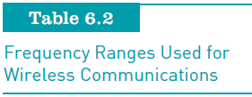
Basic Telecommunications Channel Characteristics (continued)
Principles of Information Systems, Tenth Edition

Slide 15
Short Range Wireless Options
Near field communication (NFC)
  Short-range wireless connectivity technology designed for cell phones and credit cards
Bluetooth
  Wireless communications specification that describes how cell phones, computers, personal digital assistants, etc., can be interconnected
Ultra wideband (UWB)
  Short-range communications that employs extremely short electromagnetic pulses lasting just 50 to 1,000 picoseconds
Principles of Information Systems, Tenth Edition

Slide 16
Short Range Wireless Options (continued)
Infrared transmission
  Sends signals at a frequency of 300 GHz and above
Zigbee
  Form of wireless communications frequently used in security systems and heating and cooling control systems
Principles of Information Systems, Tenth Edition

Slide 17
Medium-Range Wireless Options
Wi-Fi:
  Wireless telecommunications technology brand owned by the Wi-Fi Alliance
Wireless access point:
  Consists of a transmitter with an antenna
  Receives the signal and decodes it
Wi-Fi access points:
  Have maximum range of about 300 feet outdoors and 100 feet within a dry-walled building
Principles of Information Systems, Tenth Edition

Slide 18
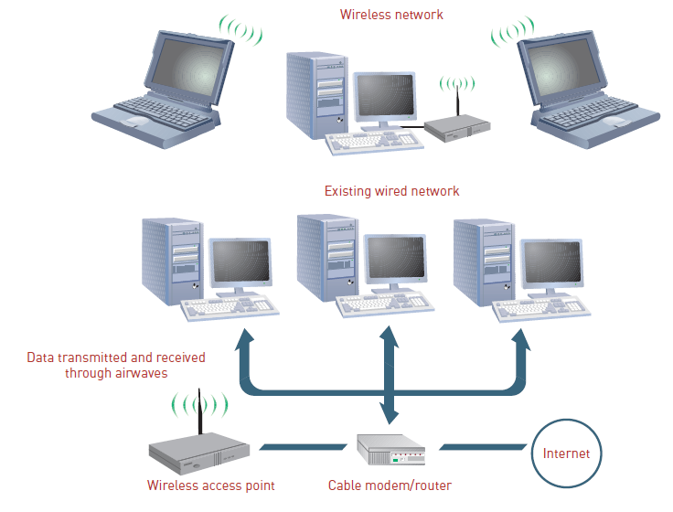

Medium-Range Wireless Options (continued)
Principles of Information Systems, Tenth Edition

Slide 19
Wide Area Wireless Network Types
Microwave transmission:
  High-frequency (300 MHz–300 GHz) signal sent through the air
  Common forms of satellite communications:
    Geostationary satellite
    Low-earth orbit (LEO) satellite
    Very small aperture terminal (VSAT)
Wireless mesh:
  Uses multiple Wi-Fi access points to link a series of interconnected local area networks
Principles of Information Systems, Tenth Edition

Slide 20
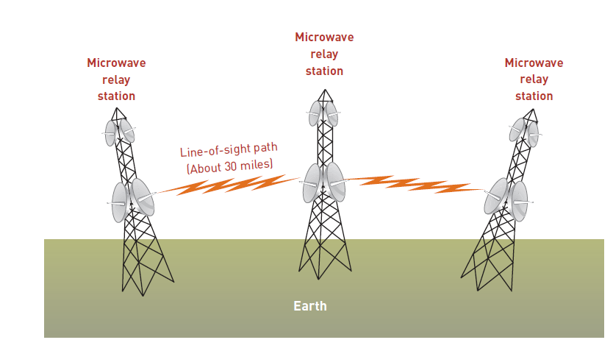
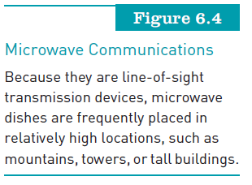
Wide Area Wireless Network Types (continued)
How do they arrive at 30 mile spacing?
Principles of Information Systems, Tenth Edition

Slide 21
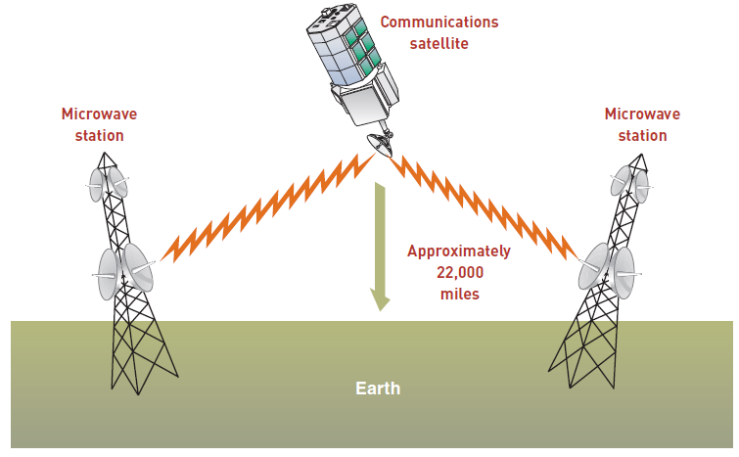
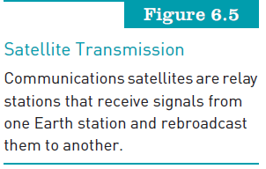
Wide Area Wireless Network Types (continued)-
Principles of Information Systems, Tenth Edition

Slide 22
Wide Area Wireless Network Options (continued)
3G wireless communications:
  Support wireless voice and broadband speed data communications in a mobile environment
4G wireless communications:
  Will provide increased data transmission rates in the 20–40 Mbps range
Worldwide Interoperability for Microwave Access (WiMAX):
  Set of IEEE 802.16 wireless metropolitan area network standards
Principles of Information Systems, Tenth Edition

Slide 23
Networks and Distributed Processing
Computer network:
  Consists of communications media, devices, and software needed to connect two or more computer systems or devices
  Can transmit and receive information to improve organizational effectiveness and efficiency
Principles of Information Systems, Tenth Edition

Slide 24
Network Types
Personal area networks:
  Support interconnection of information technology within a range of about 33 feet (10 meters)
Local area networks:
  Connect computer systems and devices within a small area (e.g., office or home) (100 meters)
Metropolitan area networks:
  Connect users and their devices in a geographical area that spans a campus or city (1000 meters?)
Wide area networks:
  Connect large geographic regions-3rd party involved
Principles of Information Systems, Tenth Edition

Slide 25
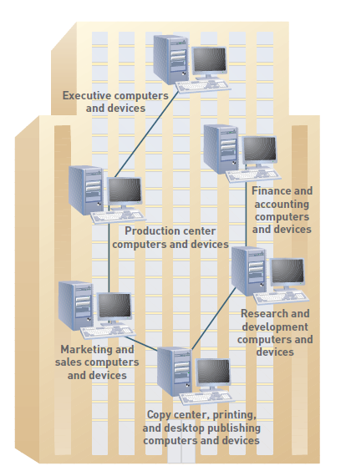
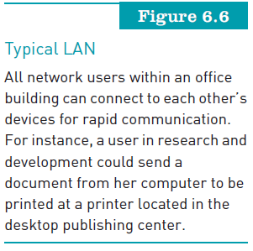
Principles of Information Systems, Tenth Edition

Slide 26
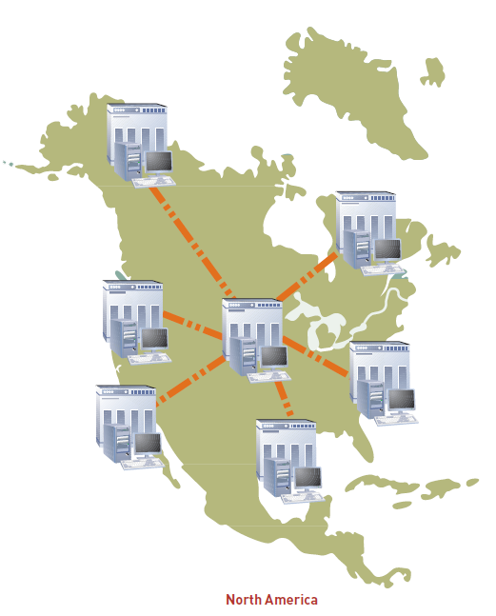
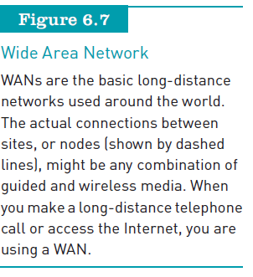
Principles of Information Systems, Tenth Edition

Slide 27
Basic Processing Alternatives
Centralized processing:
  All processing occurs in a single location or facility
Decentralized processing:
  Processing devices are placed at various remote locations
Distributed processing:
  Processing devices are placed at remote locations but are connected to each other via a network
File server systems:
  Users can share data through file server computing
Principles of Information Systems, Tenth Edition

Slide 28
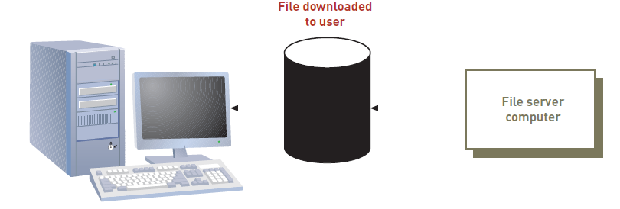
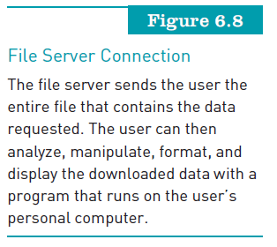
Basic Processing Alternatives (continued)
Principles of Information Systems, Tenth Edition

Slide 29
Client/Server Systems
Client/server architecture:
  Multiple computer platforms are dedicated to special functions
Client:
  Any computer that sends messages requesting services from the servers on the network
Database server:
  Sends only the data that satisfies a specific query, not the entire file
Principles of Information Systems, Tenth Edition

Slide 30
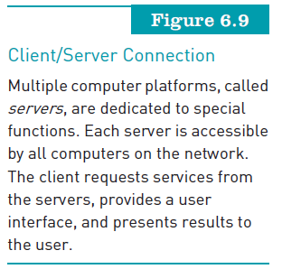
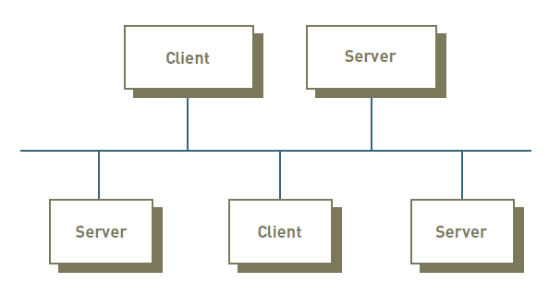
Client/Server Systems (continued)
Principles of Information Systems, Tenth Edition

Slide 31
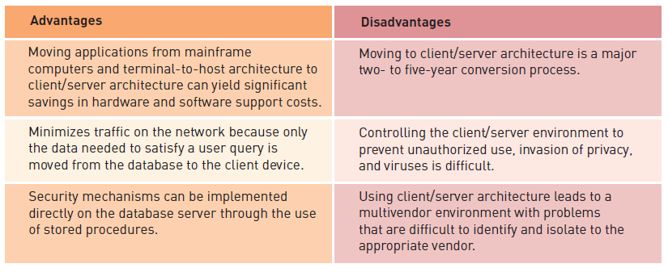
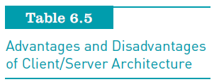
Client/Server Systems (continued)
Principles of Information Systems, Tenth Edition

Slide 32
Telecommunications Hardware
Smartphones
  Combine the functionality of a mobile phone, camera, Web browser, e-mail tool, MP3 player, and other devices
  Have their own software operating systems
Modems
  Modulation/demodulation devices (analog/digital)
Multiplexers
  Combine data from multiple data sources into a single output signal that carries multiple channels
Principles of Information Systems, Tenth Edition

Slide 33
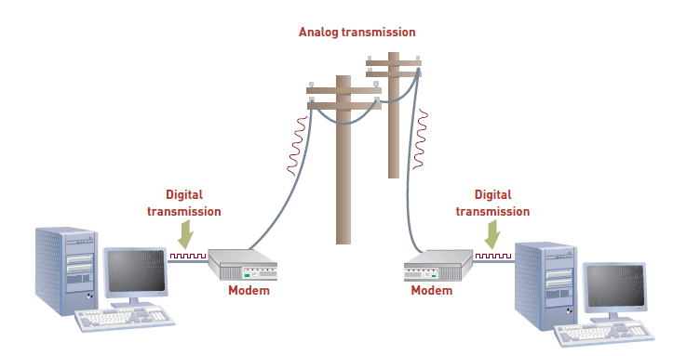
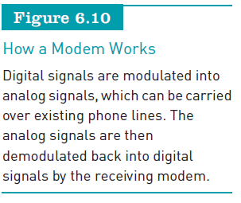
Telecommunications Hardware (continued)
Principles of Information Systems, Tenth Edition

Slide 34
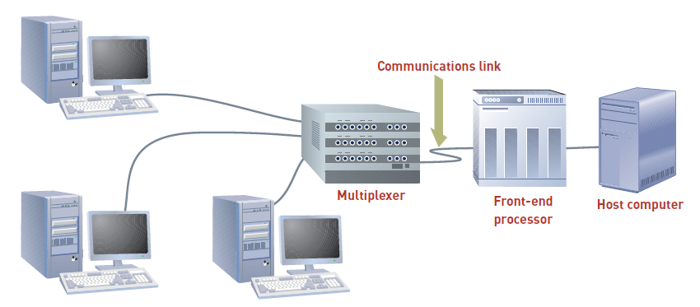
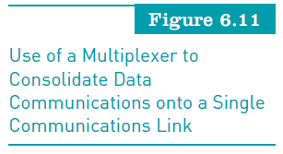
Telecommunications Hardware (continued)
Principles of Information Systems, Tenth Edition

Slide 35
Telecommunications Hardware (continued)
Front-end processors
  Special-purpose computers that manage communications to and from a computer system
Private branch exchange (PBX)
  Telephone switching exchange that serves a single organization
Principles of Information Systems, Tenth Edition

Slide 36
Telecommunications Hardware (continued)
Switches, bridges, routers, and gateways
  Switch: uses the physical device address in each incoming message on the network
  Bridge: connects two LANs together using the same telecommunications protocol
  Router: forwards data packets across two or more distinct networks toward their destinations
  Gateway: serves as an entrance to another network
Principles of Information Systems, Tenth Edition

Slide 37
Telecommunications Software
Network operating system (NOS):
  Systems software that controls the computer systems and devices on a network
Network management software:
  Protects software from being copied, modified, or downloaded illegally
  Locates telecommunications errors and potential network problems
Principles of Information Systems, Tenth Edition

Slide 38
Securing Data Transmission
Encryption:
  Converting an original message into a form that can only be understood by the intended receiver
Encryption key:
  Variable value that is applied (using an algorithm) to a set of unencrypted text to produce encrypted text or to decrypt encrypted text
Principles of Information Systems, Tenth Edition

Slide 39
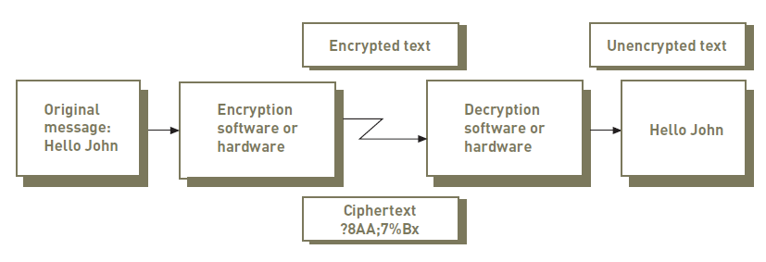

Securing Data Transmission (continued)
Principles of Information Systems, Tenth Edition

Slide 40
Securing Data Transmission (continued)
Securing wireless networks:
  Wired equivalent privacy (WEP):
    Used encryption based on 64-bit key, which has been upgraded to a 128-bit key
  Wi-Fi Protected Access (WPA):
    Security protocol that offers significantly improved protection over WEP
  War driving:
    Involves hackers driving around with a laptop and antenna trying to detect insecure wireless access points
Principles of Information Systems, Tenth Edition

Slide 41
Virtual Private Network (VPN)
Private network that uses a public network (usually the Internet) to connect multiple remote locations
Provides network connectivity over a potentially long physical distance
Supports secure, encrypted connections between a company’s private network and remote users
Principles of Information Systems, Tenth Edition

Slide 42
Telecommunications Services and Network Applications
Cellular phone services:
  Cellular phones:
    Operate using radio waves to provide two-way communications
    May be linked to a cordless phone via a Bluetooth connection
  Picocell:
    Miniature cellular base station designed to serve a very small area such as part of a floor inside a building
Principles of Information Systems, Tenth Edition

Slide 43
Cellular Phone Services
Digital subscriber line (DSL) service:
  Telecommunications service that delivers high-speed Internet access
  Asymmetric DSL (ADSL) line:
    Designed to provide download speed that is three to four times faster than upload speed
  Symmetric DSL (SDSL):
    Used mainly by small businesses
    Does not allow you to use the phone at the same time
    The speed of receiving and sending data is the same
Principles of Information Systems, Tenth Edition

Slide 44
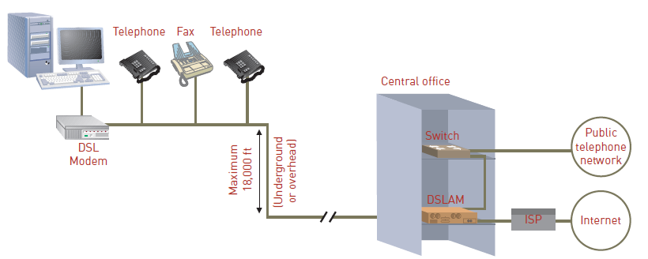
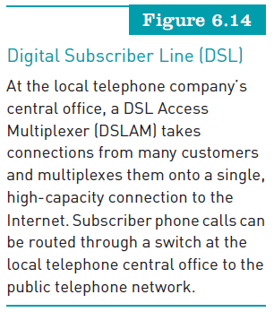
Principles of Information Systems, Tenth Edition

Slide 45
Linking Personal Computers to Mainframes and Networks
Basic way that telecommunications connect users to information systems:
  Connecting personal computers to mainframe computers so that data can be downloaded or uploaded
Unattended systems:
  Perform functions automatically, without user intervention
Principles of Information Systems, Tenth Edition

Slide 46
Voice Mail
Users can send, receive, and store verbal messages for and from other people around the world
Voice mail-to-text services
  Capture voice mail messages, convert them to text, and send them to an e-mail account
Reverse 911 service
  Delivers emergency notifications to users in a selected geographical area
Principles of Information Systems, Tenth Edition

Slide 47
Home and Small Business Networks
DSL modem:
  Enables each computer in the network to access the Internet
Firewall:
  Filters the information coming from the Internet into your network
Router:
  Encrypts all wireless communications to keep your network secure
Principles of Information Systems, Tenth Edition

Slide 48
Electronic Document Distribution
Lets you send and receive documents in a digital form without printing them
Much faster to distribute electronic documents via networks than to mail printed forms
Viewing documents on screen instead of printing
  Saves paper and document storage space
Principles of Information Systems, Tenth Edition

Slide 49
Call Centers
Location where an organization handles customer and other telephone calls
Used by:
  Customer service organizations
  Telemarketing companies
  Computer product help desks
  Charitable and political campaign organizations
Principles of Information Systems, Tenth Edition

Slide 50
Telecommuting and Virtual Workers and Workgroups
Telecommuting:
  Use of computing devices and networks so that employees can work effectively away from the office
Telecommuters:
  Need to be strongly self-motivated, organized, focused on their tasks with minimal supervision
Jobs unsuitable for telecommuting:
  Those that require frequent face-to-face interaction, need much supervision, and have many short-term deadlines
Principles of Information Systems, Tenth Edition

Slide 51
Electronic Meetings
Videoconferencing:
  Enables people at multiple locations to communicate using simultaneous two-way video and audio transmissions
  Reduces travel expenses and time
  Increases managerial effectiveness through:
    Faster response to problems, access to more people, and less duplication of effort
Principles of Information Systems, Tenth Edition

Slide 52
Electronic Data Interchange
Idea behind EDI:
  Connecting corporate computers among organizations
EDI:
  Can link the computers of customers, manufacturers, and suppliers
  Eliminates the need for paper documents and substantially cuts down on costly errors
Principles of Information Systems, Tenth Edition

Slide 53
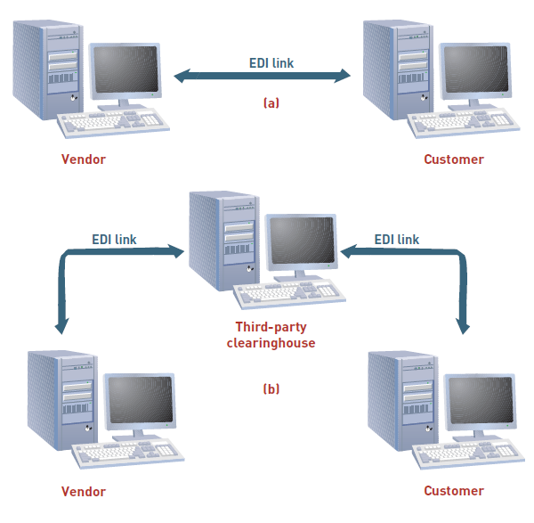
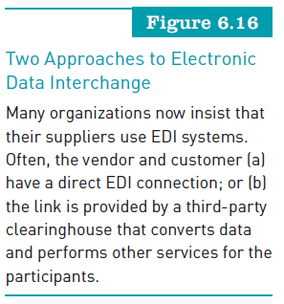
Electronic Data Interchange (continued)
Principles of Information Systems, Tenth Edition

Slide 54
Electronic Data Interchange (continued)
Electronic funds transfer
  System of transferring money from one bank account directly to another without any paper money changing hands
  Used for:
    Credit transfers, such as payroll payments
    Debit transfers, such as mortgage payments
  Benefits:
    Reduced administrative costs
    Increased efficiency
    Simplified bookkeeping and greater security
Principles of Information Systems, Tenth Edition

Slide 55
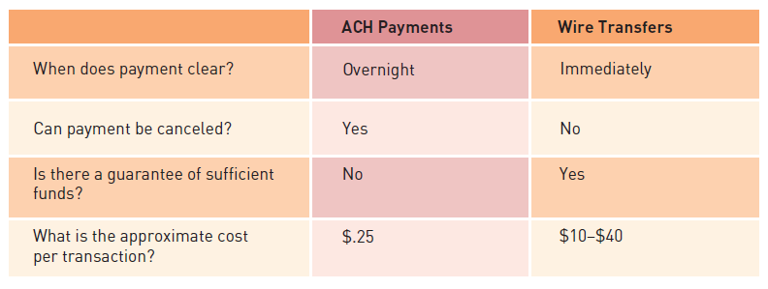
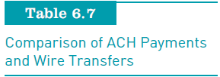
Electronic Data Interchange (continued)
Principles of Information Systems, Tenth Edition

Slide 56
Unified Communications
Provides a simple and consistent user experience across all types of communications
Presence:
  Knowing where one’s desired communication participants are and if they are available at this instant
  Goal:
    To reduce the time required to make decisions and communicate results
Principles of Information Systems, Tenth Edition

Slide 57
Global Positioning System Applications
Global navigation satellite system that uses two dozen satellites roughly 11,000 miles above the earth
GPS receivers:
  Have become as small as a cell phone and are relatively inexpensive
  Are commonly found in automobiles, boats, planes, laptop computers, and cell phones
GPS tracking technology:
  Has become the standard by which fleet managers monitor the movement of their cars
Principles of Information Systems, Tenth Edition

Slide 58
Summary
Networking protocol:
  Defines the set of rules that govern the exchange of information over a telecommunications channel
Channel bandwidth:
  Refers to the rate at which data is exchanged, usually expressed in bits per second
Geographic area covered by a network:
  Determines whether it is called PAN, LAN, WAN
Principles of Information Systems, Tenth Edition

Slide 59
Summary (continued)
Telecommunications and networks:
  Creating profound changes in business because they remove the barriers of time and distance
Networks:
  Let users share hardware, programs, and databases across the organization
  Can transmit and receive information to improve organizational effectiveness and efficiency
Principles of Information Systems, Tenth Edition

Slide 60
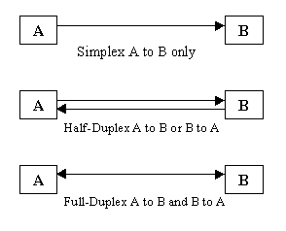
Principles of Information Systems, Tenth Edition

