Slide 1
Principles of Information Systems, Tenth Edition
Chapter 7
The Internet, Web, Intranets, and Extranets

Slide 2
Principles and Learning Objectives
The Internet provides a critical infrastructure for delivering and accessing information and services
  Briefly describe how the Internet works, including methods for connecting to it and the role of Internet service providers
Principles of Information Systems, Tenth Edition

Slide 3
Principles and Learning Objectives (continued)
Originally developed as a document-management system, the World Wide Web has grown to become a primary source of news and information, an indispensible conduit for commerce, and a popular hub for social interaction, entertainment, and communication
  Describe the World Wide Web and how it works
  Explain the use of markup languages, Web browsers, and Web servers
  Identify and briefly describe the process of creating software applications for the Web
Principles of Information Systems, Tenth Edition

Slide 4
Principles and Learning Objectives (continued)
The Internet and Web provide numerous resources for finding information, communicating and collaborating, socializing, conducting business and shopping, and being entertained
  List and describe several sources of information on the Web
  Describe methods of finding information on the Web
  List and describe several forms of online communication, along with the benefits and drawbacks of each, in terms of convenience and effectiveness
Principles of Information Systems, Tenth Edition

Slide 5
Principles and Learning Objectives (continued)
  Explain Web 2.0 and provide examples of Web 2.0 sites
  List and describe sources of online media and entertainment
  Explain how Web resources are used to support shopping and travel
  Briefly name and describe two useful Internet utilities
Principles of Information Systems, Tenth Edition

Slide 6
Principles and Learning Objectives (continued)
Popular Internet and Web technologies have been applied to business networks in the form of intranets and extranets
  Explain how intranets and extranets use Internet and Web technologies, and describe how the two differ
Principles of Information Systems, Tenth Edition

Slide 7
Why Learn About the Internet?
Businesses use the Internet to:
  Sell and advertise their products and services, reaching out to new and existing customers
People working in every field and at every level use the Internet in their work
Most companies have Internet sites that:
  List job opportunities, descriptions, qualifications, salaries, and benefits
Principles of Information Systems, Tenth Edition

Slide 8
Use and Functioning of the Internet
ARPANET:
  Ancestor of the Internet
  Project started by the U.S. Department of Defense (DoD) in 1969
Internet Protocol (IP):
  Enables computers to route communications traffic from one network to another
Principles of Information Systems, Tenth Edition

Slide 9
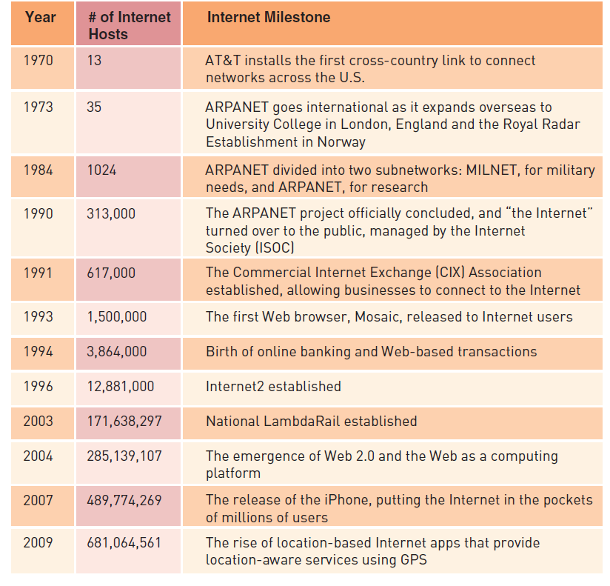
Use and Functioning of the Internet (continued)
Principles of Information Systems, Tenth Edition

Slide 10
How the Internet Works
Backbone:
  One of the Internet’s high-speed, long-distance communications links
Transmission Control Protocol (TCP):
  Transport-layer protocol that most Internet applications use with IP
Uniform Resource Locator (URL):
  An assigned address on the Internet for each computer
Principles of Information Systems, Tenth Edition

Slide 11
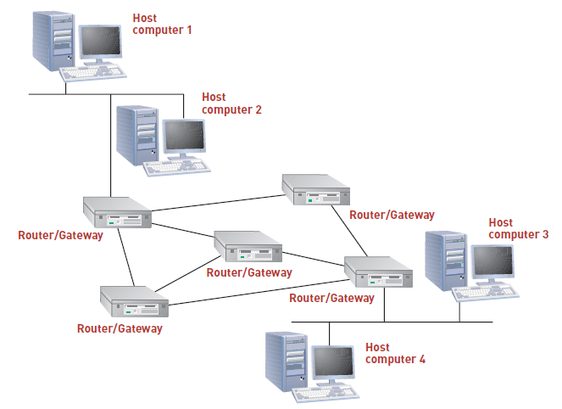
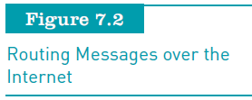
How the Internet Works (continued)
Principles of Information Systems, Tenth Edition

Slide 12
How the Internet Works (continued)
IP address:
  64-bit number that identifies a computer on the Internet
Internet Corporation for Assigned Names and Numbers (ICANN)
  Responsible for managing IP addresses and Internet domain names
  Has authority to resolve domain name disputes
Principles of Information Systems, Tenth Edition

Slide 13
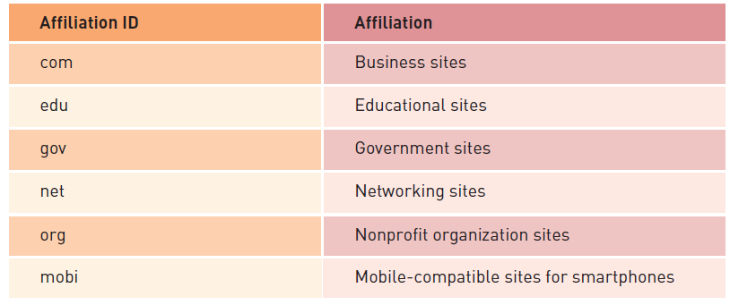
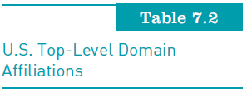
How the Internet Works (continued)
Principles of Information Systems, Tenth Edition

Slide 14
Accessing the Internet
Connecting via LAN server:
  Used by businesses and organizations that manage a local area network (LAN)
Connecting via Internet service providers:
  Internet service provider (ISP):
    Any organization that provides Internet access to people
Principles of Information Systems, Tenth Edition

Slide 15
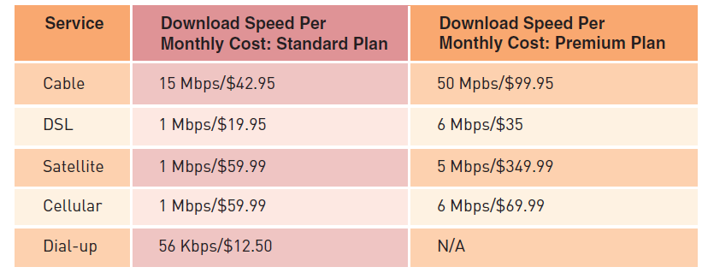
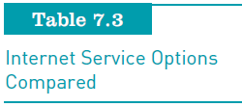
Accessing the Internet (continued)
Principles of Information Systems, Tenth Edition

Slide 16
Cloud Computing
Computing environment in which:
  Software and storage are provided as an Internet service and accessed with a Web browser
Extremely scalable and often takes advantage of virtualization technologies
Advantages to businesses:
  Businesses can save on system design, installation, and maintenance
  Employees can access corporate systems from any Internet-connected computer
Principles of Information Systems, Tenth Edition

Slide 17
The World Wide Web
Developed by Tim Berners-Lee at CERN
Originally conceived of as an internal document-management system
The Web has grown to become:
  A primary source of news and information
  An indispensable conduit for commerce
  A popular hub for social interaction, entertainment, and communication
Principles of Information Systems, Tenth Edition

Slide 18
How the Web Works
The Internet:
  Made up of computers, network hardware such as routers and fiber-optic cables, software, and the TCP/IP protocols
The Web:
  Consists of server and client software, the Hypertext Transfer Protocol (http), standards, and mark-up languages that combine to deliver information and services over the Internet
Principles of Information Systems, Tenth Edition

Slide 19
How the Web Works (continued)
Hyperlink:
  Highlighted text or graphics in a Web document that, when clicked, opens a new Web page
Web browser:
  Web client software such as Internet Explorer, Firefox, and Safari used to view Web pages
Hypertext Markup Language (HTML):
  Standard page description language for Web pages
Principles of Information Systems, Tenth Edition

Slide 20
How the Web Works (continued)
HTML tags:
  Tell the Web browser how to format text
Extensible Markup Language (XML):
  Markup language for Web documents containing structured information
Cascading Style Sheet (CSS):
  Markup language that defines the visual appearance of content in a Web page
Principles of Information Systems, Tenth Edition

Slide 21
Web Programming Languages
Java:
  Object-oriented programming language from Sun Microsystems based on C++
  Allows small programs (applets) to be embedded within an HTML document
Other languages:
  Asynchronous JavaScript and XML (AJAX)
  Hypertext Preprocessor (PHP)
  Adobe Flash and Microsoft Silverlight
Principles of Information Systems, Tenth Edition

Slide 22
Web Services
Standards and tools that streamline and simplify communication among Web sites
XML:
  The key to Web services
Principles of Information Systems, Tenth Edition

Slide 23
Web Services (continued)
Other components used in Web service applications:
  SOAP (Simple Object Access Protocol)
  WSDL (Web Services Description Language)
  UDDI (Universal Discovery Description and Integration)
Principles of Information Systems, Tenth Edition

Slide 24
Developing Web Content and Applications
Popular tools for creating Web pages and managing Web sites:
  Adobe Dreamweaver, Microsoft Expression Web, and Nvu
Web application framework:
  Web development software that provides the foundational code for a professional, interactive Web site
Principles of Information Systems, Tenth Edition

Slide 25
Internet and Web Applications
Popular uses for the Internet and Web:
  Publishing information
  Assisting users in finding information
  Supporting communication and collaboration
  Building online community
  Providing software applications
  Providing a platform for expressing ideas
  Delivering media of all types
  Providing a platform for commerce
  Supporting travel and navigation
Principles of Information Systems, Tenth Edition

Slide 26
Online Information Sources
News and opinion
  The Web is a powerful tool for keeping informed about local, state, national, and global news
Education and training
  Web is ideally suited:
    As a tool for sharing information and a primary repository of information on all subjects
  Distance education:
    Conducting classes over the Web with no physical class meetings
Principles of Information Systems, Tenth Edition

Slide 27
Online Information Sources (continued)
Business information
  Businesses often use Internet and Web-based systems for knowledge management
Personal and professional advice and support
  Medical and health Web sites assist in diagnosing health problems and advising on treatments
  The Web is an excellent source of job-related information
Principles of Information Systems, Tenth Edition

Slide 28
Search Engines and Web Research
Search engine:
  Enables you to find information on the Web by specifying keywords
  Market is dominated by Google
  Uses an automated approach that scours the Web with automated programs called spiders
Wikipedia:
  Can be used for online research
Wikimedia:
  Has wikis for books, news, media, and open learning
Principles of Information Systems, Tenth Edition

Slide 29
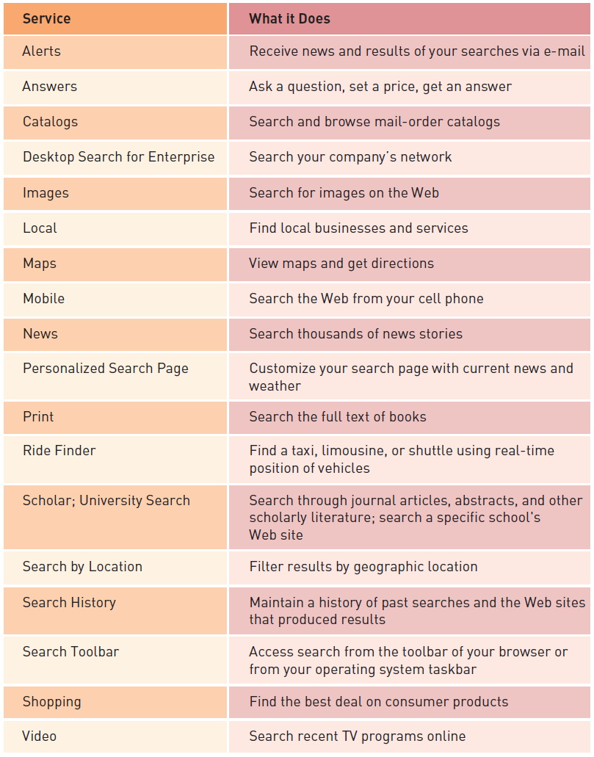

Search Engines and Web Research (continued)
Principles of Information Systems, Tenth Edition

Slide 30
Web Portals
Web portal:
  Web page that combines useful information and links and acts as an entry point to the Web
Vertical portals:
  Pages that provide information and links for special-interest groups
Corporate portals:
  Provide access to work-related resources
  Can be used to provide employees with work-related online content and to limit access to other Web content
Principles of Information Systems, Tenth Edition

Slide 31
Communication and Collaboration
E-mail:
  Internet communication
  Supports text communication, HTML content, and sharing documents as e-mail attachments
Instant messaging:
  Online, real-time communication between two or more people who are connected to the Internet
Microblogging, status updates, and news feeds
  Twitter is a Web application that allows members to report on what they are doing throughout the day
Principles of Information Systems, Tenth Edition

Slide 32
Communication and Collaboration (continued)
Conferencing:
  Internet has made it possible for those involved in teleconferences to share computer desktops
  Telepresence takes video conferencing to the ultimate level
  Some people, businesses, and organizations hold meetings in virtual space
  Virtual worlds such as Second Life allow users to take on a virtual presence through the use of avatars
Principles of Information Systems, Tenth Edition

Slide 33
Web 2.0
The social Web
  Web sites such as YouTube and Flickr allow users to share video and photos
  Social networking Web sites provide Web-based tools for users to share information
  Social networks are popular for finding old friends, staying in touch with current friends, and making new friends
Principles of Information Systems, Tenth Edition

Slide 34
Web 2.0 (continued)
Rich Internet applications
  Software that has the functionality and complexity of traditional application software, but does not require local installation and runs in a Web browser
  Most take advantage of being online by emphasizing their collaborative benefits
Principles of Information Systems, Tenth Edition

Slide 35
Blogging and Podcasting
Web log:
  Web site that people can create and use to write about their observations, experiences, and opinions on a wide range of topics
Blogger:
  Person who creates a blog
Blogging:
  The process of placing entries on a blog site
Podcast:
  Audio broadcast over the Internet
Principles of Information Systems, Tenth Edition

Slide 36
Online Media and Entertainment
Content streaming:
  Method of transferring large media files over the Internet so that the data stream of voice and pictures plays continuously as the file is being downloaded
Music:
  The Web has had a dramatic impact on the music industry
  Internet radio is digitally delivered to your computer over the Internet
  Compressed music formats such as MP3 have made music swapping popular
Principles of Information Systems, Tenth Edition

Slide 37
Online Media and Entertainment (continued)
Movies, video, and television:
  The Web and TV are rapidly merging into a single integrated system
  Web sites such as Hulu and Internet-based television platforms like Joost provide television programming
  Motion pictures are also making their way to Internet distribution
  YouTube supports the online sharing of user-created videos
Principles of Information Systems, Tenth Edition

Slide 38
Online Media and Entertainment (continued)
E-books and audio books:
  An e-book is a book stored digitally
  Apple’s iPad changed the eBook industry by providing a form factor that is similar to but larger than the Kindle
Online games:
  Video games have become a huge industry
  Many video games are available online
  Game consoles such as the Wii, Xbox, and PlayStation provide multiplayer options for online gaming
Principles of Information Systems, Tenth Edition

Slide 39
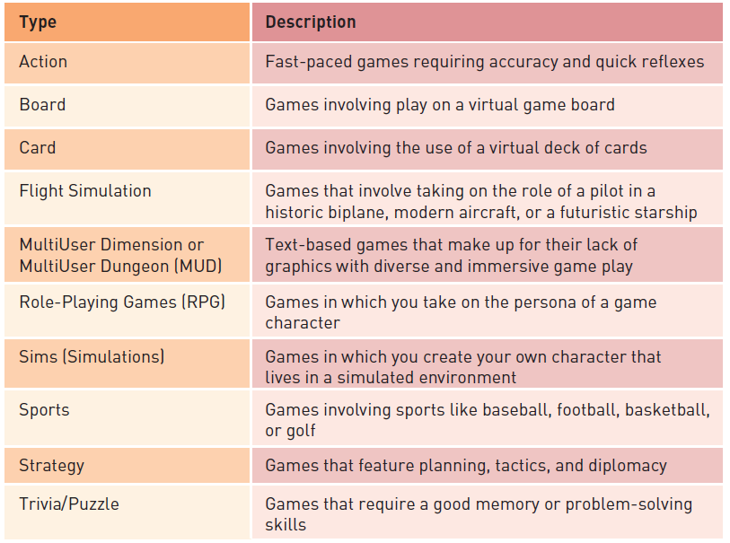

Online Media and Entertainment (continued)
Principles of Information Systems, Tenth Edition

Slide 40
Shopping Online
E-tail stores:
  Online versions of retail stores
  Provide access to many products that may be unavailable in local stores
Online clearinghouses, Web auctions, and marketplaces:
  Provide a platform for businesses and individuals to sell their products and belongings
www.eBay.com
  The most popular online auction or marketplace
Principles of Information Systems, Tenth Edition

Slide 41
Travel, Geolocation, and Navigation
Businesses that have a strong online presence:
  Travel agencies
  Resorts, airlines, cruise lines
  All businesses associated with travel
Google Maps:
  Provides extensive location-specific business information, satellite imagery, up-to-the-minute traffic reports, and Street View
Principles of Information Systems, Tenth Edition

Slide 42
Travel, Geolocation, and Navigation (continued)
Geo-tagging:
  Technology that allows for tagging information with an associated location
  Makes it easy to overlay photos on a map, as Google Maps and Bing Maps have done
Geolocation information:
  Does pose a risk to privacy and security
  Many people prefer for their location to remain unknown
Principles of Information Systems, Tenth Edition

Slide 43
Internet Utilities
Telnet:
  Network protocol that enables users to log on to networks remotely over the Internet
Telnet software:
  Uses a command-line interface that allows the user to work on a remote server directly
File Transfer Protocol (FTP):
  Supports file transfers between a host and a remote computer
Principles of Information Systems, Tenth Edition

Slide 44
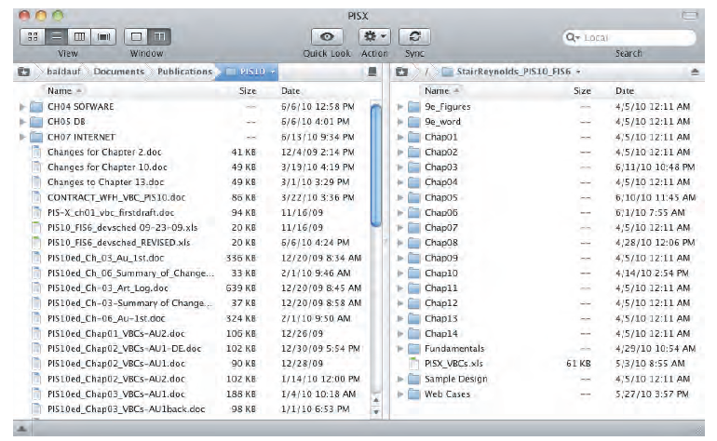
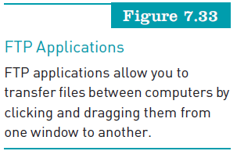
Internet Utilities (continued)
Principles of Information Systems, Tenth Edition

Slide 45
Intranets and Extranets
Intranet:
  Internal corporate network built using Internet and World Wide Web standards and technologies
Extranet:
  Network that links selected resources of a company’s intranet with its customers, suppliers, or other business partners
Principles of Information Systems, Tenth Edition

Slide 46
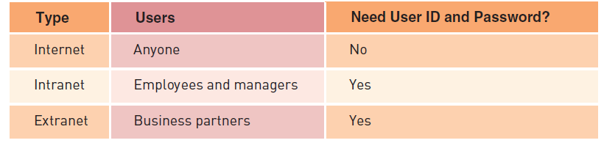
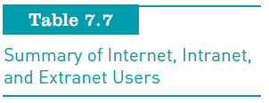
Intranets and Extranets (continued)
Principles of Information Systems, Tenth Edition

Slide 47
Intranets and Extranets (continued)
Virtual private network (VPN):
  Secure connection between two points on the Internet
Tunneling:
  Process by which VPNs transfer information by encapsulating traffic in IP packets over the Internet
Principles of Information Systems, Tenth Edition

Slide 48
Summary
The Internet started with ARPANET
Internet Protocol (IP):
  The set of conventions used to pass packets from one host to another
Transmission Control Protocol (TCP):
  Other protocol used with IP
Uniform Resource Locator (URL):
  Web address that specifies the exact location of a Web page and the location on the host
Principles of Information Systems, Tenth Edition

Slide 49
Summary (continued)
The Web:
  Collection of tens of millions of servers providing information via hyperlink technology
Hypertext Markup Language (HTML):
  Standard page description language for Web pages
Web 2.0:
  The Web as a computing platform that supports software applications and the sharing of information among users
Principles of Information Systems, Tenth Edition

Slide 50
Summary (continued)
The Web:
  The most popular medium for distributing and accessing information
Intranet:
  Internal corporate network built using Internet and World Wide Web standards and products
Extranet:
  Network that links selected resources of the intranet of a company with its customers, suppliers, or other business partners
Principles of Information Systems, Tenth Edition

Slide 51
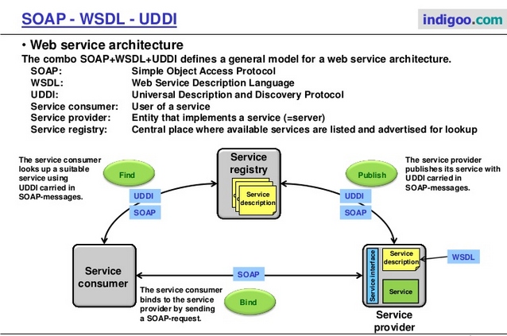
Principles of Information Systems, Tenth Edition

