Slide 1
Principles of Information Systems, Tenth Edition
Chapter 8
Electronic and Mobile Commerce

Slide 2
Principles and Learning Objectives
Electronic and mobile commerce are evolving, providing new ways of conducting business that present both potential benefits and problems
  Describe the current status of various forms of e-commerce, including B2B, B2C, C2C, and e-Government
  Outline a multistage purchasing model that describes how e-commerce works
  Define m-commerce and identify some of its unique challenges
Principles of Information Systems, Tenth Edition

Slide 3
Principles and Learning Objectives (continued)
E-commerce and m-commerce can be used in many innovative ways to improve the operations of an organization
  Identify several e-commerce and m-commerce applications
  Identify several advantages associated with the use of e-commerce and m-commerce
Principles of Information Systems, Tenth Edition

Slide 4
Principles and Learning Objectives (continued)
Although e-commerce and m-commerce offer many advantages, users must be aware of and protect themselves from many threats associated with this technology
  Identify the major issues that represent significant threats to the continued growth of e-commerce and m-commerce
Organizations must define and execute a strategy to be successful in e-commerce and m-commerce
  Outline the key components of a successful e-commerce and m-commerce strategy
Principles of Information Systems, Tenth Edition

Slide 5
Principles and Learning Objectives (continued)
E-commerce and m-commerce require the careful planning and integration of a number of technology infrastructure components
  Identify the key components of technology infrastructure that must be in place for e-commerce and m-commerce to work
  Discuss the key features of the electronic payment systems needed to support e-commerce and m-commerce
Principles of Information Systems, Tenth Edition

Slide 6
Why Learn About Electronic and Mobile Commerce?
Electronic and mobile commerce:
  Have transformed many areas of our lives and careers
One fundamental change has been:
  The manner in which companies interact with their suppliers, customers, government agencies, and other business partners
Principles of Information Systems, Tenth Edition

Slide 7
An Introduction to Electronic Commerce
Electronic commerce:
  Conducting business activities electronically over computer networks
Business activities that are strong candidates for conversion to e-commerce:
  Paper based
  Time-consuming
  Inconvenient for customers
Principles of Information Systems, Tenth Edition

Slide 8
Business-to-Business (B2B)
E-Commerce
Subset of e-commerce
All the participants are organizations
Useful tool for connecting business partners in a virtual supply chain to cut resupply times and reduce costs
An organization will use both:
  Buy-side e-commerce to purchase goods and services and
  Sell-side e-commerce to sell products to its customers
Principles of Information Systems, Tenth Edition

Slide 9
Business-to-Consumer (B2C)
E-Commerce
Form of e-commerce in which customers deal directly with an organization and avoid intermediaries
Disintermediation:
  The elimination of intermediate organizations between the producer and the consumer
Principles of Information Systems, Tenth Edition

Slide 10
Consumer-to-Consumer (C2C)
E-Commerce
Subset of e-commerce that involves consumers selling directly to other consumers
Popular sites:
  Bidzcom, Craigslist, eBid, Kijiji
  ePier, Ibidfree, Ubid, and Tradus
Etsy is a C2C Web site that:
  Specializes in the buying and selling of handmade and vintage items
  Facilitates sales worth more than $10 million each month
Principles of Information Systems, Tenth Edition

Slide 11
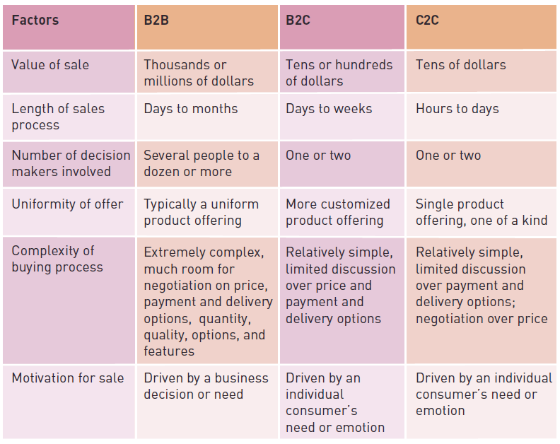
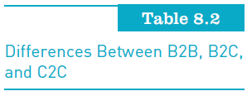
Consumer-to-Consumer (C2C)
E-Commerce (continued)
Principles of Information Systems, Tenth Edition

Slide 12
e-Government
Use of information and communications technology to:
  Simplify the sharing of information
  Speed formerly paper-based processes
  Improve the relationship between citizen and government
Forms of e-Government:
  Government-to-consumer (G2C)
  Government-to-business (G2B)
  Government-to-government (G2G)
Principles of Information Systems, Tenth Edition

Slide 13
Multistage Model for E-Commerce
Search and identification
Selection and negotiation
Purchasing products and services electronically
Product and service delivery
After-sales service
Principles of Information Systems, Tenth Edition

Slide 14
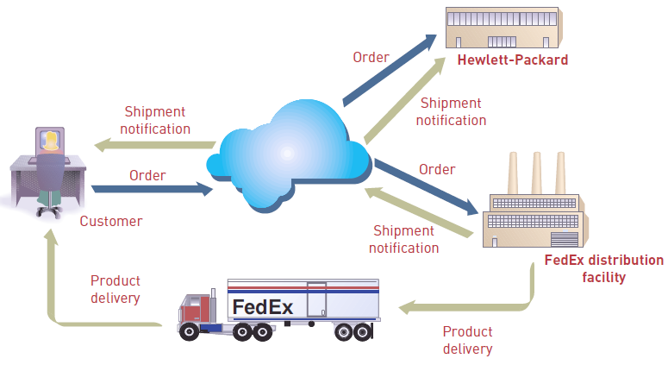
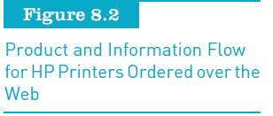
Multistage Model for E-Commerce (continued)
Principles of Information Systems, Tenth Edition

Slide 15
E-Commerce Challenges
Defining an effective e-commerce model and strategy
Dealing with consumer privacy concerns
Overcoming consumers’ lack of trust
Overcoming global issues
Principles of Information Systems, Tenth Edition

Slide 16
Defining an Effective E-Commerce Model and Strategy
First major challenge:
  For the company to define an effective e-commerce model and strategy
Three components of a successful model:
  Community, content, and commerce
Principles of Information Systems, Tenth Edition

Slide 17
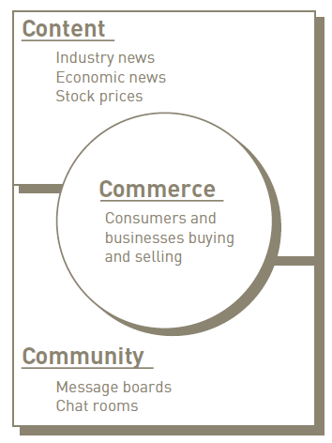
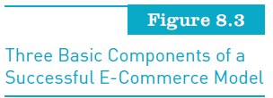
Defining an Effective E-Commerce Model and Strategy (continued)
Principles of Information Systems, Tenth Edition

Slide 18
Dealing with Consumer Privacy Concerns
Identify theft:
  Someone using your personally identifying information without your permission to commit fraud
Companies must be prepared to:
  Make a substantial investment to safeguard their customers’ privacy or run the risk of losing customers
Principles of Information Systems, Tenth Edition

Slide 19
Overcoming Consumers’ Lack of Trust
Lack of trust in online sellers:
  One of the most frequently cited reasons that some consumers are not willing to purchase online
Online marketers must:
  Create specific trust-building strategies for their Web sites by analyzing their customers, products, and services
Principles of Information Systems, Tenth Edition

Slide 20
Overcoming Global Issues
These include:
  Cultural challenges
  Language challenges
  Time and distance challenges
  Infrastructure challenges
  Currency challenges
  State, regional, and national law challenges
Principles of Information Systems, Tenth Edition

Slide 21
An Introduction to Mobile Commerce
Mobile commerce (m-commerce) relies on the use of wireless devices
The Internet Corporation for Assigned Names and Numbers (ICANN)
  Created a .mobi domain to help attract mobile users to the Web
Principles of Information Systems, Tenth Edition

Slide 22
Mobile Commerce in Perspective
The market for m-commerce in North America:
  Maturing much later than in Western Europe and Japan
M-commerce spending in the United States:
  Grew from $369 million in sales in 2008 to $1.2 billion in 2009
M-commerce sales for 2010 projected to be $2.4 billion
Principles of Information Systems, Tenth Edition

Slide 23
M-Commerce Web Sites
@imshopping:
  Can be accessed from Twitter by sending a shopping-related question
mdog.com:
  Portal for your mobile device’s Web browser
Principles of Information Systems, Tenth Edition

Slide 24
Advantages of Electronic and Mobile Commerce
Reduce costs
Speed the flow of goods and information
Increase accuracy
Improve customer service
Principles of Information Systems, Tenth Edition

Slide 25
Electronic and Mobile Commerce Applications
Many B2B, B2C, C2C, and m-commerce applications are being used in:
  Retail and wholesale
  Manufacturing
  Marketing and advertising
  Price comparison
  Couponing
  Investment and finance
  Banking and e-boutiques
Principles of Information Systems, Tenth Edition

Slide 26
Retail and Wholesale
Electronic retailing (e-tailing):
  Direct sale from business to consumer through electronic storefronts
Cybermall:
  Single Web site that offers many products and services at one Internet location
Manufacturing, repair, and operations (MRO):
  Purchases often approach 40 percent of a manufacturing company’s total revenues
Principles of Information Systems, Tenth Edition

Slide 27
Manufacturing
Electronic exchange:
  Electronic forum where manufacturers, suppliers, and competitors buy and sell goods, trade market information, and run back-office operations
Private exchanges:
Owned and operated by a single company
Public exchanges:
  Owned and operated by industry groups
Principles of Information Systems, Tenth Edition

Slide 28
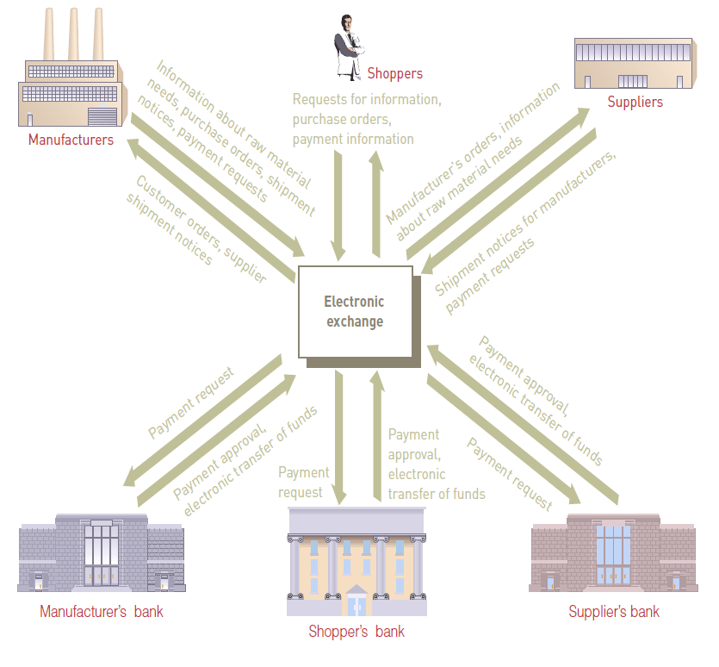
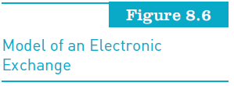
Manufacturing (continued)
Principles of Information Systems, Tenth Edition

Slide 29
Marketing
Market segmentation:
  Identification of specific markets to target them with advertising messages
Nielsen, the marketing and media information company:
  Has developed its Business-Facts database that provides information for more than 13 million businesses
Principles of Information Systems, Tenth Edition

Slide 30
Advertising
Mobile ad impressions are generally bought at:
  Cost per thousand (CPM), cost per click (CPC), or cost per action (CPA)
Three types of mobile ad networks:
  Blind, premium blind, and premium networks
Price comparison:
  Mobile phone services enable shoppers to compare prices and products on the Web
Couponing:
  Shoppers can subscribe to mobile coupon aggregators
Principles of Information Systems, Tenth Edition

Slide 31
Investment and Finance
The Internet:
  Has revolutionized the world of investment and finance
The brokerage business:
  Adapted to the Internet faster than any other arm of finance
Principles of Information Systems, Tenth Edition

Slide 32
Banking
Online banking customers:
  Can check balances of their savings, checking, and loan accounts
  Transfer money among accounts
  Pay their bills
Principles of Information Systems, Tenth Edition

Slide 33
E-Boutiques
Key to the success of Web sites such as ShopLaTiDa:
  A philosophy of high customer service and strong, personal client relationships
Principles of Information Systems, Tenth Edition

Slide 34
Threats to Electronic and Mobile Commerce
Businesses must ensure that e-commerce and m-commerce transactions are safe and consumers are protected
Principles of Information Systems, Tenth Edition

Slide 35
Security
Methods to increase security:
  Address Verification System
  Card Verification Number technique
  Visa’s Advanced Authorization process
  Federal Financial Institutions Examination Council’s “Authentication in an Internet Banking Environment” guidelines
Principles of Information Systems, Tenth Edition

Slide 36
Theft of Intellectual Property
Intellectual property:
  Works of the mind that are distinct somehow and are owned or created by a single entity
Digital rights management (DRM):
  The use of any of several technologies to enforce policies for controlling access to digital media such as movies, music, and software
Principles of Information Systems, Tenth Edition

Slide 37
Fraud
Phishing:
  Sending bogus messages to pry personal information from customers by convincing them to go to a “spoof” Web site
Click fraud:
  Can arise in a pay-per-click online advertising environment when additional clicks are generated beyond those that come from actual, legitimate users
Principles of Information Systems, Tenth Edition

Slide 38
Invasion of Consumer Privacy
Online profiling:
  Practice of Web advertisers’ recording online behavior to produce targeted advertising
Clickstream data:
  Data gathered based on the Web sites you visit and the items you click
Principles of Information Systems, Tenth Edition

Slide 39
Lack of Internet Access
Digital divide:
  Difference between people who do and do not use modern technology such as computers, the Internet, telephone, and television to improve their standard of living
Principles of Information Systems, Tenth Edition

Slide 40
Legal Jurisdiction
When conducting e-commerce, sales must not violate county, state, or country legal jurisdictions
Examples:
  Selling stun guns and similar devices
  Selling cigarettes or alcohol to underage customers
Principles of Information Systems, Tenth Edition

Slide 41
Taxation
U.S. Supreme Court ruling:
  Internet-based merchants must apply sales tax only when buyers live in a state where the company has physical facilities, or “nexus”
Principles of Information Systems, Tenth Edition

Slide 42
Strategies for Successful
E-Commerce and M-Commerce
Companies must develop effective Web sites that include the following characteristics:
  Easy to use
  Accomplish the goals of the company
  Safe and secure
  Affordable to set up and maintain
Principles of Information Systems, Tenth Edition

Slide 43
Defining the Web Site Functions
Decide which tasks the site must accomplish
Create an attractive presence for the company
Meet the needs of its visitors
  Example: Obtaining information about the organization and its products
Redefining your site’s basic business model to capture new business opportunities
Principles of Information Systems, Tenth Edition

Slide 44
Establishing a Web Site
Web site hosting companies:
  Allow you to set up a Web page and conduct e-commerce within a matter of days
  Little up-front cost
Storefront broker:
  Company that acts as an intermediary between your Web site and online merchants who have the products and retail expertise
Principles of Information Systems, Tenth Edition

Slide 45
Building Traffic to Your Web Site
Measures to attract customers:
  Obtain and register a domain name
  Make your site search-engine friendly
  Include a meta tag in your store’s home page
  Use Web site traffic data analysis software
  Provide quality, keyword-rich content
  Add new content to the Web site on a regular basis
  Acquire links to your site
Principles of Information Systems, Tenth Edition

Slide 46
Maintaining and Improving Your Web Site
Personalization:
  Tailoring Web pages to specifically target individual consumers
Explicit personalization:
  Captures user-provided information
Implicit personalization:
  Captures data from customer Web sessions
Principles of Information Systems, Tenth Edition

Slide 47
Technology Infrastructure Required to Support E-commerce and
M-commerce
Poor Web site performance:
  Drives consumers to abandon some e-commerce sites in favor of those with better, more reliable performance
Principles of Information Systems, Tenth Edition

Slide 48
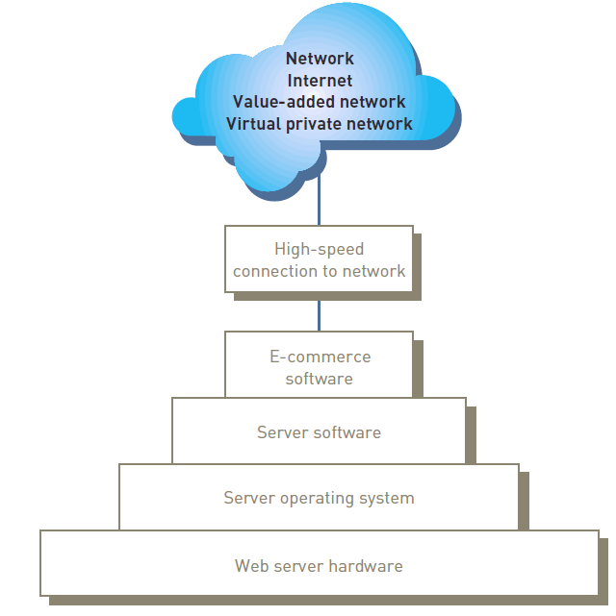
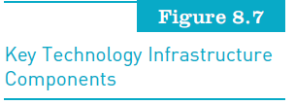
Technology Infrastructure (continued)
Principles of Information Systems, Tenth Edition

Slide 49
Web Server Software
Security and identification
Retrieving and sending Web pages
Web site tracking
Web site development
Web page development
Principles of Information Systems, Tenth Edition

Slide 50
E-Commerce Software
Catalog management
Product configuration
Shopping cart
E-commerce transaction processing
Web traffic data analysis
Principles of Information Systems, Tenth Edition

Slide 51
Mobile Commerce Hardware and Software
Handheld devices have limitations that complicate their use:
  Screens are small
  Input capabilities are limited to a few buttons
  Less processing power and less bandwidth
The Wireless Application Protocol (WAP):
  Standard set of specifications for Internet applications that run on handheld, wireless devices
Principles of Information Systems, Tenth Edition

Slide 52
Electronic Payment Systems
Digital certificate:
  Attachment to an e-mail message or data embedded in a Web site that verifies the identity of a sender or Web site
Certificate authority (CA):
  Trusted third-party organization or company that issues digital certificates
Principles of Information Systems, Tenth Edition

Slide 53
Electronic Payment Systems (continued)
Secure Sockets Layer (SSL):
  Used to secure sensitive data
Electronic cash:
  An amount of money that is computerized, stored, and used as cash for e-commerce transactions
Credit, charge, debit, and smart cards:
  Smart card:
    Credit card-sized device with an embedded microchip to provide electronic memory and processing capability
Principles of Information Systems, Tenth Edition

Slide 54
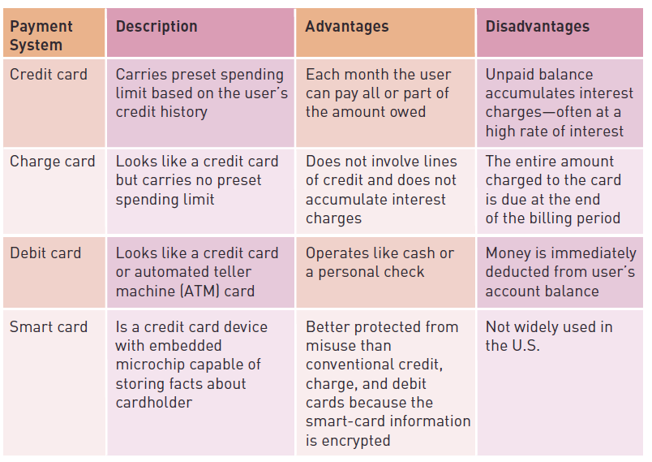
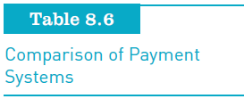
Electronic Payment Systems (continued)
Principles of Information Systems, Tenth Edition

Slide 55
Electronic Payment Systems (continued)
P-Card
  Credit card used to streamline the traditional purchase order and invoice payment processes
Payments using cell phones
  Available options:
    Payments linked to your bank account
    Payments added to your phone bill
Principles of Information Systems, Tenth Edition

Slide 56
Summary
Electronic commerce:
  Conducting business activities electronically over computer networks
Types of e-commerce:
  Business-to-consumer (B2C), business-to-business (B2B), and consumer-to-consumer (C2C)
Successful e-commerce system:
  Must address the many stages consumers experience in the sales life cycle
Principles of Information Systems, Tenth Edition

Slide 57
Summary (continued)
Electronic retailing (e-tailing):
  Direct sale from a business to consumers through electronic storefronts
Businesses and people use e-commerce and m-commerce to:
  Reduce transaction costs
  Speed the flow of goods and information
  Improve the level of customer service
  Enable the close coordination of actions among manufacturers, suppliers, and customers
Principles of Information Systems, Tenth Edition

Slide 58
Summary (continued)
An effective Web site is one that creates an attractive presence and meets the needs of its visitors
M-commerce presents additional infrastructure challenges including:
  Improving the ease of use of wireless devices
  Addressing the security of wireless transactions
  Improving network speed
Principles of Information Systems, Tenth Edition

