Slide 1
Chapter VI Information System Architecture
Meas Vandeth

Slide 2
គោលបំណង
សិក្សា
ណែនាំអោយស្គាល់ Architecture of Information System(System) ដែលនិយមប្រើប្រាស់ក្នុងសម័យបច្ចុប្បន្ន។

Slide 3
1. What is IS Architecture?
An information system architecture is a formal definition of the business processes and rules, systems structure, technical framework, and product technologies for a business or organizational information system.

Slide 4
IS Architecture (Con)
បើសិនយើងសិក្សាអោយស៊ីជំរៅ​ Information system architecture គេចែកជា៤ផ្នែកឬស្រទាប់ Business process architecture, systems architecture, technical architecture, and product delivery architecture.
ដោយសារស្នូលរបស់ប្រព័ន្ធព័ត៌មានគឺ Database ដូចនេះ System architecture ដែលយើងសិក្សាគឺយក Database Process Architecture ជាមូលដ្ឋាន។

Slide 5
IS Architecture(Con)
មាន ៣​ Architure ដែលនិយមប្រើប្រាស់គឺៈ
Desktop System Architecture
Client/Server System Architecture
Distributed System Architecture.

Slide 6
2. Desktop System Architecture
ជា System ដែលប្រើប្រាស់ Desktop DBMS សម្រាប់រក្សាទុកទិន្នន័យ។ Desktop Database ជា Database ដែល Database Engine Access database’s file. Ex: System​ ដែលប្រើប្រាស់ MS Access សម្រាប់ Store Data.
APPLICATION
Database File and Engine

Slide 7
2. Desktop System Architecture
Desktop System អាចប្រើប្រាស់ក្នុង Networks បានក្នុងរូបភាពជា Multi user and centralize database.
Desktop Database run​លើ Networks តាមរយៈការ file sharing.

Slide 8
3. Client/Server System Architecture
ជា System ដែល​ Application ដើរតួរជាClients Access Database file តាមរយៈDatabase Server Engine និងរាល់ប្រតិបត្តការទិន្នន័យរអនុវត្តក្នុងទំរង់ Request and Response.
Ex: System ដែលប្រើប្រាស់ MS SQL Server, Oracle, My SQL, Sybase,…
APPLICATION (CLIENTS)
Database Server Engine
(SERVER INSTANCE)
Database File
Request
Response

Slide 9
3. Client/Server System Architecture
Client/Server System ចែកជាៈ
Fat Client/Server vs Thin Client/Server Architecture: ការបែងចែកដោយផ្អែកលើការរៀបចំ Business Logic or Business Process(Codes).
2 Tiers Client/Server vs 3 Tiers Client/Server Architecture: បែងចែកផ្អែកលើការ ប្រើប្រាស់ Technology and installation.

Slide 10
3. Fat vs Thin Client/Server
ក្នុងបរិបទ Developer System មាន៣​ ស្រទាប់គឺៈ
- Presentation Layer: ជា Form, Report, Pages,… សំរាប់Display Data
- Business Layer: ជា Programming codes សម្រាប់រៀបចំ data transaction query,…ដើម្បីអោយឆ្លើយតបតាម តំរូវការនិងគោលការណ៍ក៍ដូចជា និតិវិធីអាជីវកម្ម។
- Data Store Layer: ជា Database files សំរាប់រក្សាទុកទិន្នន័យរបស់អាជីវកម្មជាអចិន្រ្តៃ។
Presentation Layer
Business Logic Layer
Data Store Layer

Slide 11
3. Fat Client/Server
CLIENTS
Fat Client/Server or Thick Client/Server: ជា​ Client/Server ដែលមាន Business logic or Business layer ត្រូវបានរៀបចំ(សរសេរកូដ)លើ Application(Client) ទាំងស្រុងឬច្រើនជាង Server.
Presentation
Business Logic
Server
Database Files

Slide 12
3. Thin Client/Server
Thin Client/Server : ជា​ Client/Server ដែលមាន Business logic or Business layer ត្រូវបានរៀបចំ(សរសេរកូដ)លើ Database Server ច្រើនជាង ខាង Clients.
CLIENTS
Presentation
Server
Business Logic
Database Files

Slide 13
Which one is Better ?
Thin Client/Server is better because
Performance​​: Thin client/server ដើរលឿនជាងឆ្ងាយជាពិសេសពេលProcess Data ធំៗដោយសា កាត់បន្ថយ Network traffic ក៍ដូចជាកាត់បន្ថយ Check syntax, security and compile codes…..
More reusable codes: Code សរសេរលើ Server អាច Call ពី Any Connection អាច Call ពី Form, Report, Web,..
Easy to update​ and maintenance: កែរលើតែ Server កែរទាំងអស់
Security: លើServerដែលមានប្រព័ន្ធសវត្ថិភាពខ្ពស់ មាន ការកំណត់សិទ្ធិ,…

Slide 14
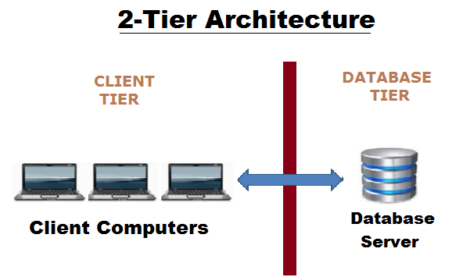
2 Tiers Client/Server VS 3 Tiers Client/Server
2 Tier Client/Server Architecture: ជា Client/Server ដែលគ្រប់ Clients connect direct ទៅកាន់ Database Serverដូចនេះរាល់ប្រតិបត្តការអនុវត្តលើតែ 2 Nodes នៃ Networks គឺ Client and Server។ (2 Tier Client/Server is Standard Client/Server).
Ex: Windows Client/Server System តាមផ្សាទំនើប។

Slide 15
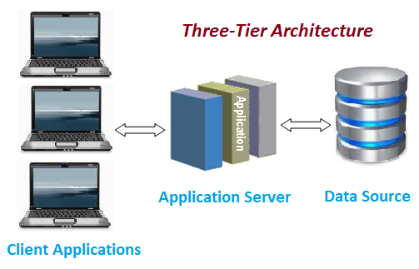
2 Tiers Client/Server VS 3 Tiers Client/Server
3 Tier Client/Server Architecture: ជា Client/Server ដែលគ្រប់ Clients connect direct ទៅកាន់ Database Server តាមរយៈ Application Sever ដែលជា Middle tier ដូចនេះរាល់ប្រតិបត្តការអនុវត្តលើតែ 3 Nodes នៃ Networks គឺ Client , Application Server and Database Server
Ex: Web Application System

Slide 16
Advantage & Disadvantage of 2 Tier
Advantage:
Easy to develop and Modify
Performance លឿនជាងពេលចំនួន Clients តិច
More Easy to Use.
Disadvantage
Down speed(slower) ពេល Users កើនច្រើន
Cost
Hard to deploy and Maintenance.

Slide 17
Advantage & Disadvantage of 3 Tier
Advantage:
High performance, light weight ពេលទោះជាចំនួន Users ច្រើន
Scalability
Easy to deploy
Better reuse
Security
Easy to modify and maintenance
Disadvantage
Hard to develop and configure

Slide 18
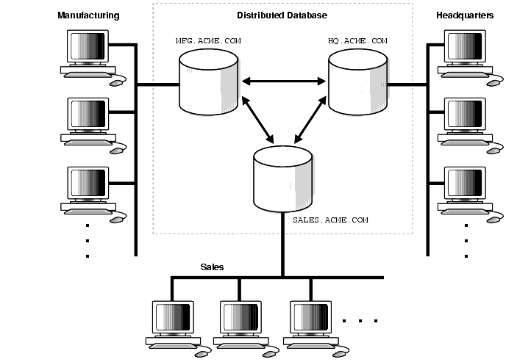
4. Distributed System
Distributed system ចែកជាពីរទំរង់គឺ
Distributed Database System
Distributed Application
Distributed Database System: ជា Client/Server System ដែលមាន Database(Physical Database) សម្រាប់រក្សាទុកទិន្នន័យលើច្រើន Nodes​ នៃ Networks តែទិន្នន័យអាចផ្ទេរចុះផ្ទេរឡើង ឬផ្តុំ ....​តាម គោលការណ៍និតិវិធីរបស់ស្ថាប័នយ៉ាងរលូន។

Slide 19
Distributed Database System
Example:
System IPS(Internal Post Management System)
Airline Booking and Sale System
Banking System
VISA CARD ,MASTER CARD
……….

Slide 20
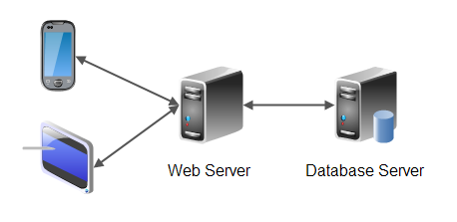
. Distributed Application System
B. Distributed Application System: ជា Client/Server System ឬ Distributed Database System ដែលមាន Application ច្រើនផ្សេងៗគ្នាសហការគ្នាដើម្បី Process បញ្ចូន ទិន្នន័យតាម លក្ខខ័ណ្ឌសហប្រតិបត្តិការរវាងក្រុមហ៊ុនឬស្ថាប័ន។
Web Service(API)
Web Service(API)
Web Service(API)

Slide 21
. GRID COMPUTING ARCHITECTURE
Grid computing is a processor architecture that combines computer resources from various domains to reach a main objective. In grid computing, the computers on the network can work on a task together, thus functioning as a supercomputer.
Typically, a grid works on various tasks within a network, but it is also capable of working on specialized applications. It is designed to solve problems that are too big for a supercomputer while maintaining the flexibility to process numerous smaller problems. Computing grids deliver a multiuser infrastructure that accommodates the discontinuous demands of large information processing.

