Slide 1
27 in.
Height Difference: 7.5 in
Distance between rack holes: 9 inches
Rack hole diameter: 0.5 inches
Height Difference = Space Between
Shelves
Height Difference: 7.5 in
Space for more shelving
Shelf 1
16.5 in
25.5 in
Height Difference: 7.5 in
Shelf 2
16.5 in
25.5 in
Height Difference: 7.5 in
57 in.
Height Difference: 7.5 in
Space for more shelving
Shelf 3
16.5 in
25.5 in
Height Difference: 8.5 in
Shelf 4
16.5 in
25.5 in
Height Difference: 10.25 in
Bottom of Incubator
17 in
26.5 in

Slide 2
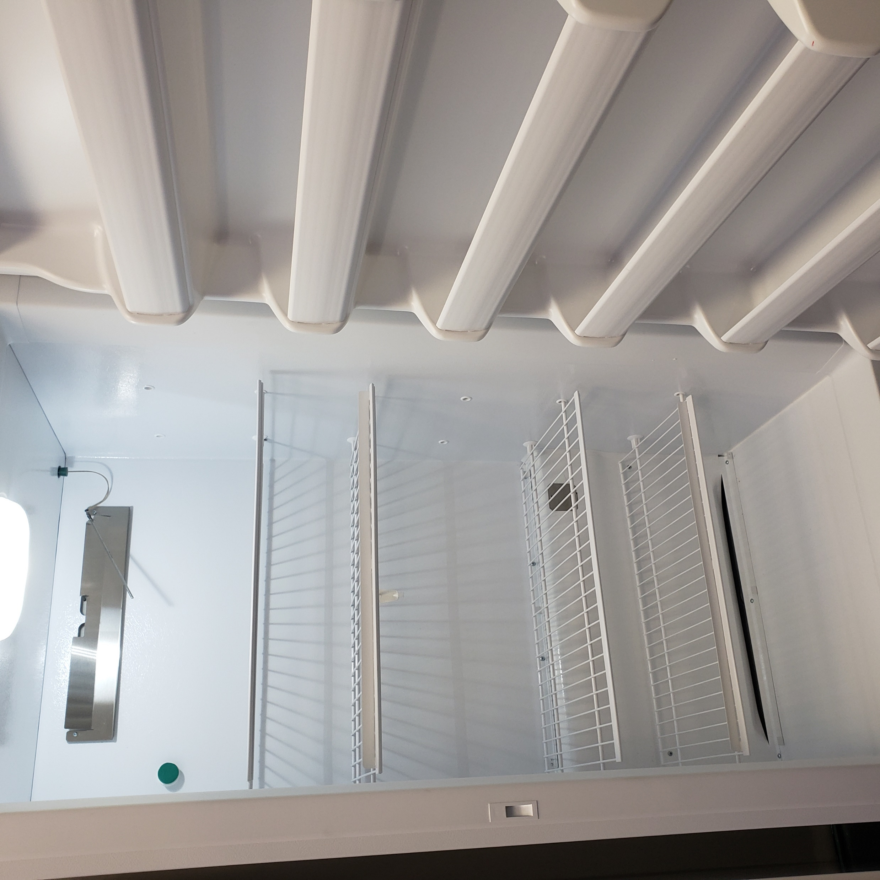
Shelf Holes
Shelf 3
Shelf Holes
Shelf 2
Shelf 1
Bottom of Incubator

Slide 3
Equipment Storage Plan
12-16 well plats per rack -
4 well plates along the length
3-4 well plates along the width
Well plate dimensions:
Length x Width x Height
5 inches x 3.5 inches x 0.6 inches
Space between shelves allows for 12 stacks
4-Litre Tanks Scenario (2 tanks) –
Tank 8 in x 9 in
Carrying Tray 10.5 in x 14 in

