Slide 1














Machine Learning Engineer Case Scenario

Slide 2
Github: https://github.com/PutraAlFarizi15/nawatech-case-study

Slide 3
Case 1
Task 1 Sentiment Analysis

Slide 4
Problem & Data Understanding
Objective: To analyze and build a sentiment analytics model based on Twitter posts regarding cellular service providers.
Dataset: dataset_tweet_sentiment_cellular_service_provider.csv.
Data Structure:
Id: ID of individual rows.
Sentiment: Sentiment of the text.
Text Tweet: Twitter's posts.

Slide 5
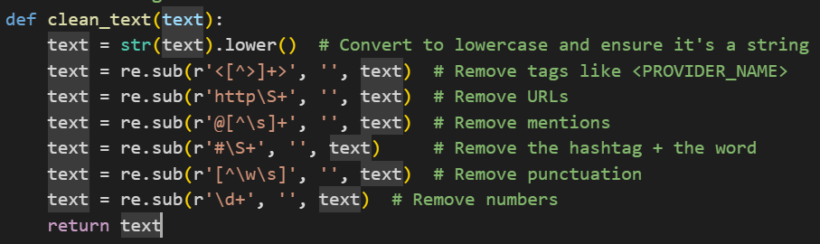
Data Processing
Case Folding: Converting all text to lowercase.
Noise Removal: Removing URLs, mentions (@), hashtags (#), and other irrelevant characters.

Slide 6
Model Development and Training
Step 1: Dataset Splitting
Splitting the data into an 80:20 ratio, with 80% Training Data to train the model to recognize sentiment patterns and 20% Testing Data to measure the model's performance.
Step 2: Data preparation for modelling
Feature Extraction (TF-IDF): Highly effective for finding sentiment-defining keywords because it weights words based on their frequency in a single tweet (TF) and their uniqueness across the entire dataset (IDF).
Label Encoding: Converts sentiment labels (positive, negative) into a number format (1, 0) so that they can be processed by the model.
Step 3: Model Selection & Training: SVM
The Support Vector Machine (SVM) model was chosen because it yielded good evaluation results.

Slide 7
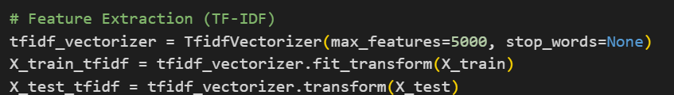
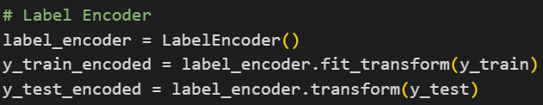
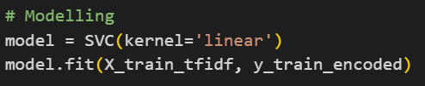
Model Development and Training

Slide 8
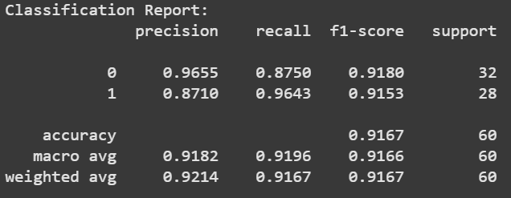
Model Evaluation
Excellent Performance: Overall, your model demonstrates excellent performance with an accuracy of 91.7% and high F1-scores across both classes.
Model Characteristics:
The model is highly precise when predicting Class 0. This means that if it predicts "this is Class 0," you can be very confident in that prediction (low risk of False Positives).
The model has a very high recall for Class 1. This means the model is very reliable at "finding" all the instances that are actually Class 1 (low risk of False Negatives).

Slide 9
Case 1
Task 2 Insight from data

Slide 10
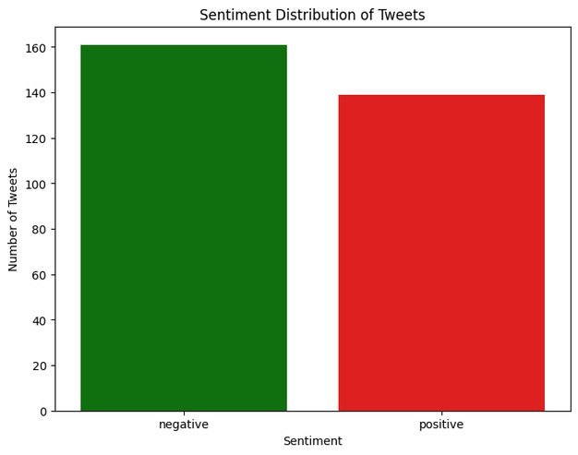
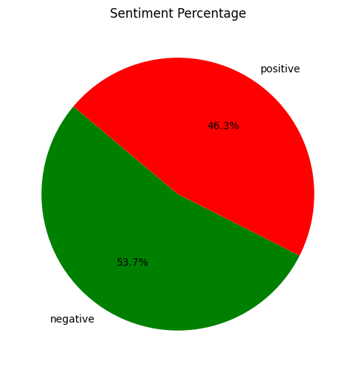
Insight from Data
The majority of user responses or reviews tend to be negative, indicating a potential problem, dissatisfaction, or poor experience that needs to be addressed.

Slide 11
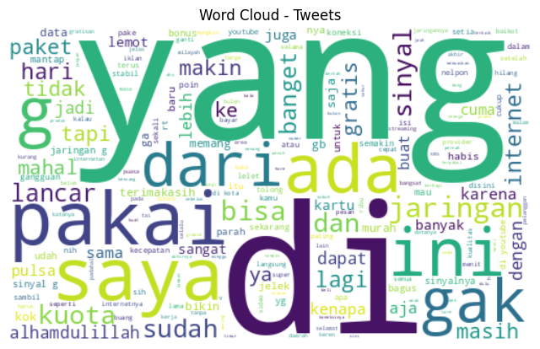
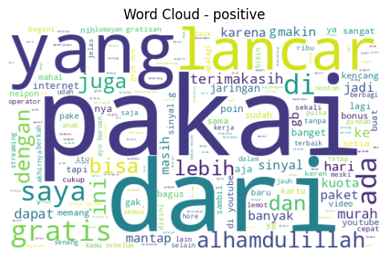
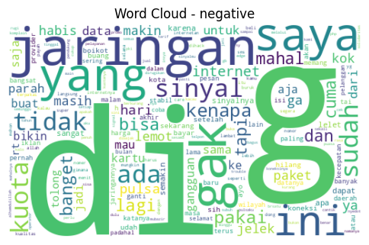
Insight from Data
Overall, the most frequently occurring words in the tweets are "yang" and "di".
For positive sentiment, the most commonly used words are "lancar", "pakai", "dari", and "yang".
Meanwhile, for negative sentiment, the most frequent words are "di", "g", "gak", and "jaringan".

Slide 12
Quality Improvement Recommendations
Data Quality Improvement:
Add more data and make the data more balanced for negative and positive sentiment.
Model Quality Improvement:
Using hyperparameter tuning, using more advanced architectures (e.g., Transformers), or data augmentation.

Slide 13
Case 2
FAQ Chatbot
Task 1 Design

Slide 14
Objective and Tools
Objective: To create a chatbot capable of accurately answering FAQs from the FAQ_Nawa.xlsx file using an LLM.
Technology Stack:
Language: Python
UI: Streamlit
LLM: OpenAI
RAG Tools: FAISS
RAG Pipeline: Langchain

Slide 15
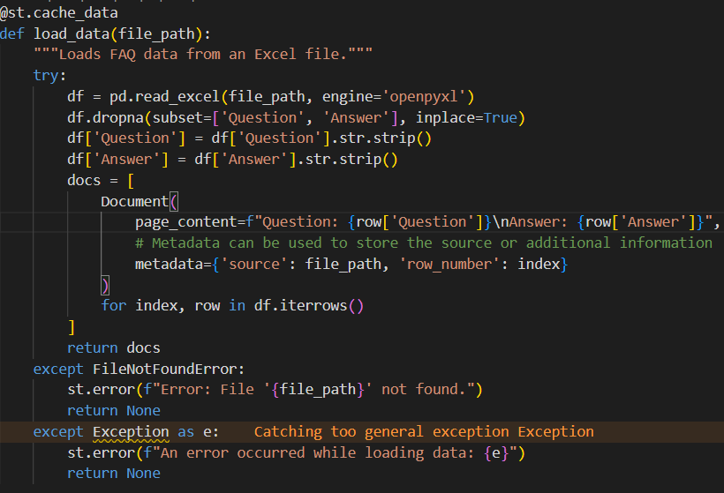
Development Process (Step-by-Step)
Step 1: Data Loading & Preprocessing
Read file excel
Drop empty data
Remove whitespace at the beginning and end of text
Turns each row in the DataFrame into a Document object with question and answer contents, and metadata file name and row number.
Error Handling: If the file is not found: display an error message. If other errors occur: display a generic error message along with the error message.

Slide 16
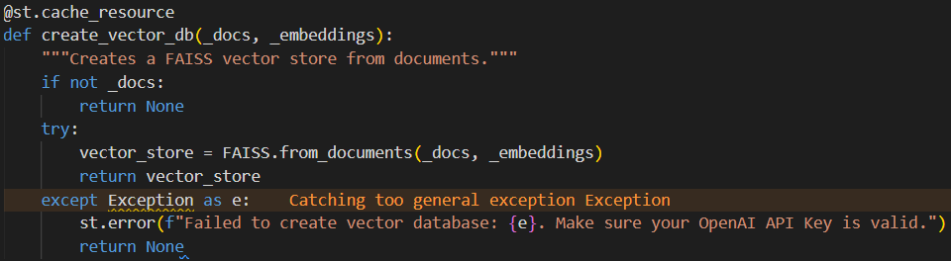

Development Process (Step-by-Step)
Step 2: Embedding & RAG (Retrieval-Augmented Generation):
initialize embedding models such as OpenAIEmbedding and faq_doc result load data
Converts text documents into vectors, then stores them in the FAISS index for quick search.
Error Handling: If failed created database

Slide 17
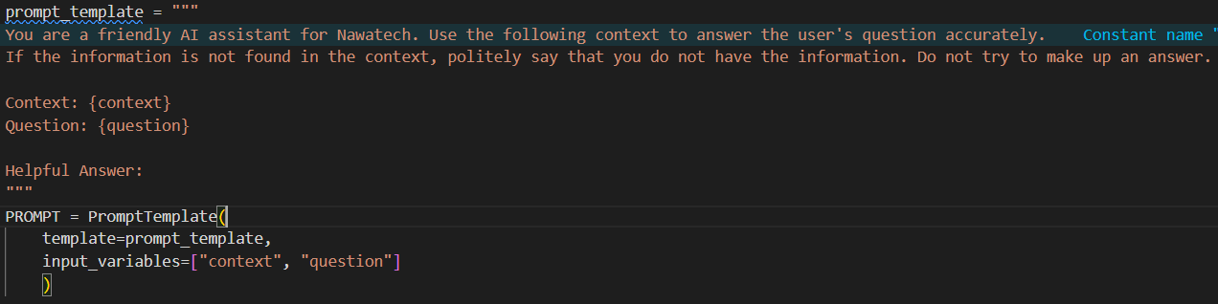
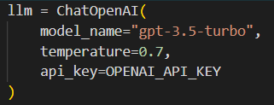
Development Process (Step-by-Step)
Step 3: LLM Integration & Answer Generation:
Define Prompt with input context and question
Define LLM

Slide 18
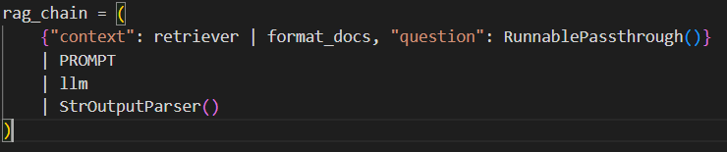
Development Process (Step-by-Step)
Create a retriever that returns the top 3 most similar texts from the vector database
LangChain RAG pipeline: A RAG flow that automatically retrieves documents, collates them, queries the LLM, and then returns a text answer.
Generate Answer

Slide 19
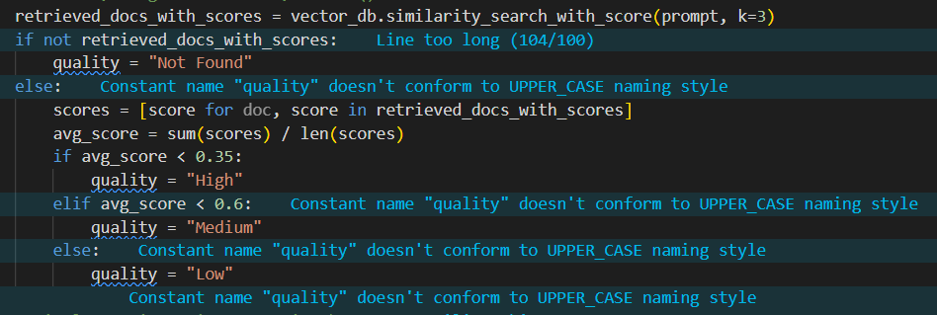
Quality Scoring
Retrieve the 3 closest documents from the database vector.
Calculate the average similarity score.
Quality assessment: High: score < 0.35, Medium: score < 0.6, and Low: score ≥ 0.6.

Slide 20
Security from Prompt Injection
Using strong system instructions and context grounding.
Role-Defining Preamble: The instruction You are a friendly AI assistant for Nawatech sets a firm boundary for the LLM's behavior.
Instructional Guardrails: The commands Use the following context to answer... and If the information is not found... politely say that you do not have the information. Do not try to make up an answer are critical. You are explicitly telling the LLM to ground its response only in the documents retrieved from your FAQ database. This makes it much harder for a user to steer the model off-topic.
Separation of Concerns: The RAG pipeline, built with LangChain Expression Language (LCEL), inherently separates the trusted data (context) from the untrusted user input (question). The LLM is instructed to prioritize the context.

Slide 21
Case 2
FAQ Chatbot
Task 1 Containerization

Slide 22
Dockerfile
Conten Dockerfile
# Define Base Image
FROM python:3.12-slim
# Set Working Directory
WORKDIR /app
# Copy and Install Dependencies
COPY requirements.txt .
RUN pip install --no-cache-dir -r requirements.txt
# Copy Application Code and Data
COPY . .
# Expose Port
EXPOSE 8501
# Run the Application
CMD ["streamlit", "run", "app.py", "--server.port=8501", "--server.address=0.0.0.0"]

Slide 23
Deployment with Docker
Clone github repository “https://github.com/PutraAlFarizi15/nawatech-case-study”
Build Docker Image
Open a terminal, navigate into the Case2_FAQ_Chatbot/ folder,
then run the following command to create the image
“docker build -t nawatech-chatbot .”
Run Docker Container
After the image is successfully created, run the container from the image
“docker run -p 8501:8501 -e OPENAI_API_KEY="your_api_key" nawatech-chatbot”
Don't forget to change the fire key
Once the container is running, you can open your browser and access http://localhost:8501 atau http://127.0.0.1:8501 to interact with the chatbot.

Slide 24
Thank you very much!

