Slide 1
FPGA Based Prime Number Guessing Game With ROM Based Multi-User Authentication And RAM-Score Tracking
ECE 6370 – Advanced Digital Design
Team: ArithmeticAces
Dharani Kandhalam - 2431389
Sri Sai Dhanush Karnatapu - 2357472
Narendhar Puttinti - 2454090
Mukesh Musham - 2430886
Hysritha Sai Kasarapu - 2442341

Slide 2
Overview
Interactive FPGA-based game where the system generates a hidden prime number.
Player guesses the number using FPGA switches and push buttons.
Real-time feedback displayed using 7-segment displays.
Designed completely using Verilog HDL with modular digital architecture.
Combines FSMs, ROMs, LFSRs, Timers, and Display Controllers into one integrated system.

Slide 3
Objectives
System Architecture
Game Flow
Game Interface on Board
Details about Modules of the System
Testing and Verification
Results
Conclusion

Slide 4
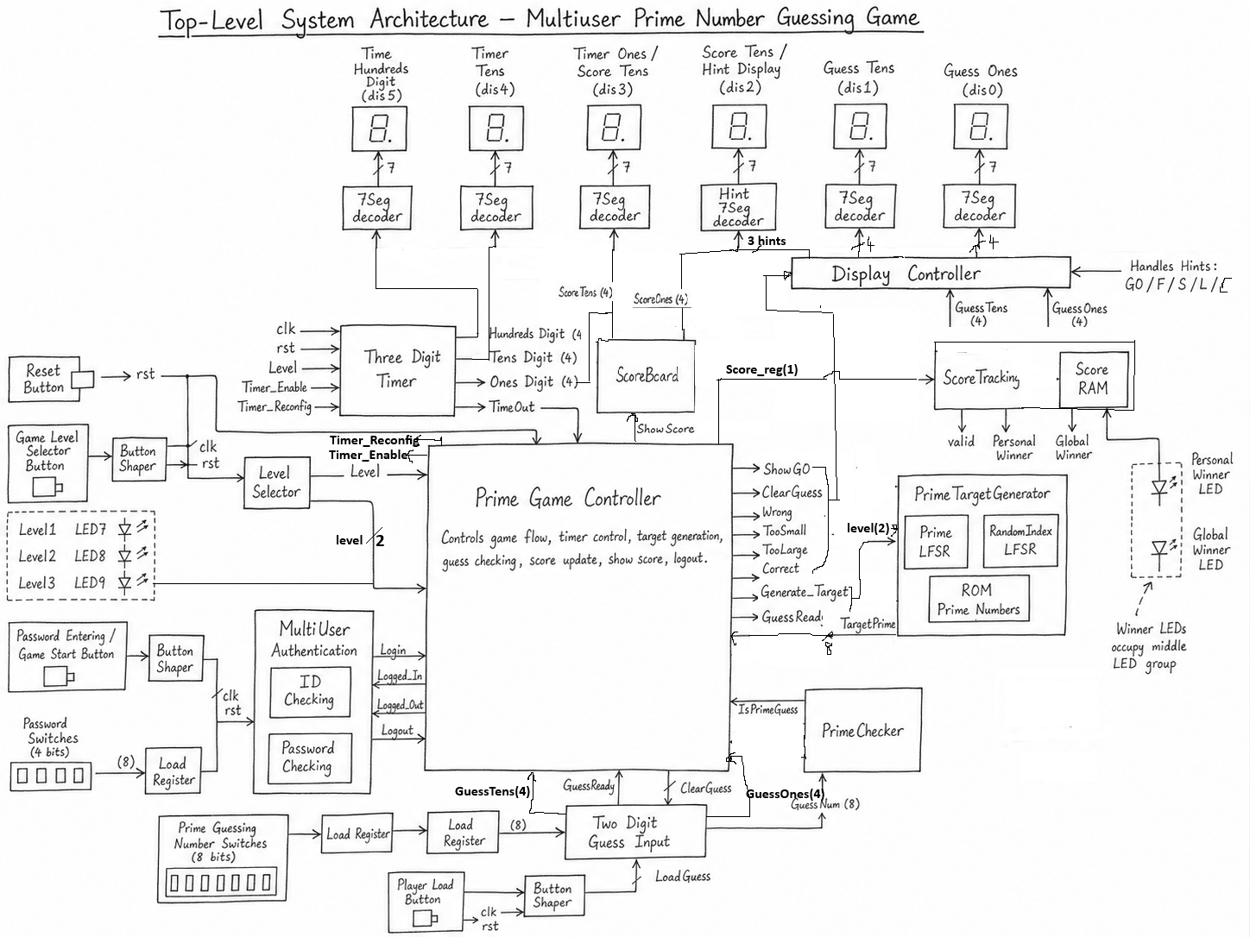
System Architecture

Slide 5
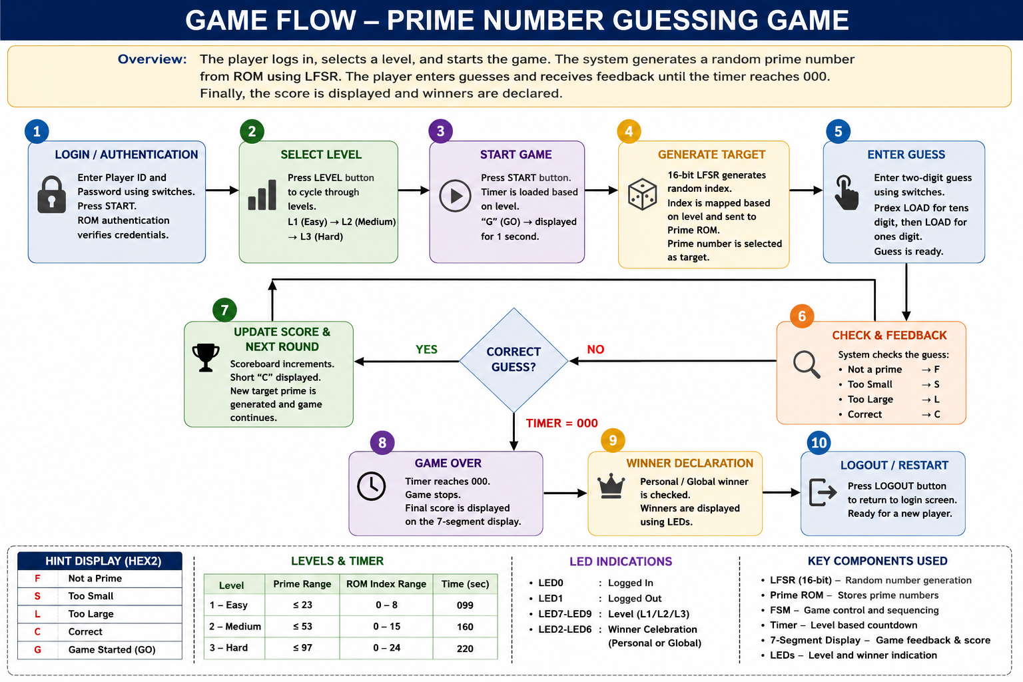

Slide 6
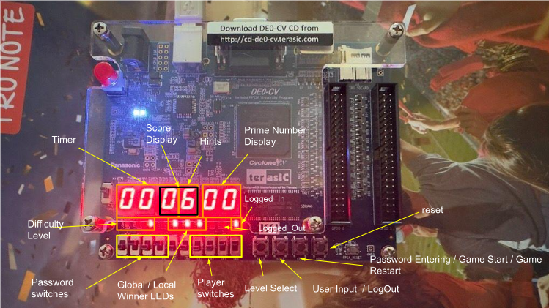
Interface

Slide 7
PrimeGameController FSM
Central FSM controlling overall gameplay.
Implements deterministic state-based hardware control.
States include IDLE, START_GAME, SHOW_GO, ACTIVE, NEW_ROUND, and GAME_OVER.
Controls timers, score updates, target generation, and display hints.
Coordinates interaction between all major modules.
Ensures stable sequential operation throughout gameplay.

Slide 8
Prime Target Generation
PrimeTargetGenerator generates hidden target primes.
Uses RandomIndexLFSR for pseudo-random address generation.
ROM_PrimeNumbers stores all valid prime numbers.
ROM_PrimeNumbers.hex initializes ROM memory contents.
Level-based address clamping ensures difficulty control.
ROM-based approach guarantees valid prime generation without expensive computations.

Slide 9
Level Selection Module
LevelSelector controls gameplay difficulty.
User cycles through difficulty levels using LEVEL button.
Level 1: Prime range up to 23 with 099-second timer.
Level 2: Prime range up to 53 with 160-second timer.
Level 3: Prime range up to 97 with 220-second timer.
Level changes are blocked during active gameplay for stability.

Slide 10
LFSR Randomization
PrimeLFSR implements a 16-bit Linear Feedback Shift Register.
Provides hardware-efficient pseudo-random number generation.
RandomIndexLFSR extracts ROM addresses from LFSR outputs.
Consumes fewer FPGA resources compared to arithmetic RNGs.
Ensures different target primes for every round.
Improves unpredictability and gameplay variation.

Slide 11
Authentication System
Multi-user login mechanism implemented using ROM-based verification.
Authentication module controls secure gameplay access.
Player IDs and passwords stored in dedicated ROM files.
ID_Checking_Module validates Player IDs.
Password_Checking_Module validates passwords.
PlayerID_ROM.hex and Password_ROM.hex store authorized credentials.
Logged-In and Logged-Out states are shown using LEDs.
ButtonShaper eliminates switch bounce and generates clean one-clock-cycle pulses for reliable START, LOAD, RESET, and LEVEL button operations.

Slide 12
Two-Digit GuessInput Module
Captures player guesses digit-by-digit.
Shared switch interface minimizes hardware usage.
First LOAD stores tens digit.
Second LOAD stores one's digit.
Outputs GuessNumber and GuessReady signals.
Rejects invalid digit values greater than 9.
Simplifies user interaction on FPGA hardware.

Slide 13
PrimeChecker Module
PrimeChecker validates whether entered guess is prime.
Uses combinational lookup architecture.
Rejects invalid non-prime guesses.
Outputs IsPrimeGuess signal to Game Controller.
Enables instant feedback generation.
Improves overall gameplay efficiency and response speed.

Slide 14
Timer System
OneSecTimer generates precise 1-second pulses.
ThreeDigitTimer maintains countdown gameplay timer.
hundredmsecTimer and countTo10Timer provide timing synchronization.
msecTimer_LFSR supports internal timing operations.
Different timer values assigned according to selected difficulty level.
Timer expiration triggers GAME OVER condition automatically.

Slide 15
Scoreboard and Score Tracking
Scoreboard increments score after correct guesses.
ScoreTracking maintains player performance statistics.
Score_RAM stores score values internally.
Scores remain hidden during gameplay.
Final score displayed only after timer expiration.
Supports future leaderboard and persistent storage expansion.

Slide 16
Display System
DisplayController manages all visual outputs.
My7SegmentDecoder_4To7 converts binary data into display patterns.
Hint7SegmentDecoder controls gameplay feedback characters.
Displays guesses, scores, timers, and hint messages.
Supports dynamic real-time FPGA visualization.
Improves usability and player interaction experience.

Slide 17
LED Layout and Winner Detection
LEDs indicate login status and difficulty levels.
Winner celebration LEDs activate after gameplay completion.
Personal Winner indication lights selected LEDs.
Global Winner indication lights all celebration LEDs.
Visual indicators improve gameplay excitement and user experience.
Dedicated hardware signaling enhances FPGA interaction.

Slide 18
Testing and Verification
All modules tested independently before integration.
FSM transitions verified through simulation.
ROM target generation validated across all levels.
Timer synchronization verified with FPGA clock.
Display outputs tested for correct gameplay feedback.
Integrated system successfully demonstrated on FPGA hardware.

Slide 19
Results
Successfully stored 25 prime numbers in ROM.
Implemented 16-bit LFSR randomization.
Integrated 3 difficulty levels with adaptive timers.
Implemented complete 10-state gameplay FSM.
Verified real-time gameplay operation on FPGA.
Achieved stable authentication, gameplay, scoring, and display control.
Demonstrated reliable modular digital system integration.

Slide 20
Conclusion
Successfully designed and implemented a complete FPGA-based Prime Number Guessing Game.
Integrated Authentication, FSM Control, ROM Storage, LFSR Randomization, Timers, Scoreboards, and Display Systems.
Achieved modular, scalable, and hardware-efficient architecture.
Resolved real FPGA hardware challenges involving timing and display synchronization.
Demonstrated practical application of digital system design using Verilog HDL.
Project provides strong foundation for future embedded gaming and FPGA applications.

Slide 21
Thank You

