Slide 1
Title : A real-time chat and communication app
Team Member’s :
PUVEEVARMA S (Team Leader) SELVA BHARATHI S SALMAN FAARAS S SYED NAVEED ABDULLAH N

Slide 2
DESCRIPTION
A Real-Time Chat and Communication App is a powerful platform designed to enable instant, seamless communication between individuals and groups across various devices. Whether for personal, professional, or customer interactions, the app provides a fast, secure, and easy-to-use solution for real-time messaging, voice calls, and video communication.
With this app, users can connect in the blink of an eye, ensuring that conversations flow smoothly without interruptions, no matter where they are in the world. It's ideal for both casual chats and formal collaborations, supporting individual conversations, group messaging, file sharing, and even high-quality video conferencing.

Slide 3
Main Activity.java:
package com.project.pradyotprakash.flashchat
import androidx.compose.runtime.Composable
import androidx.compose.runtime.remember
import androidx.navigation.compose.NavHost
import androidx.navigation.compose.composable
import androidx.navigation.compose.rememberNavController
import com.google.firebase.auth.FirebaseAuth
import com.project.pradyotprakash.flashchat.nav.Action
import com.project.pradyotprakash.flashchat.nav.Destination.AuthenticationOption
import com.project.pradyotprakash.flashchat.nav.Destination.Home
import com.project.pradyotprakash.flashchat.nav.Destination.Login
import com.project.pradyotprakash.flashchat.nav.Destination.Register
import com.project.pradyotprakash.flashchat.ui.theme.FlashChatTheme
import com.project.pradyotprakash.flashchat.view.AuthenticationView
import com.project.pradyotprakash.flashchat.view.home.HomeView
import com.project.pradyotprakash.flashchat.view.login.LoginView
import com.project.pradyotprakash.flashchat.view.register.RegisterView
@Composable
fun NavComposeApp() {
val navController = rememberNavController()

Slide 4
val actions = remember(navController) { Action(navController) }
FlashChatTheme {
NavHost(
navController = navController,
startDestination =
if (FirebaseAuth.getInstance().currentUser != null)
Home
else
AuthenticationOption
) {
composable(AuthenticationOption) {
AuthenticationView(
register = actions.register,
login = actions.login
)
}
composable(Register) {
RegisterView(
home = actions.home,
back = actions.navigateBack
)
}
composable(Login) {

Slide 5
LoginView(
home = actions.home,
back = actions.navigateBack
)
}
composable(Home) {
HomeView()
}
}
}
}
Android View.xml
<?xml version="1.0" encoding="utf-8"?>
<manifest xmlns:android="http://schemas.android.com/apk/res/android"
package="com.project.pradyotprakash.flashchat">
<uses-permission android:name="android.permission.INTERNET"/>
<application
android:allowBackup="true"

Slide 6
android:icon="@mipmap/ic_launcher"
android:label="@string/app_name"
android:roundIcon="@mipmap/ic_launcher_round"
android:supportsRtl="true"
android:theme="@style/Theme.FlashChat">
<activity
android:name=".MainActivity"
android:exported="true"
android:label="@string/app_name"
android:theme="@style/Theme.FlashChat.NoActionBar">
<intent-filter>
<action android:name="android.intent.action.MAIN" />
<category android:name="android.intent.category.LAUNCHER" />
</intent-filter>
</activity>
</application>
</manifest>

Slide 7
package com.project.pradyotprakash.flashchat
import androidx.test.platform.app.InstrumentationRegistry
import androidx.test.ext.junit.runners.AndroidJUnit4
import org.junit.Test
import org.junit.runner.RunWith
import org.junit.Assert.
@RunWith(AndroidJUnit4::class)
class ExampleInstrumentedTest {
@Test
fun useAppContext() {
// Context of the app under test.
val appContext = InstrumentationRegistry.getInstrumentation().targetContext
assertEquals("com.project.pradyotprakash.flashchat", appContext.packageName)
}
}

Slide 8
package com.project.pradyotprakash.flashchat
import org.junit.Test
import org.junit.Assert.
Example local unit test, which will execute on the development machine (host).
See [testing documentation](http://d.android.com/tools/testing).
class ExampleUnitTest {
@Test
fun addition_isCorrect() {
assertEquals(4, 2 + 2)
}
}

Slide 9
plugins {
id 'com.android.application'
id 'kotlin-android'
id 'com.google.gms.google-services'
}
android {
compileSdk 30
defaultConfig {
applicationId "com.project.pradyotprakash.flashchat"
minSdk 21
targetSdk 30
versionCode 1
versionName "1.0"
testInstrumentationRunner "androidx.test.runner.AndroidJUnitRunner"
vectorDrawables {
useSupportLibrary true
}
}
buildTypes {

Slide 10
release {
minifyEnabled false
proguardFiles getDefaultProguardFile('proguard-android-optimize.txt'), 'proguard-rules.pro'
}
}
compileOptions {
sourceCompatibility JavaVersion.VERSION_1_8
targetCompatibility JavaVersion.VERSION_1_8
}
kotlinOptions {
jvmTarget = '1.8'
useIR = true
}
buildFeatures {
compose true
}
composeOptions {
kotlinCompilerExtensionVersion compose_version
kotlinCompilerVersion '1.5.10'
}
packagingOptions {
resources {

Slide 11
excludes += '/META-INF/{AL2.0,LGPL2.1}'
}
}
}
dependencies {
implementation 'androidx.core:core-ktx:1.6.0'
implementation 'androidx.appcompat:appcompat:1.3.1'
implementation 'com.google.android.material:material:1.4.0'
implementation "androidx.compose.ui:ui:$compose_version"
implementation "androidx.compose.material:material:$compose_version"
implementation "androidx.compose.ui:ui-tooling-preview:$compose_version"
implementation 'androidx.lifecycle:lifecycle-runtime-ktx:2.3.1'
implementation 'androidx.activity:activity-compose:1.3.1'
implementation 'androidx.lifecycle:lifecycle-livedata-ktx:2.3.1'
implementation 'androidx.lifecycle:lifecycle-viewmodel-ktx:2.3.1'
implementation "androidx.compose.runtime:runtime-livedata:$compose_version"
implementation 'androidx.lifecycle:lifecycle-viewmodel-compose:1.0.0-alpha07'
implementation "androidx.navigation:navigation-compose:2.4.0-alpha06"
implementation platform('com.google.firebase:firebase-bom:28.3.0')
implementation 'com.google.firebase:firebase-analytics-ktx'
implementation 'com.google.firebase:firebase-auth-ktx'

Slide 12
implementation 'com.google.firebase:firebase-firestore-ktx'
implementation 'com.google.firebase:firebase-auth:21.0.3'
implementation 'com.google.firebase:firebase-firestore:24.1.1'
testImplementation 'junit:junit:4.13.2'
androidTestImplementation 'androidx.test.ext:junit:1.1.3'
androidTestImplementation 'androidx.test.espresso:espresso-core:3.4.0'
androidTestImplementation "androidx.compose.ui:ui-test-junit4:$compose_version"
debugImplementation "androidx.compose.ui:ui-tooling:$compose_version"
}

Slide 13
#!/usr/bin/env sh
#
# Copyright 2015 the original author or authors.
#
# Licensed under the Apache License, Version 2.0 (the "License");
# you may not use this file except in compliance with the License.
# You may obtain a copy of the License at
#
# https://www.apache.org/licenses/LICENSE-2.0
#
# Unless required by applicable law or agreed to in writing, software
# distributed under the License is distributed on an "AS IS" BASIS,
# WITHOUT WARRANTIES OR CONDITIONS OF ANY KIND, either express or implied.
# See the License for the specific language governing permissions and
# limitations under the License.
Gradle start up script for UN*X

Slide 14
# Attempt to set APP_HOME
# Resolve links: $0 may be a link
PRG="$0"
# Need this for relative symlinks.
while [ -h "$PRG" ] ; do
ls=`ls -ld "$PRG"`
link=`expr "$ls" : '.*-> \(.*\)$'`
if expr "$link" : '/.*' > /dev/null; then
PRG="$link"
else
PRG=`dirname "$PRG"`"/$link"
fi
done
SAVED="`pwd`"
cd "`dirname \"$PRG\"`/" >/dev/null
APP_HOME="`pwd -P`"
cd "$SAVED" >/dev/null
APP_NAME="Gradle"
APP_BASE_NAME=`basename "$0"`
# Add default JVM options here. You can also use JAVA_OPTS and GRADLE_OPTS to pass JVM options to this script.
DEFAULT_JVM_OPTS='"-Xmx64m" "-Xms64m"'

Slide 15
# Use the maximum available, or set MAX_FD != -1 to use that value.
MAX_FD="maximum"
warn () {
echo "$*"
}
die () {
echo
echo "$*"
echo
exit 1
}
# OS specific support (must be 'true' or 'false').
cygwin=false
msys=false
darwin=false
nonstop=false
case "`uname`" in
CYGWIN* )
cygwin=true
;;
Darwin* )

Slide 16
darwin=true
;;
MINGW* )
msys=true
;;
NONSTOP* )
nonstop=true
;;
esac
CLASSPATH=$APP_HOME/gradle/wrapper/gradle-wrapper.jar
# Determine the Java command to use to start the JVM.
if [ -n "$JAVA_HOME" ] ; then
if [ -x "$JAVA_HOME/jre/sh/java" ] ; then
# IBM's JDK on AIX uses strange locations for the executables
JAVACMD="$JAVA_HOME/jre/sh/java"
else
JAVACMD="$JAVA_HOME/bin/java"
fi
if [ ! -x "$JAVACMD" ] ; then
die "ERROR: JAVA_HOME is set to an invalid directory: $JAVA_HOME

Slide 17
Please set the JAVA_HOME variable in your environment to match the
location of your Java installation."
fi
else
JAVACMD="java"
which java >/dev/null 2>&1 || die "ERROR: JAVA_HOME is not set and no 'java' command could be found in your PATH.
Please set the JAVA_HOME variable in your environment to match the
location of your Java installation."
fi
# Increase the maximum file descriptors if we can.
if [ "$cygwin" = "false" -a "$darwin" = "false" -a "$nonstop" = "false" ] ; then
MAX_FD_LIMIT=`ulimit -H -n`
if [ $? -eq 0 ] ; then
if [ "$MAX_FD" = "maximum" -o "$MAX_FD" = "max" ] ; then
MAX_FD="$MAX_FD_LIMIT"
fi
ulimit -n $MAX_FD
if [ $? -ne 0 ] ; then
warn "Could not set maximum file descriptor limit: $MAX_FD"
fi

Slide 18
else
warn "Could not query maximum file descriptor limit: $MAX_FD_LIMIT"
fi
fi
# For Darwin, add options to specify how the application appears in the dock
if $darwin; then
GRADLE_OPTS="$GRADLE_OPTS \"-Xdock:name=$APP_NAME\" \"-Xdock:icon=$APP_HOME/media/gradle.icns\""
fi
# For Cygwin or MSYS, switch paths to Windows format before running java
if [ "$cygwin" = "true" -o "$msys" = "true" ] ; then
APP_HOME=`cygpath --path --mixed "$APP_HOME"`
CLASSPATH=`cygpath --path --mixed "$CLASSPATH"`
JAVACMD=`cygpath --unix "$JAVACMD"`
# We build the pattern for arguments to be converted via cygpath
ROOTDIRSRAW=`find -L / -maxdepth 1 -mindepth 1 -type d 2>/dev/null`
SEP=""
for dir in $ROOTDIRSRAW ; do
ROOTDIRS="$ROOTDIRS$SEP$dir"
SEP="|"

Slide 19
done
OURCYGPATTERN="(^($ROOTDIRS))"
# Add a user-defined pattern to the cygpath arguments
if [ "$GRADLE_CYGPATTERN" != "" ] ; then
OURCYGPATTERN="$OURCYGPATTERN|($GRADLE_CYGPATTERN)"
fi
# Now convert the arguments - kludge to limit ourselves to /bin/sh
i=0
for arg in "$@" ; do
CHECK=`echo "$arg"|egrep -c "$OURCYGPATTERN" -`
CHECK2=`echo "$arg"|egrep -c "^-"` ### Determine if an option
if [ $CHECK -ne 0 ] && [ $CHECK2 -eq 0 ] ; then ### Added a condition
eval `echo args$i`=`cygpath --path --ignore --mixed "$arg"`
else
eval `echo args$i`="\"$arg\""
fi
i=`expr $i + 1`
done

Slide 20
case $i in
0) set -- ;;
1) set -- "$args0" ;;
2) set -- "$args0" "$args1" ;;
3) set -- "$args0" "$args1" "$args2" ;;
4) set -- "$args0" "$args1" "$args2" "$args3" ;;
5) set -- "$args0" "$args1" "$args2" "$args3" "$args4" ;;
6) set -- "$args0" "$args1" "$args2" "$args3" "$args4" "$args5" ;;
7) set -- "$args0" "$args1" "$args2" "$args3" "$args4" "$args5" "$args6" ;;
8) set -- "$args0" "$args1" "$args2" "$args3" "$args4" "$args5" "$args6" "$args7" ;;
9) set -- "$args0" "$args1" "$args2" "$args3" "$args4" "$args5" "$args6" "$args7" "$args8" ;;
save () {
for i do printf %s\\n "$i" | sed "s/'/'\\\\''/g;1s/^/'/;\$s/\$/' \\\\/" ; done
echo " "
}
APP_ARGS=`save "$@"`
eval set -- $DEFAULT_JVM_OPTS $JAVA_OPTS $GRADLE_OPTS "\"-Dorg.gradle.appname=$APP_BASE_NAME\"" -classpath "\"$CLASSPATH\"" org.gradle.wrapper.GradleWrapperMain "$APP_ARGS"
exec "$JAVACMD" "$@"

Slide 21
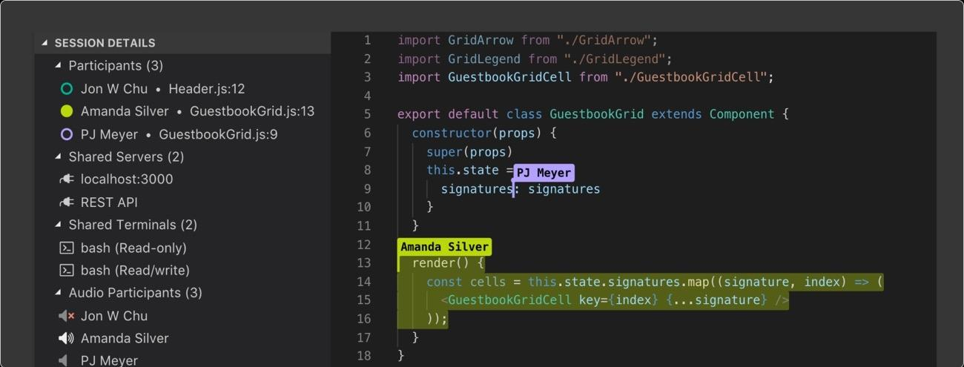
Output :

Slide 22
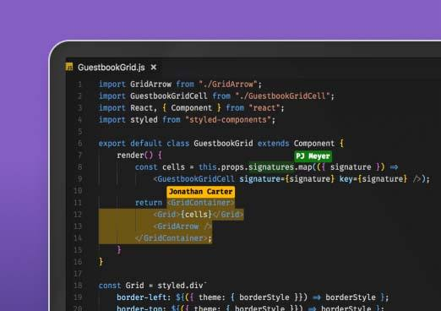

Slide 23
