Slide 1
Lumen
let v: km/h = 10 m/s;
print(v);
// compiles to
print 36.0 "km/h"
A programming language where every number knows its unit
Compiler Design (BCSE307L) · Final project review
Sanjay Suresh 24BCE2685
Sugesh Kumar 24BCE2687
Noel Ninan 24BCE2737
Advaith Sivakumar 24BCE2715
Ajay Kumar 24BCE2721

Slide 2
Two bugs a compiler could not see
1999 · Mars Climate Orbiter
1983 · Air Canada "Gimli Glider"
×4.45
1.77 ≠ 0.803
lbf·s was read as N·s
lb/L was used as kg/L
Ground software gave thruster impulse in pound-force seconds. Navigation expected newton seconds. The spacecraft was lost: $327.6 million.
The crew loaded less than half the fuel needed. Both engines quit at 41,000 ft. They glided for 17 minutes and nobody died.
To the compiler, both numbers were just float. Nothing could notice.

Slide 3
The idea: a number is its unit too
1. The unit is part of the type
9.8 m/s^2 and 12.5 lbf*s are different kinds of value.
2. The compiler does the physics
Multiply adds the exponents, divide subtracts them, plus needs equal dimensions.
3. Then the units are erased
The program that runs is plain arithmetic. No cost at run time.
You write | Ordinary language | Lumen
100 m + 9.58 s | 109.58, meaningless | error: cannot add time to length
pass 12.5 as N*s | compiles | rejected: unit unknown
1 km + 500 m | 501? 1.5? 1500? | 1.5 km
12.5 lbf*s as N*s | remember x4.45 | 55.6 N*s, automatic

Slide 4
The language at a glance
unit min = 60 s;
unit h = 3600 s;
fn pace(d: km, t: min) -> km/h {
return d / t;
}
fn main() {
let d = 42.195 km;
let t = 3 h + 30 min;
print(pace(d, t));
print(d in m);
}
Units are declared in the program
Types can be units: km, N*s, km/h
Mixed scales convert exactly: 3 h + 30 min
The compiler converts the km/min result to km/h
"in" is an explicit conversion
Money is its own dimension: unit INR;
12.05571429 km/h
42195.0 m

Slide 5
Seven phases, one pipeline
Lexer
Parser
Unit checker
IR
Optimizer
Bytecode
VM
lexer.py
parser.py
semantic.py
units.py
irgen.py
optimizer.py
codegen.py
vm.py
tokens
syntax tree
typed tree
3-address code
faster code
stack code
output
Blue boxes know about units. From the IR onwards a quantity is just a number, which is why units cost nothing at run time.

Slide 6
How the unit checker thinks
Expression | Rule | Result
3 m + 2 s | plus needs equal dimensions | error
1 km + 500 m | same dimension: convert the right side | 1.5 km
100 m / 20 s | divide subtracts exponents | 5 m/s
3 m * 4 m | multiply adds exponents | 12 m^2
2 km / 500 m | everything cancels, scale applied | 4 (plain number)
v in m/s | same dimension required | exact conversion
Conversion changes the scale only, never the dimension. A plain number never turns into a quantity (except 0).

Slide 7
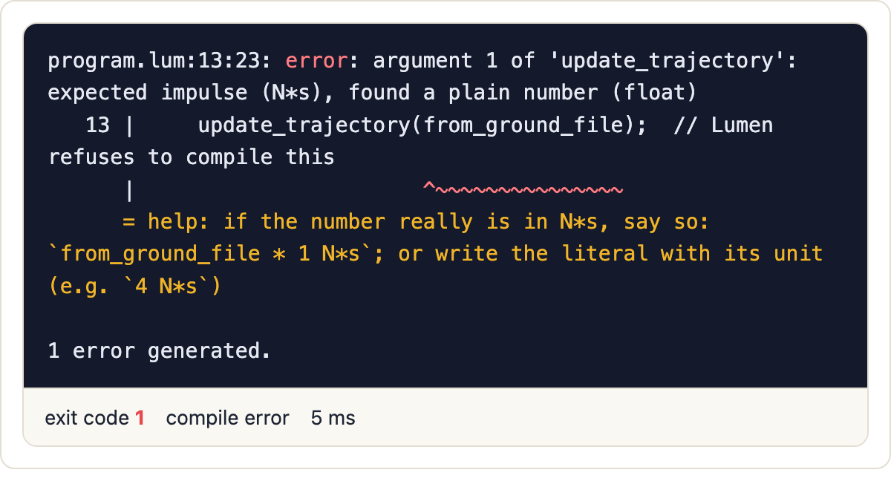
Mars Orbiter: rejected
mars_bug.lum
compiler output
unit N = 1 kg*m/s^2;
unit lbf = 4.4482216152605 N;
fn update_trajectory(impulse: N*s) {
print(impulse);
}
fn main() {
let from_ground_file = 12.5;
update_trajectory(from_ground_file);
}
A bare 12.5 where N*s is needed is a compile error, and the message suggests the fix.

Slide 8

Mars Orbiter: fixed
mars_fixed.lum
compiler output
unit N = 1 kg*m/s^2;
unit lbf = 4.4482216152605 N;
fn update_trajectory(impulse: N*s) {
print(impulse);
}
fn main() {
let from_ground_file = 12.5 lbf*s;
update_trajectory(from_ground_file);
}
Write the unit and Lumen converts it: 12.5 lbf*s becomes 55.6 N*s, the factor Mars needed.

Slide 9
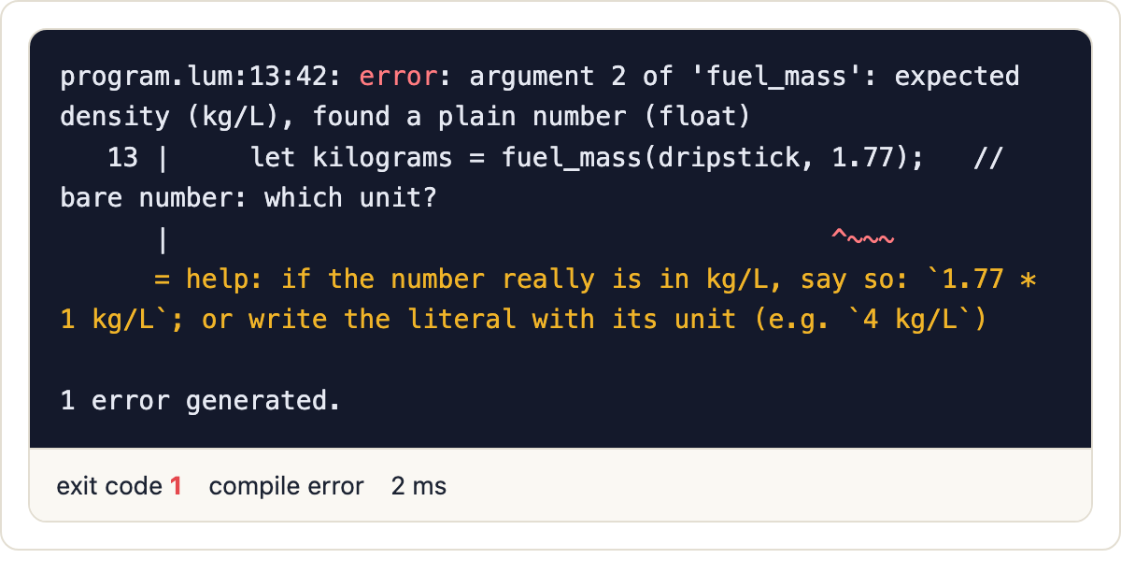
Gimli Glider: rejected
gimli_bug.lum
compiler output
unit L = 0.001 m^3;
unit lb = 0.45359237 kg;
fn fuel_mass(volume: L, density: kg/L) -> kg {
return volume * density;
}
fn main() {
let dripstick = 7682 L;
let density = 1.77 lb/L;
let kilograms = fuel_mass(dripstick, 1.77);
print(kilograms);
}
1.77 passed as kg/L is refused. Written as 1.77 lb/L it converts to 0.803 kg/L automatically.

Slide 10
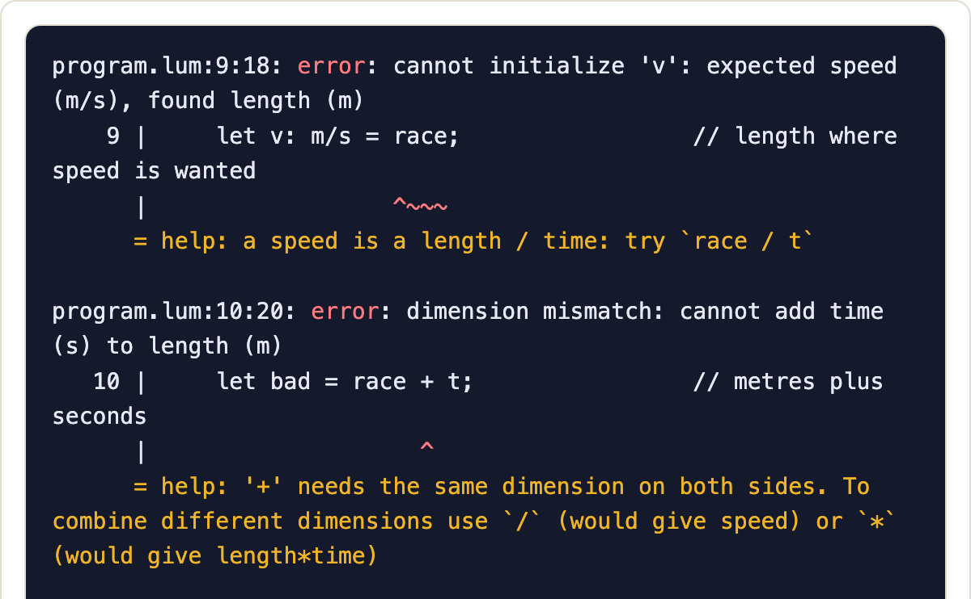
Many errors in one run
err_units.lum
compiler output
unit h = 3600 s;
fn speed(d: m, t: s) -> m/s { return d / t; }
fn main() {
let race = 100 m;
let t = 9.58 s;
let v: m/s = race;
let bad = race + t;
let w = speed(race, 5);
let q = race in s;
let z = 5 mtr;
if (race > t) { print(1); }
}
Six unit mistakes in one run (first two shown). Each has a line, a caret and a help line.

Slide 11
Inside the checker: the typed tree
phases_demo.lum → --ast
Let(name='v')
Binary(op='/') : km/h
Var(name='d') : km
Var(name='t') : h
Print(label='km/h')
Var(name='v') : km/h
Print(label='m/s')
Convert(from_scale=0.2777..., to_scale=1) : m/s
Var(name='v') : km/h
Every node carries its unit
d / t gives km/h on its own
The Convert node was inserted by the checker: km/h and m/s differ only in scale (5/18)

Slide 12
The optimizer
zero_cost.lum: let v: km/h = 10 m/s; print(v);
before
after
func main():
t1 = 10.0 * 3.6 ; convert
v = t1
print v "km/h"
return
func main():
print 36.0 "km/h"
return
It folds constants, fuses conversions, removes dead code and prunes branches that can never run.
20 → 6
10 → 2
21/21
instructions in optimizer_demo
instructions in orbit.lum
programs print the same output with and without it

Slide 13
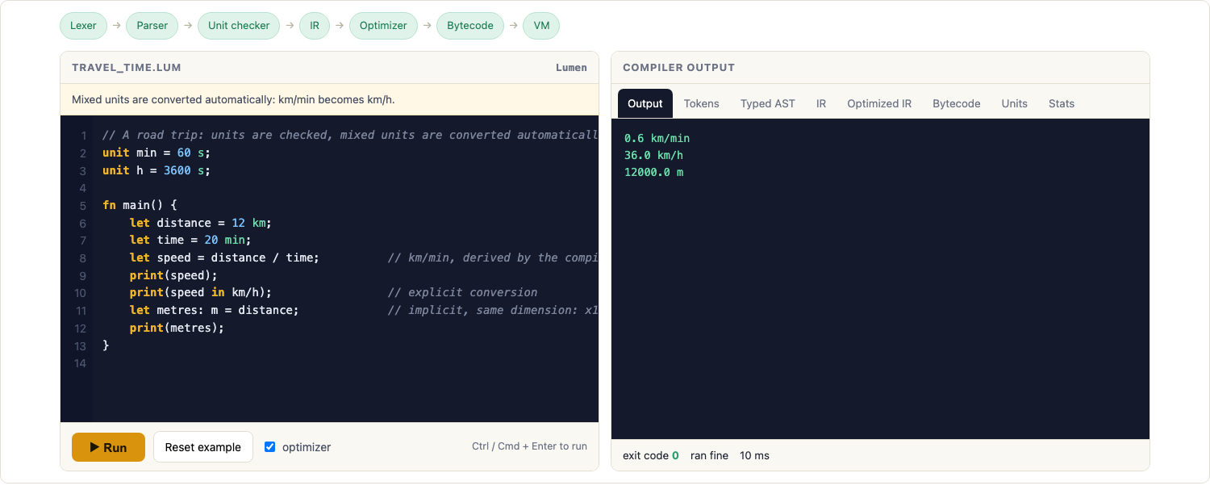
The playground we built to show it
A local web page around the real compiler: pick an example, press Run, and read every phase in the tabs. It also has a blank editor.

Slide 14
Testing, limits and what is next
Testing
Limits, and next
187 tests, all passing
34 example programs with recorded outputs
Optimized and unoptimized runs compared on 21 programs
6,000 randomly corrupted programs: no crashes
3,437 lines of Python
Checks one program: Mars crossed two
A person can still write the wrong unit
No temperatures (°C): needs offset units
Next: typed file boundary, native back end, editor plugin

