Slide 1
Lumen
let v: km/h = 10 m/s;
print(v);
A programming language where every number knows its unit
Review 2: design and architecture, 4 of 7 phases built
Compiler Design (BCSE307L)
Sanjay Suresh 24BCE2685
Sugesh Kumar 24BCE2687
Noel Ninan 24BCE2737
Advaith Sivakumar 24BCE2715
Ajay Kumar 24BCE2721

Slide 2
The problem we are solving
1999 · Mars Climate Orbiter
1983 · Air Canada "Gimli Glider"
×4.45
1.77 ≠ 0.803
Pound-force seconds were read as newton-seconds. The spacecraft was lost: $327.6 million.
Pounds per litre were used as kg per litre. The plane ran out of fuel at 41,000 ft.
To a normal compiler both numbers are just float, so nothing notices.
Our goal: a language whose compiler catches unit mistakes before the program runs, and costs nothing at run time.

Slide 3
Objectives and scope
What we will build
What we leave out
A small language where the unit is part of a number's type
A seven-phase compiler for it, in plain Python
Exact unit conversion, and clear errors with a help line
Units erased after checking: no run-time cost
Tests for every phase
Temperatures like °C (they need offsets)
Telling torque from energy (same dimension)
Checking across several programs
Native machine code: we target our own VM

Slide 4
Language design
unit min = 60 s;
unit h = 3600 s;
fn pace(d: km, t: min) -> km/h {
return d / t;
}
fn main() {
let d = 42.195 km;
let t = 3 h + 30 min;
print(pace(d, t));
print(d in m);
}
A number followed by a unit is a quantity: 42.195 km
Units are declared with unit; unit INR; makes a new base unit
Types can be units: km, N*s, km/h
in converts explicitly
Ordinary parts: let, fn, if, while, return, print
Types: int, float, bool, string and units

Slide 5
Architecture: seven phases
Lexer
Parser
Unit checker
IR
Optimizer
Bytecode
VM
lexer.py
parser.py
semantic.py
units.py
irgen.py
optimizer.py
codegen.py
vm.py
tokens
syntax tree
typed tree
3-address code
faster code
stack code
output
Solid blue: built and tested. Dashed: designed, to be built for Review 3.
Front end (lexer, parser, checker) understands the program and its units. The middle (IR, optimizer) simplifies it. The back end (bytecode, VM) runs it. Units exist only in the front end; from the IR onwards a quantity is a plain number.

Slide 6
What each phase hands to the next
Phase | Input | Output | Key data structure
Lexer | source text | tokens | Token(kind, text, line, col)
Parser | tokens | syntax tree | Node classes: Binary, Let, Call...
Unit checker | syntax tree | typed tree + errors | Type(kind, dimension, scale)
IR | typed tree | 3-address code | Instr(op, dst, a, b)
Optimizer | IR | smaller IR | same IR, rewritten
Bytecode | IR | stack code | BC(op, arg)
VM | stack code | program output | Frame(slots, stack, ip)
Errors from every phase use one shared record: Diagnostic (severity, message, line, column, help).

Slide 7
Grammar and parsing approach
program = { unitDecl | function } EOF
unitDecl = "unit" IDENT [ "=" NUMBER unitExpr ] ";"
function = "fn" IDENT "(" [params] ")" block
statement = let | assign | if | while
| return | print | block
expr = logicOr [ "in" unitExpr ]
term = factor { ("+"|"-") factor }
factor = unary { ("*"|"/"|"%") unary }
primary = NUMBER [unit] | IDENT | "(" expr ")"
Hand-written recursive descent: one function per rule
LL(1): one token of lookahead
Precedence from layering the rules
Two unit rules: a name after a number is a unit; a unit continues over * and / only if the next name is a known unit
Panic-mode error recovery

Slide 8
Unit type system
Every number has three parts: kind, dimension, scale
Unit | Dimension (powers of m, kg, s) | Scale
m | length m¹ | 1
km | length m¹ | 1000
km/h | speed m¹ s⁻¹ | 5/18
N | force kg¹ m¹ s⁻² | 1
Operator | Rule
+ - < | dimensions equal
* | add the powers
/ | subtract the powers
in | same dimension
Scales are exact fractions, so conversions never drift. Conversion changes the scale only, never the dimension, and a plain number never becomes a quantity (except 0).

Slide 9
Error handling design
Errors are collected, not thrown: one run shows many
A bad expression gets an error type, so there is no cascade
Every error has a line, a caret and usually a help line
Lexical errors are shown alone; syntax errors stop before the checker
Never a Python crash on a user's mistake
error: dimension mismatch: cannot add
time (s) to length (m)
10 | let bad = race + t;
| ^
= help: '+' needs the same dimension
on both sides.
Exit codes
0 ran fine 1 compile error
2 bad file 3 runtime error

Slide 10
Progress so far: about 60%
4 of 7 phases built
Phase | Status | What works today
1 Lexer | Done | tokens with line and column, exact numbers, all lexical errors
2 Parser | Done | full grammar, syntax tree, error recovery
3 Unit checker | Done | dimension algebra, conversions, scope, types, warnings
4 IR | Done | three-address code, short-circuit jumps, loops
5 Optimizer | Planned | design done (folding, fusion, dead code)
6 Bytecode | Planned | instruction set designed
7 VM | Planned | frame and error model designed

Slide 11
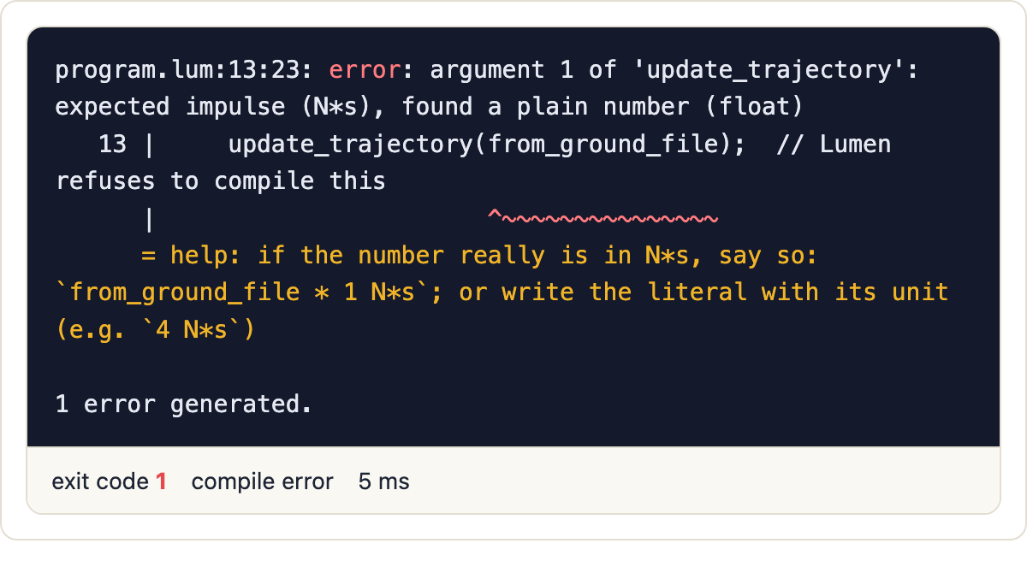
What runs today
python -m lumen run phases_demo.lum --ir
Mars bug, rejected by the checker
func main():
d = 90.0
t = 1.5
t1 = d / t
v = t1
print v "km/h"
t2 = v * 0.2777777777777778
; convert
print t2 "m/s"
return
A bare 12.5 where N*s is needed is a compile error with a fix suggested.
The unit conversion is already a plain multiplication here.

Slide 12
Testing so far
102
Module | Tests
Unit checker | 63
Parser | 20
Lexer | 12
Unit algebra | 7
Each phase is tested on its own
Error messages are tested, not only success cases
Example programs (Mars, Gimli, dosing, currency) are checked by hand
automated tests pass for phases 1 to 3
Planned for Review 3: golden outputs for every example, and a test that the optimizer never changes a program's output.

Slide 13
Remaining work for Review 3
Work | What it involves | Owner
Optimizer | constant folding and propagation, conversion fusion, dead code, branch pruning | Noel
Bytecode generator | stack instruction set, slots and labels | Ajay
Virtual machine | frames, runtime errors, step and depth limits | Ajay
Test suite | golden outputs, optimizer-on versus off comparison | Ajay, Noel
Demo and docs | web playground, examples, viva notes | Ajay, Sanjay
Risk: optimizer bugs could change a program's meaning. Plan: share one arithmetic function between the optimizer and the VM, and never fold a division that can fail.

Slide 14
Team and responsibilities
Member | Register no. | Part
Sanjay Suresh | 24BCE2685 | Lexer, error messages, command line
Advaith Sivakumar | 24BCE2715 | Parser and syntax tree
Sugesh Kumar | 24BCE2687 | Unit system and unit checker
Noel Ninan | 24BCE2737 | Intermediate code and optimizer
Ajay Kumar | 24BCE2721 | Bytecode, VM, tests, playground
Each of us can explain every phase; the split decides who goes deepest.

