Slide 1





Slide 2




1.
2.
3.

Slide 3






Slide 4





Slide 5


Slide 6



give an intuitive grasp

Slide 7
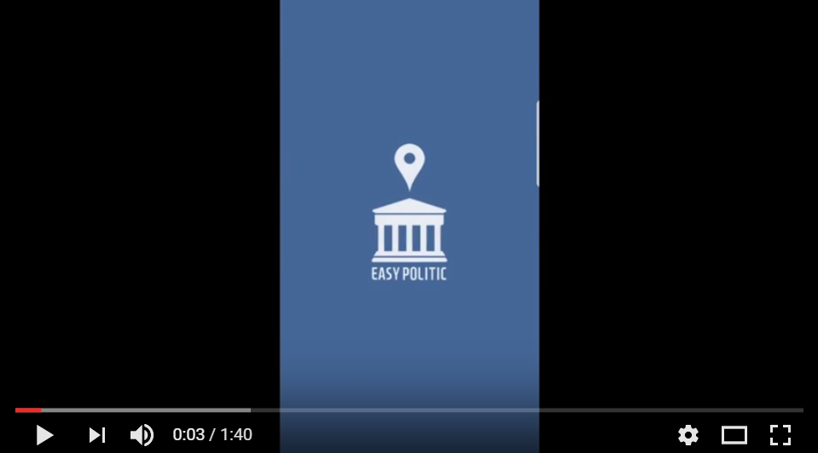


Slide 8


Slide 9


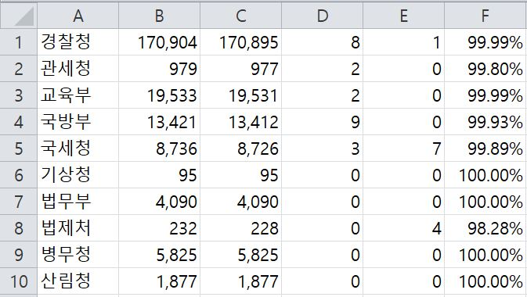
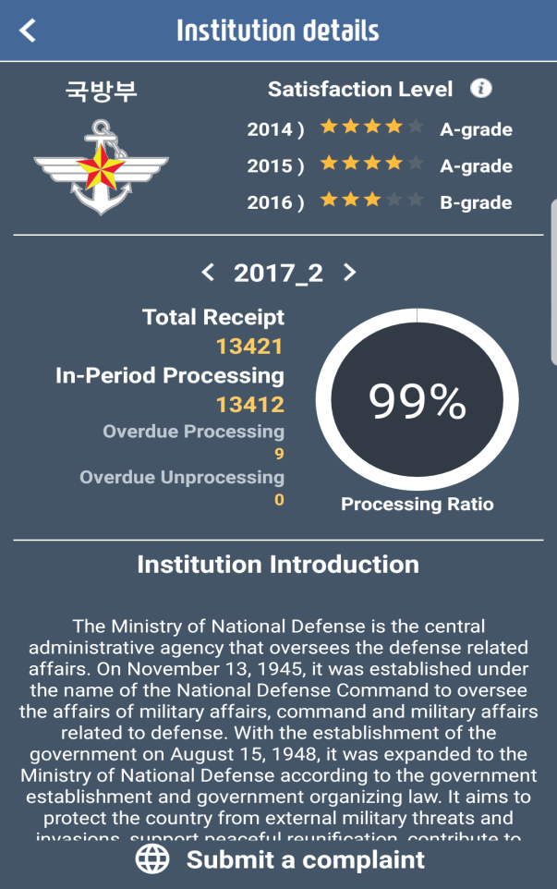

Slide 10
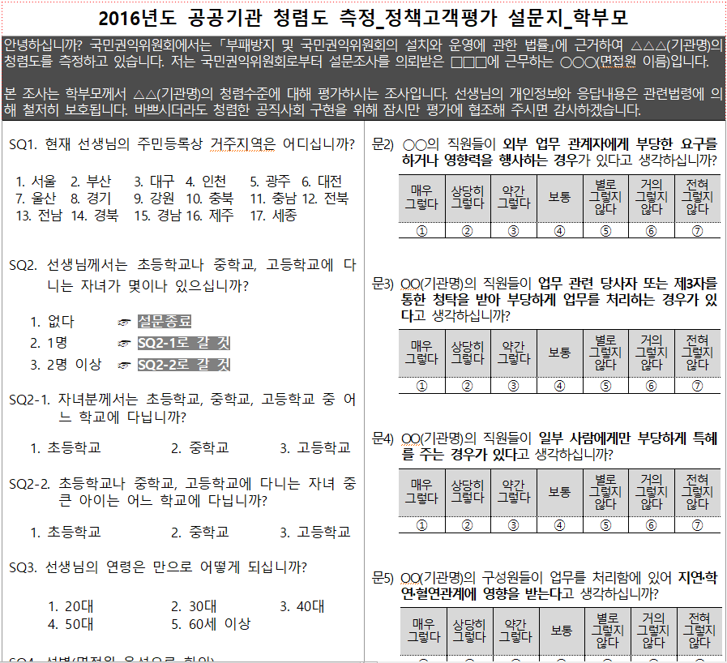
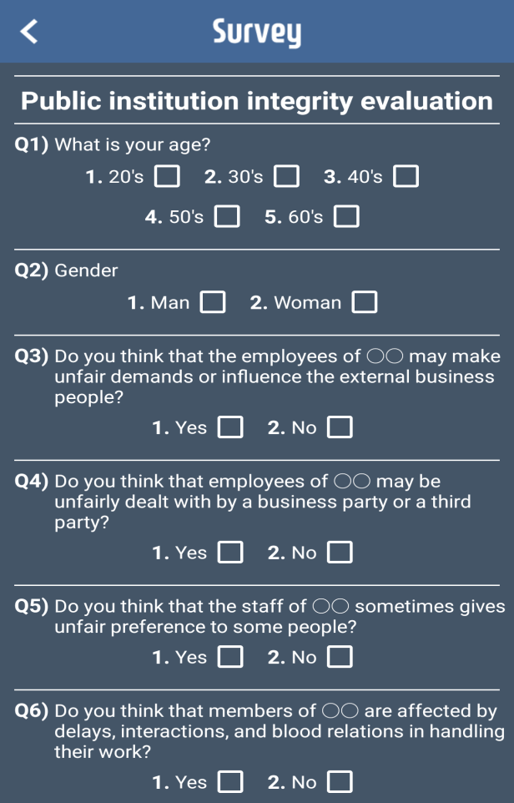

Slide 11







