Slide 1





Slide 2




1.
2.
3.

Slide 3









Slide 4



Slide 5



give an intuitive grasp

Slide 6
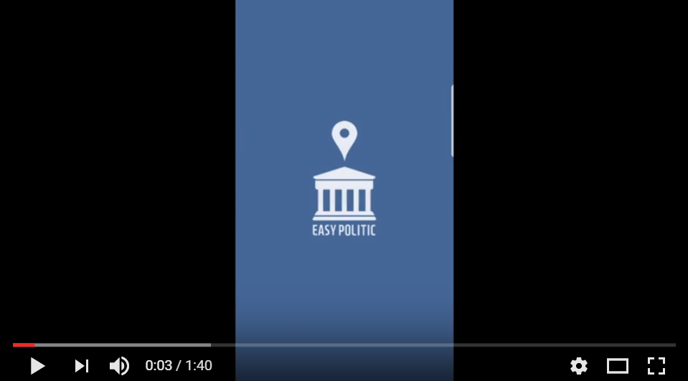


Slide 7


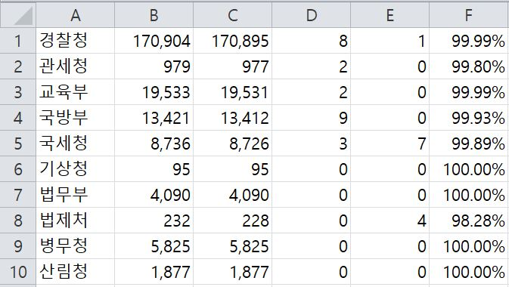
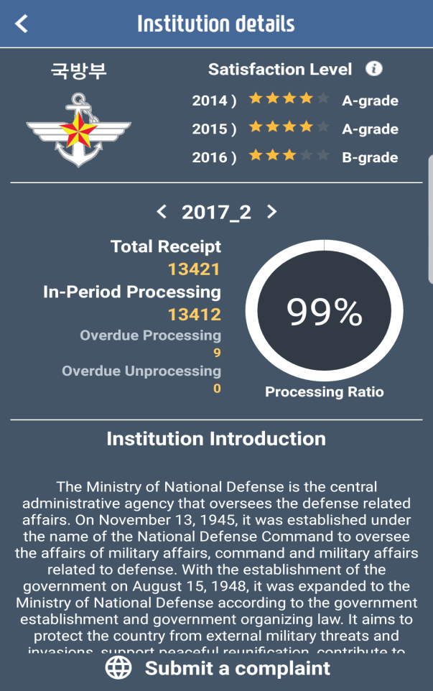

Slide 8
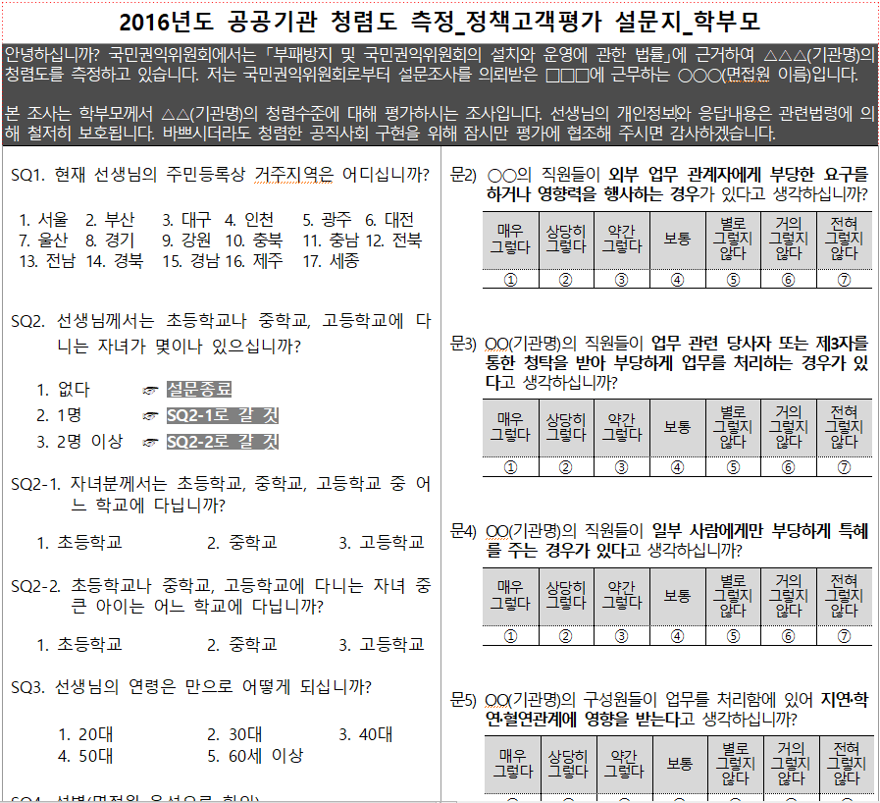
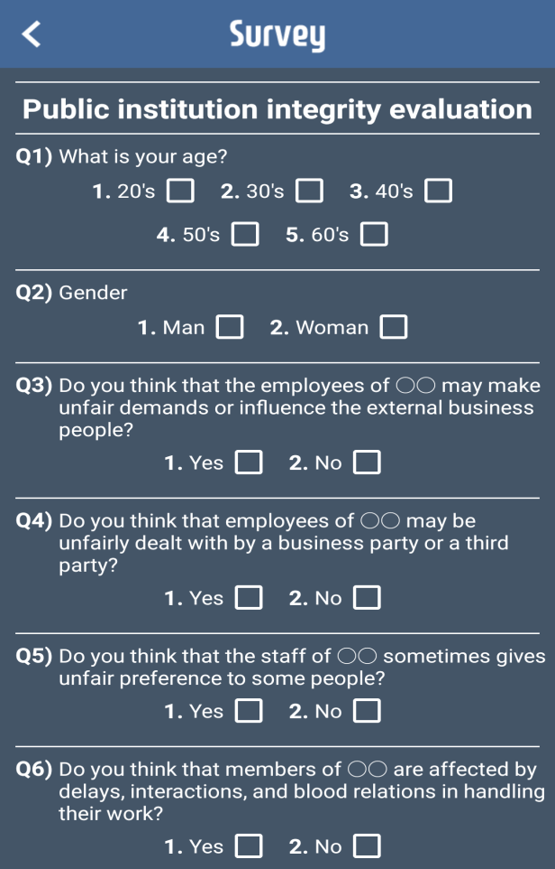

Slide 9


Slide 10







