Slide 1
Final Presentation
Team Black

Slide 2
Final Architecture
Master
start
register worker (receive worker info)
partitioning - send boundaries
shuffling complete
sorting complete
merging complete
Worker
start
register with master
sampling
shuffling
sorting
merging

Slide 3
Revised Implementations (0)
grpc and communication
Masterservice
rpc RegisterWorker(RegisterWorkerRequest) returns (RegisterWorkerReply);
rpc ShuffleComplete(ShuffleCompleteRequest) returns (ShuffleCompleteReply);
rpc SortComplete(SortCompleteRequest) returns (SortCompleteReply);
rpc PickBoundariesComplete(GetDataRequest) returns (GetDataResponse);
rpc MergeComplete(MergeCompleteRequest) returns (MergeCompleteReply);
WorkerService
rpc StartShuffle(ShuffleRequest) returns (ShuffleReply);
rpc StartSort(SortRequest) returns (SortReply);
rpc SendPartitionData(PartitionDataRequest) returns (PartitionDataReply);

Slide 4
Revised Implementations (1)
sorting - identical
sampling
worker별로 sampling한 파일 저장 후 해당 파일을 pickBoundariesComplete 전송
partitioning
worker의 GetDataRequest에 master는 partitioning 완료 후 partition boundary를 담은 GetDataReply로 답변

Slide 5
Revised Implementations (2)
shuffling
모든 데이터를 받은 뒤 notifyShuffleComplete
merging
buffers에 worker가 받은 receiveBuffers와 localKeyValue 병합
이후 재귀적으로 mergeSort 상행
output으로 출력 이후 notifyMergeComplete

Slide 6
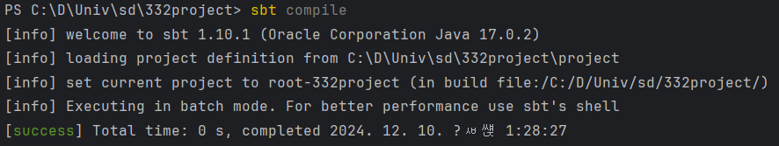
How to Run
master: sbt
sbt:distributedSortingProject> runMain machine.MasterApp
worker: sbt
sbt:distributedSortingProject> runMain machine.Worker [Master_Ip]:7777 -I [Input_path] -O [Output_Path]

Slide 7
Overall progress after last presentation
후술할 오류 해결
코드 구현 완료

Slide 8
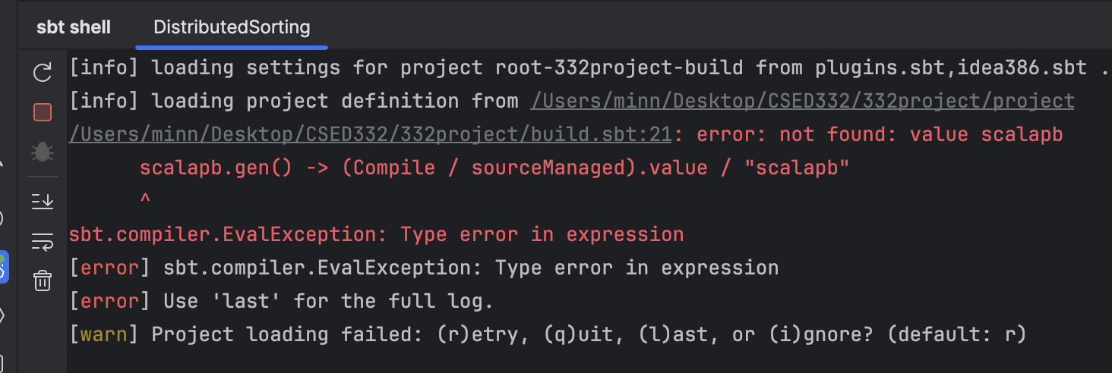
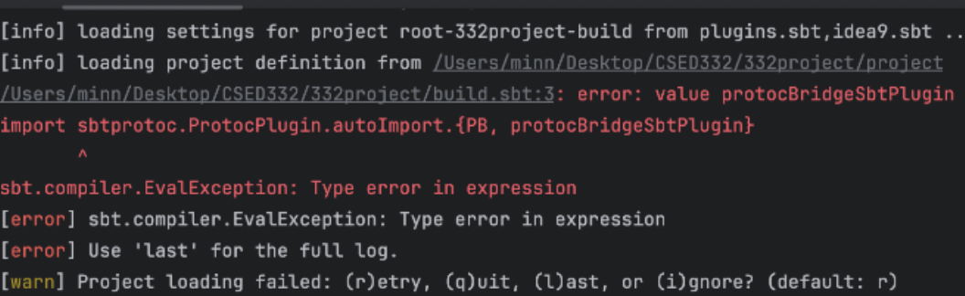
Major Difficulties
Implementing build.sbt & Solving dependencies and error fetching libraries, error resolving symbol definitions, …
Solution: error-free .sbt files, manually fixing dependency .xml files, …

Slide 9
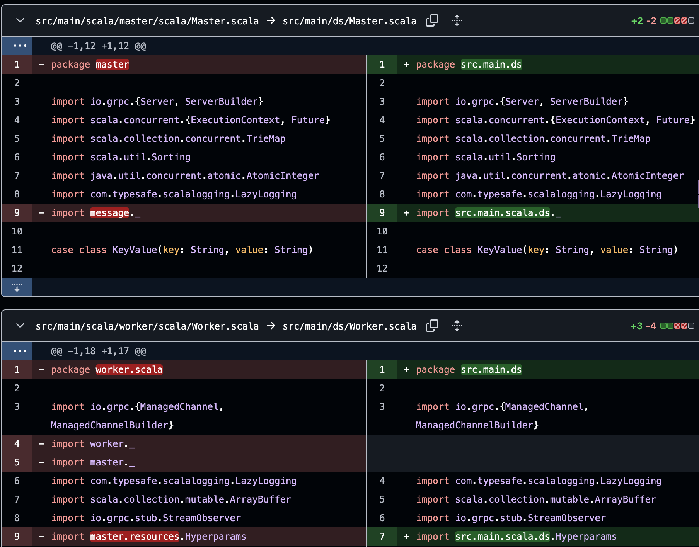
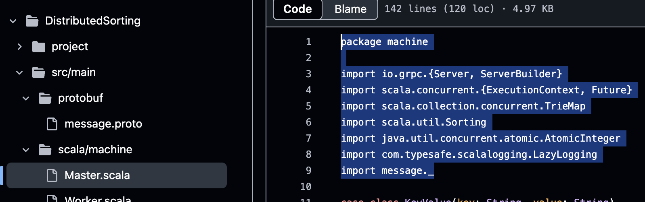
Major Difficulties
package naming and file/directory location ㄹㄹ final ver.
Solution: directory 구조와 통일함

Slide 10
Lessons Learned
프로젝트 각 부분의 분량을 완벽히 가늠한 후 역할 분담
코드를 구현하기 전 구조 디자인을 명확히 하기
서로 필요한 부분에 대해서 지속적으로 대화를 하면서 개발하면 효과적

