Slide 1
Image contrast enhancement using triple clipped dynamic histogram equalisation based on standard deviation (σ)
Swarnava Bag (19EE38018)
Saad Ansari (19EE38023)
Saraf Parth Vikrant(19EE38020)

Slide 2
Table of Contents
1
4
Comparisons
Intro to TCDHE-SD
2
Implemented Algorithm
5
Why it’s better?
3
Observations

Slide 3



Triple clipped dynamic histogram equalisation based on standard deviation (σ)
Triple Partitioning
& Clipping
Dynamic Histogram Equalisation
Partitioned the histogram into 3 sub-histograms based on the standard deviation
Clipping each sub-histogram using a threshold over that intensity range
Mapping each partition to a new dynamic range
Equalising each sub-histogram independently
01
02
03
Why 3- Partitioning
Why Clipping?
Why Dynamic Mapping?
Avoiding insignificant enhancements.
Preventing Intensity Saturation
Contrast Enhancement
Notes:
© Copyright PresentationGO.com – The free PowerPoint and Google Slides template library

Slide 4
Implementation of the Algorithm
Step 1
Triple partitioning of the histogram
Step 2
Histogram clipping
Step 4
Equalising each partition independently
Step 3
Mapping each partition to a new dynamic range
Step 5
Entropy Calculations and Comparisons
Notes:
© Copyright PresentationGO.com – The free PowerPoint and Google Slides template library

Slide 5
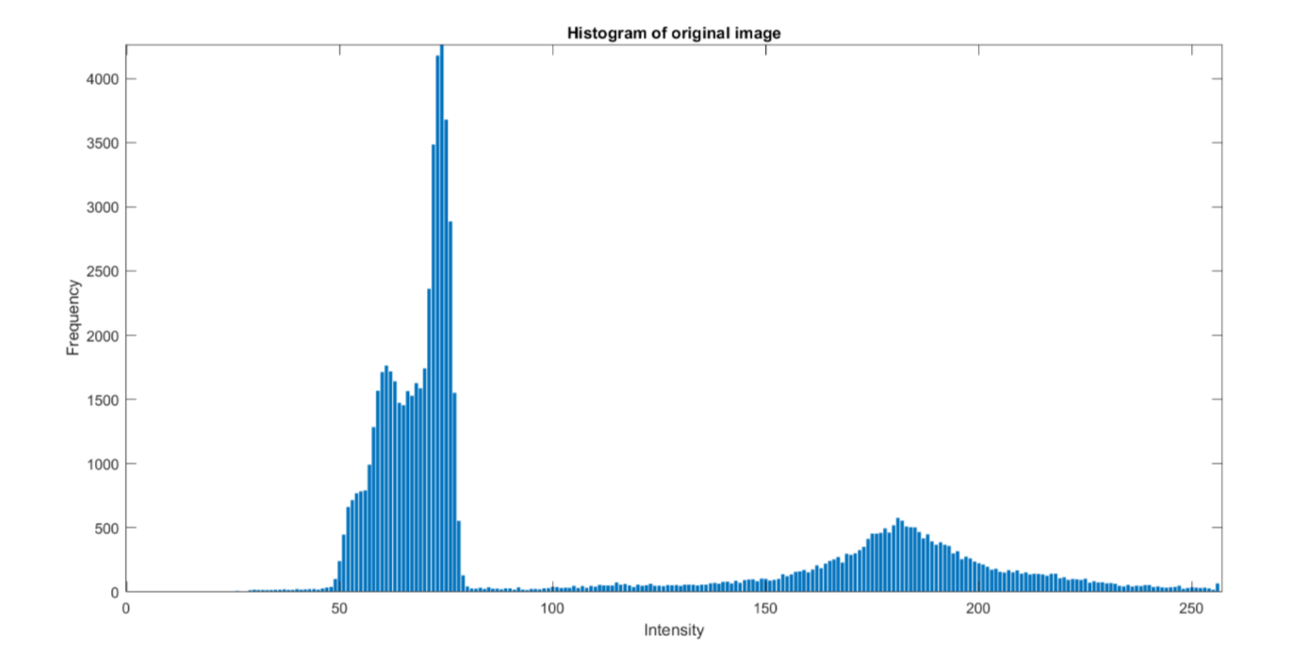
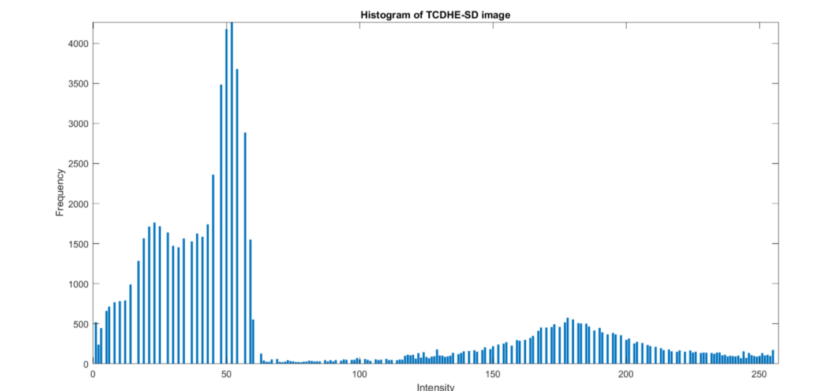
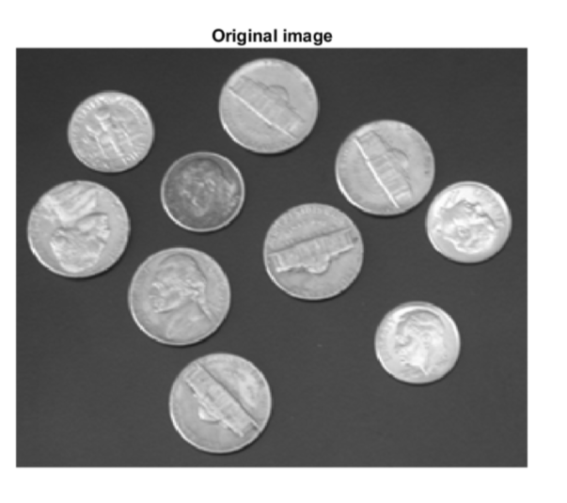
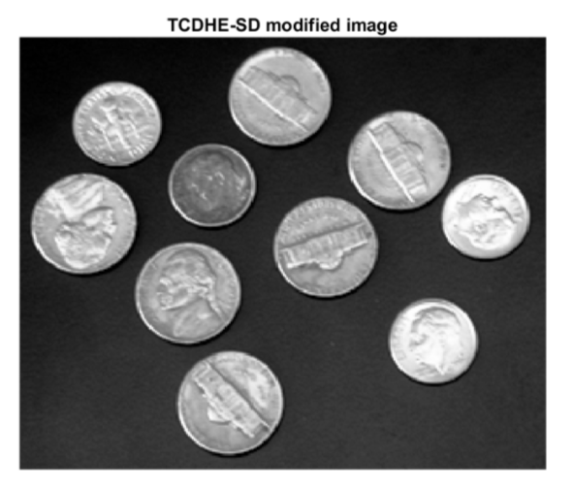
Histogram and Image Transformations

Slide 6
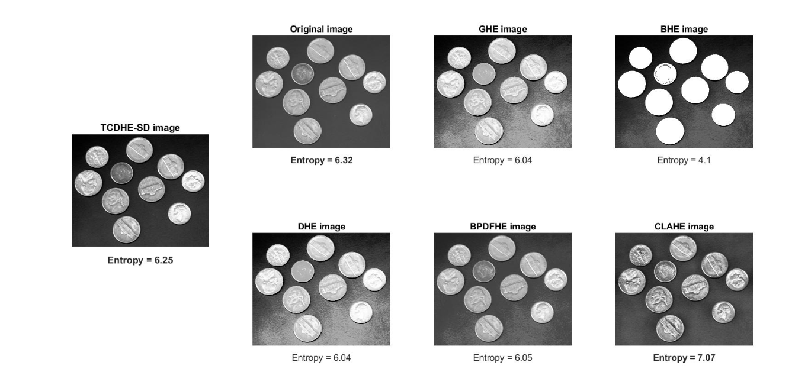
Comparisons between Equalization Techniques
Notes:
© Copyright PresentationGO.com – The free PowerPoint and Google Slides template library

Slide 7



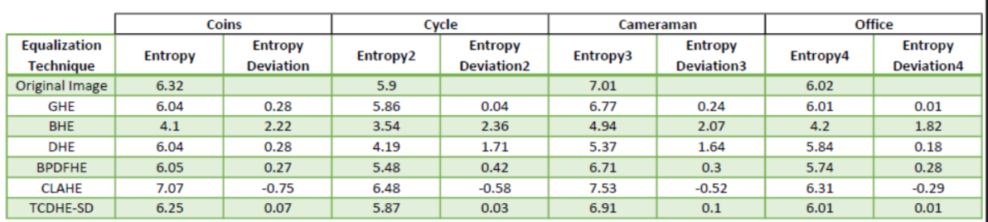
Why is Triple Clipped DHE Better?
01
02
03
Contrast Enhancement
Mean Brightness Preservation
Preservation of average information content

Slide 8
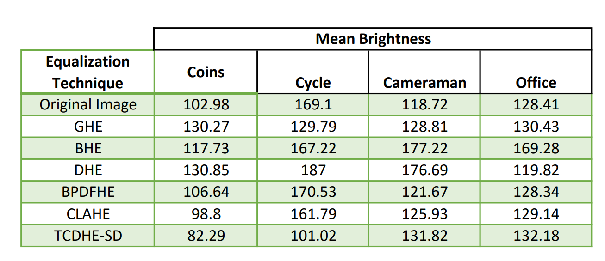
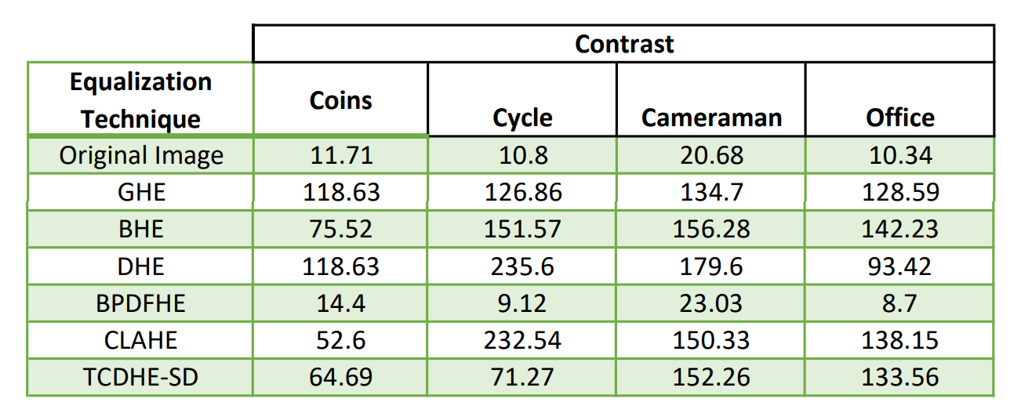

Why is Triple Clipped DHE Better?
https://github.com/Pvsaraf/DIP-Capstone-Project

Slide 9
Thank You! :)

