Slide 1
Trading Strategies and Dashboard
Strategies Team: Cole Astaire, Ramzi Mourtada, Uddipon Das
Dashboard Team: Ryan Booth, Ilio Benvenuti
CS399-F19 Project 6

Slide 2
Project 6
Methods
Dashboard

Slide 3
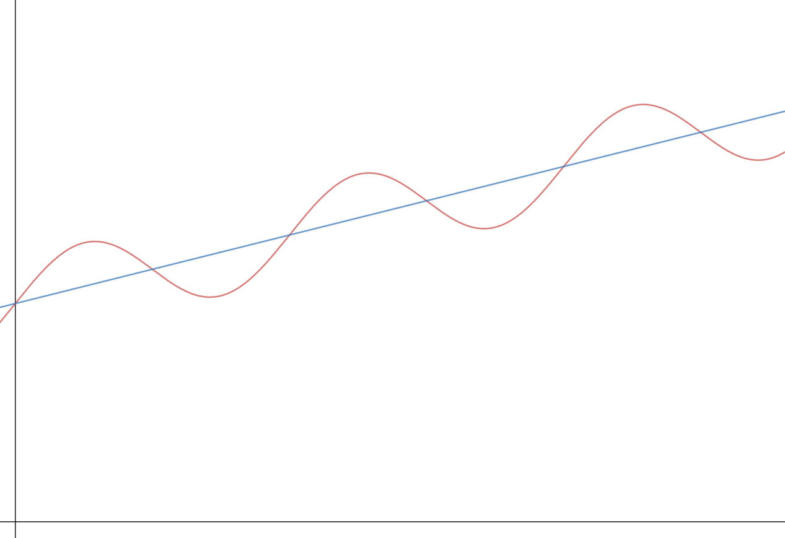

Short Trend Method
Buy
Sell
Average
Adjusted Close
Value
Day

Slide 4
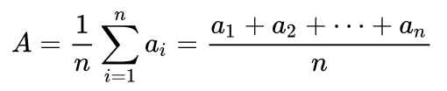
Mean Reversion Method
Buy
Sell
Average
Adjusted Close
Value
Day

Slide 5
Long-Hold Method
Buy
Sell
Average
Adjusted Close
90 Days
Value
Day

Slide 6
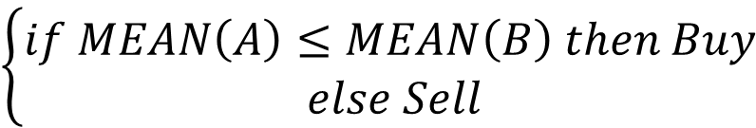
Bi-Trend Method
Buy
Sell
Average
Adjusted Close
(A)50 Days
Value
(B)200 Days
Day
$$\left\{\begin{aligned}if MEAN\left(A\right)≤MEAN\left(B\right) then Buy \\ else Sell\end{aligned}\right.$$

Slide 7
Project 6
Methods
Dashboard

Slide 8
Demo

Slide 9
Questions/Comments

