Slide 1

Indian Institute Of Technology,
Bhubaneswar
Industrial Training Defence ( EE4T001) Presentation
Design and Development of a Planar Flyback
Transformer for Isolated Power Supply
Applications
Mentor: Srinivas Bhaskar Karanki
Name: Pavan Wankhade Roll No: 22EE01040

Slide 2
Abstract
• Limitations of conventional wire-wound transformers
Bulky and heavy
Poor high-frequency performance
Higher copper and core losses
Limited power density
Benefits of planar transformers:
Compact and low-profile
High-frequency operation
Better thermal management
Higher power density & efficiency

Slide 3
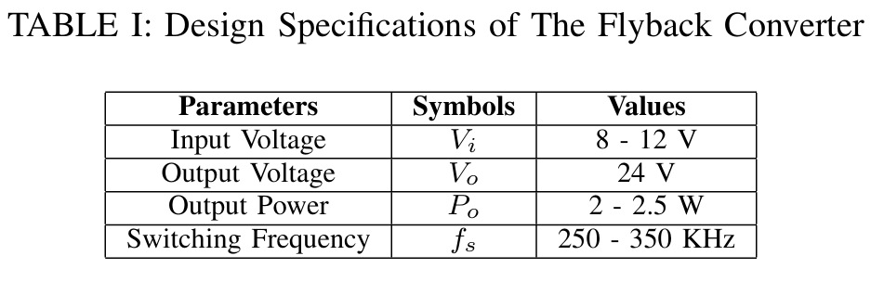
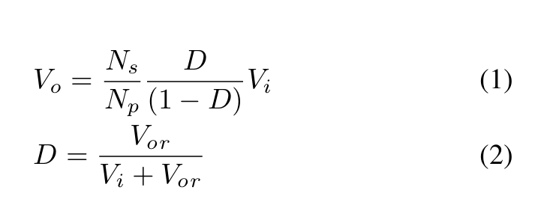
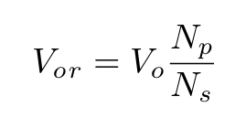
• Objective: 2.5W flyback converter with planar transformer • Tools used: Ansys PEmag, KiCad, Q3D, Maxwell 3D,Icepak, Simplorer, FreeCAD.
The flyback converter was designed by using Equations 1 &2. The reflected voltage, Vor was adjusted to 8V so that the duty cycle, D is 0.5.
The primary to secondary turns ratio, Np/ Ns is found to be 0.32 from below equation.

Slide 4
Design Equations & Core Geometry & Material Selection
BCM critical factor: K_crit = (1 - D)^2 =(2Ls)/(R*Ts)
Required secondary inductance : L_s = R_o · K_crit / (2·f_s)
L_s = 74.40 µH.
Primary inductance from turns: L_p = (N_p / N_s)^2 · L_s
→ L_p = 7.619 µH.
Why This Core Was Chosen
Material: Ferrite 3F3
Low core loss at high frequency (200–500 kHz).
Suitable for SMPS applications.
Core Shape: Planar E14/3.5/5
Optimized for planar windings (flat copper traces).
Compact size, low profile — good for PCB integration.
Magnetic Properties
High permeability for efficient flux linkage.
Bmax ~0.3 T ensures safe operation without saturation.
Thermal Advantage
Large surface area → better heat dissipation compared to wound cores.

Slide 5
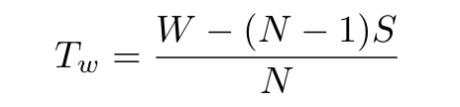
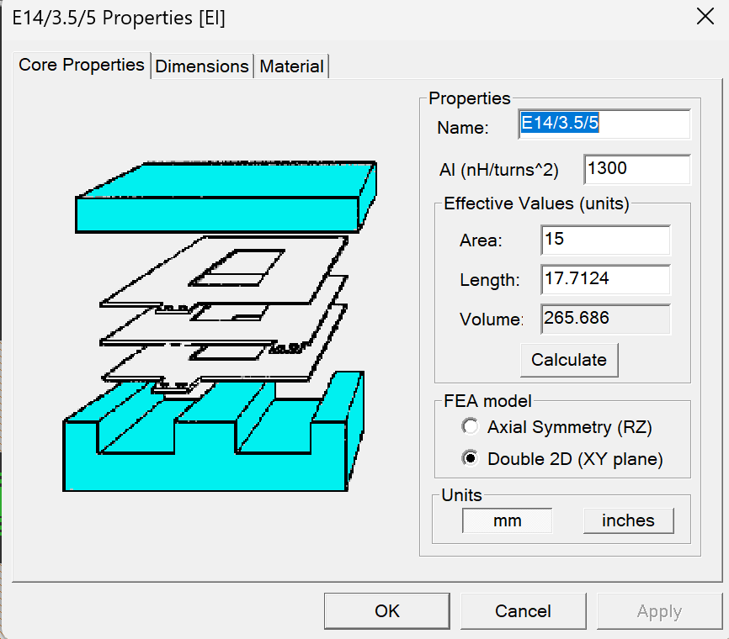
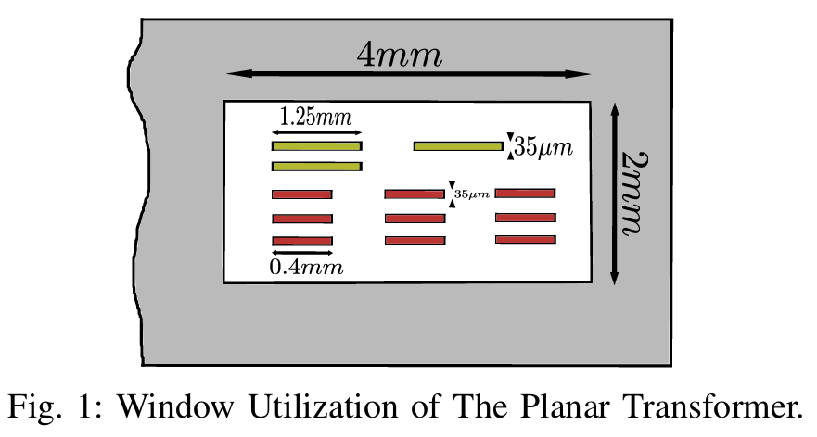
Use A_L (inductance factor): A_L = L / N^2 to find N
Decide turns: N_p = 3, N_s = 9 (from A_L and required ratio).
The maximum possible width of the PCB track
Is calculated from below equation.

Slide 6
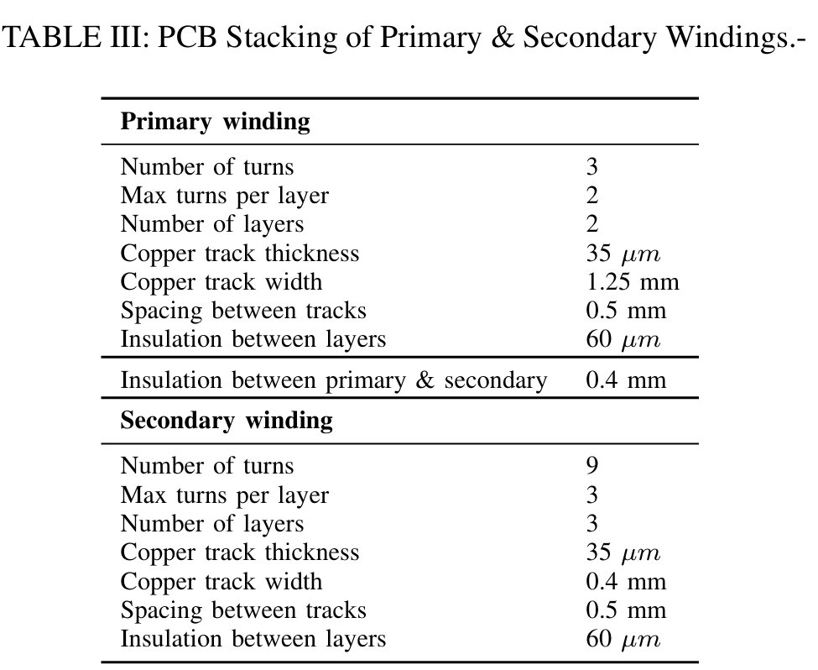
Planar Transformer Modelling

Slide 7


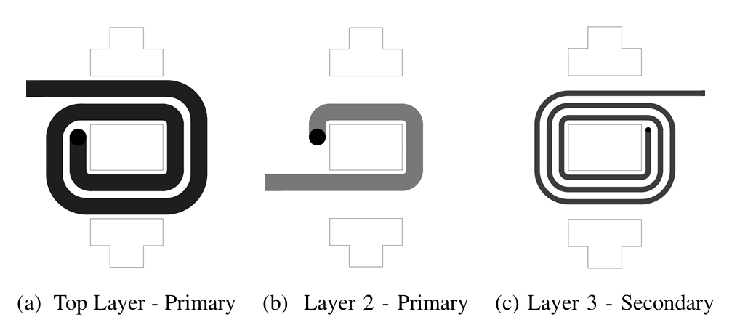
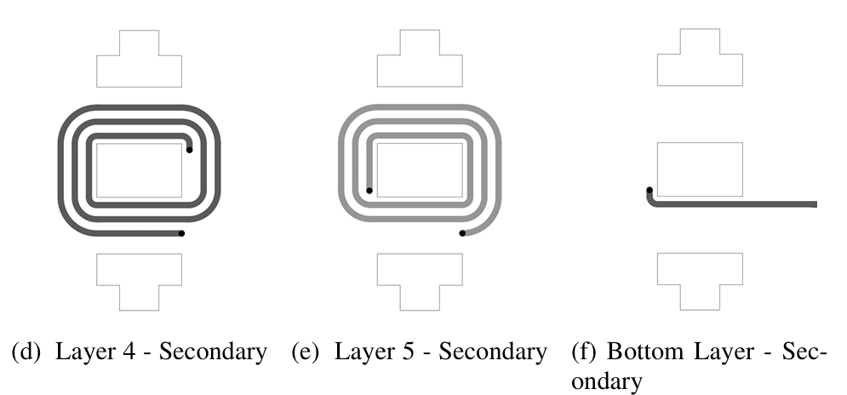
Planar Transformer 2D Model - Ansys PEmag.
Kicad design of planar transformer PCB.
Layers of planar transformer PCB.

Slide 8
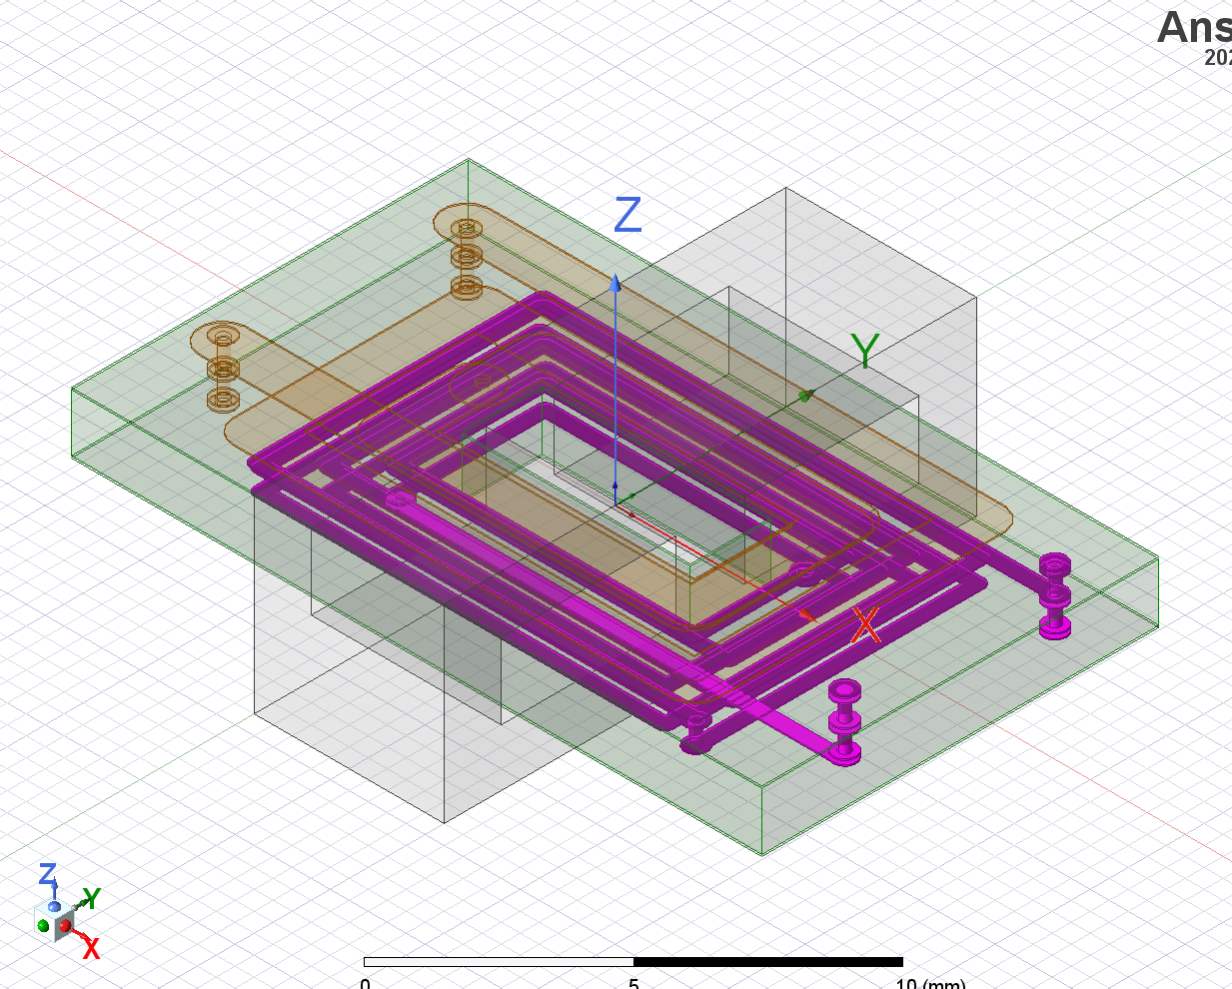
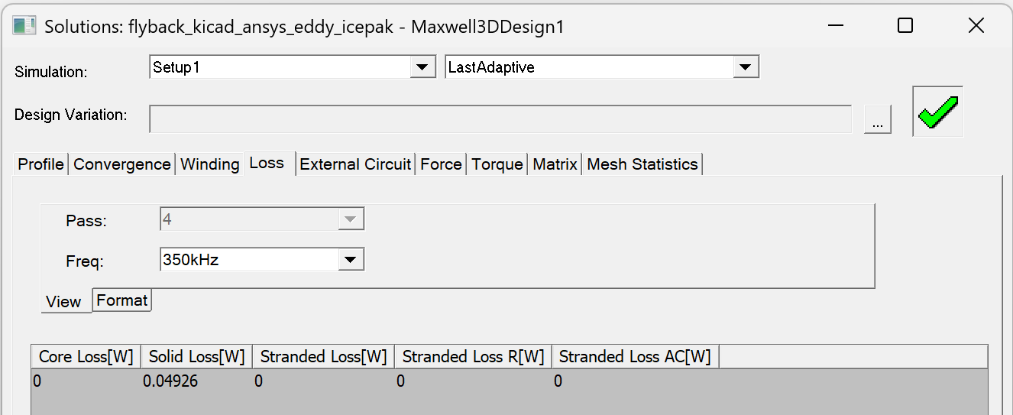
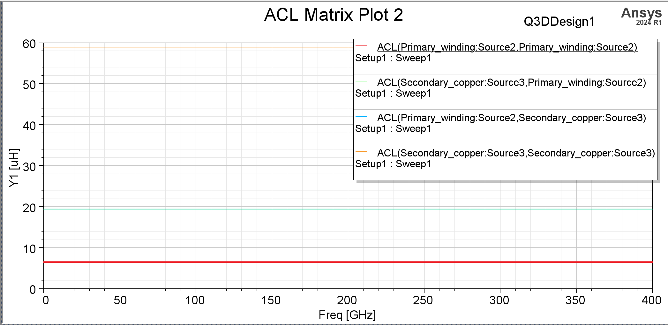
3D FEA Simulation Q3D and Eddy Current
Planar Transformer 3DModel-Ansy Q3D Extractor.
ACL Matrix Plot

Slide 9
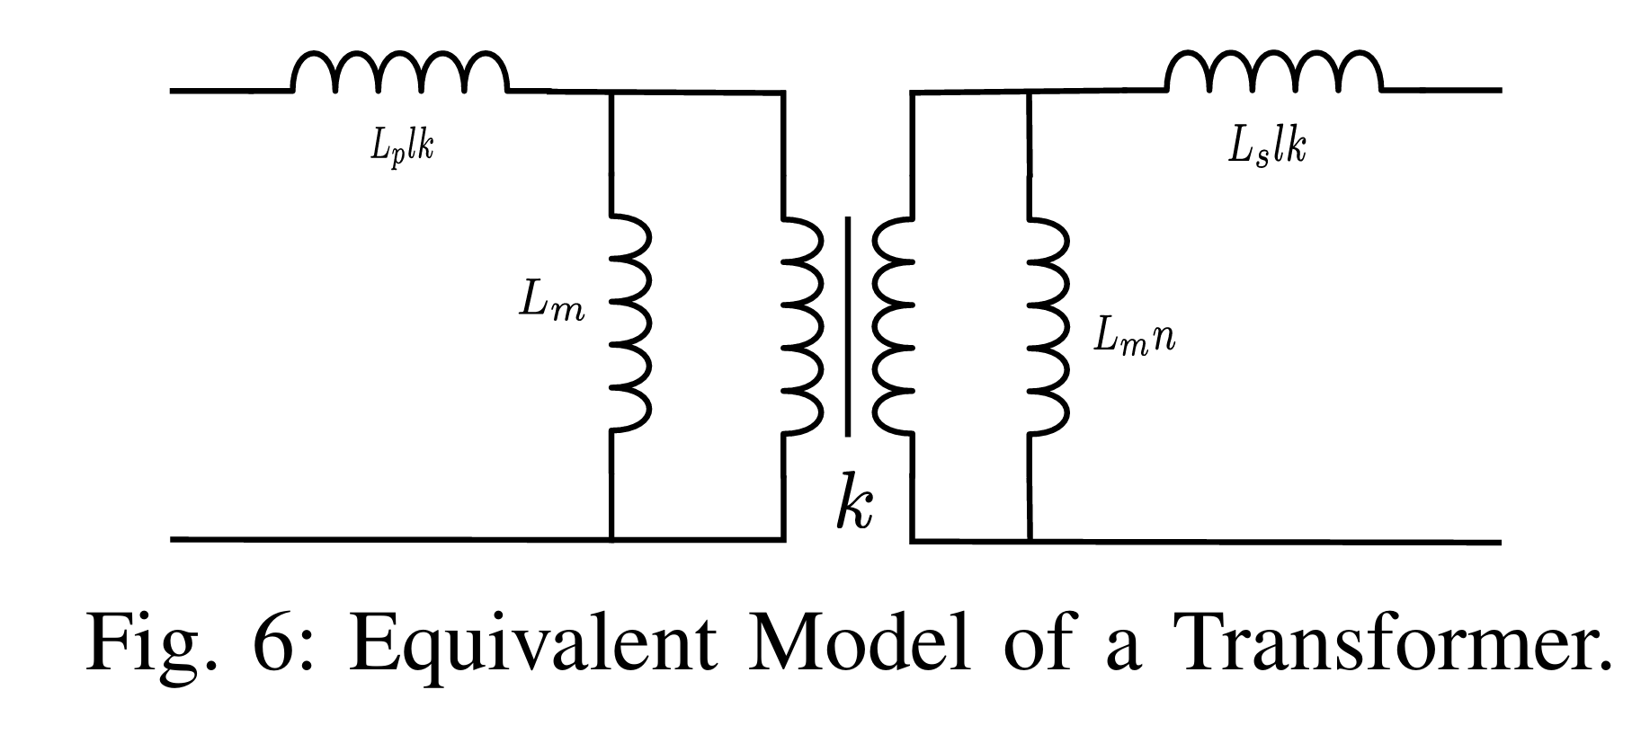
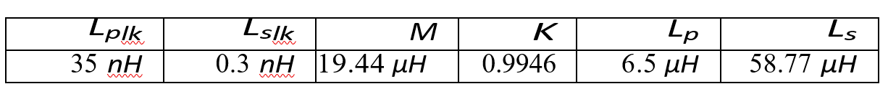
Lp, Ls, Leakage, Mutual, Inductance & Coupling Coffecient.
• Primary leakage: L_plk = L_p · (1 - k)
• Secondary leakage: L_slk = L_s · (1 - k)
• Coupling coefficient: k = M / sqrt(L_p.L_s)
Simulated Parameters of the planar flyback transformer

Slide 10
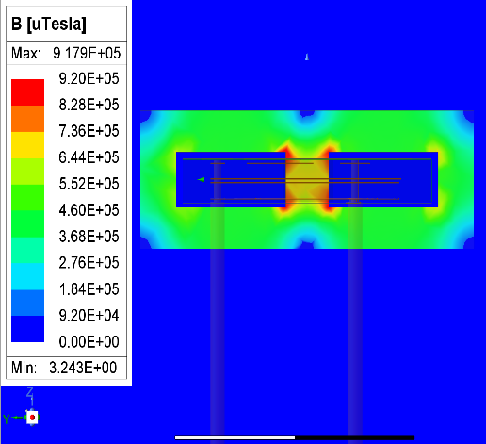
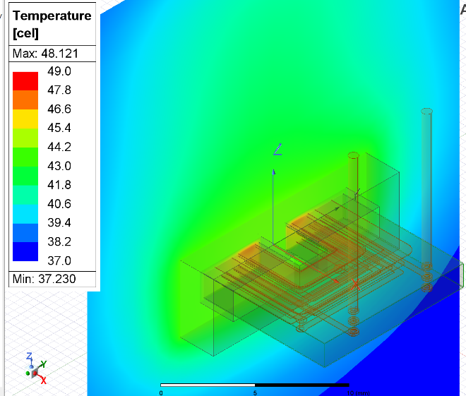
3D FEA Simulation Maxwell and Icepak
3D FEA Analysis of the planar transformer
Thermal Distribution of the Designed Planar Transformer .

Slide 11
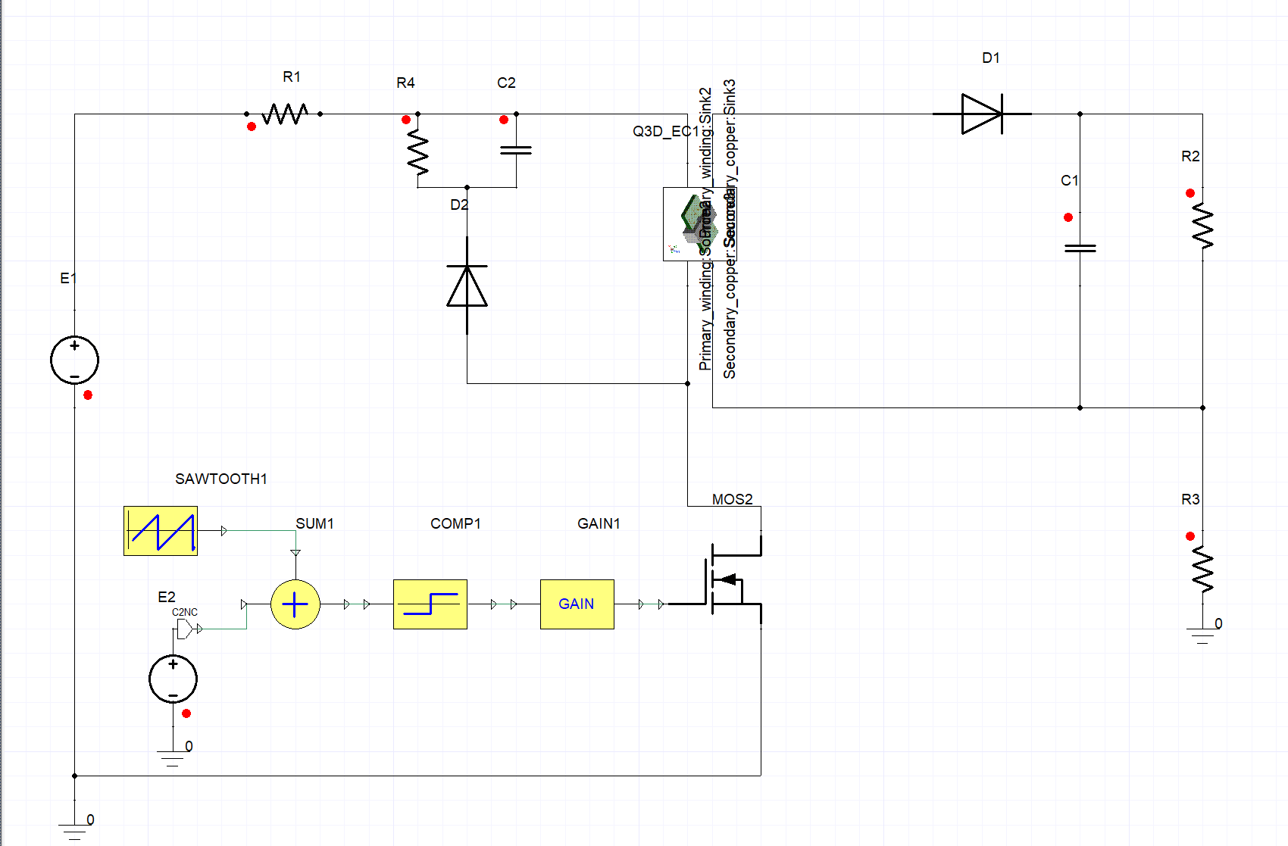
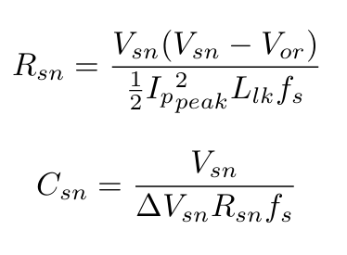
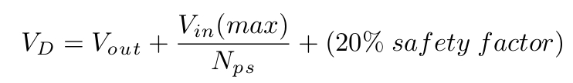
RCD Snubber Circuit & Simplorer Simulation
For the designed flyback converter circuit, 20V is considered to be the maximum Vds. So, Vsn=Vds−Vi=12V.
Ansys Simplorer Simulation Model.

Slide 12
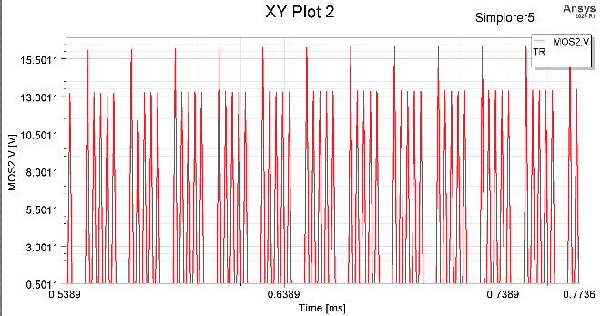
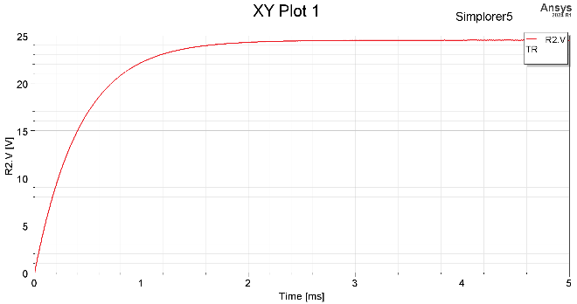
Simplorer Simulation
Drain to Source voltage, Vds of the MOSFET (V= 2.5/Div; Time = 0.1ms/Div).
b) Output voltage accross the load resistor (V =5V/Div; Time = 1mS/Div).

Slide 13
Conclusion
Successfully designed and analyzed a planar flyback transformer.
Covered complete workflow: Core design → PEmag → PCB → Q3D → Eddy current → Maxwell → Icepak→ Simplorer.
Achieved:
Compact and low-profile design.
Reduced leakage inductance through interleaving.
Safe thermal and electromagnetic performance.
Validated performance with multiphysics simulations.
Confirms planar magnetics as an efficient and reliable solution for high-frequency converters.

