Slide 1
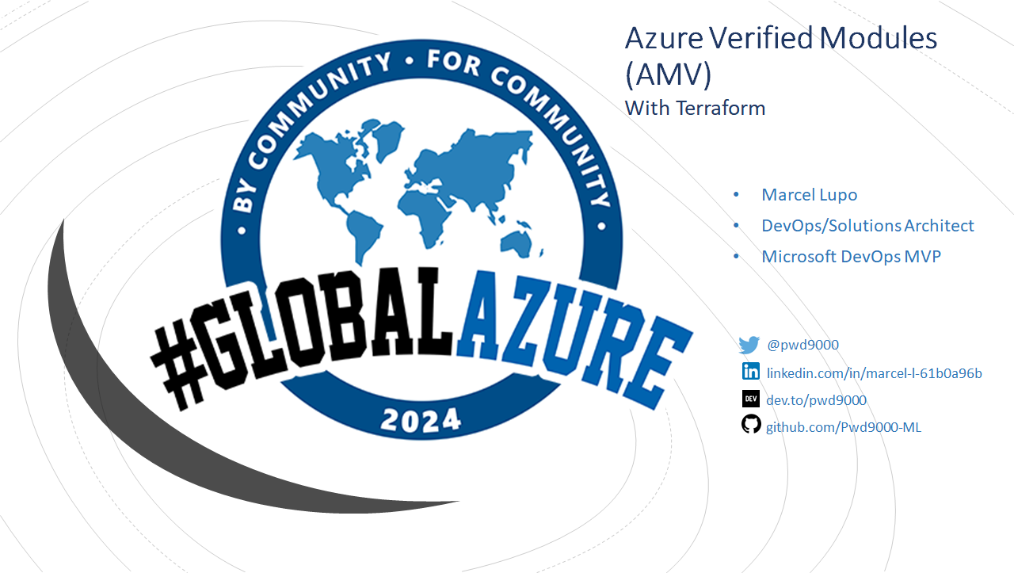
Notes:
This presentation was automatically generated by PowerPoint Copilot based on content found in this document: https://avanade.sharepoint.com/:w:/r/sites/UKISoftwareEngineeringTalentCommunity/_layouts/15/Doc.aspx?sourcedoc=%7B3834143E-D43B-420D-B803-5D37005A2FFF%7D&file=Azure%20Verified%20Modules.docx&action=default&mobileredirect=true AI-generated content may be incorrect.

Slide 2

Agenda
Introduction to Azure Verified Modules
Challenges with Infrastructure as Code
Benefits of Azure Verified Modules
Consistency in Features/Interfaces
Azure Verified Modules in Action
Notes:
Agenda * Introduction to Azure Verified Modules * Challenges with Infrastructure as Code * Benefits of Azure Verified Modules * Consistency in Features * Examples of Consistent Features * Azure Verified Modules in Action

Slide 3
Introduction to Azure Verified Modules
Curated set of infrastructure-as-code modules
Compliant with Azure Well-Architected Framework that follows best practice
Actively maintained, tested, and verified by Microsoft
Designed to build secure, scalable, and resilient cloud environments
Supported languages: Terraform and Bicep
Uniform and consistent configuration options
Same pattern and features across all modules (interfaces)
Notes:
Microsoft Azure Verified Modules are a set of infrastructure-as-code modules compliant with the Azure Well-Architected Framework. They are designed to help build secure, scalable, and resilient cloud environments on Azure. The usage of these modules in a Terraform configuration allows for uniform and consistent configuration options across multiple modules. Original Content: Microsoft Azure Verified Modules (AVM) are a curated set of infrastructure-as-code (IaC) modules that are compliant with the Azure Well-Architected Framework and is actively maintained, tested and verified by Microsoft. These modules are designed to help you build secure, scalable, and resilient cloud environments on Azure. The usage of Azure Verified Modules (AVM) in a Terraform configuration where configuration options are uniform and consistent across multiple modules, in terms of best practices and security. Implantation of uniform and consistent configuration options across multiple modules is a key feature of Azure Verified Modules (AVM). This is achieved by having the same configuration options across all modules in the same pattern and features, which makes it easier to use and understand the modules and attain a consistent configuration across all modules.

Slide 4
Challenges with Infrastructure as Code
Effort and time required to write and maintain modules
Community modules can be risky due to uncertainty about their upkeep
Feature development in fast-paced cloud environments like Azure where innovation is constant
Notes:
Infrastructure as Code, or IAC, has its challenges. One of the biggest is the effort required to write and maintain modules, especially in a fast-paced environment like Azure where innovation is constant. Original Content: With Infrastructure as Code (IAC) there are a few challenges. One of the biggest is the effort required to write and maintain modules, especially in a fast-paced environment like Azure where innovation is constant.

Slide 5
Benefits of Azure Verified Modules
Supported by Microsoft FTEs directly
Modules undergo thorough testing to ensure functionality
Modules follow consistent design patterns and features which improve usability and maintainability (interfaces)
“Defaults” are based on secure and best practices
Notes:
Microsoft introduced Azure Verified Modules to unify and regulate Infrastructure-as-Code modules. These modules are supported by Microsoft FTEs, undergo thorough testing, and follow consistent design patterns for improved usability and maintainability. Original Content: Many Microsoft partners, developers and community supporter develop their own modules, but the level of maintenance and support can vary widely. Relying on community-shared modules can be risky due to uncertainty about their upkeep. That’s where Microsoft saw the opportunity to invest time, people, and resources to address this challenge, Microsoft introduced Azure Verified Modules (AVM). AVM provides modules that are: · Supported by Microsoft FTEs directly. · Modules undergo thorough testing to ensure functionality. · Modules follow consistent design patterns and features which improve usability and maintainability. AVM is a Microsoft project to unify and regulate Infrastructure-as-Code modules, using both internal and external communities. These modules act as modular components for deploying Azure resources and extensions in a uniform way.

Slide 6
Consistency in Features
AVM modules have consistent configuration features
Resource modules support optional features/extension
Top-level variables/parameter are named the same in every module
Consistent naming conventions facilitate seamless integration and usage
Examples of consistent interfaces include:
Diagnostic Settings
Role Assignments
Resource Locks
Tags
Managed Identities
Private Endpoints
Customer Managed Keys
Azure Monitor Alerts
Notes:
AVM modules have consistent configuration features, including optional features and extension resources. Top-level variables and parameters are named the same in every module, and AVM interfaces act as a shim over the existing API. This consistency facilitates seamless integration and usage. Original Content: Azure verified module’s – consistency in features AVM modules have consistent configuration features. It is necessary to understand these features regardless of if you use or write AVM modules. Resource modules support below optional features/extension resources, as specified, if it is supported by the primary resource. The top-level variable/parameter are also named the same. So, we have the same names in every module. AVM interfaces acts as a shim over the existing API, ensuring consistent naming conventions. This consistency extends from the AVM modules to the underlying API, facilitating seamless integration and usage. This is a great benefit. AVM is worrying about providing the right data passed in the underlying api. Examples of Consistent features to name a few: Lets look at this in action:

Slide 7



Azure Verified Modules in Action
GitHub Demo
Azure Verified Modules
Notes:
This slide is about Azure Verified Modules, which can be found on Github. Original Content: https://github.com/Pwd9000-ML/Azure-Verified-Modules

