Slide 1





Marcel Lupo
Solutions and DevOps Architect @ Avanade
Dual Category Microsoft MVP:
Developer Technologies
Azure
@pwd9000
linkedin.com/in/marcel-l-61b0a96b
dev.to/pwd9000
github.com/Pwd9000-ML

Slide 2
Agenda
Introduction to GitHub Secrets
Using GitHub Secrets (Basic)
Why is it important?
Common Pitfalls to Avoid
Using GitHub Secrets (With Azure Key Vault)
Access Control and Best Practices

Slide 3
Introduction to GitHub Secrets
Importance of Secure Information Handling
Crucial for Development: Example – Protecting API keys or credentials required in your Codebase.
Prevents Unauthorised Access: Avoids data breaches by obtaining secrets committed to code.
Maintains Trust: Ensures compliance and user trust in your application.
What are GitHub Secrets?
Secure Storage: Encrypts sensitive data.
Authorised Access: Only accessible to approved workflows and Users.
Easy Integration: Fits seamlessly into CI/CD automation workflows

Slide 4
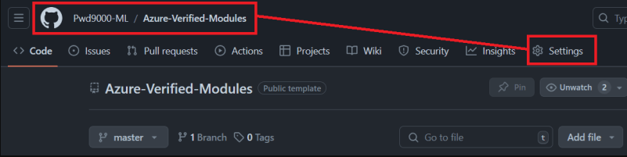
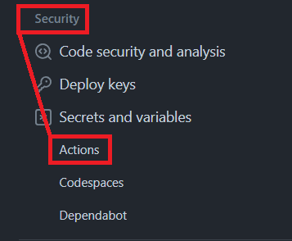
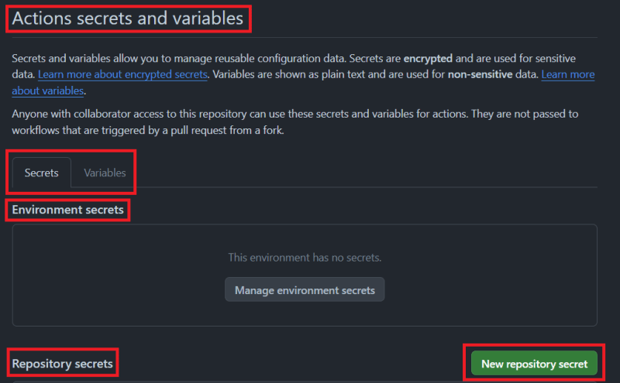
Using GitHub Secrets (Basic)
2
1
3
4
Environment Secrets: At the environment level, requiring approval for access.
Organisation Secrets: Shared across repositories with access policies; not available for free private repositories.
Repository Secrets: Stored in a single repository, used by workflows in the same repository, not available to forks.

Slide 5
Why is it important?
Benefits of Using GitHub Secrets
Ensures encryption of sensitive data.
Access restricted to authorised workflows.
Prevents unauthorised access and potential data breaches.
Essential for Security and Integrity
Maintains the security and integrity of applications and codebase.

Slide 6
Common Pitfalls to Avoid
Hardcoding Secrets: Never hardcode secrets in your codebase. Always use GitHub Secrets or secret management tools such as Azure Key Vault.
Improper Access Control: Ensure that only necessary workflows and users have access to secrets.
Exposing Secrets in Logs: Be cautious not to print secrets in logs, logs can be accessed by unauthorised users.
Note: As of now, GitHub still requires Admin access to create and manage secrets at both the repository and organization levels. This means that team members without Admin access cannot see or manage secrets through the UI

Slide 7

Using GitHub SecretS… With… Azure Key Vault

Slide 8
Access Control and Best Practices
Using Azure Key Vault allows you to store secrets in a centralised location, separate from your codebase, apart from Organization Secrets, it addresses the limitation with Repository Secrets where secrets have to be set in each unique repository, making secrets management/rotation cumbersome.
Using Azure Key Vault integration means secrets can be accessed by multiple repositories and workflows, secret rotation can be managed centrally.
Access to secrets can be controlled using Azure RBAC/IAM instead of assigning Admin access over repos.
Secrets history can be maintained for auditing purposes and previous versions of secrets can be restored if needed.
Integration with Azure Key Vault with GitHub can be done by using passwordless/federation using OIDC (Open ID Connect)

Slide 9



Best practices for using github secrets
GitHub Demo REPO
Github pro tips blog

