Slide 1





Passwordless authentication using OIDC
With GitHub and Azure
Marcel Lupo
DevOps/Solutions Architect
Microsoft DevOps MVP
HashiCorp Ambassador
@pwd9000
linkedin.com/in/marcel-l-61b0a96b
dev.to/pwd9000
github.com/Pwd9000-ML

Slide 2

What is OpenID Connect?
OIDC is an authentication protocol that provides an identity layer on top of the OAuth 2.0 authorization protocol. It enables applications to verify the identity of users and to obtain basic profile information in a standardised manner.
It allows users to sign into multiple websites, apps, and services with one set of credentials, improving security and simplifying the user experience.
This Photo by Unknown Author is licensed under CC BY-SA-NC

Slide 3
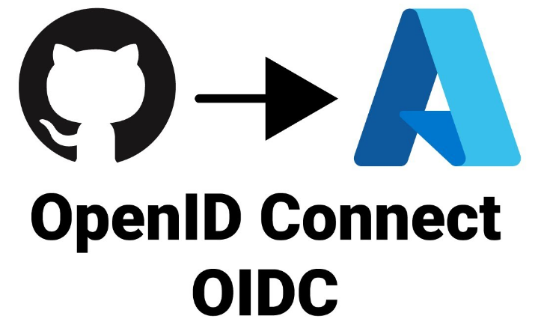
What are the benefits of using OIDC with GitHub and Azure?

Slide 4

Single Sign-On (SSO):
To simplify the user experience and reduce the cognitive load of remembering multiple usernames and passwords.
Integration with Existing Identity Providers:
Both GitHub and Azure have extensive user bases so by federating authentication between them can allow users to authenticate seamlessly using identity driven auth
Security:
OIDC is a secure and standardised protocol for authentication..
Scalability and Consistency:
OIDC provides a scalable and consistent solution for managing identity authentication across different applications.
Core Functionality:
By using OIDC allows your applications secure authentication between GitHub and Azure.

Slide 5

DEMO:
https://github.com/Pwd9000-ML/GitHub-Azure-2023-OIDC-Demo
This Photo by Unknown Author is licensed under CC BY-SA-NC

