Slide 1
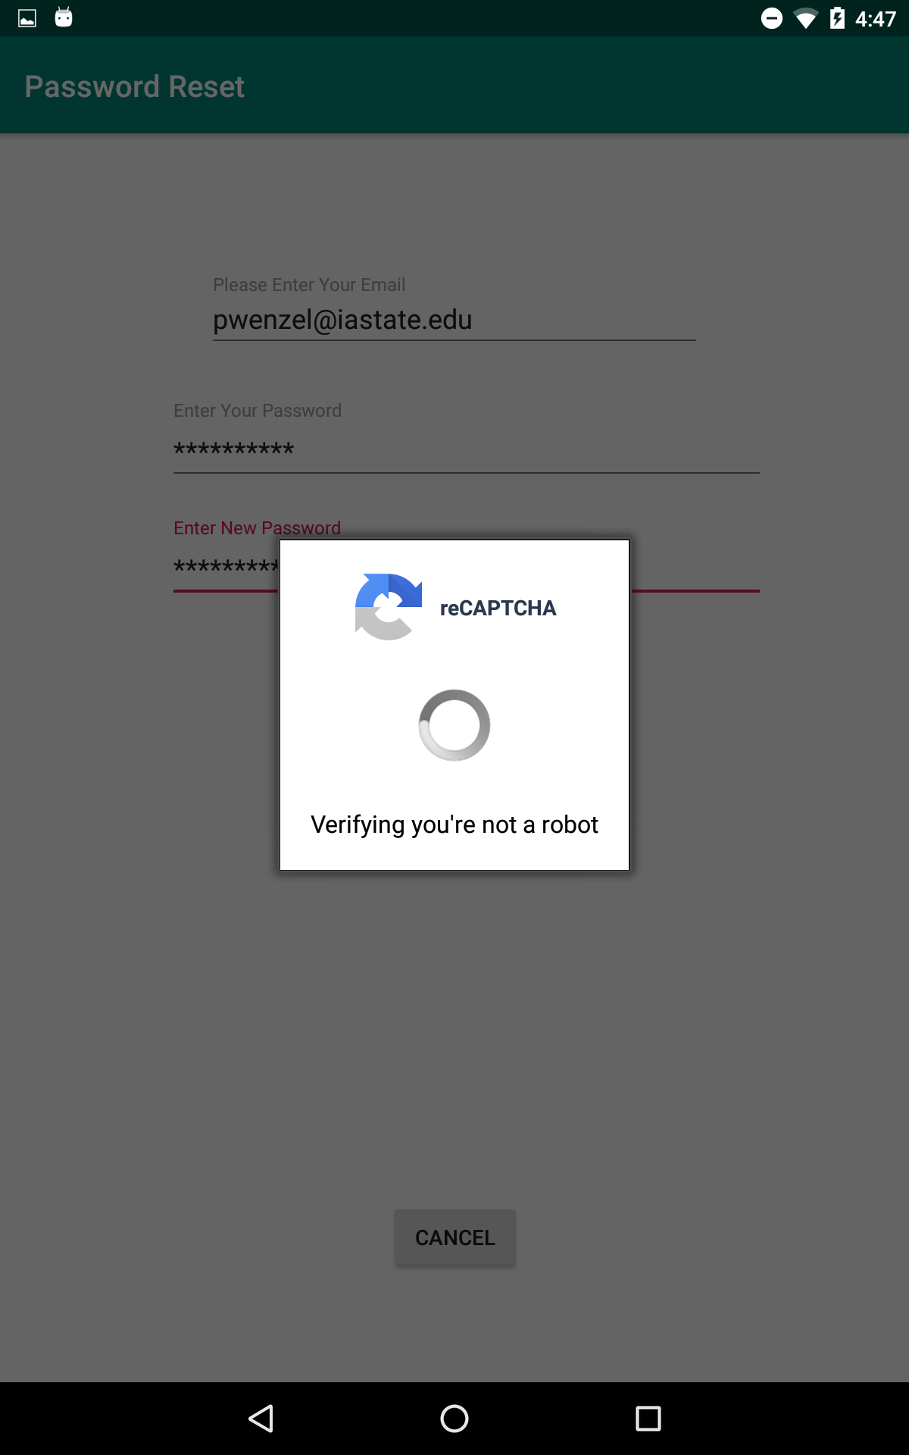
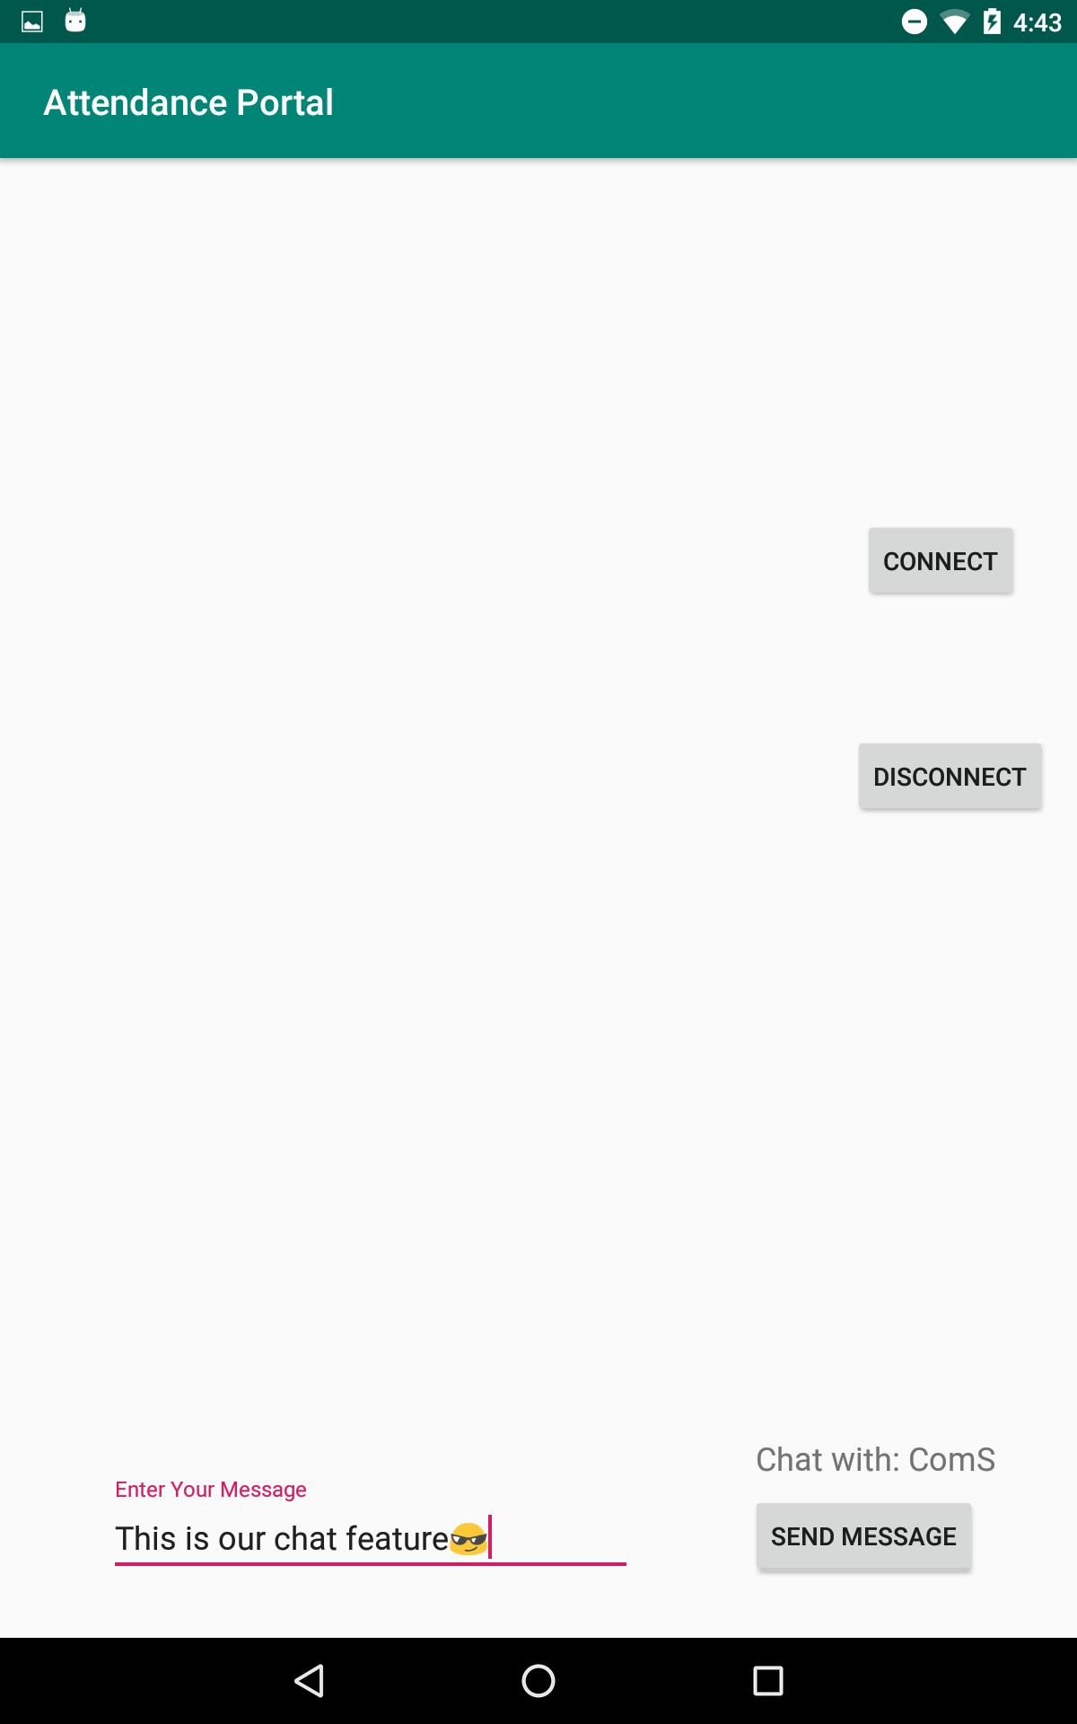
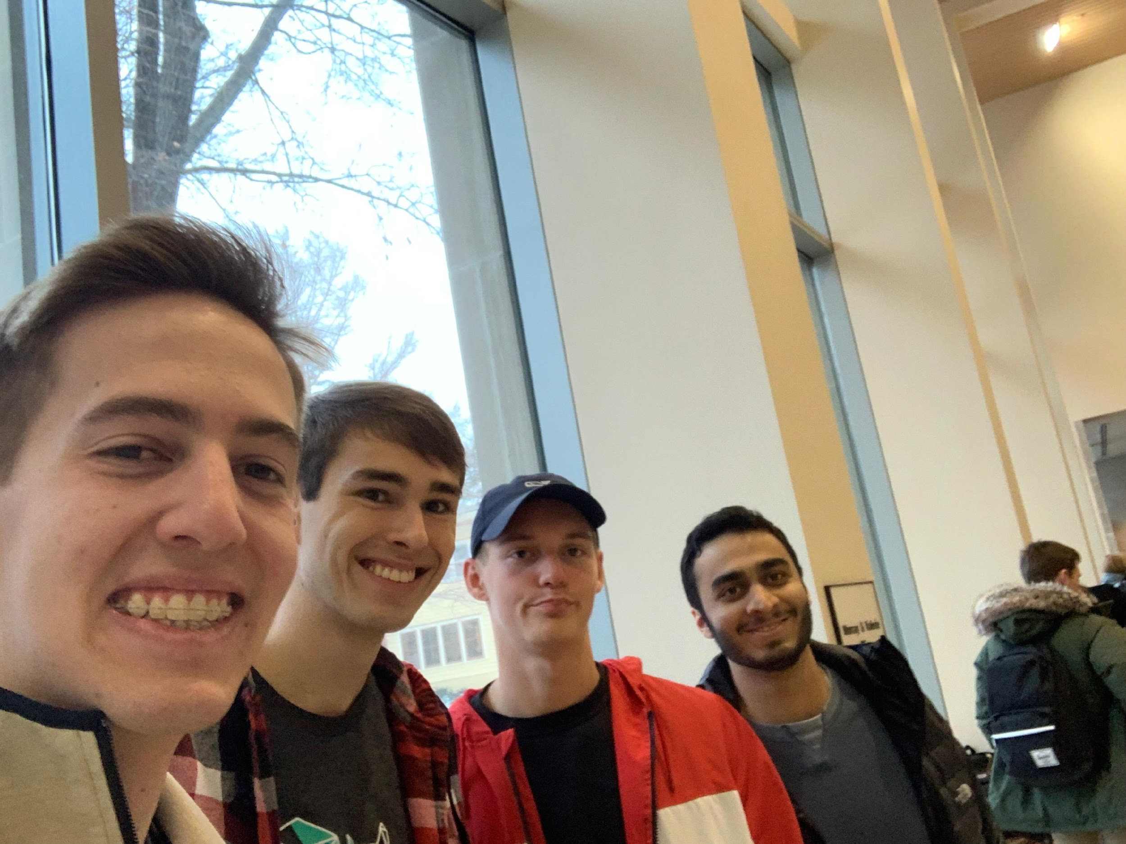
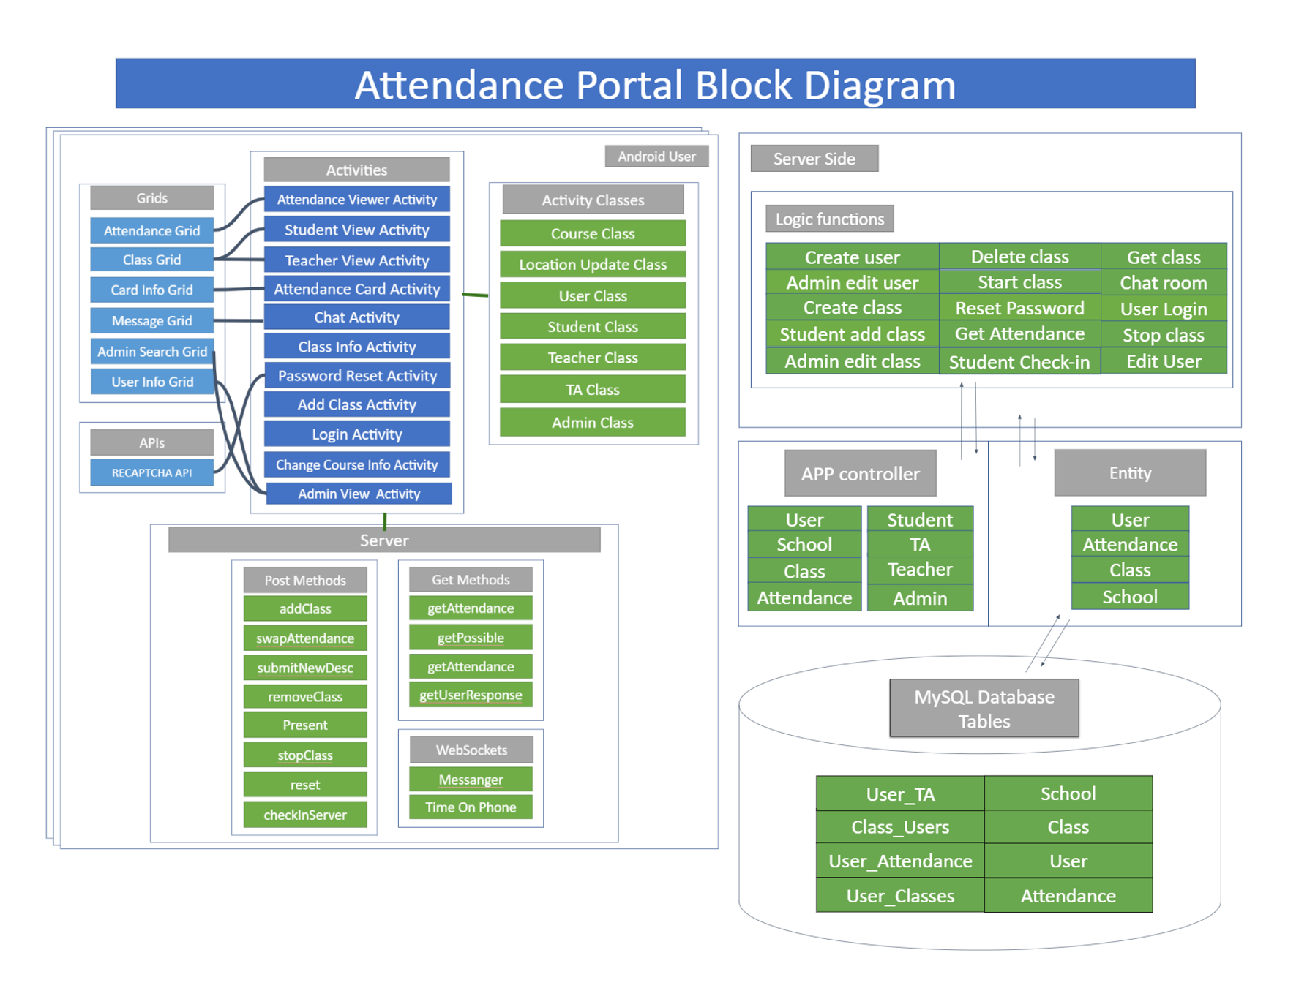
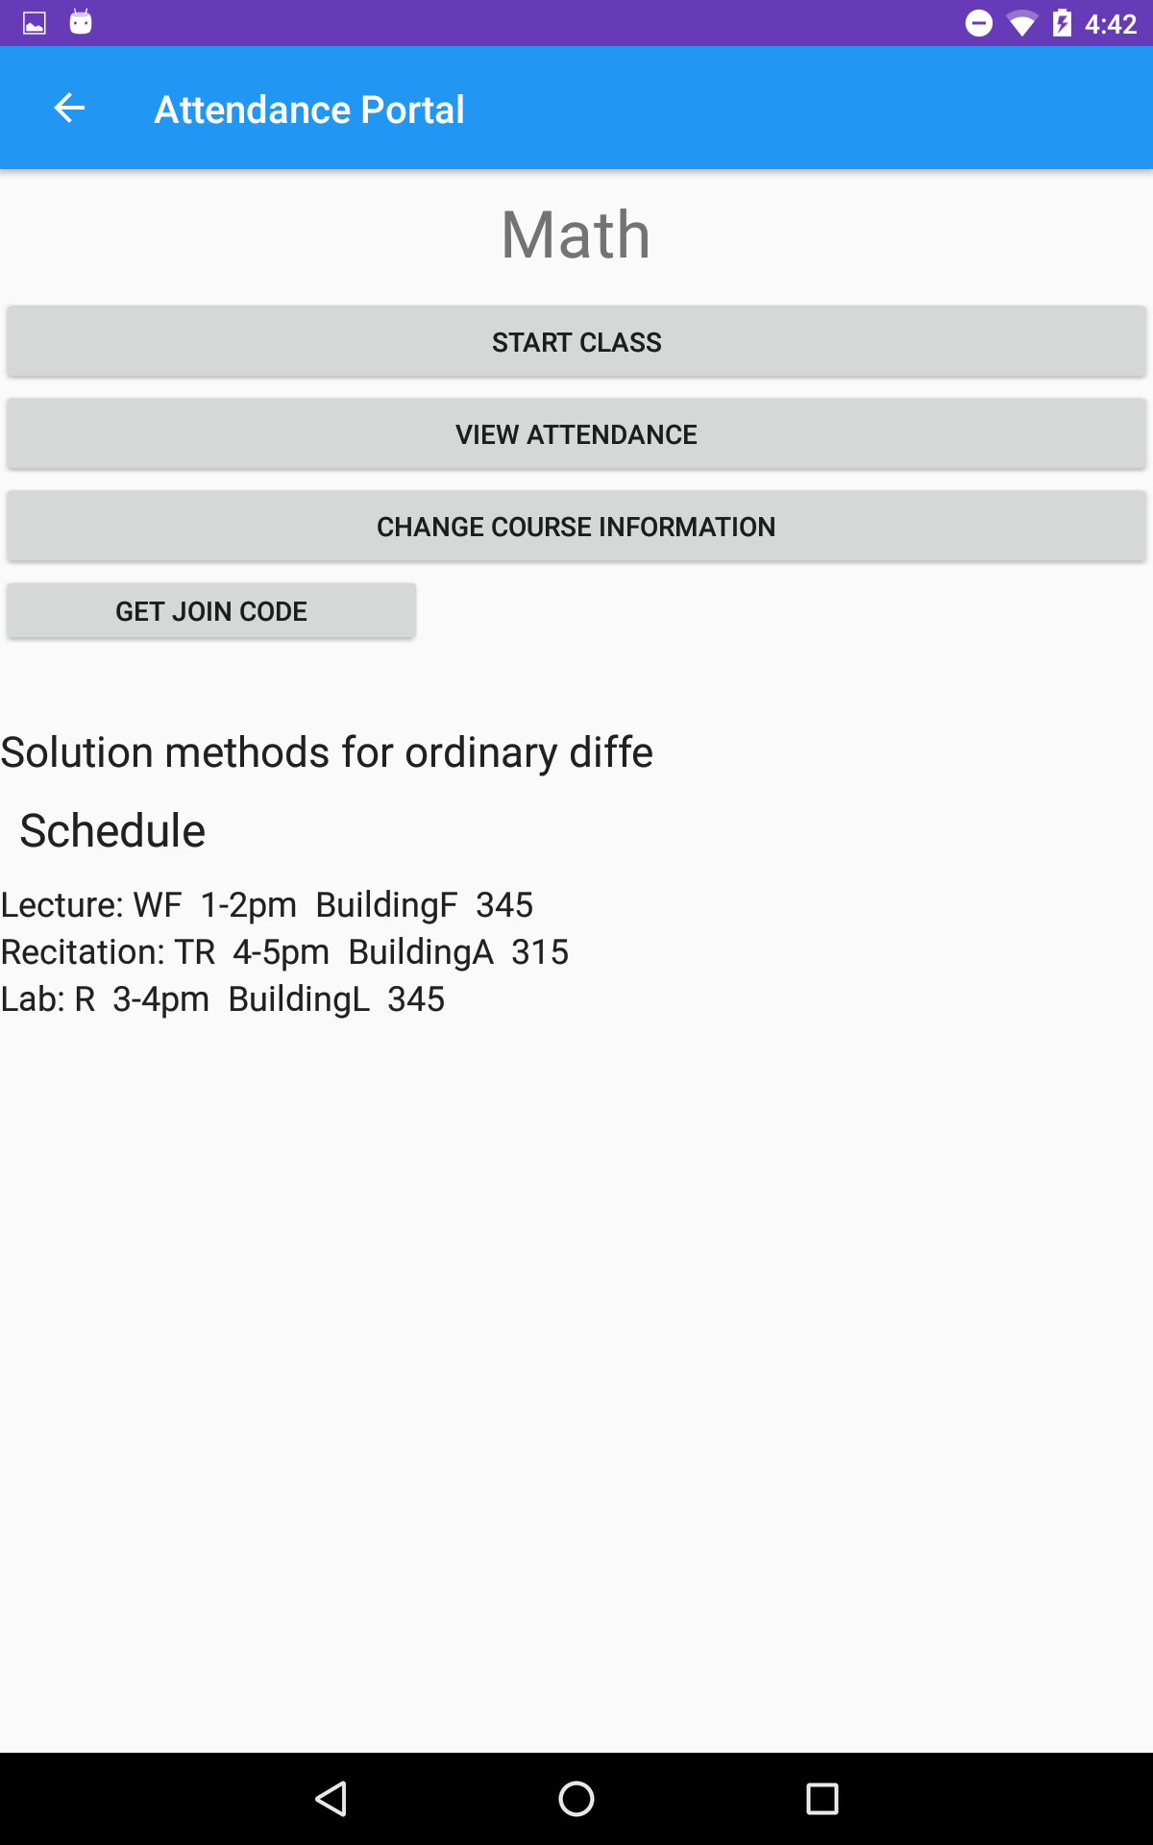
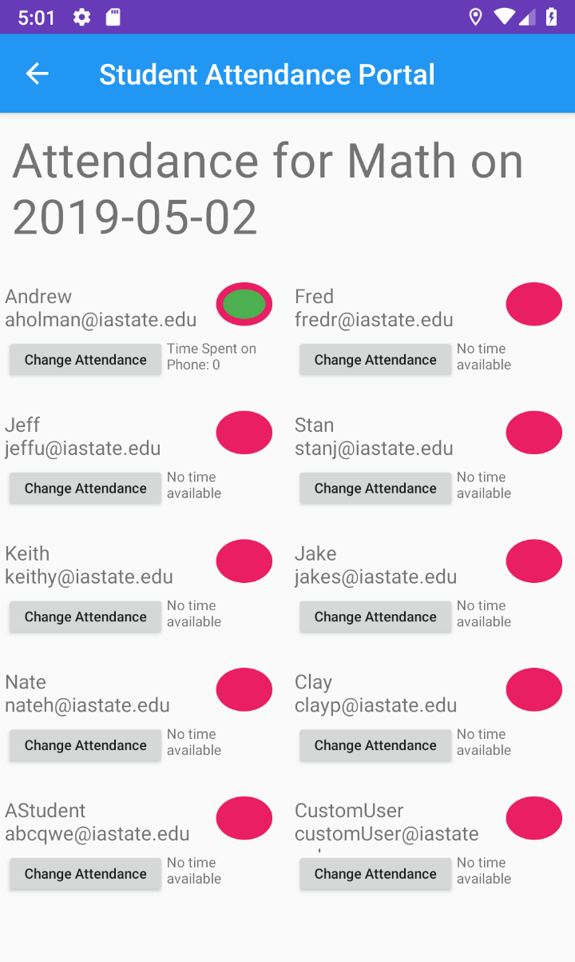
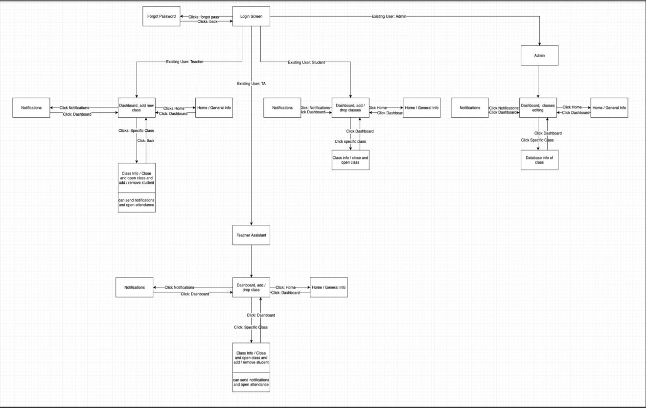
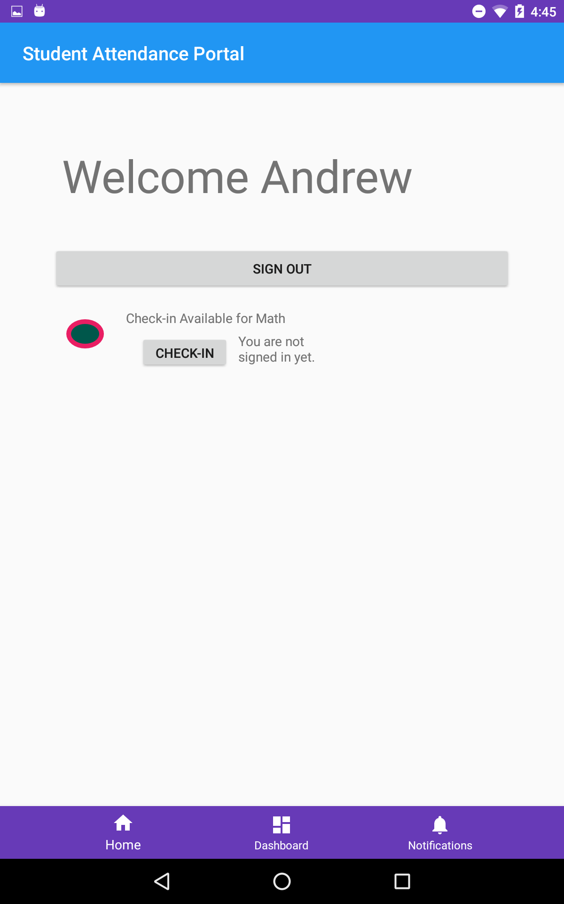
Attendance Portal
Key Design Decisions:
Making a universal dashboard for all our user types
Work distribution on the front end was split between new app utilities and required functions
Each user type was saved as a string rather than assigning each their own object type
Saving the date and time on the server side as a meaningful object type (i.e. Instant)
Project Description:
Attendance Portal is primarily a utility app that is used by students and teachers. For students, it was designed to let them check into a class and message with their peers. On the other hand, teachers could use the app to keep track of their student’s daily attendance, phone use in class, and verify a student’s location during class time.
Actors:
Students
Teacher Assistants
Teachers
Administrators
Use Cases:
Teacher taking attendance during class
Teacher manually changes the attendance of a student
Administrator changes a classes meeting times
Administrator removes a user from a class
Student messages a peer
Student gets to class and checks to see if he is able to check in yet
Patrick Wenzel: Sophomore (CPR E)
Andrew Holman: Sophomore (CPR E)
Josh Loftus: Sophomore (COM S)
Saoud Alkaabi: Sophomore (S E)
Com S 309 Spring 2019
What Went Right:
Teachers can add or create a class
Students can message other students
Recaptcha checks if a user is valid
Attendance is properly recorded and displayed for both students and teachers
What Went Wrong:
Group messaging didn’t work how we wanted
Inefficient communication between the UI and the server
Redundant methods in backend controllers
Beginning user interfaces were simple and unintuitive
Lessons Learned:
Communication is very important
Need to be flexible with vision and work times
Frontend workers are now able to use Volley and Android Studios effectively
Backend learned about interactions between Spring and MySql
Module interfaces descriptions:
Dashboard Interface:
The Dashboard interface is been using by both student and teacher for their dashboard.
Chat Interface:
We used chat interface in multiple different places. We use it in the chatroom and attending page.
Searching Interface:
- This interface is used for searching for classes. Both of the student and the teacher use it in different places. The teacher uses it for searching for attendance..

