Slide 1
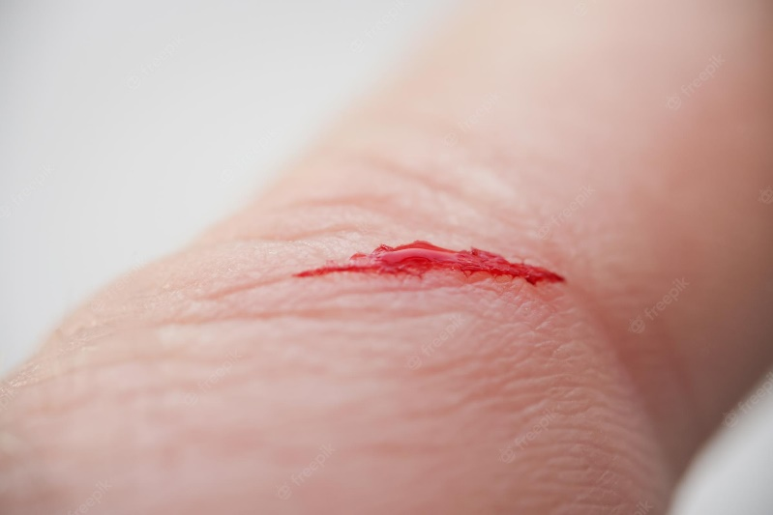
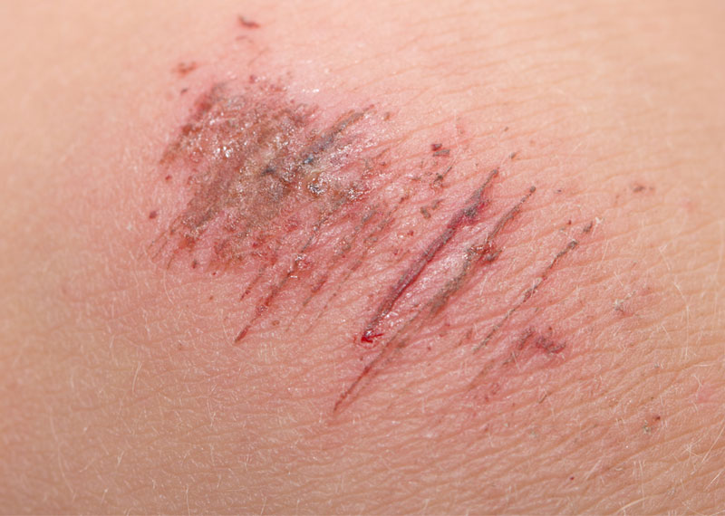
Cuts/Abrasions

Slide 2
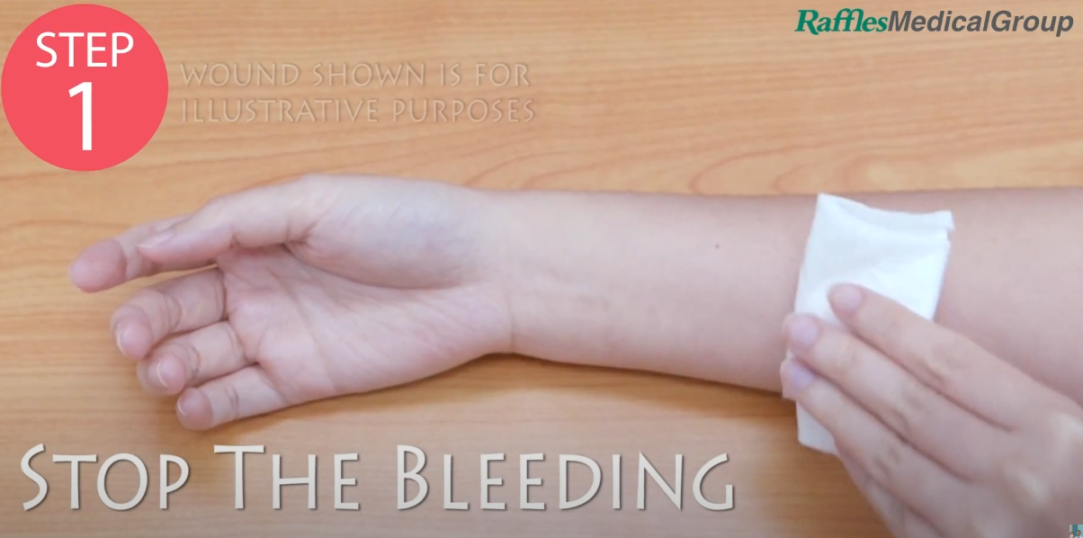
Step 1: Stop the bleeding
Apply pressure with a clean bandage or cloth, and keep that part of your body elevated above the heart, if possible
0:13

Slide 3
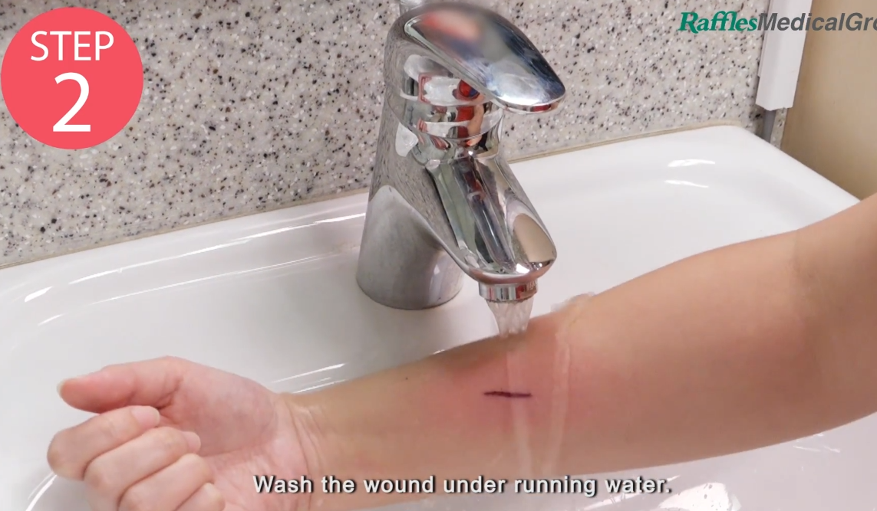
Step 2: Clean the wound
Rinse the wound with water. Keeping the wound under running tap water will reduce the risk of infection.
If water is not available, use betadine solution to clean the wound.
0:20

Slide 4
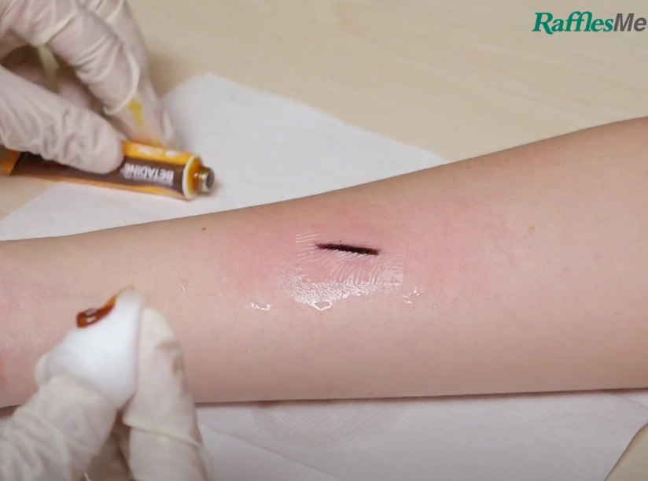
Step 3: Apply antibiotic
Apply a thin layer of an antibiotic ointment.
0:31

Slide 5
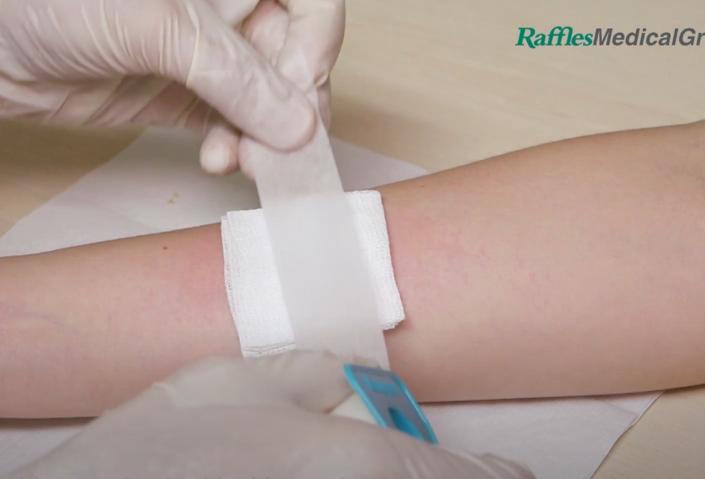
Step 4: Cover the wound
Apply a thin bandage or rolled gauze directly over the wound.
Secure with micropore tape on the sides of the wound dressing.
0:36

Slide 6
Sources:
Video source: https://www.youtube.com/watch?v=AhANvBB9hz0
Steps source(s): https://www.mayoclinic.org/first-aid/first-aid-cuts/basics/art-20056711
https://www.piedmont.org/living-better/first-aid-101-how-to-treat-a-cut
Image source(s): https://galnet.fandom.com/wiki/ABRASIONS_AND_ITS_TYPES
https://www.freepik.com/premium-photo/injured-persons-finger-with-bleeding-open-cut-wound_21522096.htm
https://www.wikihow.com/images/thumb/e/e1/Treat-a-Puncture-Wound-Step-10-Version-4.jpg/aid189531-v4-728px-Treat-a-Puncture-Wound-Step-10-Version-4.jpg.webp
https://els-jbs-prod-cdn.jbs.elsevierhealth.com/cms/attachment/36766d86-072a-4b0a-a406-e69ce1d18648/gr1_lrg.jpg

