Slide 1
SC1015 Group 8
Members: Daniel, Jonathan, Shunya
Notes:
Hi, I’m Daniel from group 8, consisting of myself, Jonathan and Shunya, and today I will be presenting on our mini project.

Slide 2
Table of Contents
Our Problem
Identified Issue and Relevance
Data Cleaning
Preparation of Data
Exploratory Data Analysis
Data exploration
Conclusion
Determined Factors and Insights Gained
Machine Learning
Core Analysis and Approach
Notes:
Firstly, a list of our presentation outline, where we will cover the problem we identified, what datasets we used, how we cleaned it, as well as our analysis and choice of ML methods, before wrapping it up with our conclusions and insights.

Slide 3

Topic: Family Planning
Which country would be the best to live in for a family?
Notes:
For our project, our main consideration in mind was how we determine which country would be best to live in for a family.

Slide 4
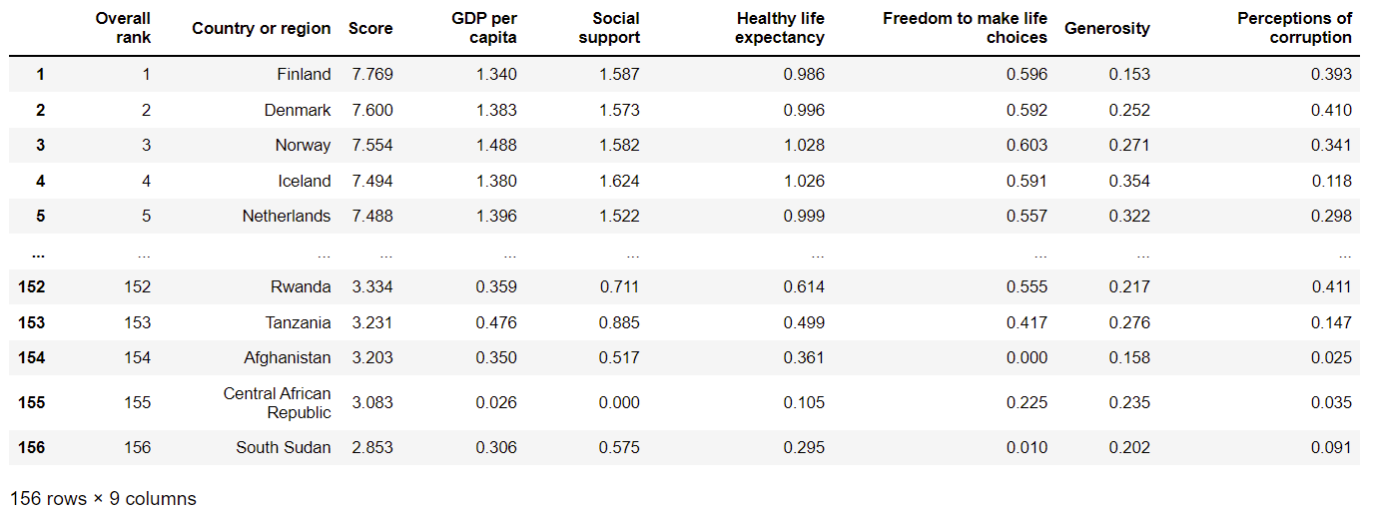
Dataset: Happiness 2019
Notes:
The dataset we look to first, is from a 2019 world happiness report. It consists of the list of countries, a finalised score and other columns that contribute to the score. We opted for happiness as it makes most sense that a family would choose a country that has high happiness.

Slide 5




Additional Datasets
Life Expectancy
Education
Peacefulness
Unemployment
Notes:
We also explored 4 more datasets, such as Life Expectancy of countries, education quality, the level of peace in countries, as well as the unemployment rate of countries, as we felt that these would greatly influence how a family plans to live in a country

Slide 6

Dataset Cleaning
Using values from the most recent year:
Year of data used is 2019
Chronological Data is already reflected in most recent data
Our problem looks at current trend and state
Unnecessary columns removed:
Non-contributive columns removed
Left Index scores of each variables and respective country
Notes:
We have a lot of data based on a range of years, but since chronological data does not apply much to our issue and analysis, we instead look at the most recent data. Furthermore we pinpoint and filter out unnecessary data such as empty columns and factors contributing towards the index score of each dataset, only leaving out country names and their respective scores for Happiness, life expectancy, education, peacefulness, and unemployment rate.

Slide 7
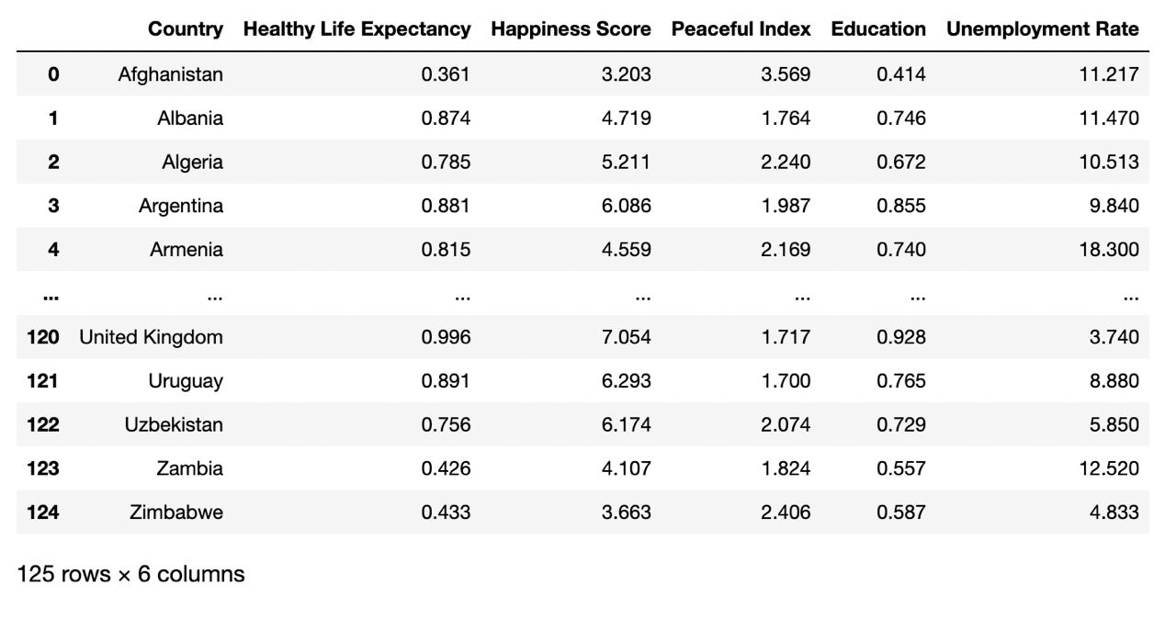
Cleaned and Merged Dataset
Notes:
Afterwards, we present our data under a merged dataset with all 5 variables and countries, that allows us to easily compare the data and proceed on with our exploratory data analysis. We list the dataset in alphabetical order for presentation.

Slide 8
Exploratory Data Analysis
Notes:
Now with our merged dataset, we will move into explore the trends, and patterns behind our data, to identify and gain a deeper insight of how we can use these data to solve our problem.

Slide 9
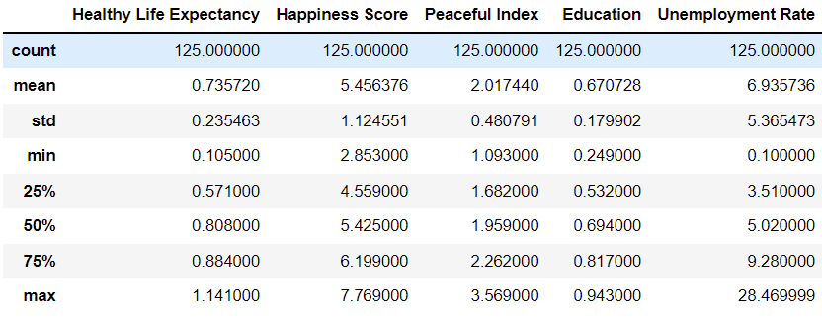
Distribution of Merged Dataset
Notes:
To start off, we have a distribution of the merged dataset, where we can see the specific mean, standard dev, min and max and Q1-3 values of each variable, to garner a deeper understanding of the values. Interesting enough, unemployment has some peculiar values that we can look into.

Slide 10
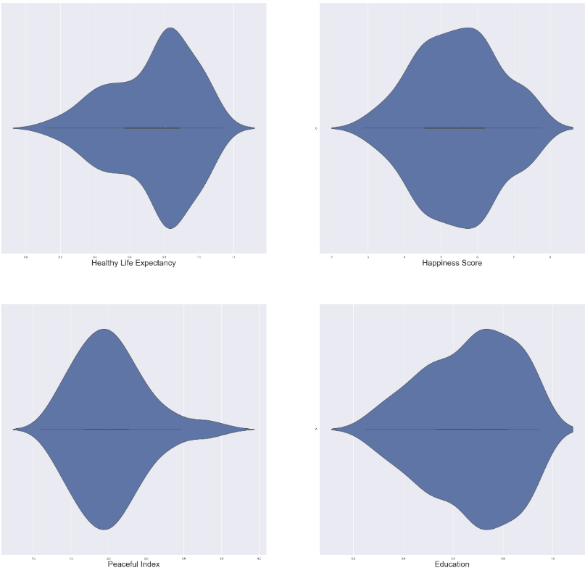
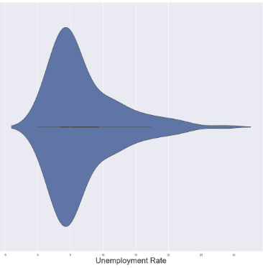

Initial Violin Plot
Notes:
With the merged dataset, we first explored how the data is presented, by using violin plot and skew to see how each variable with is structured and visualise it. We see that Happiness is the least skewed but Life expectancy and education are skewed towards the right, whereas Peaceful index and Unemployment is skewed towards the right. Furthermore, Unemployment is very skewed.

Slide 11
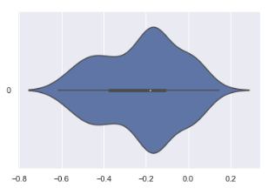




Usage of BoxCox Function
We utilise BoxCox out of other functions we tried such as Sigmoid, Hyperbolic Tangent and Log + 1, to reduce skew.
Healthy Life Expectancy
Notes:
As part of our data preparation, we aimed to minimise the skew by passing Life expectancy through as series of functions to see which is most ideal. As shown out of Sigmoid, Hyperbolic Tangent, Log +1 and Box Cox, Box Cox gives us a skew value of - 0.2577, a much better value than -0.6206 before.

Slide 12
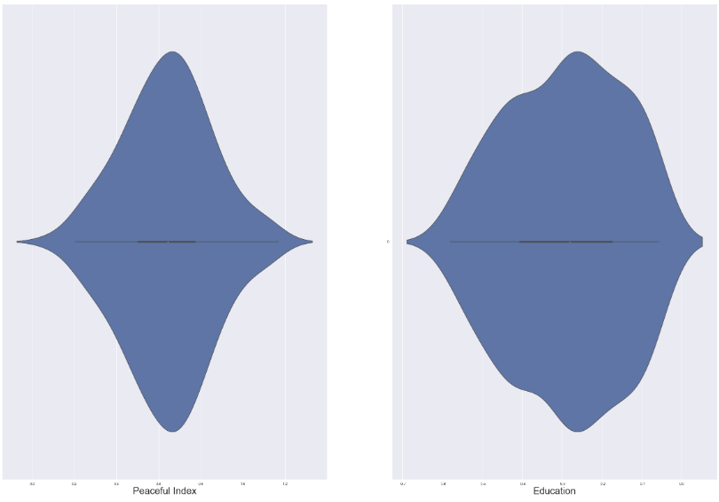
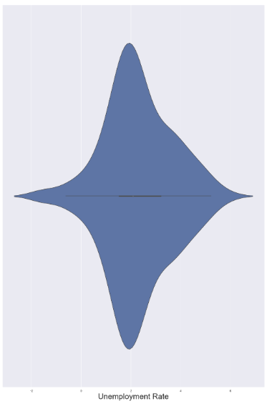
New Violin plot of other Variables and Skew
Notes:
Likewise, we also pass the remaining variables through the Box Cox function, and express the new violin plot as well as new skew values accordingly. Now, the variables would be better suited to be used for our machine learning models.

Slide 13
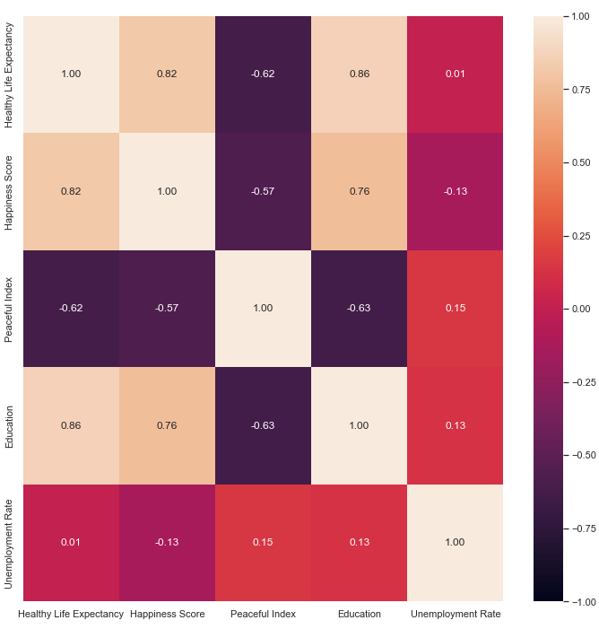
Heatmap of Merged Data
Now our data is less skewed, we express it in form of a heatmap to see the various correlation of each variable.
In our case, we will use Happiness Score as the main deciding factor for the answer to our question
Notes:
We also express the data we have into a heatmap, to visually see the correlation of each variable with one another, and focus on happiness.

Slide 14
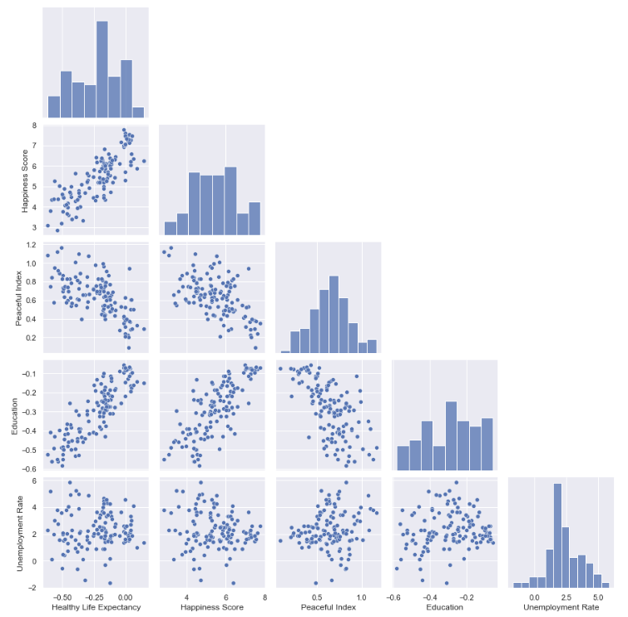
PairPlot Model
Usage of PairPlot shows the correlation and standardisation of each variable with one another
As shown from the scatterplot of Unemployment, we see its everywhere and not consistent
Histograms of the other 4 variables are quite normal, removing bias
Notes:
Additionally, we implement a pairplot to see the scatterplot of each variable, to see standardisation and correlation, and see that out of the 4 variables, unemployment has a scatterplot that seems random and everywhere, and is inconsistent.
The histograms of the remaining 3 variables further express the skew of the variables, where they are quite normal.

Slide 15
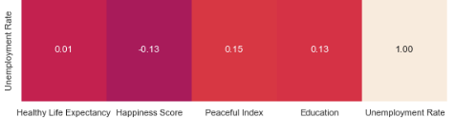
Machine Learning Model: Linear Regression
Happiness = a x Life Expectancy + b x Education + c x Peacefulness + d x Unemployment rate
As we see that unemployment has very little correlation with other variables and happiness score, statistic wise we would omit it.
Notes:
As such we have the correlation values, and can express Happiness score as a equation of the other 4 variables. However, as previously stated, Unemployment was abnormal to the other variables, where its scatterplot shows random distribution, and now the heatmap shows it has very little to no correlation with the rest of the variables. As such we should omit it.

Slide 16
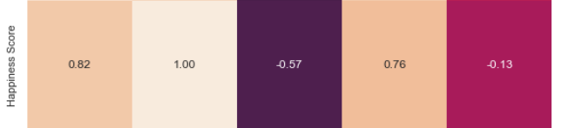
Linear Regression Model: Revised
Happiness = 0.82 x Life Expectancy + 0.76 x Education - 0.57x Peacefulness
Notes:
This gives us a more revised Linear regression model equation, where Happiness, is quantified by Life expectancy, education and peacefulness. Where LE has highest coefficient out of the other 2 variables, and peacefulness as the least.

Slide 17

Conclusion
Our equation is merely a measure of whether it is worth considering the country
Life Expectancy, gauged by quality of healthcare and percentage of GDP put into the health budget, has most influence over the decision to live in a country
Quality of Education and Peacefulness comes 2nd and 3rd respectively
Notes:
We found that a country’s worth that people uses to gauge whether it is a good place, is quantifiable through the data we found, and thus we have a suitable formula that allows us to predict which country would be ideal to live in, when we consider only the quality of life, education and security of the country,

Slide 18
Additional Point of Interest
Irregularity of Unemployment
Interesting enough, We considered Unemployment to be a crucial factor in deciding which country is best to live in, but it has least correlation with all other variables. From a data science perspective, we will omit it, but realistically families should consider this, especially as foreigners would be at a disadvantage of being hired, else they cannot sustain themselves.

