Slide 1


PY-EXPO
2K24
TeamID:T112
Team Name: BYTE WIZARDS
Genius innovation leaves behind a legacy...
PYEXPO 2K24

Slide 2
PS Code: 58
Problem Statement:
Develop An Ai-Powered Chatbot For Education Department
02
PYEXPO 2K24

Slide 3
Solution
Educational Chatbots :
EDUCATIONAL CHATBOTS are interactive artificial intelligence (AI) applications utilized by EdTech companies, universities, schools, and other educational institutions. Example like Duolingo, Mondly.
It gives guidance to who completed 10std and 12 std for UG program and diploma programs
Implement DATABASE INTEGRATION to store user profiles, protect user data and privacy , conversation history and Database Systems are MongoDB , MySQL.
Deploy chatbot on a suitable platform, such as AWS, Azure or Google Cloud.
Technology Stack
Technology Stack Used Python (tkinter module), HTML,CSS.
03
PYEXPO 2K24

Slide 4
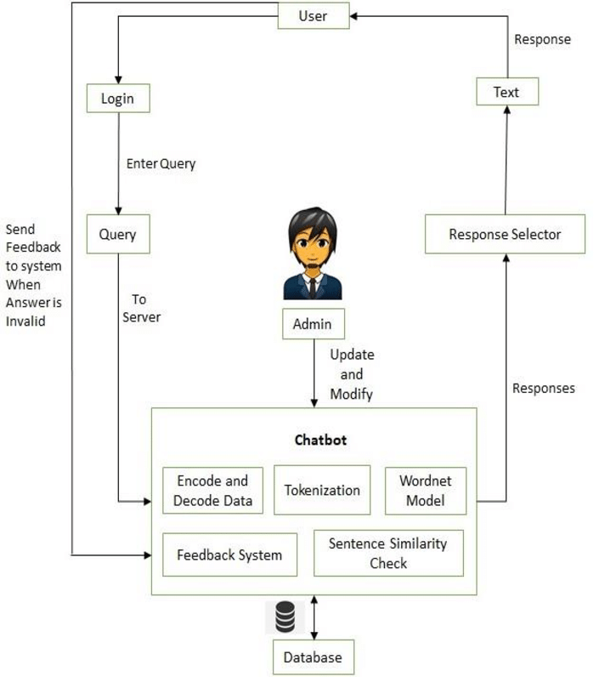
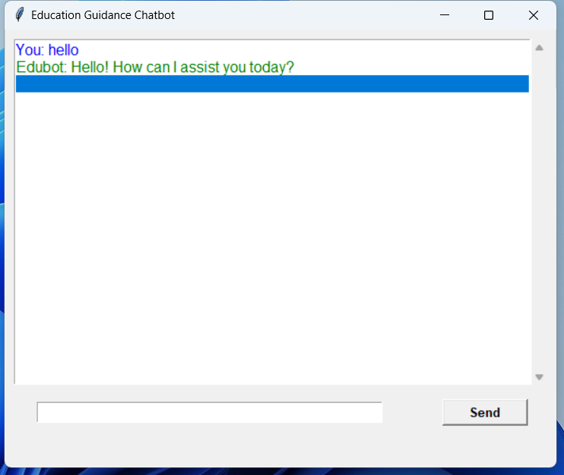
Technology Stack: Technology Stack Used Python (tkinter module), HTML,CSS.
04
PYEXPO 2K24

Slide 5
Team Member Details:
AMITH ADITYA C P
DHARAKA S
GANIGA M
YAMUNA S
05
PYEXPO 2K24

Slide 6

Thank You
Any Queries?
PYEXPO 2K24

