Slide 1


PY-EXPO
2K24
Team ID: T30
Team Name: CODE049
Genius innovation leaves behind a legacy...
PYEXPO 2K24

Slide 2
PS Code: PY48
Problem Statement:
Car parking space detection system
02
PYEXPO 2K24

Slide 3
PARKING SPACE DETECTION:
Libraries like opencv to handle image manipulation and processing
Used pre trained object detection models YOLO to detect cars in the images and videos
Implementing logic to determine whether a parking space is occupied or vacant by using machine learning models
03
PYEXPO 2K24

Slide 4
Solution
Gathering a dataset of images containing parking lots with annotated bounding boxes around parking spaces.
Preprocess the dataset by resizing the image to a suitable input size for the normalizing pixel values.
Integrating the deployed model with the video feed processing pipeline to perform real time parking space detection.
Processing the detected bounding boxes to determine the occupancy status of each parking space
04
PYEXPO 2K24

Slide 5
Uses:
Automatically monitor parking spaces in parking lots to provide real time information about available spaces , reduces the time drivers spend searching for parking spots
Integrate parking detection system with smart city infrastructure to optimize traffic flow by directing drivers to available parking spaces and reduces congestion
Enhance security in parking facilities by detecting suspicious or unauthorized vehicle parked illegally or for extended periods in restricted areas , improving compliance with parking regulations
Technology Stack
Technology Stack Used
PYTHON,OPENCV,PICKLE,NUMPY
05
PYEXPO 2K24

Slide 6
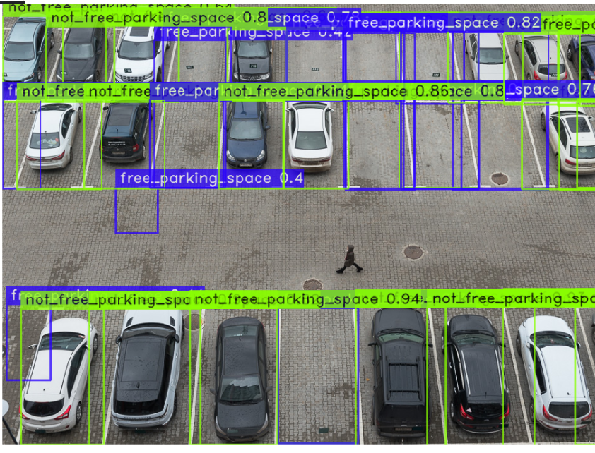
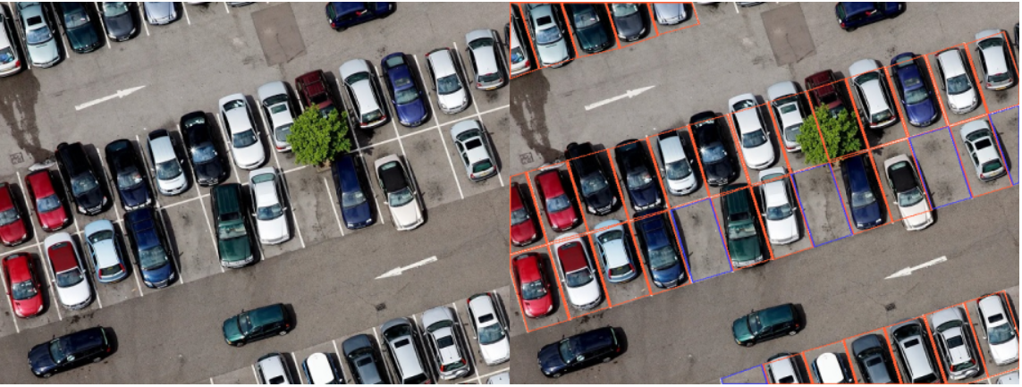
PYEXPO 2K24
06

Slide 7
Team Member Details:
SANJAY S 23AIB24
THRIKUDA DEVI DKL 23AIB53
PRAVEEN N 23AIB04
PRASANNA DEVI V 23AIB03
07
PYEXPO 2K24

Slide 8
Thank You
PYEXPO 2K24

