Slide 1


PY-EXPO
2K24
Team Id:12738056a
Team Name: CYBER EXPERTS
Genius innovation leaves behind a legacy...
PYEXPO 2K24

Slide 2


PS Code: PY-11
Problem Statement: Basic Healthcare Data Analysis using Electronic Medical Record
Every year nearly 98,000 Indians die due to misdiagnosis and medical errors. . A number that could be significantly reduced with better access to comprehensive medical record keeping systems. Our Healthcare sector is plagued by fragmented and often incompatible electronic record keeping systems leading to inefficiencies and risk to patients lives.
WHERE IS THE PROBLEM?
*FRAGMENTED MEDICAL RECORDS
*LACK OF TRANSPARENCY AND PATIENT CONTROL
*INEFFICIENT COMMUNICATION
*LACK OF INTEROPERABILITY
*PRIVACY AND SECURITY CONCERNS
*INEFFECTIVE HEALTHCARE MANAGEMENT
02
PYEXPO 2K24

Slide 3

Solution
Here's a step-by-step process to create a
simple EMR solution using Python:
1. Define Requirements
2. Choose a Database
3. Setup Database
4. Choose a Web Framework
5. Model Creation
6. Create Views/Routes
7. User Authentication
8. Frontend Development
9. Testing the units
10. Deployment
11. Implement Security Compliances
12. Maintenance and Updates
TECHNOLOGY STACK :
*Html
*CSS
*FLASK
*PYTHON
*JAVA Script
03
PYEXPO 2K24

Slide 4







FLOWCHART:
DOCTORS
HEALTHCARE PROVIDERS
EMR
PATIENT
MEDICAL REPORT
OBJECTIVE:
Main point of this platform is to ensure quick details of patients in case of emergency situations and giving them the optimal treatment rather than spending time on manual health records. Thus this helps to save so many lives and helps to avoid misdiagnosis and medical errors…
PHARMACY
04
PYEXPO 2K24

Slide 5
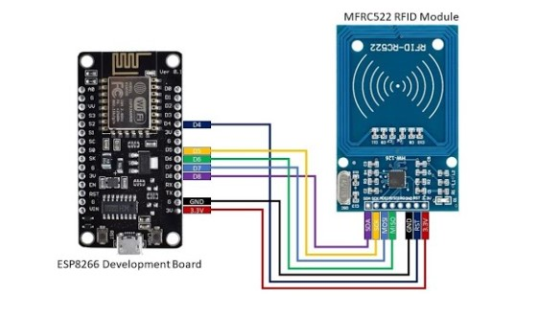
05
PYEXPO 2K24

Slide 6

TEAM MEMBERS NAME:
SAIF S (23ECB21)
MANOAJKUMAR R (23ECB01)
SAKTHIVIYASH G (23ECB22)
PRADEEP P (23ECB12)
06
PYEXPO 2K24

