Slide 1


PY-EXPO 2K24
TeamID:053
TeamName: Elite Innovators
Genius innovation leaves behind a legacy...
PYEXPO 2K24

Slide 2
PS Code: PY128
Problem Statement:
Memory Training Game
cognitive abilities and memory retention are crucial for day-to-dayduties and activities in the fast-paced world of today. The goal of thisproject is to create a Pygame-based Memory Match game in order tosatisfy the need for memory training and improvement. Players willhave to match pairs of cards that have pictures or symbols by turningeach card over one at a time in this challenging game. Players' focus,memory recall, and cognitive ability will all increase with repeatedgameplay sessions.
02
PYEXPO 2K24

Slide 3
Solution :
Prototypes:
1. User Login Page Prototype: Design the interface for user authentication.
2. Level Selection Prototype: Interface for selecting different game levels.
3. Music Selection Prototype: Interface for selecting different music tracks.
4. Scoreboard Display Prototype: Interface for displaying high scores.
5. Timer Display Prototype: Interface for displaying the game timer.
Functions/Methods:
1.User Management Functions: Register new users, authenticate users, update
user data, etc.
2.Level Management Functions: Load different levels, manage level progression,
etc.
3.Music Management Functions: Load music tracks, play/pause music, etc.
4.Scoreboard Functions: Update scores, display high scores, etc.
5.Timer Functions: Start, stop, and update game timer.
03
PYEXPO 2K24

Slide 4
IDEA:
UsersMultiple levels of difficulty offer a progressive challenge, catering to users of all skill l Multiple levels of difficulty offer a progressive challenge, catering to users of all skill levels. Background musics will be provided for users to have better experience while playing.
A comprehensive scoreboard displays the highest scores achieved by players, encouraging healthy competition.
timer mechanism will be set to track the duration of each gameplay session, enhancing the competitive aspect of the game.
@
Technology Stack:
Data Structures:
@
User Profile Stack: To manage user logins and store user data.
Level Stack: To keep track of different game levels.
Music Stack: To store different music tracks for the game.
Scoreboard: Could be implemented as a dictionary or list of tuples with user scores. Timer: A timer object to manage game time.
PYTHON CSS HTML
04
PYEXPO 2K24

Slide 5
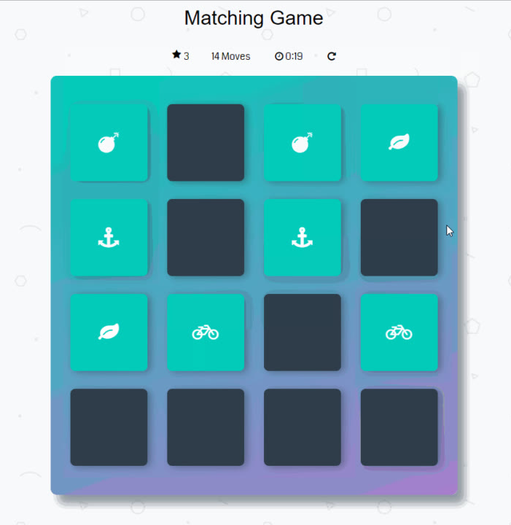
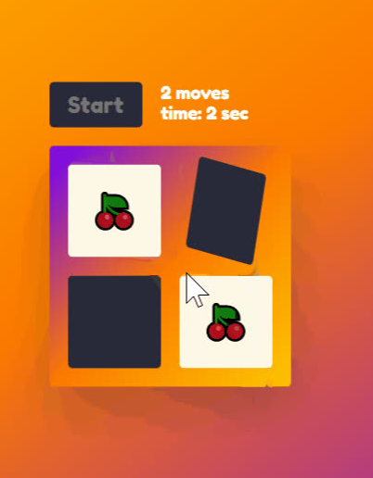
MODEL:
05
PYEXPO 2K24
simple
harde

Slide 6
Team Member Details:
Priyadharshni.R 23CSB13 CSE-B
Sugirtha.R. 23CSB46 CSE-B
Priya dharshini.SS. 23CSB12 CSE-B
Swetha.C. 23CSB50 CSE-B
Yuva sri.R. 23CSB63 CSE-B
06
PYEXPO 2K24

Slide 7
Conclusion:
"Memory Master" offers a fun and interactive solution for individuals looking to improve their memory and cognitive skills. By combining engaging gameplay with innovative features such as user authentication, music selection, and competitive scoring, our project aims to make memory training accessible and enjoyable for everyone.
Let "Memory Master" be your companion on the journey to sharper memory and enhanced cognitive abilities!
Thank You!
PYEXPO 2K24

