Slide 1


PY-EXPO
2K24
Team ID: T087
Team Name: PHONIEX
Genius innovation leaves behind a legacy...
PYEXPO 2K24

Slide 2
PS Code: PY115
Problem Statement:
Create a Python-based quiz application that allows users to
answer a series of multiple-choice questions. The program
should present questions, accept user input, provide feedback
on correctness, keep track of the score, and display the final
score at the end. Additionally, implement a timer for
each question, and include a variety of question types (FOR
EXAMPLE : The game will end the score will be send for the mail.)
02
PYEXPO 2K24

Slide 3
Solution
our platform has something for everyone. With a wide range of topics and questions, you'll have the opportunity to expand your understanding of Python
in a fun and interactive way
INTEGRATION WITH OTHER TECHNOLOGIES
EASY TO LEARN PYTHON
RICH ECOSYSTEM
Technology Stack
Technology Stack Used
HTML
CSS
JAVA SCRIPT
DJANGO
PYTHON
J QUERY
03
PYEXPO 2K24

Slide 4
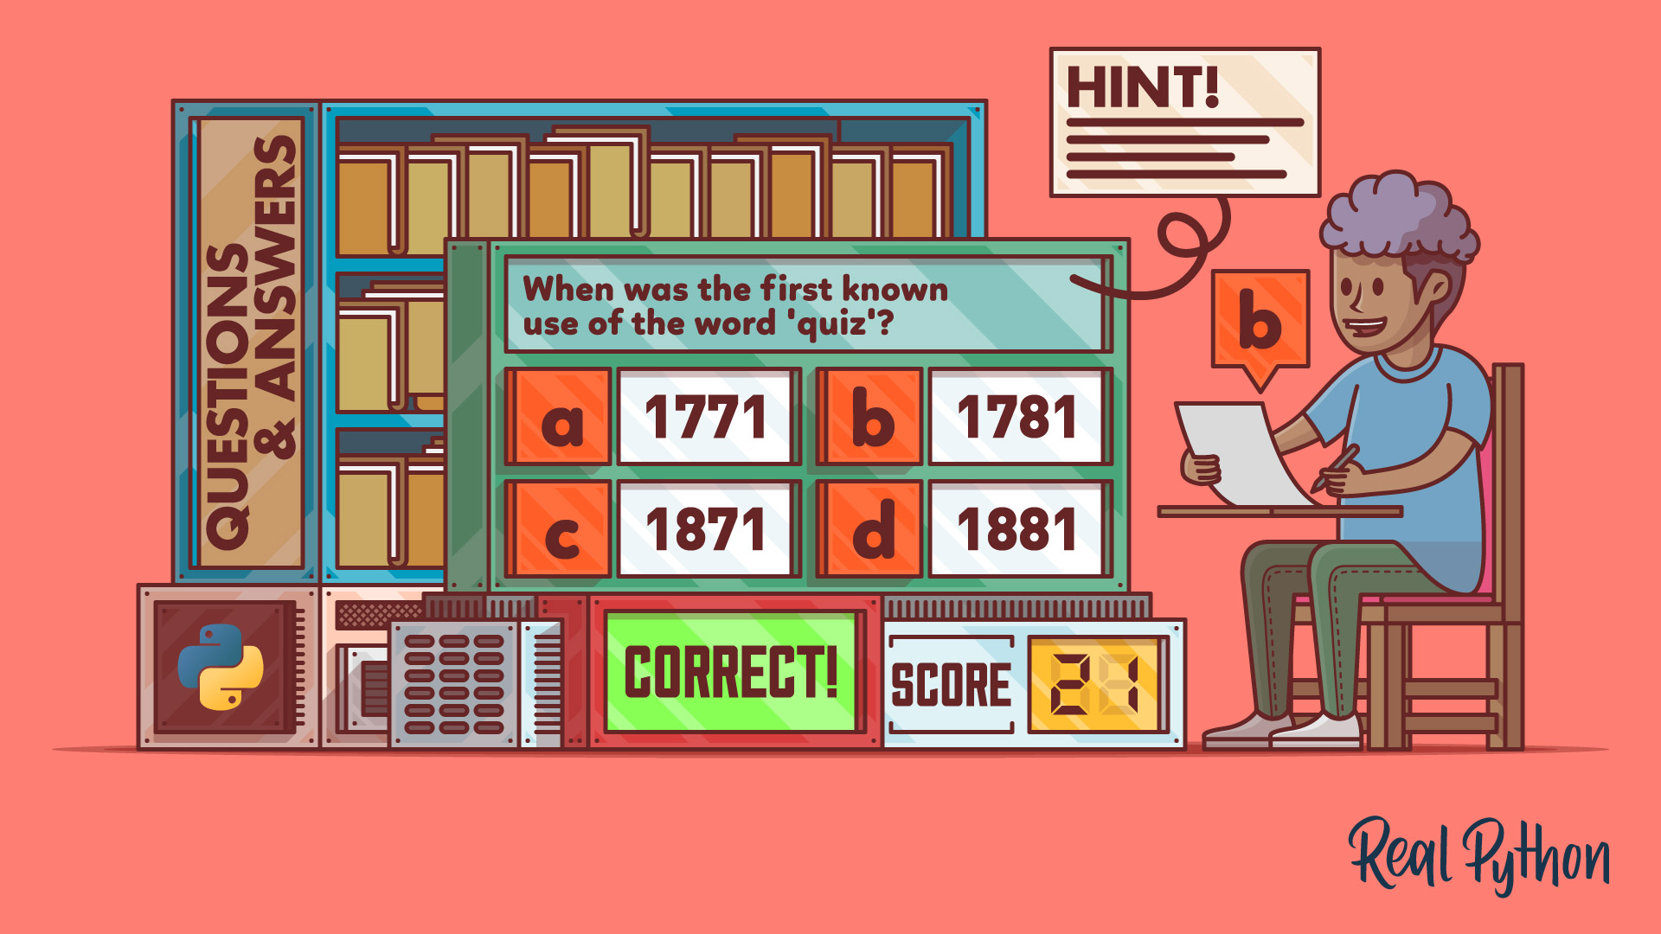
Deployment
Web Server
Database
Monitoring and Logging
Security
Ba
04
PYEXPO 2K24

Slide 5
Team Member Details:
TEAM LEADER:
MANIMEKALAI M
23ECA63
TEAM MEMBERS:
ABINATHA K
23ECA03
ABINAYA S
23ECA04
05
PYEXPO 2K24
BALA MURUGAN S P
23ECA18

Slide 6
Thank You
PYEXPO 2K24
Notes:
‹#›

