Slide 1
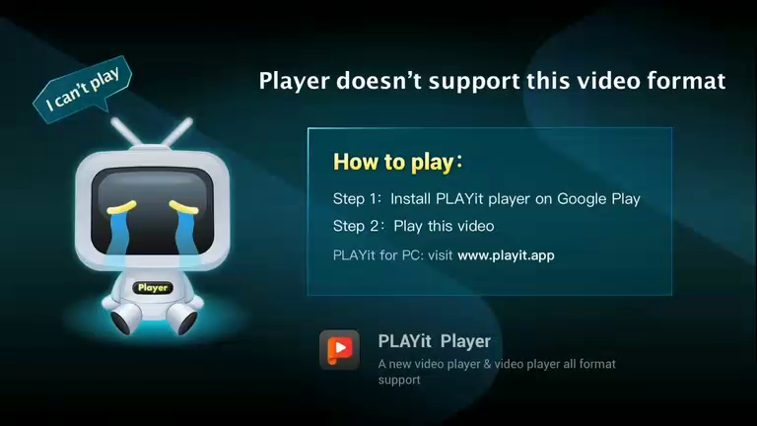
fo Player doesn’t support this video format
\ How to play:
‘Step 1: Install PLAYit player on Google Play
Step 2: Play this video
PLAVYit for PC: visit www.playit.app_
PLAYit Player

