Slide 1


PY-EXPO
2K24
Team ID: T029
Team Name: THE CONQUERORS
Genius innovation leaves behind a legacy...
PYEXPO 2K24

Slide 2
PS Code: PY42
Problem Statement: CCTV Analysis Tool For Vehicle Identification And Classification
A CCTV analysis tool designed specifically for identifying and classifying vehicles.Imagine a surveillance system that not only monitors vehicle movements but also swiftly categorizes them in real-time. Our tool does just that, leveraging cutting-edge technology to provide accurate and immediate insights into the types of vehicles passing through monitored areas.
02
PYEXPO 2K24

Slide 3
Solution
Our solution for a CCTV analysis tool for vehicle identification and classification By collecting diverse datasets of vehicle images and videos, we preprocess the data to ensure its quality and uniformity. We then train a convolutional neural network (CNN) model, utilizing architectures like ResNet or VGG, to accurately identify and classify various types of vehicles in real-time. smart CCTV system that quickly recognizes different types of vehicles, like cars, trucks, and motorcycles, as they move through monitored areas.
Technology Stack
.Opencv
.Python
.easyOCR
03
PYEXPO 2K24

Slide 4

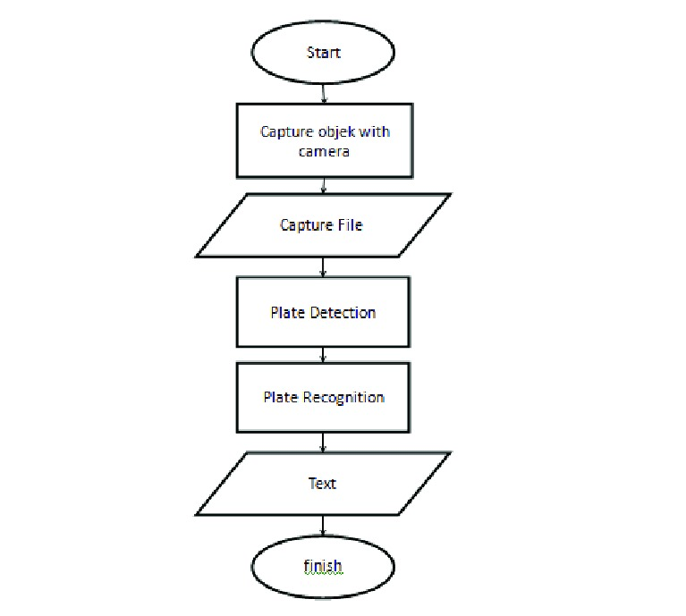
04
PYEXPO 2K24

Slide 5
Team Member Details:
PRAVEEN KUMAR B (23AIB05)
SANJAY M (23AIB23)
SWATHINI B (23AIB46)
TAMIZHARASU P (23AIB48)
VENKATRAMANAN S(23AIB56)
05
PYEXPO 2K24

Slide 6

Thank You
PYEXPO 2K24

