Slide 1

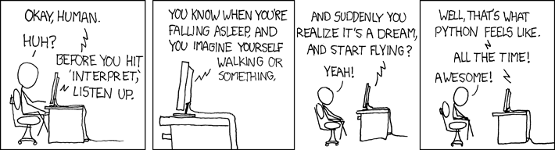

Slide 2
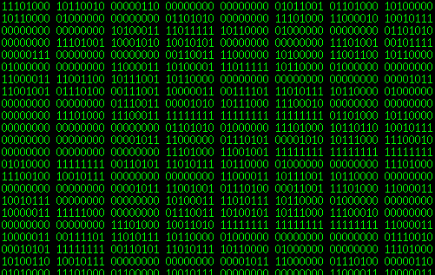
Programming Languages
Computers understand only machine language.

Slide 3
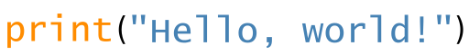
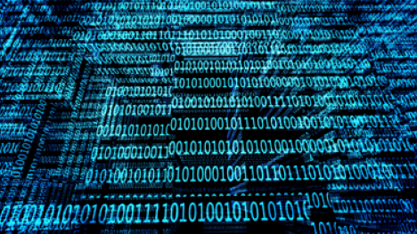

Programming Languages
Programming languages were created for human convenience. They are translated into the machine language.

Slide 4
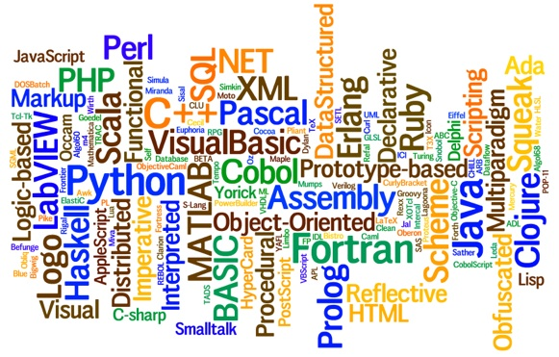
Programming Languages
A computer program is a sequence of text instructions that can be “understood" by a computer and executed.
A programming language is a machine-readable artificial language designed to express computations that can be performed by a computer.
4
Notes:
4

Slide 5

Open source (extendable, cross-platform)
General purpose: string processing, reading/writing files, sockets, websites, databases, GUI’s
Dynamic
Easy to read
Easy to write
Easy to learn

Slide 6

What can we do with it?
String processing: analyze nucleotide/amino-acid sequences, alignments, motif finding, etc.
Process data from scientific formats. Any format.
Connect to online databases for wide analysis
Image processing
Phylogenetic construction and inference
Implement statistic inference
Simulate evolutionary processes
And much more…

Slide 7
http://py4life.github.io/TAU2016/

Slide 8



Let’s begin
Install Python 3.5 by downloading the Anaconda distribution. (installed in class)
Download first lecture notebook from py4life site .
Press the win-key button
and type ‘launcher’ to open Anaconda.
In the Anaconda launcher, select “ipython-notebook”. The directories on your computer will open up in Jupiter in the internet browser. Locate the notebook you downloaded.
View mode
Interactive mode

