Slide 1
Analyzing General Sentiment of Depression subreddit with Natural Language Processing
Trying to Predict and Prevent Suicide on Reddit(/r/depression)

Slide 2
Suicide and Depression(/r/depression)
“Every 14 minutes, someone in this country commits suicide, and research on ways to reduce that grim statistic appears to be on a plateau. In other words, psychologists don't have much in the way of new ideas”… Neal Conan “Talk of the Nation” NPR Reporter
Why am I interested in this Topic?
I suffer from chronic depression.
I was hospitalized last December
I have suffered since Fall 2009
I receive medical treatment
I saw others reaching out for support on Reddit and not getting appropriate responses
I cut myself for the first time yesterday. I'm so scared. Help.
Just stop, I'm serious. Don't do it. You want to do it? Don't. When was the last time you did it? Who cares? Just push against the urge to do it, no matter how much you want to. You won't get into habit, because if you do, I will find you and hug you until you drop the blade and realize how much cutting does not help. Repeat: DOES NOT HELP.

Slide 3
Objectives
1. Classify sentiment of posts in /r/depression
positive or negative
Score 1 (pos) to -1 (neg)
2. Compare against scores against known suicide notes
Official Annotated Corpus Requires a lengthy review process with Institutional Review Board Approval
Privacy and research ethics
Unofficial Suicide notes collected off the web

Slide 4
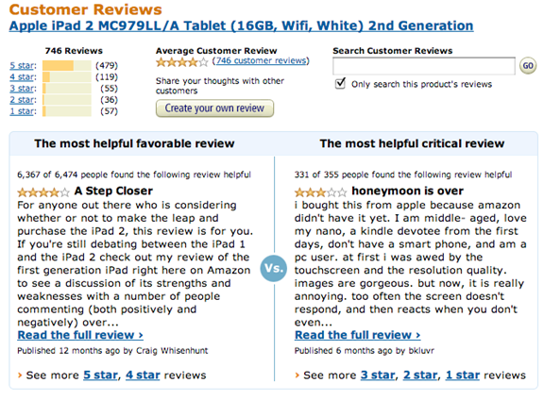
Terminology
Sentiment Analysis – gauge general sentiment of text
Examples – can be mined from texts, tweets, blogs, social media, etc…
Consumer related businesses
customer product reviews, business intelligence, customer service, management of brand reputation
Political strategists
gauge public opinion on the Internet
Obama administration
predict responses to campaign messages and policy announcements
Classifiers – Examine word usage and assign labels
Binary Classifiers – decide between two labels
Positive or Negative
Multi-label Classifiers – assign more than one label
Classification works by learning from labeled feature sets
feature set – a “key : value” mapping of a feature name to feature value
In text classification features names are words and values are “True”
{‘Hello’: True}
Notes:
Sentiment Analysis - determine the attitude or inclination of a communicator through the contextual polarity of their speaking or writing.

Slide 5
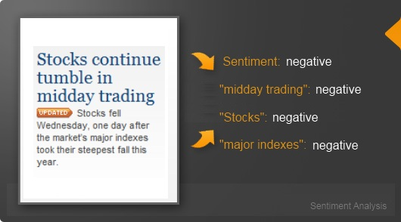
Methodology – IBM WATSON ALCHEMY
IBM Watson AlchemyAPI – uses Keyword spotting to classify text by affect categories based on the presence of unambiguous affect words.
happy, sad, afraid, bored

Slide 6
Results
/r/Depression – Analyzed 458 posts
Overall ---- sentiment, average Score
21 positive, Average score = 0.238
['Today I Feel Fine.', '3', '0.409632', 'positive']
['Worked out with a personal trainer today', '3', '0.363037', 'positive']
['Solid 8 days progress but feeling down again...', '2', '0.3863', 'positive']
464 negative, Average score = -0.498
['Alone my entire life ready to give up [20/M]', '1', '-0.87427', 'negative']
["What's wrong with me??? I feel like drowning, suffocating and idk why", '3', '-0.843522', 'negative']
['I feel like I am perpetually stuck, boxed into a corner, I just want to escape.', '1', '-0.836437', 'negative']
Suicide Notes off the Web – Analyzed 25 notes
Overall “Negative” sentiment, average Score = -0.16
7 positive, Average score = 0.174
'I thought how unpleasant it is to be locked out, and I thought how it is worse perhaps to be locked in. For you mom...the necklaces...For you, Nana & Papa...GingerSnaps (always reminds me of you)...For you Ingrid...The Happiness Project. And Dad...the Godiva chocolate truffles. I love you all...I'm sorry. I love you.'
18 negative, Average score = -0.289
Ask a guy who is gonna OD (again) tonight anything
To Whom It May Concern,
I am going to leave this for whoever stumbles across my bookmarks later on.
I hate myself and I hate living. I think that if someone who knows me reads this they will know who I am. So I will leave this unsigned. I am an a–hole. I have let everyone down and I feel as though I will never change or never improve. I am in love with a girl and I know that I am not good enough for her.

