Slide 1

Model Fine-tuning For Similarity Learning
from algorithms to infrastructure
Bo Wang
Engineering Manager@Jina AI | bo.wang@jina.ai

Slide 2
Me
Bachelor: Lanzhou University
Master: Delft University of Technology (Multimedia Computing Group)
Working: IBM (Amsterdam), Sensara (Rotterdam), Jina AI (Berlin, current)
Github: bwanglzu
Twitter: bo_wangbo

Slide 3



weather forecast

Slide 4

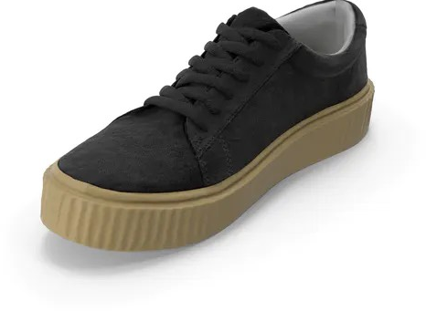
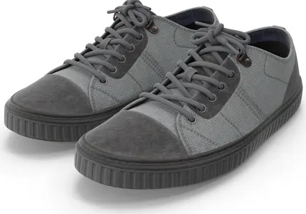
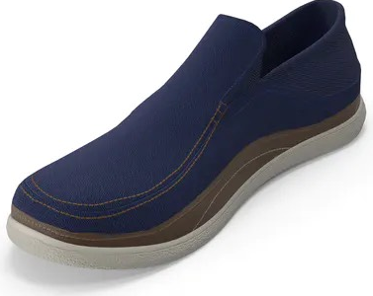
sneakers.jpg

Slide 5
black sneakers

Slide 6



Neural Search
Forget about keyword search
Basic idea: use embeddings from Deep Learning models for similarity search (cosine, euclidean)
=> [0.6, 0.4]
=> [0.5, 0.5]
=> [-0.5, 0.6]

Slide 7
However, pre-trained models do not work out-of-the-box (for search)

Slide 8
Why?
Domain shift: the training data and the application domain is different.
Task shift: Most of the models are pre-trained for classification/regression/segmentation, not for similarity matching.
Knowledge shift: Machine learning engineers do not have enough knowledge on Information Retrieval, vice versa.

Slide 9
Our Approach: Contrastive Learning

Slide 10
With Labels - 1
1
2
3
2
4
1
2
4
1
3
2
4
2
4
1
4
1
4
1
…
Batch Sampler (B=16)
1
1
1
1
2
2
2
2
3
3
3
3
4
4
4
4
Tuple/Triplet Construction
1₀
1₁
2₄
1₀
1₂
2₄
1₀
1₃
2₄
…

Slide 11
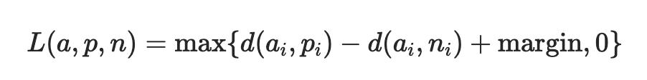
With Labels - 2
2₄
2₄
1₀
1₁
2₄
1₀
1₀
Learning
1₀
1₂
2₄
1₀
1₃
2₄
1₁
…
1₁

Slide 12
With Labels - 3
2₄- E
2₄- H
1₀
1₁
2₄- S

Slide 13
With Labels - 4
2₄
2₄
1₀
1₁
2₄
1₀
1₀
Learning
1₀
1₂
2₄
1₀
1₃
2₄
1₂
…
1₂
Xuan, Hong, Abby Stylianou, and Robert Pless. "Improved embeddings with easy positive triplet mining." Proceedings of the IEEE/CVF Winter Conference on Applications of Computer Vision. 2020.

Slide 14
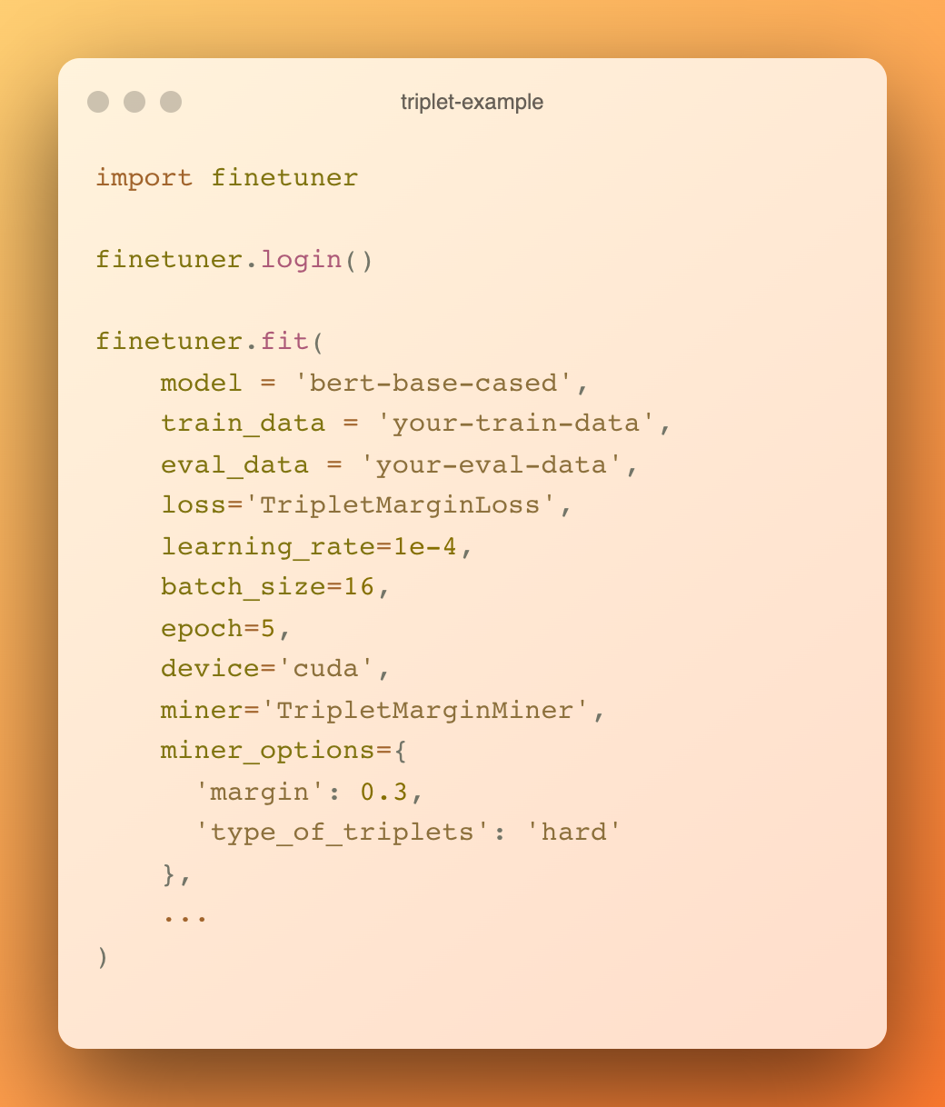

Slide 15
Without Labels - CrossModel
Text Encoder
black sneakers comfortable
feature vector V_{t}
Image Encoder
feature vector V_{i}

Slide 16
Without Labels - CrossModel
Text Encoder
T₁
V_{t1}
V_{t2}
V_{t3}
V_{t4}
V_{t5}
…
V_{tn}
T₀
…
T_{n}
V_{i1}
I₁₁
I₁₂
I₁₃
I₁₄
I₁₅
…
I_{1n}
V_{i2}
I₂₁
I₂₂
I₂₃
I₂₄
I₂₅
…
I_{2n}
Image Encoder
V_{i3}
I₃₁
I₃₂
I₃₃
I₃₄
I₃₅
…
I_{3n}
I₁
V_{i4}
I₄₁
I₄₂
I₄₃
I₄₄
I₄₅
…
I_{4n}
I₀
…
V_{i5}
I₅₁
I₅₂
I₅₃
I₅₄
I₅₅
…
I_{5n}
I_{n}
…
…
…
…
…
…
…
…
V_{in}
I_{n1}
I_{n2}
I_{n3}
I_{n4}
I_{n5}
…
I_{nn}
Radford, Alec, et al. "Learning transferable visual models from natural language supervision." International Conference on Machine Learning. PMLR, 2021.

Slide 17
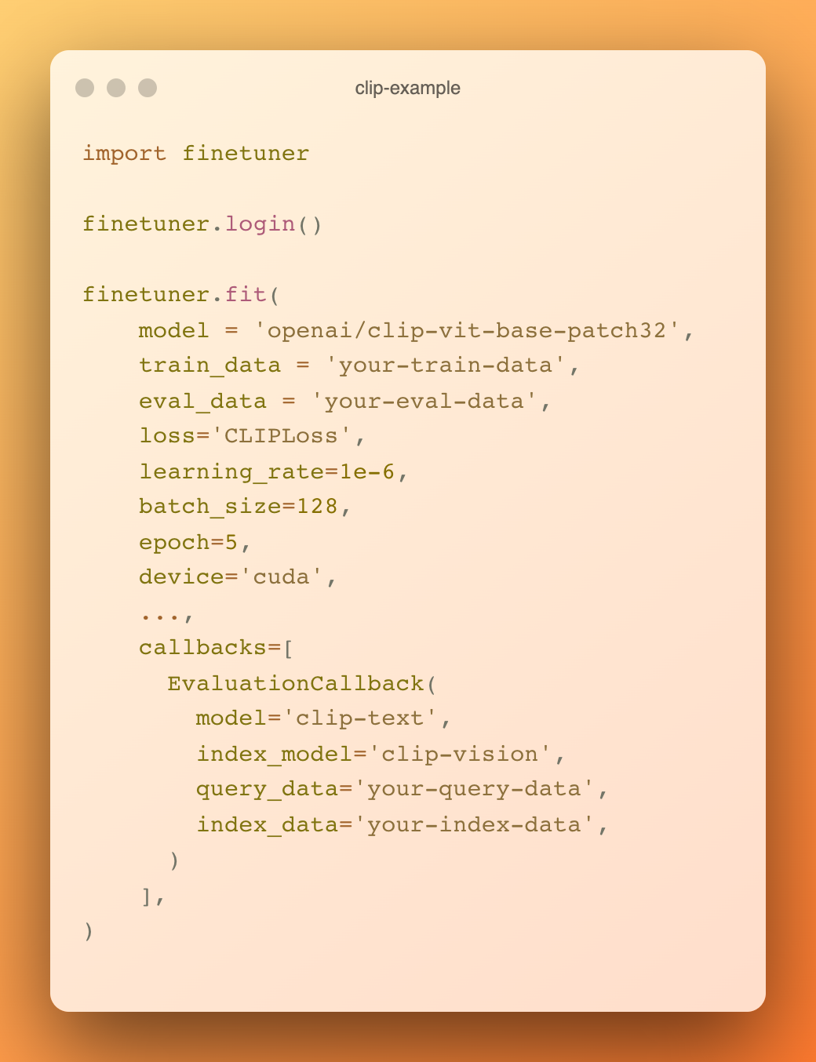

Slide 18

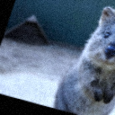
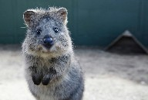
Without Labels - UniModel
Contrastive Loss
v₀
v₁
Encoder
Encoder

Slide 19
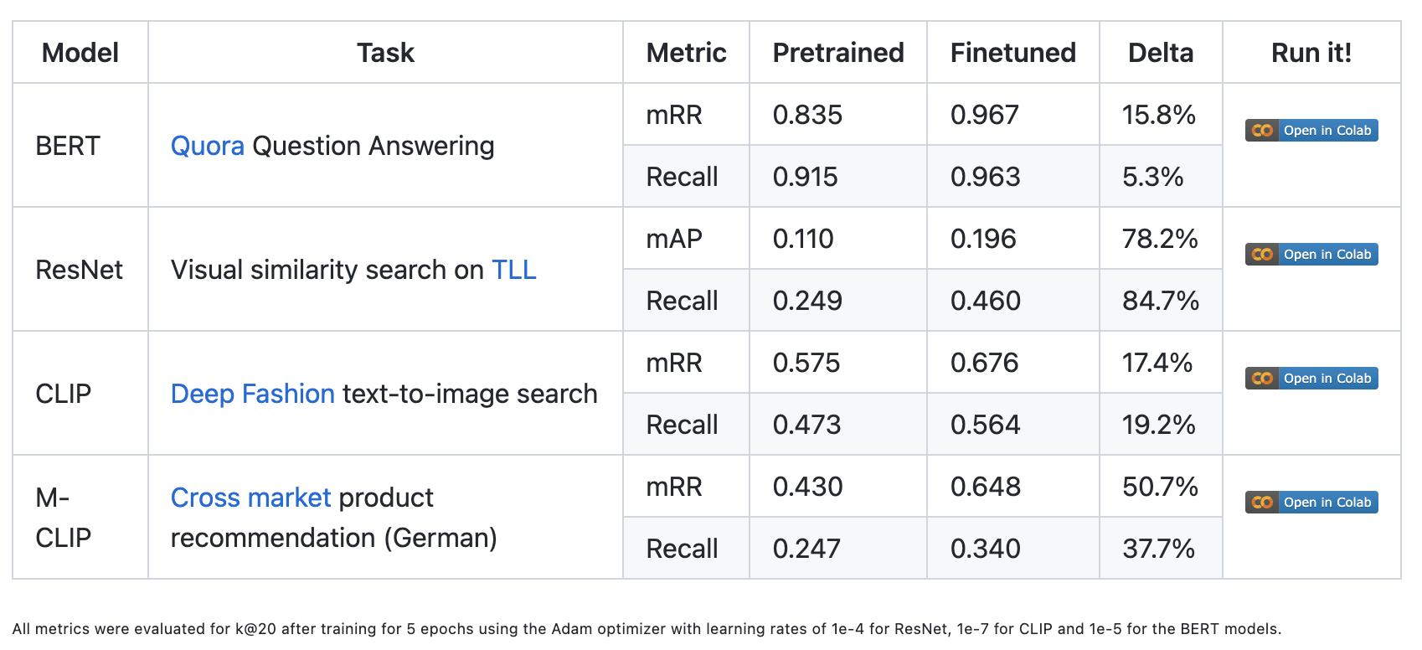
What do get from it?

Slide 20
What do you pay?
Depends, a few handureds to several thousands labeled data is sufficiently enough.
Given the effectiveness of GPU utilization, and limited amount of training data, fine-tuning could be finished in 15 minutes to less than half a day.
Fine-tuning with Low Budget and High Expectations: https://jina.ai/news/fine-tuning-with-low-budget-and-high-expectations/

Slide 21
This is not the end..

Slide 22
Model Fine-tuning as Service
For software engineers, still too complex.
Lack of computing resources, or lack of experience in GPU utilization.
Heavy dependencies (ML Frameworks).

Slide 23
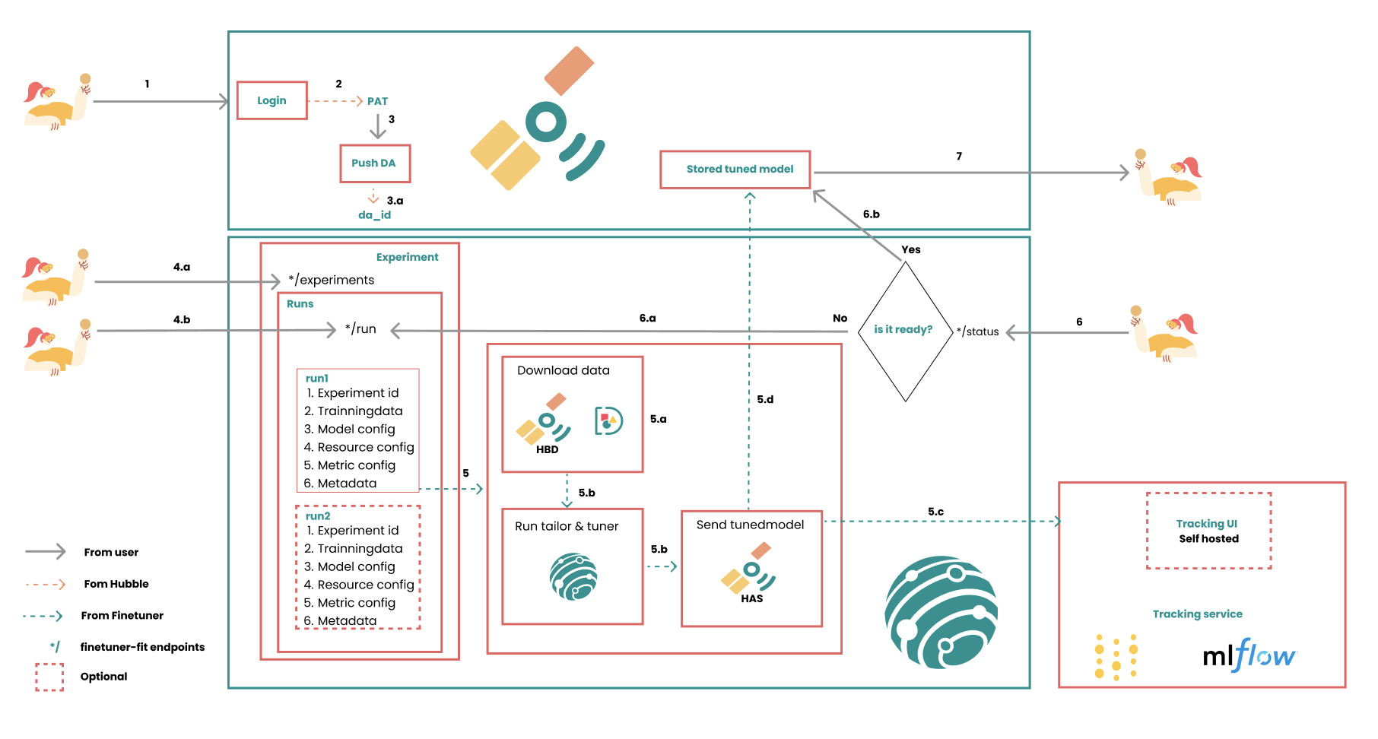

Slide 24
Before/after you call the `fit` function..
At each release, we build cpu and cuda docker image to Container Registry.
A dedicated computing resource will be applied for you, with X GPUs, Y CPUs and resources such as memory and disk space from our cloud Kubernetes Cluster.
We utilize Argo Workflow which is a container-native workflow engine to run your fine-tuning job.
We utilize Karpenter for node auto-scaling, to provision nodes based on workload requirements, at scale.
In the mean while, all the logs will be centralized in our cloud buckets & logging stack.

Slide 25
With this setup, we can efficiently setup computing resources within minutes with CPU or CUDA jobs (up to 16 Nvidia GPUs)

Slide 26
For open-source users, we always offer one free GPU.

Slide 27
What we achieved
Extreme easy user interface, even with no code.
Always full (90%+) GPU Utilization in the cloud given sufficient training data.
Huge dependency size reduction (1GB +), no need torch, torchvision etc. Since each `fit` is just an api call...
July 1st since release up to Dec 15th 2022, we help our internal & external users fine-tuned 1423 models.

Slide 28
Challenges & Next Step
Losing certain level of flexibility, for advanced users.
Data handling should at users hand, this is crucial for big entities.
Not enough ppl, even ML engineers are aware the power of embedddings.
Breakthrough embedding model towards cross-modality/mult-modality.
Be more open & developer friendly towards to the next step: inference.

Slide 29
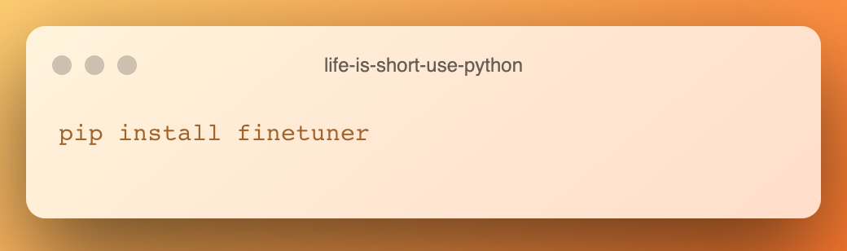
Last but not least..

Slide 30
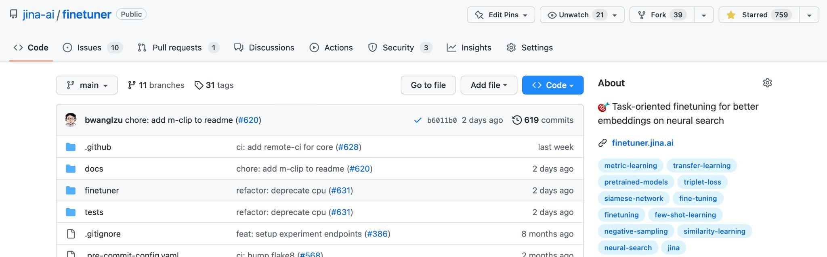

Slide 31
Thank you!

Slide 32

Thanks!
感谢观看

