Slide 1
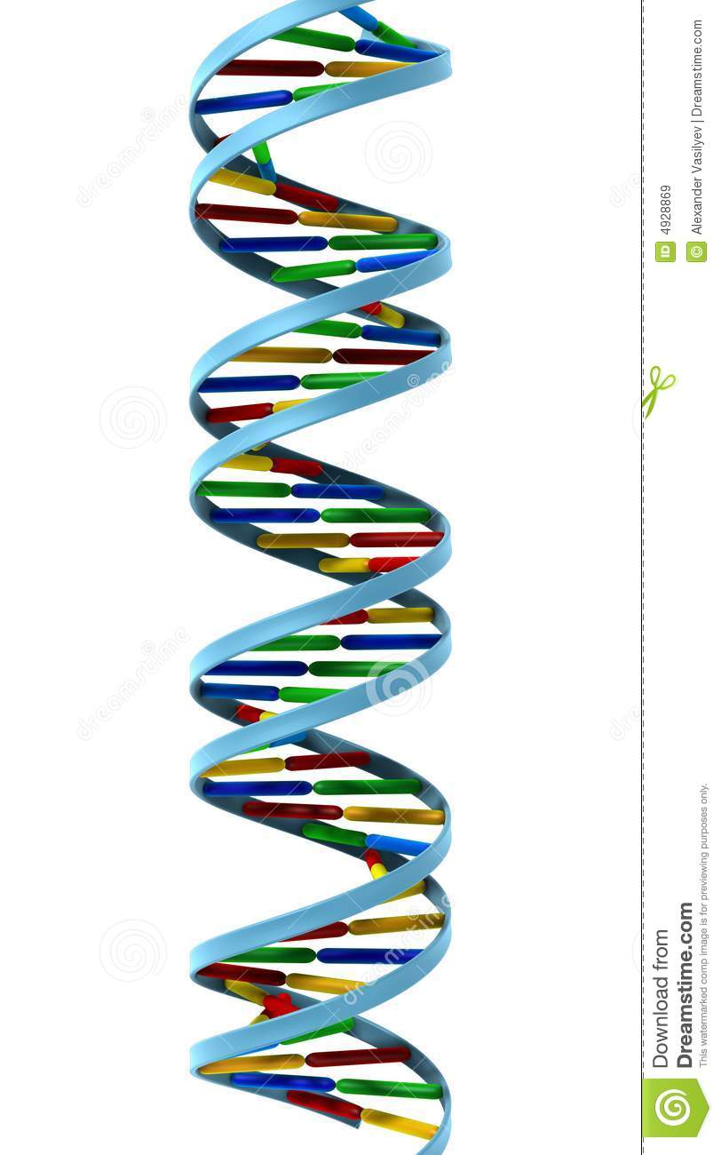
Data mining with clinical and genomic data
Jennifer Vélez Segura
Lic. Biología. Msc(C) Bioinformatics
U. Nacional

Slide 2

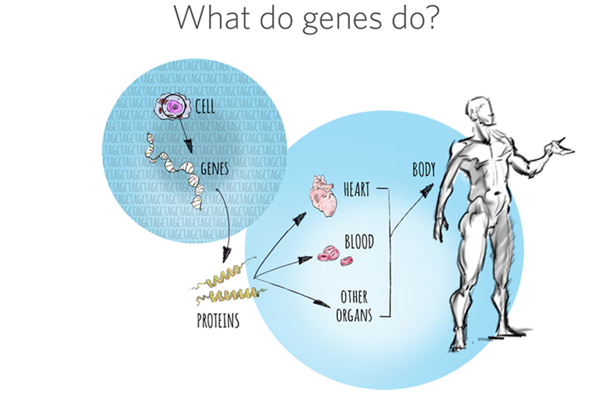
Introduction

Slide 3
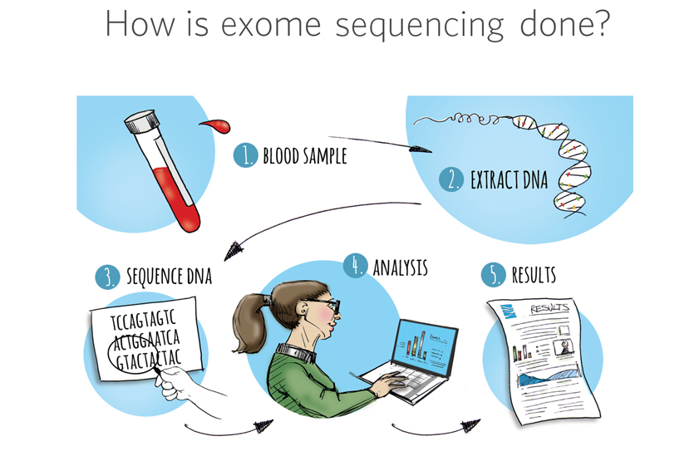
Introduction

Slide 4
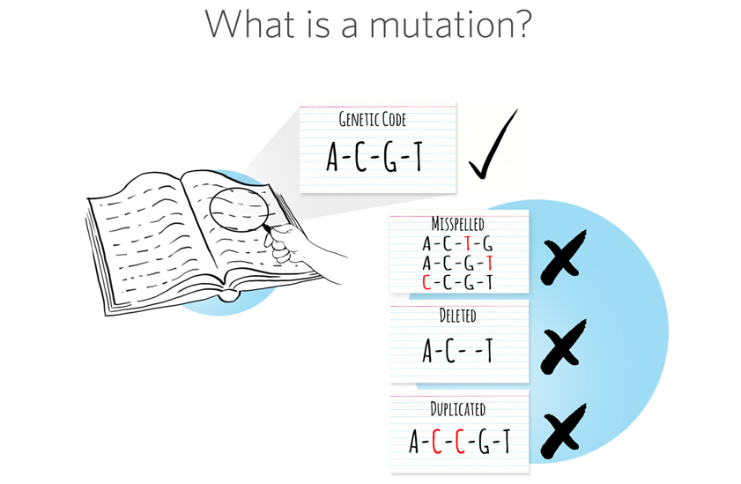
Introduction

Slide 5
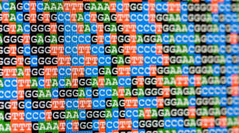
Genomic data as Big Data
3.2 billion base pair

Slide 6
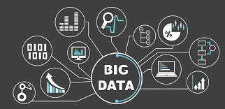
Genomic data as Big Data
3Vs: volume, variety, and velocity.
https://share.ambrygen.com/

Slide 7
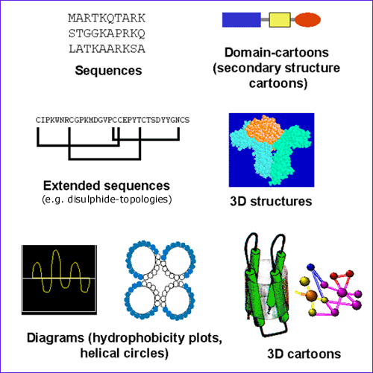
Genomic data as Big Data
Variety:

Slide 8
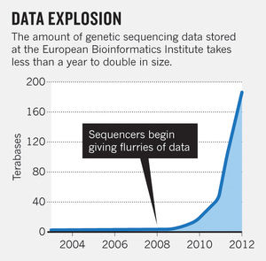
Genomic data as Big Data
Volume and
Velocity
https://share.ambrygen.com/

Slide 9
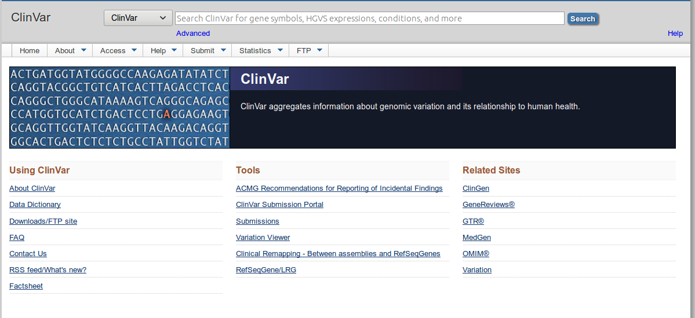
Genomic data as Big Data

Slide 10
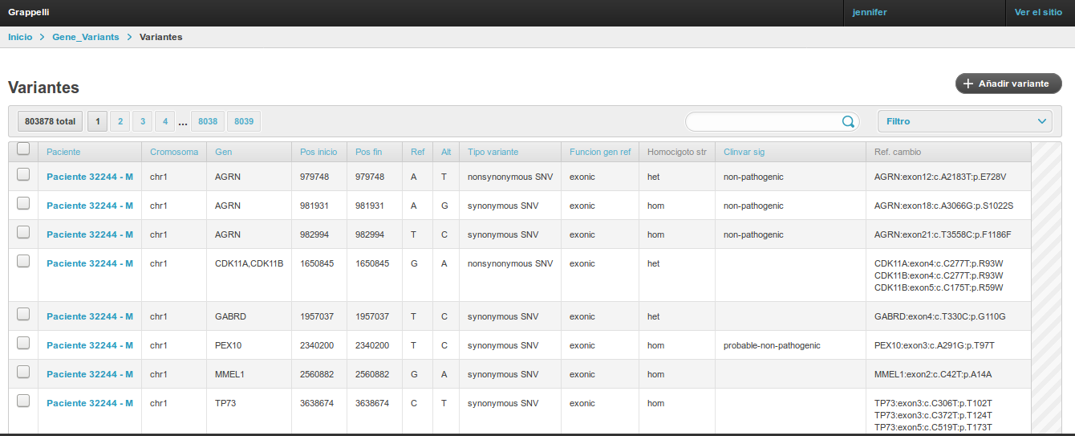
Example database human clinical exome

Slide 11

Problem of data analysis

Slide 12


Problem of data analysis

Slide 13

Data mining
Characterization of the clinical history.
Analysis with genomic data.

Slide 14
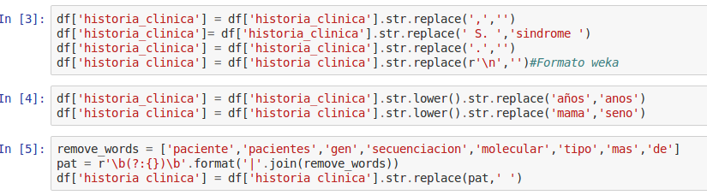
Text mining clinical information

Slide 15
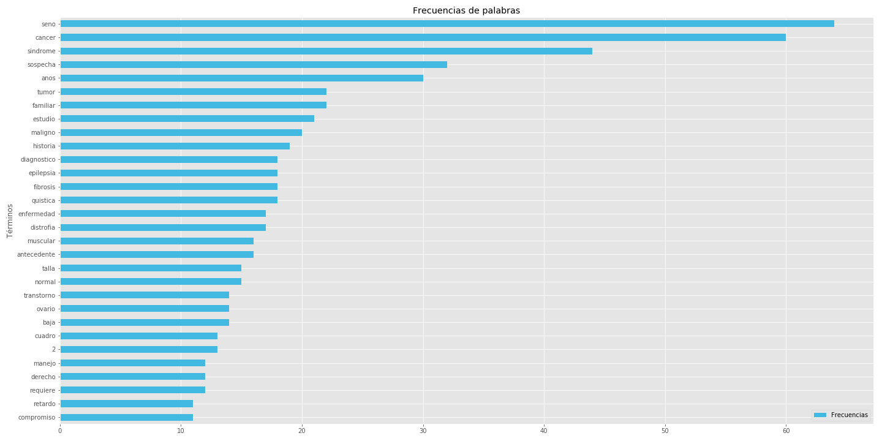
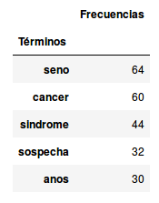
Text mining clinical information

Slide 16
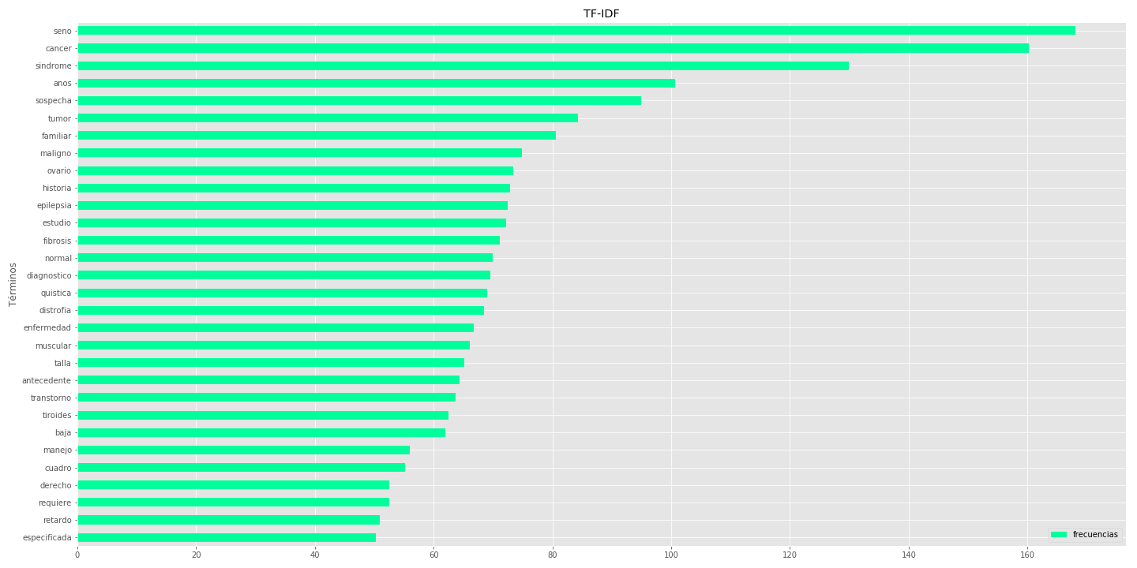
Text mining clinical information
TF-IDF

Slide 17
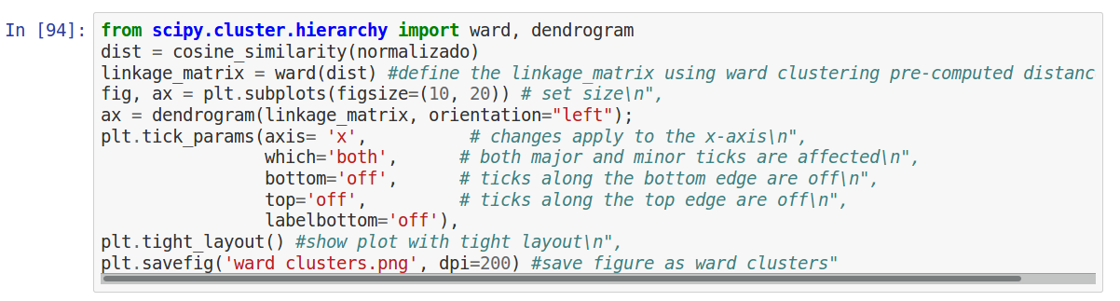
Text mining clinical information
WARD with cosine similarity

Slide 18
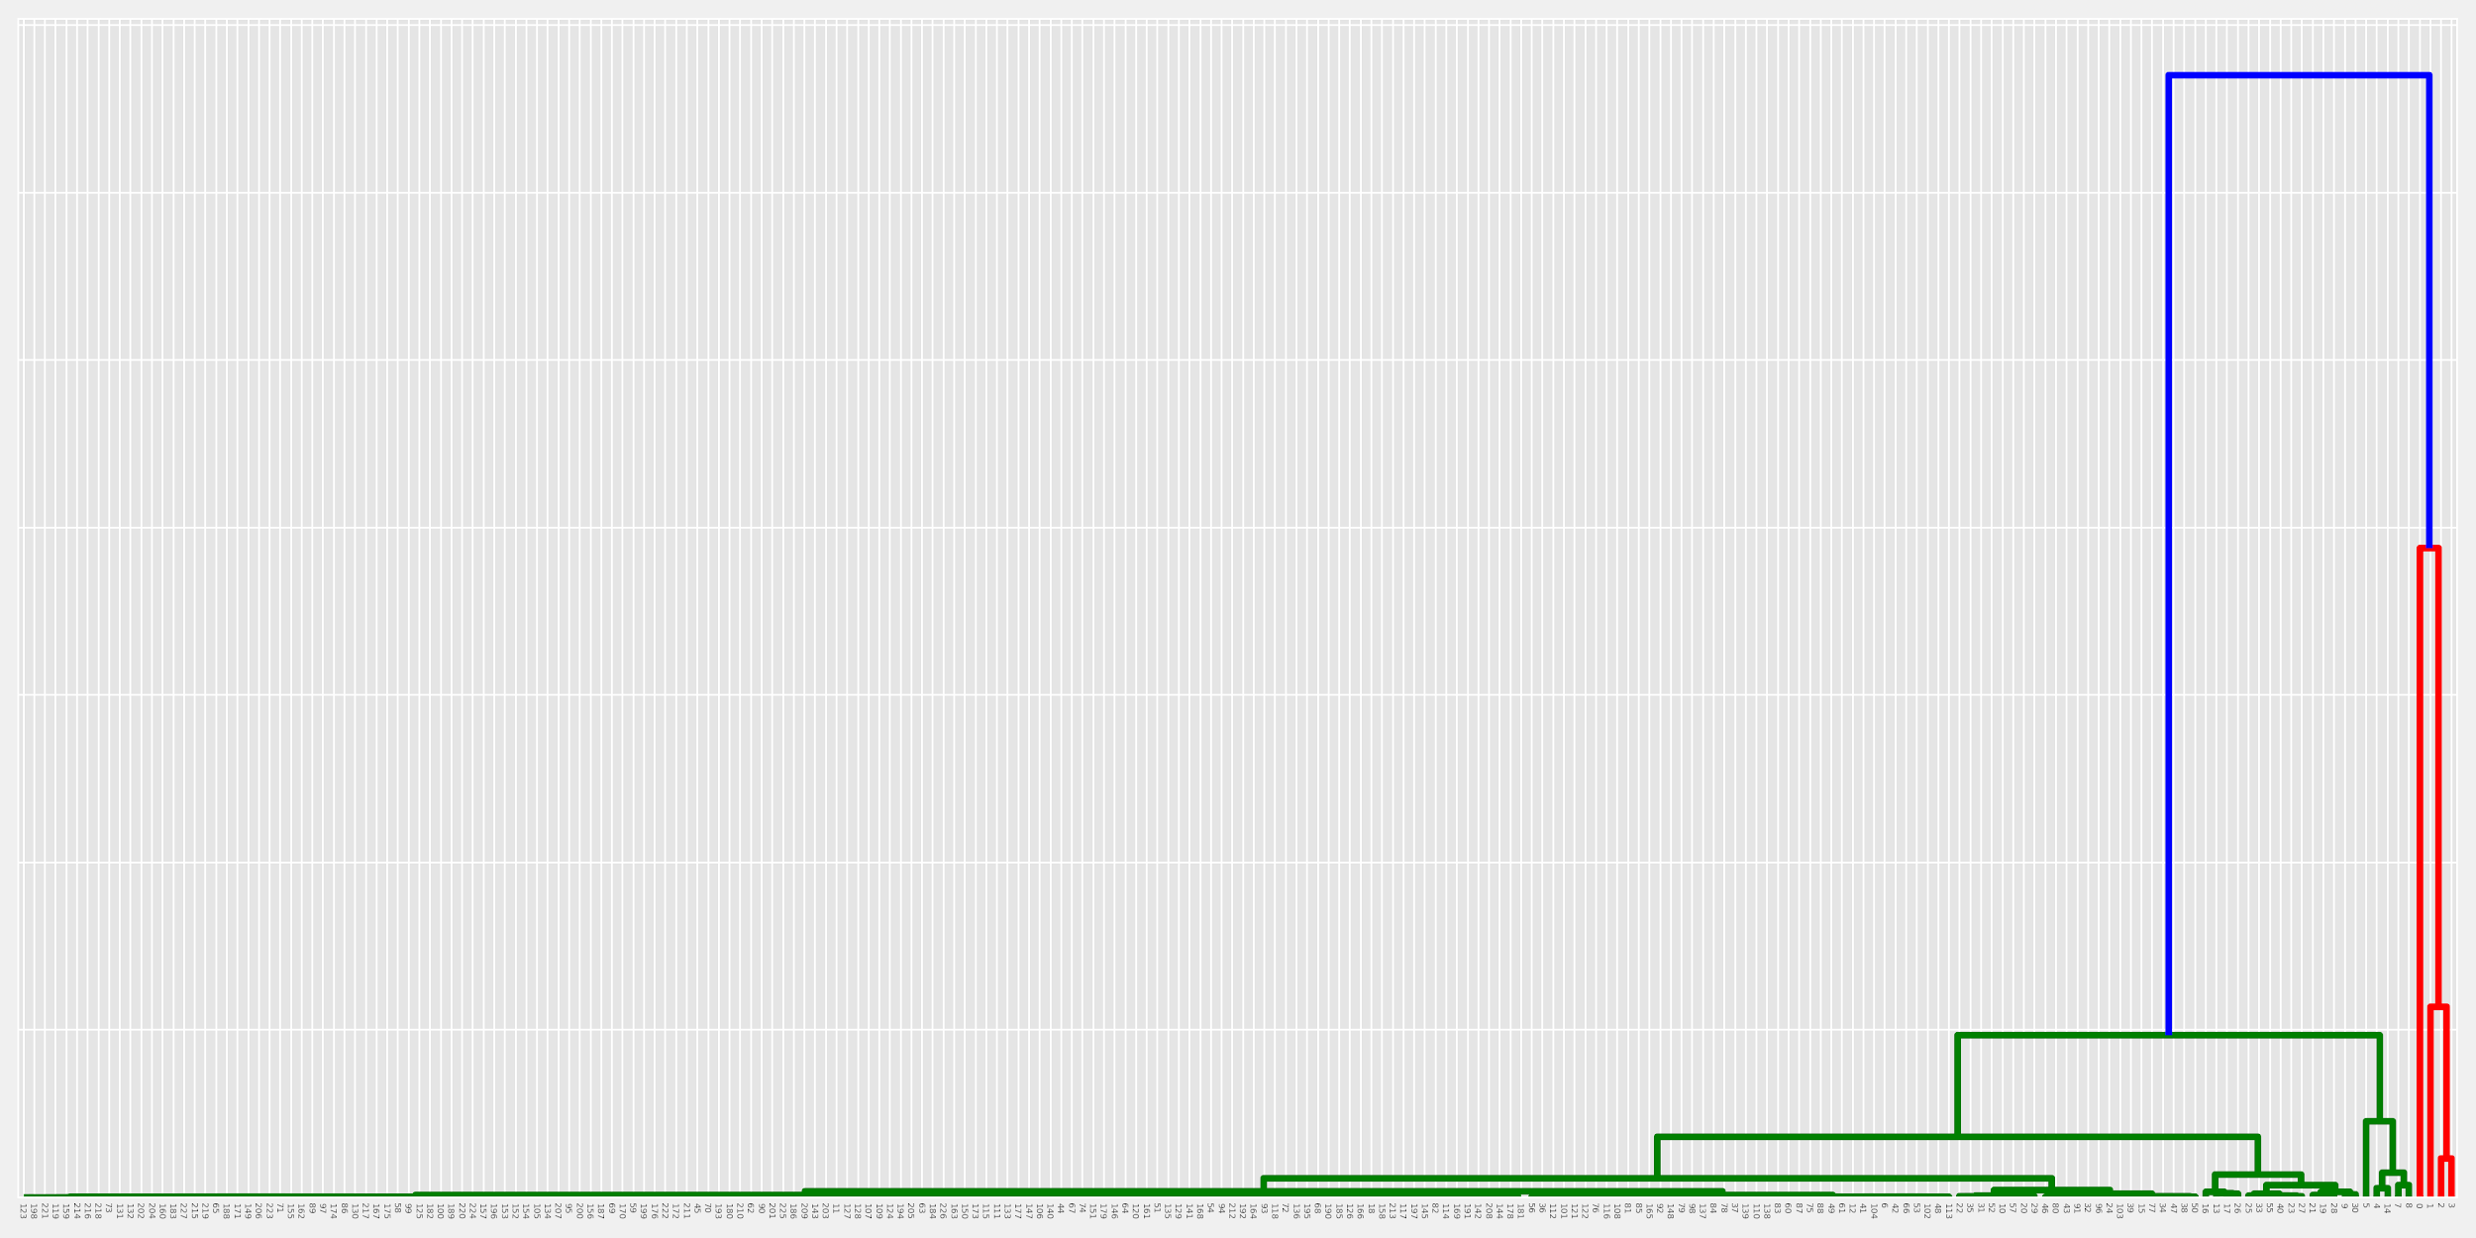
Text mining clinical information
WARD with cosine similarity

Slide 19
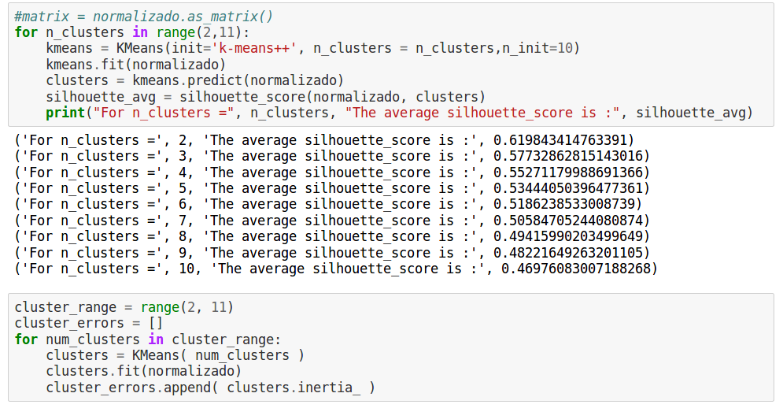
Text mining clinical information

Slide 20
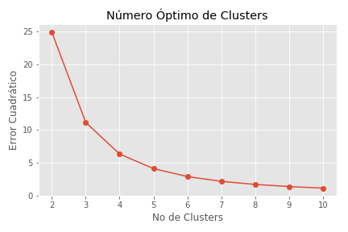
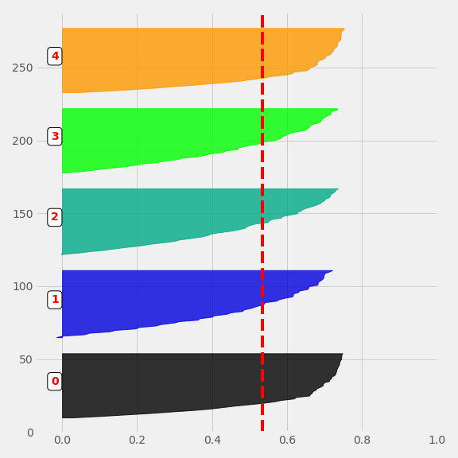
Text mining clinical information

Slide 21
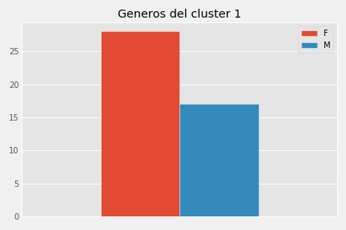
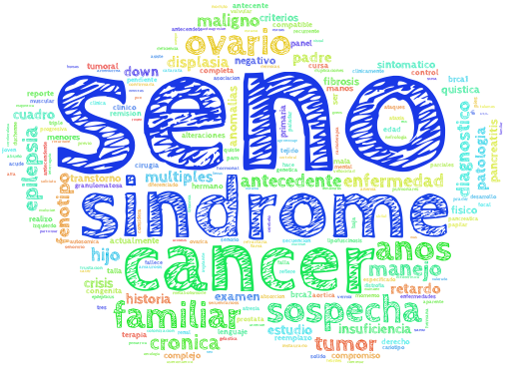
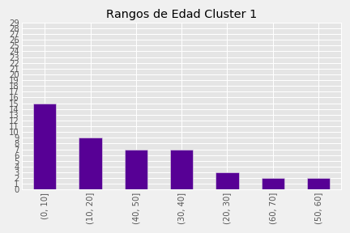
Text mining clinical information

Slide 22
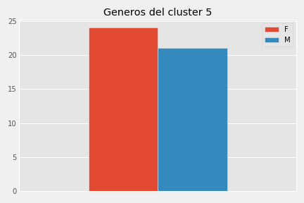
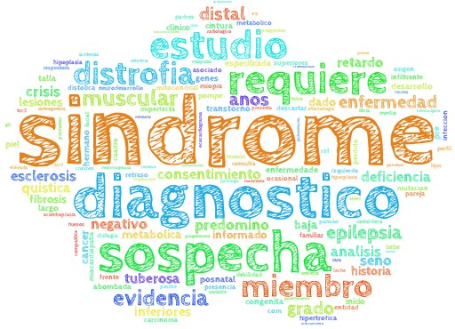
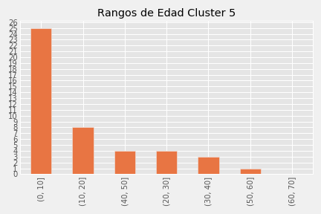
Text mining clinical information

Slide 23
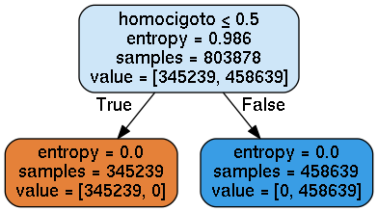
Data mining human clinical exome

Slide 24
Open App

Slide 25

Data mining human clinical exome

Slide 26
Thanks Questions?
jennifervs.bio@gmail.com
github jevelezse

