Slide 1
Solar/Actuator Team Weekly Update
10/7/19

Slide 2
Accomplished Last Week
Set up power budget
Found potential solar panel configurations
Did background research
Cutting solar panels
PCB layout/circuitry

Slide 3
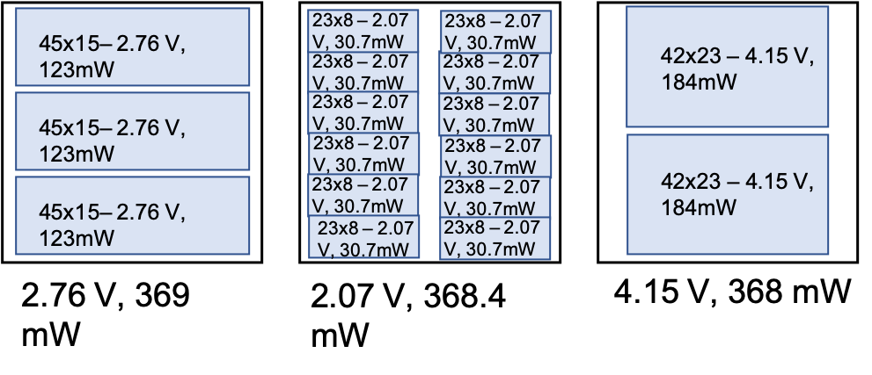
Solar Panel Configurations

Slide 4
Upcoming Tasks
Charging circuit
How many regulators? (1 per axis vs 1 per face)
Learn more about MPPTs
Solar cell calculator
Temperature? Irradiance angle?
Attitude effects
Min/max power
Make solar panel PCB layout
BOM
Supporting circuitry
Bonding of solar cells
Series vs. parallel vs. redundancy

Slide 5
What we need
Fill in the power budget as possible
Meet with avionics & figure out power system division of labor
Magnetorquers?
Can we order parts? Reimbursement?
Redundancy?

