Slide 1

December 4, 2019

Slide 2




Acknowledgements & Sponsors

Slide 3
Important Points
Emergency exits
Feedback
We’re in a borrowed space, please clean up after yourself

Slide 4
Q&A
Unless quick, hold questions until the end
Please phrase your question in a form of a question
Try to keep questions to 30 seconds or less
Avoid long statements or monologues
There will be time for open discussions after Q&A

Slide 5
PyData Code of Conduct
http://pydata.org/code-of-conduct.html

Slide 6
Quick Icebreaker

Slide 7

This Month in Data Science
Hosted by Alexandre Andorra
https://learnbayesstats.anvil.app/
Notes:
http://www.sciencemag.org/news/2018/12/google-s-deepmind-aces-protein-folding

Slide 8

Next Event
Who: Eric Ma
What: Testing Data Science Code
When: Wednesday, January 15th, 2019 (6:00pm)

Slide 9
Community Announcements?

Slide 10
December 4, 2019

Slide 12
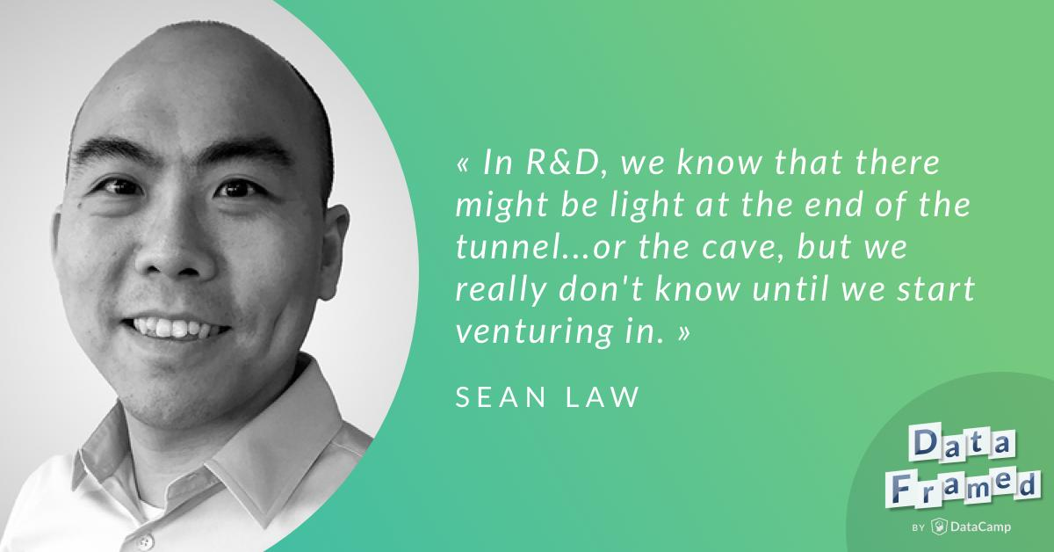
This Month in Data Science
DataFramed Podcast
https://www.datacamp.com/community/podcast/data-science-at-td-ameritrade
Notes:
http://www.sciencemag.org/news/2018/12/google-s-deepmind-aces-protein-folding

Slide 13
Researcher Developer Engineer Data Scientist
jobs.tdameritrade.com

