Slide 1

March 13, 2018

Slide 2



Acknowledgements & Sponsors

Slide 3
Important Points
Emergency exits
Speakers
Feedback
https://github.com/PyDataAnnArbor
Unless quick, hold questions until the end
We’re in a borrowed space, please clean up after yourself

Slide 4
PyData Code of Conduct
http://pydata.org/code-of-conduct.html

Slide 5
Quick Icebreaker

Slide 6

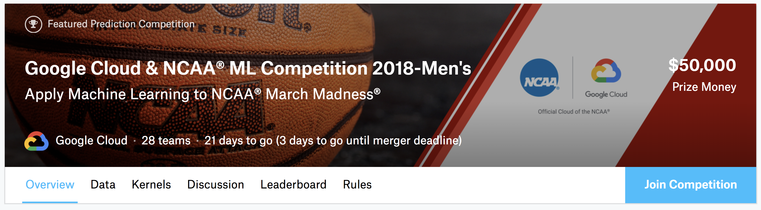
This Month in Data Science
Final Submission: Thursday, March 15, 2018
Notes:
190 people, useful for biometric identification, gender recognition, labeled

Slide 7
Data Scientist Data Analyst Java/Mobile Developer
careers.tdameritrade.com

Slide 8

Next Event
Who: YOU!
What: Lightning Talks
When: Tuesday, April 10, 2018 (6:00pm)

Slide 9
March 13, 2018

