Slide 1

February 12, 2020

Slide 2



Acknowledgements & Sponsors

Slide 3
Important Points
Emergency exits
Feedback
https://github.com/PyDataAnnArbor
We’re in a borrowed space, please clean up after yourself

Slide 4
Q&A
Unless quick, hold questions until the end
Please phrase your question in a form of a question
Try to keep questions to 30 seconds or less
Avoid long statements or monologues
There will be time for open discussions after Q&A

Slide 5
PyData Code of Conduct
http://pydata.org/code-of-conduct.html

Slide 6
Quick Icebreaker

Slide 7
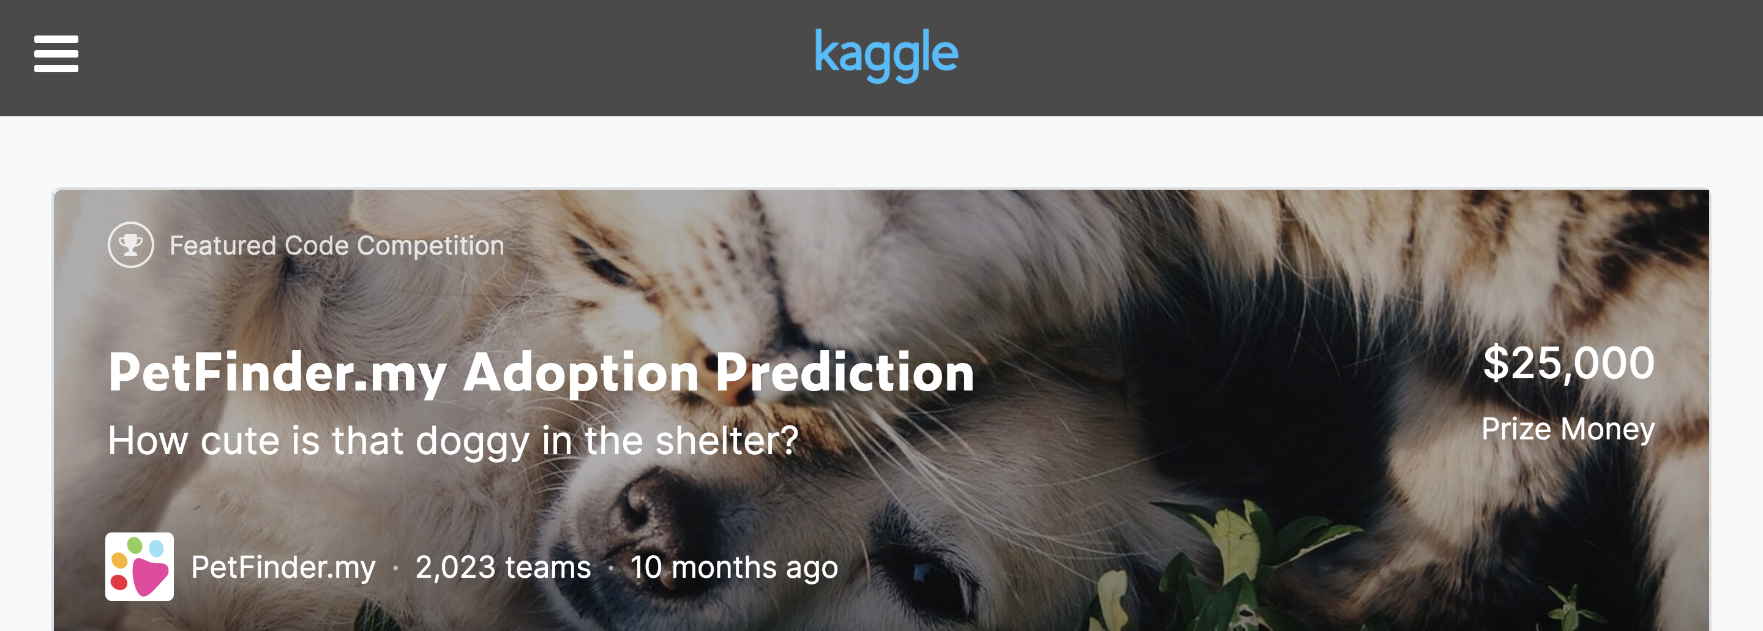
This Month in Data Science
PetFinder.my Kaggle Contest:
1st Place Winner Disqualified
https://www.kaggle.com/c/petfinder-adoption-prediction/discussion/125436

Slide 8

Next Event
Who: Shannon Axelrod (Chan Zuckerberg Initiative)
What: Building Software for Biology Research: Into the Cells
When: Wednesday, March 11th, 2020 (6:00pm)

Slide 9
Community Announcements?

Slide 10
February 12, 2020

Slide 12
Researcher Developer Engineer Data Scientist
jobs.tdameritrade.com

