Slide 1

February 6, 2019

Slide 2



Acknowledgements & Sponsors

Slide 3
Important Points
Emergency exits
Feedback
https://github.com/PyDataAnnArbor
We’re in a borrowed space, please clean up after yourself

Slide 4
Q&A
Unless quick, hold questions until the end
Please phrase your question in a form of a question
Try to keep questions to 30 seconds or less
Avoid long statements or monologues
There will be time for open discussions after Q&A

Slide 5
PyData Code of Conduct
http://pydata.org/code-of-conduct.html

Slide 6
Quick Icebreaker

Slide 7
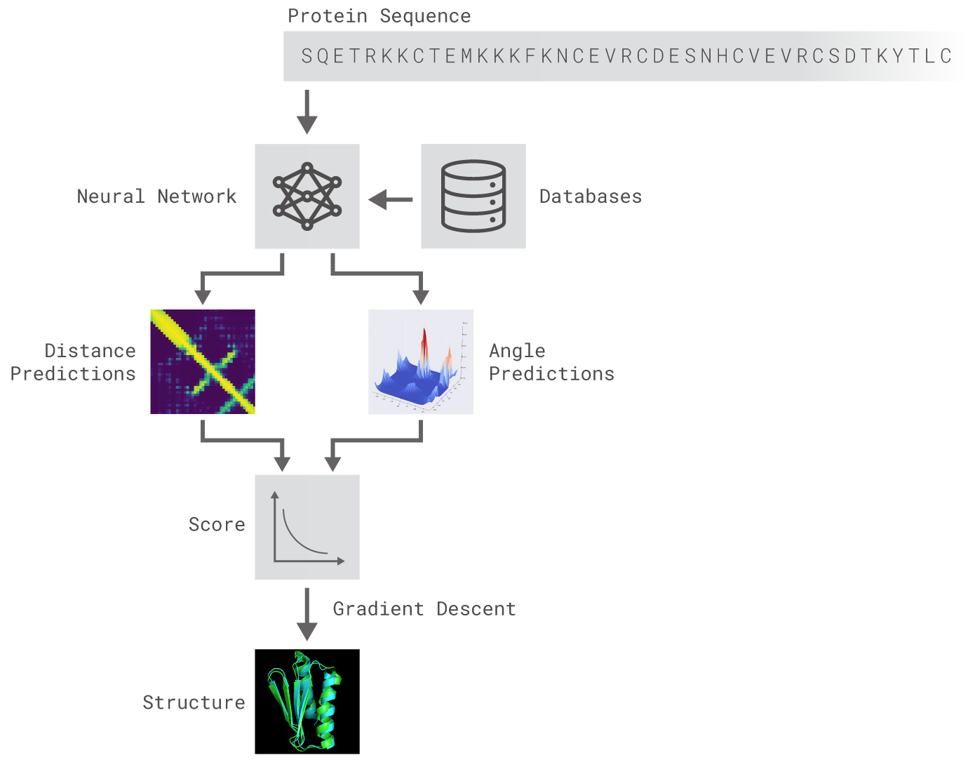
This Month in Data Science
AlphaFold: Using AI for (CASP) Protein Folding
https://deepmind.com/blog/alphafold/
Notes:
http://www.sciencemag.org/news/2018/12/google-s-deepmind-aces-protein-folding

Slide 8

Next Event
Who: Madicken Munk
What: Widgyts: yt Jupyter Widgets for Volumetric Data Explorations
When: Wednesday, March 13th, 2019 (6:00pm)

Slide 9
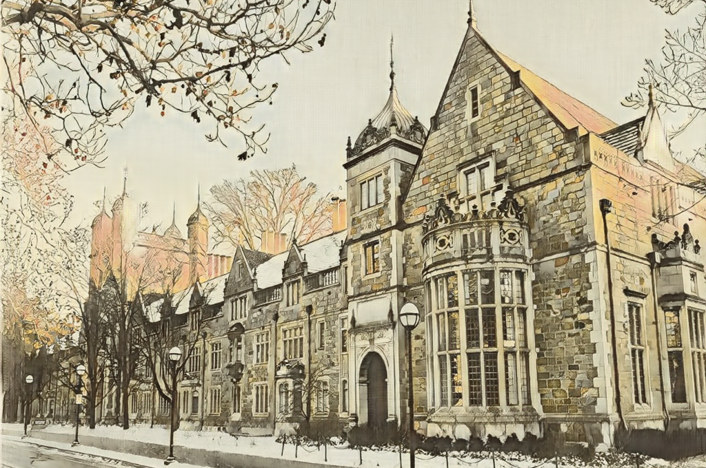
a²-dlearn⁴
Register: http://tiny.cc/a2dlearn4
Who: Kyunghyun Cho (FAIR), Sanja Fidler (NVIDIA), et al
What: 4th Ann Arbor Deep Learning Event
When: Saturday, February 23rd, 2019 (9:30am)

Slide 10
Community Announcements?

Slide 11
February 6, 2019

Slide 13
Researcher Developer Engineer Data Scientist
jobs.tdameritrade.com

