Slide 1

April 13, 2017

Slide 2
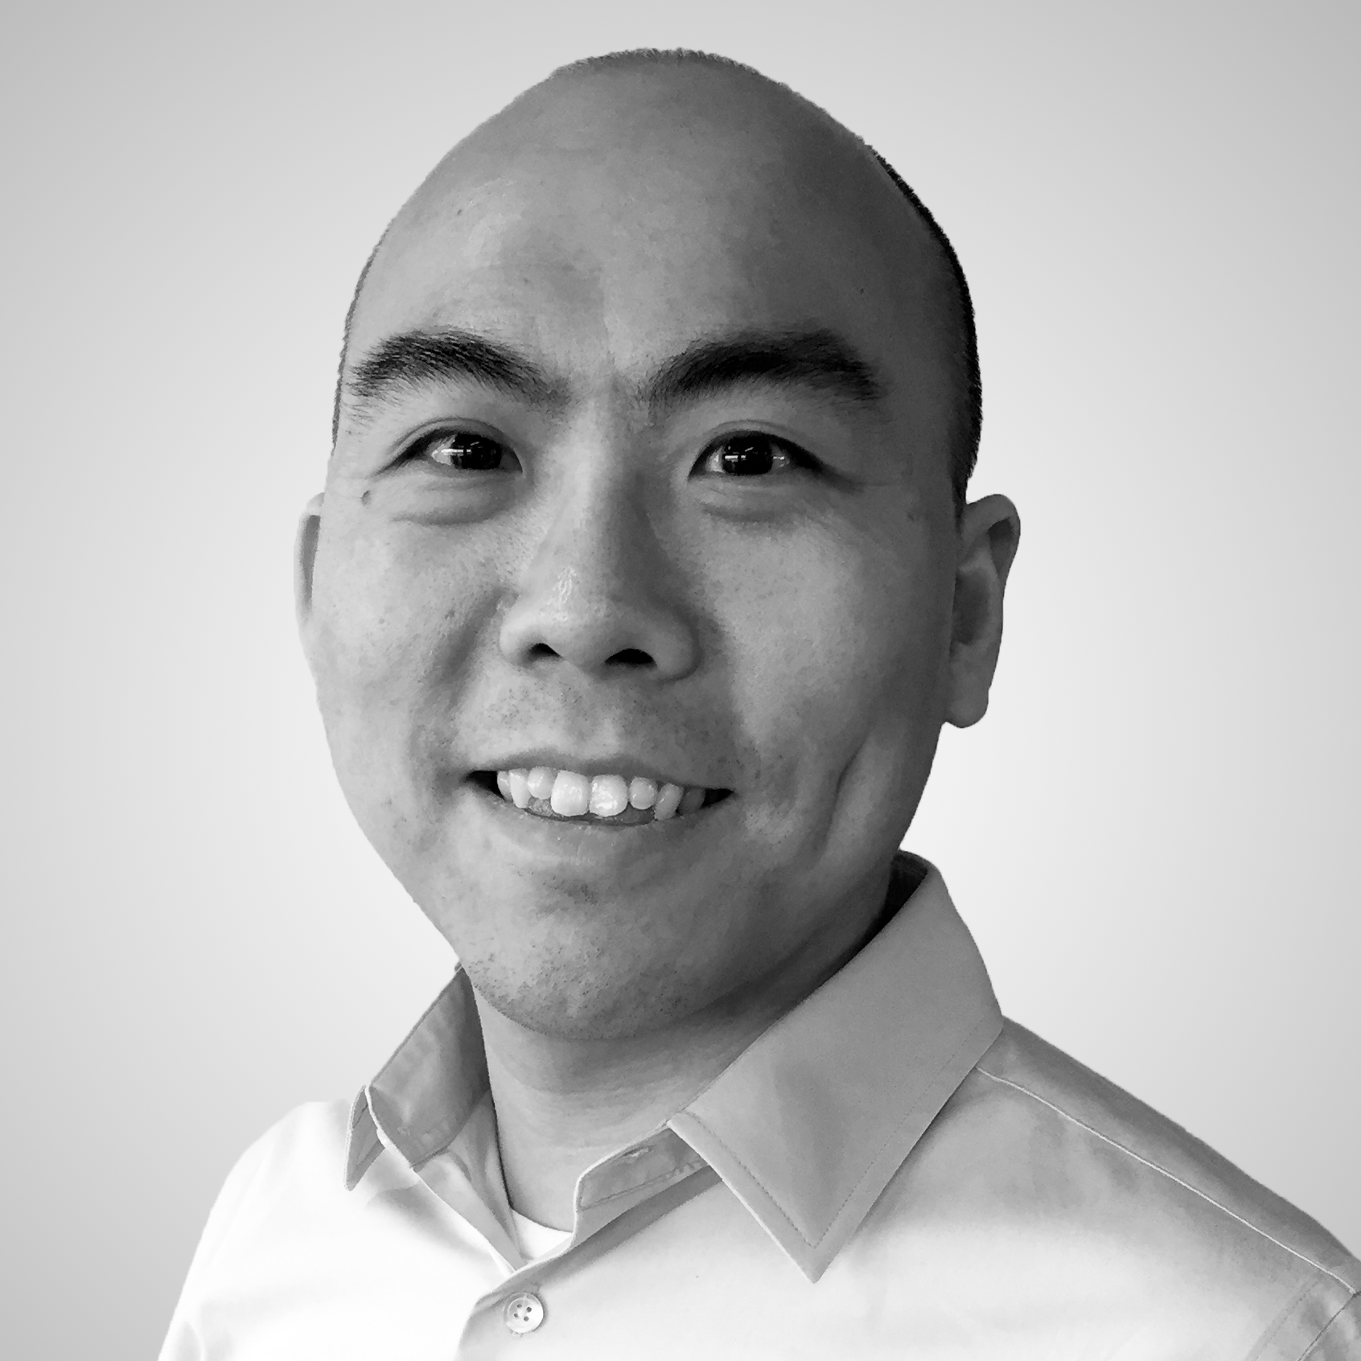
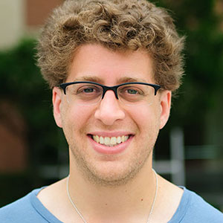
Organizers
Sean Law
@seanmylaw
Ben Zaitlen
@quasiben

Slide 3




Acknowledgements & Sponsors

Slide 4
Important Points
Emergency exits
Speakers
Sponsors
Feedback
https://github.com/PyDataAnnArbor
Unless quick, hold questions until the end
We’re in a borrowed space, please clean up after yourself

Slide 5
PyData Code of Conduct
http://pydata.org/code-of-conduct.html

Slide 6
Quick Icebreaker

Slide 7

This Month in Data Science
https://deepmind.com/blog/open-sourcing-sonnet/

Slide 8
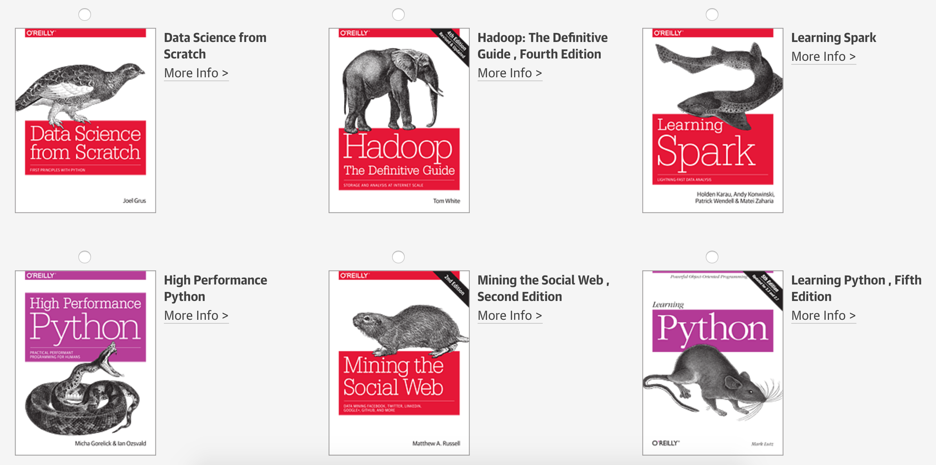
Tweet @PyDataAnnArbor

Slide 9

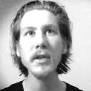
Scikit-Learn Workshop
Sebastian Raschka

Slide 10
Michigan Python Users Group
https://michipug.wordpress.com/
Date: First Thursday of Every Month
Time: 7 PM
Location: Washtenaw Community College
Notes:
Chuck Anderson

Slide 11
April 13, 2017

