Slide 1

December 7, 2017

Slide 2



Acknowledgements & Sponsors

Slide 3
Important Points
Emergency exits
Speakers
Feedback
https://github.com/PyDataAnnArbor
Unless quick, hold questions until the end
We’re in a borrowed space, please clean up after yourself

Slide 4
PyData Code of Conduct
http://pydata.org/code-of-conduct.html

Slide 5
Quick Icebreaker

Slide 6
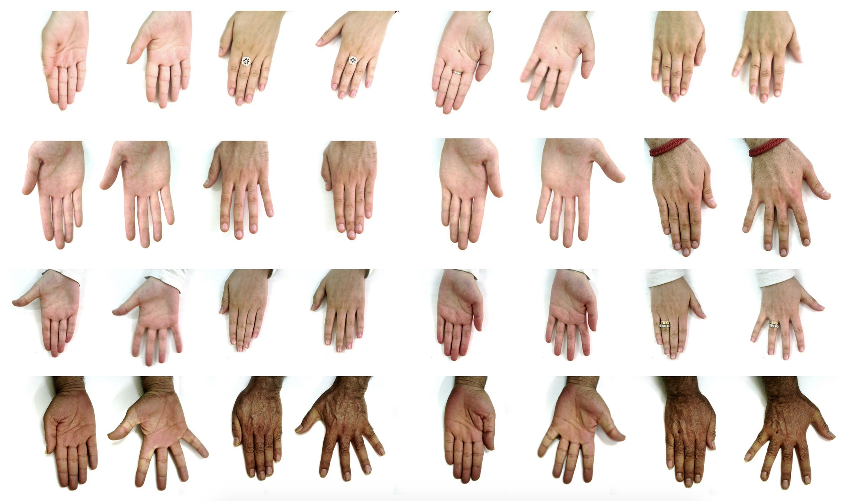
This Month in Data Science
11K Hand Data Set
Notes:
190 people, useful for biometric identification, gender recognition, labeled

Slide 7

Post-Doctoral Researcher in Computational Toxicology
Sudin Battacharya’s Lab @ MSU
http://careers.msu.edu/cw/en-us/job/498177/research-associatefixed-term
Notes:
Looking for a computation-savvy person to apply data science and machine learning to exciting problems in biology and toxicology

Slide 8

Next Event
Who: Scott Sievert
What: NEXT – Machine Learning, Crowdsourcing,
and Cartoons
When: Tuesday, January 9, 2017 (6:00pm)

Slide 9
December 7, 2017

Slide 10
Data Scientists Data Analysts
careers.tdameritrade.com

