Slide 1

May 25, 2017

Slide 2

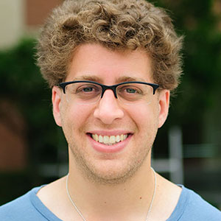
Organizers
Sean Law
@seanmylaw
Ben Zaitlen
@quasiben

Slide 3




Acknowledgements & Sponsors

Slide 4
Important Points
Emergency exits
Speakers
Sponsors
Feedback
https://github.com/PyDataAnnArbor
Unless quick, hold questions until the end
We’re in a borrowed space, please clean up after yourself

Slide 5
PyData Code of Conduct
http://pydata.org/code-of-conduct.html

Slide 6
Quick Icebreaker

Slide 7
This Month in Data Science
AudioSet: A Large-scale Dataset
of Manually Annotated Audio Events
https://research.google.com/audioset/
A Large Self-Annotated Corpus for Sarcasm
https://arxiv.org/abs/1704.05579

Slide 8

PyCon 2017
https://www.youtube.com/channel/UCrJhliKNQ8g0qoE_zvL8eVg/videos

Slide 9
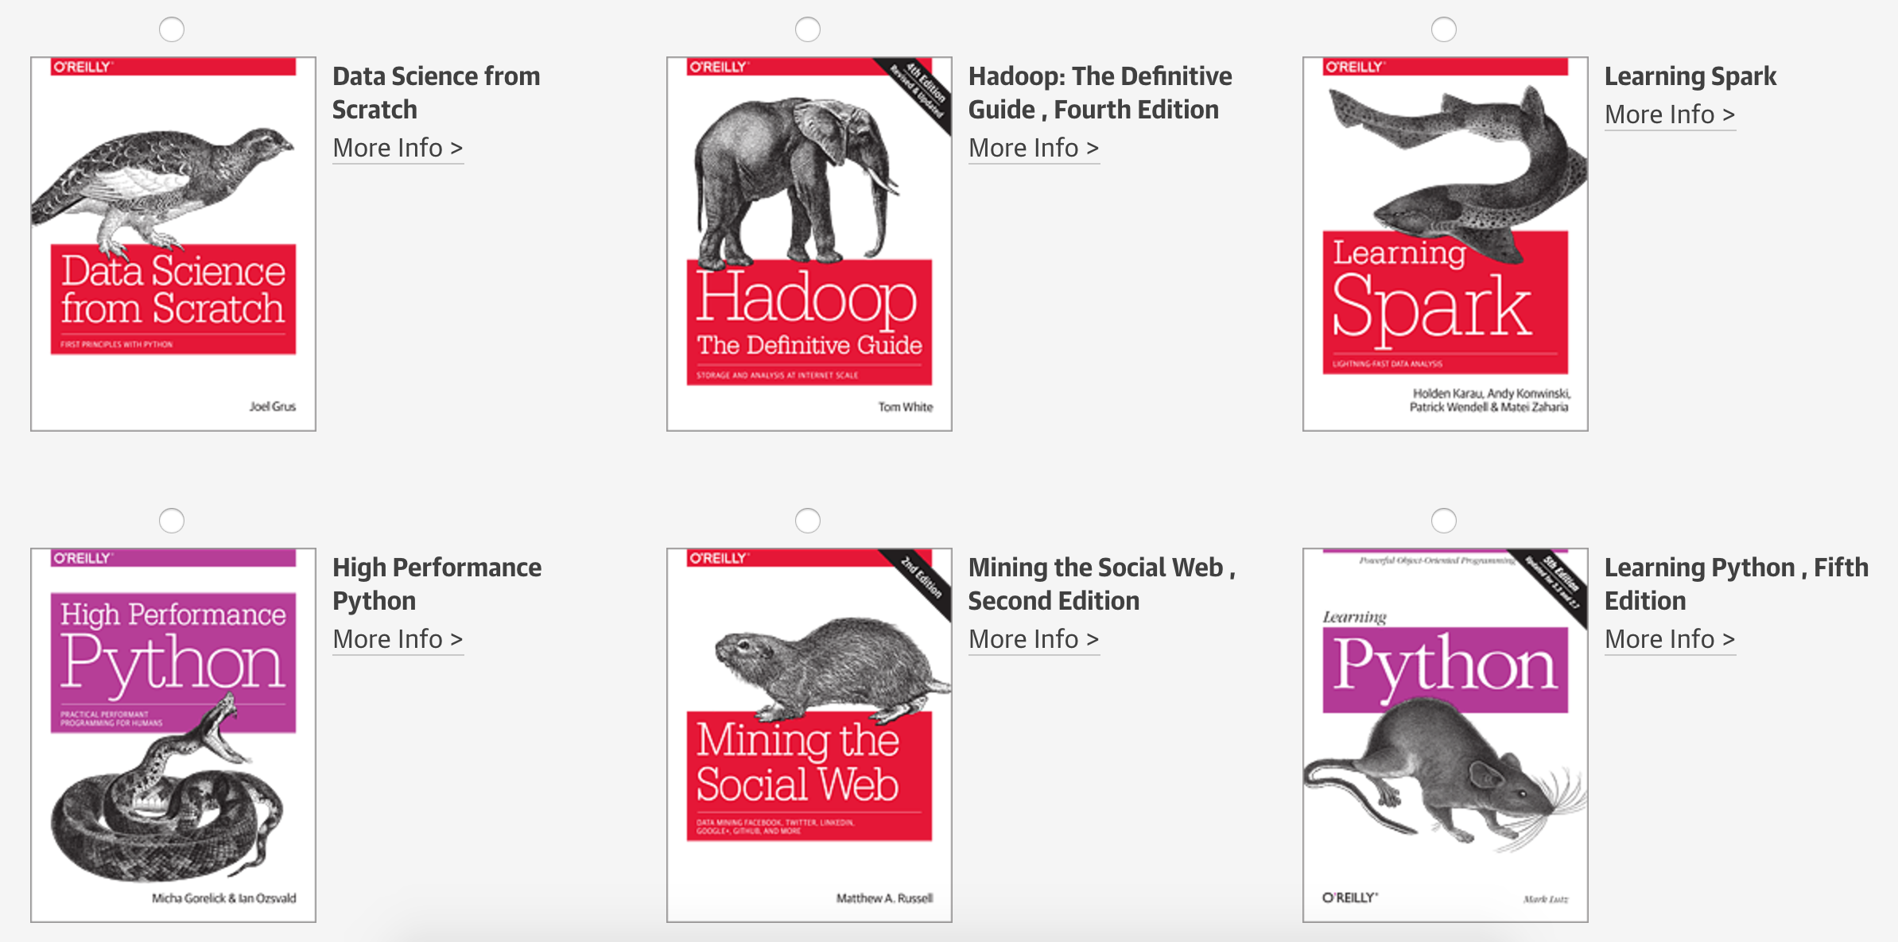
Tweet @PyDataAnnArbor

Slide 10
We’re Hiring: Sr. Data Scientist/Sr. Software Developer

Slide 11

Next Event
Who: Jennifer Marsman (Microsoft)
What: Intro to Azure Machine Learning – Predict Who Survives the Titanic
When: Thursday, June 8, 2017 (6:00pm)

Slide 12
May 25, 2017

