Slide 1

July 13, 2017

Slide 2





Acknowledgements & Sponsors

Slide 3
Important Points
Emergency exits
Speakers
Workshops
Feedback
https://github.com/PyDataAnnArbor
Unless quick, hold questions until the end
We’re in a borrowed space, please clean up after yourself

Slide 4
PyData Code of Conduct
http://pydata.org/code-of-conduct.html

Slide 5
Quick Icebreaker

Slide 6
This Month in Data Science
py.checkio.org

Slide 7
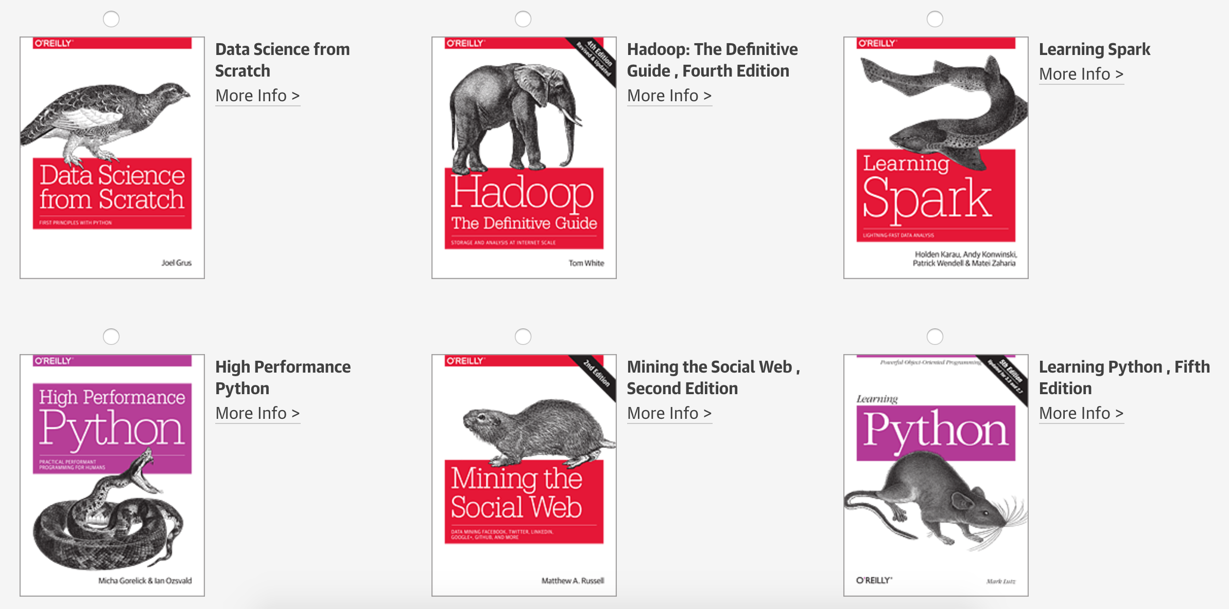
Tweet @PyDataAnnArbor

Slide 8

Next Event
Who: Sebastian Raschka (MSU, Python Machine Learning)
What: An Introduction to Deep Learning with TensorFlow
When: Thursday, August 24, 2017 (6:00pm)

Slide 9
July 13, 2017

