Slide 1

August 24, 2017

Slide 2





Acknowledgements & Sponsors

Slide 3
Important Points
Emergency exits
Speakers
Workshops
Feedback
https://github.com/PyDataAnnArbor
Unless quick, hold questions until the end
We’re in a borrowed space, please clean up after yourself

Slide 4
PyData Code of Conduct
http://pydata.org/code-of-conduct.html

Slide 5
Quick Icebreaker

Slide 6

This Month in Data Science
Nov 27-30 (Monday after Thanksgiving)

Slide 7
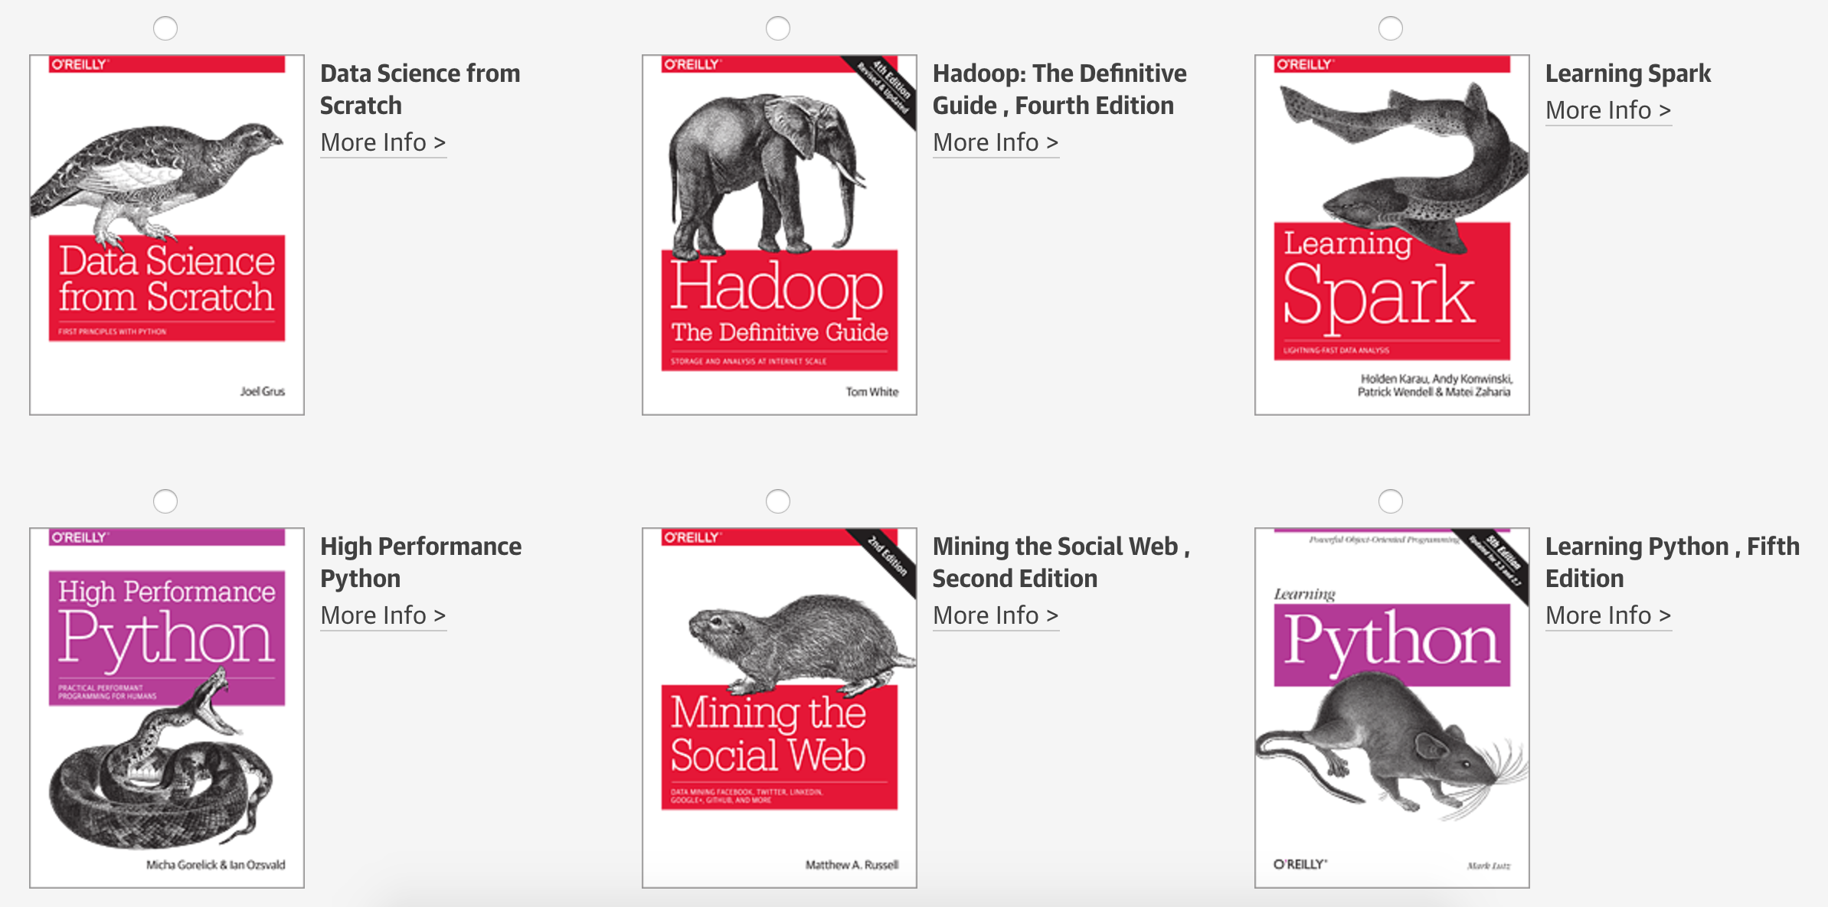
www.oreilly.com/pub/get/pydataannarbor

Slide 8
Data Scientists Data Analysts Sr Research & Developers
careers.tdameritrade.com

Slide 9
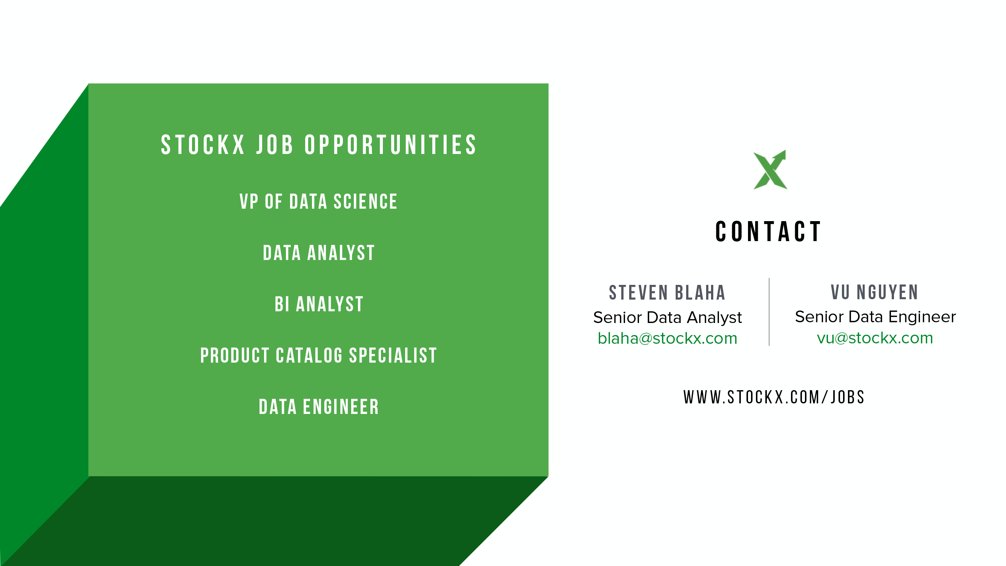

Slide 10

Next Event
Who: Brian Witherspoon (Duo Security)
What: Big(ish) Data: Scaling Up Customer-facing Logs
When: Thursday, September 14, 2017 (6:00pm)

Slide 11
August 24, 2017

